Slide 1
Sales Analysis for AtliQ Hardware
Shreya Asthana

Slide 2
Problem Statement
AtliQ Hardware, a leading computer hardware and peripherals manufacturer, has been experiencing a decline in sales across certain regions. The company, headquartered in Delhi with multiple regional offices, needs to identify the key factors contributing to this downturn and develop strategic solutions to improve performance.
To address this, a Tableau dashboard has been created to analyze key sales metrics, customer segments, and market trends. The goal of this analysis is to not only diagnose the causes of declining sales but also to provide data-driven recommendations and clear next steps to help Bhavin Patel, the Sales Director, make informed business decisions.
This presentation will highlight key insights from the analysis and propose actionable strategies to enhance sales performance and market positioning.

Slide 3
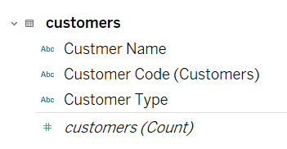
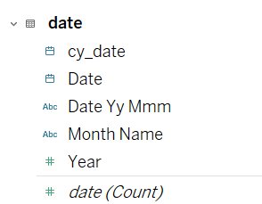
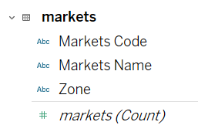
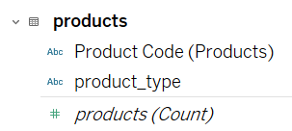
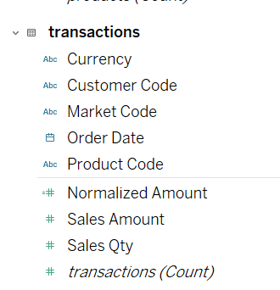
Data Overview
We have 5 tables in the MySQL Database: customers, date, markets, products, transactions
The Transactions were done in INR and US so created a calculated column called Normalized to convert all the transactions in INR (used 1US= 86.51 INR, the value at the time of dashboard creation) since the company is based in India.

Slide 4
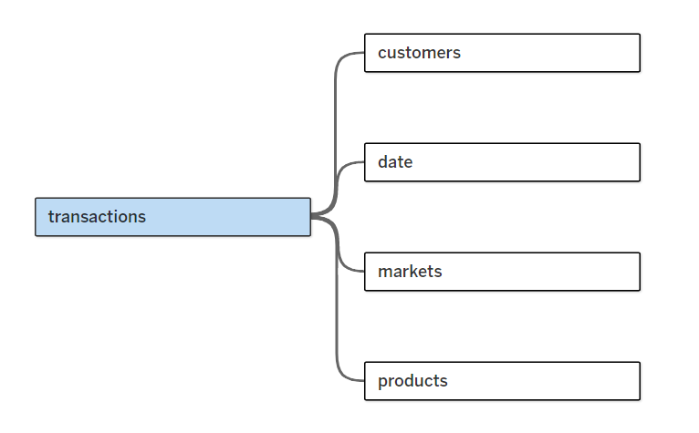
Data Overview
The fields were following a Star Schema

Slide 5
Key Insights

Slide 6
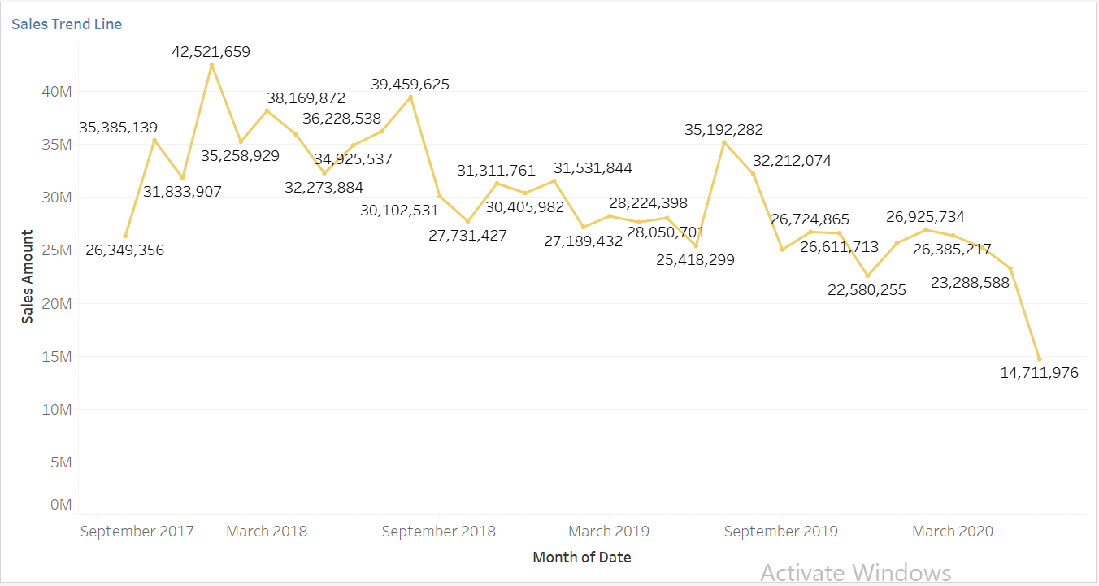
Key Insights
We can see that the trend line of Sales Revenue is always been irregular, but there’s a noticeable decline from July,2019

Slide 7
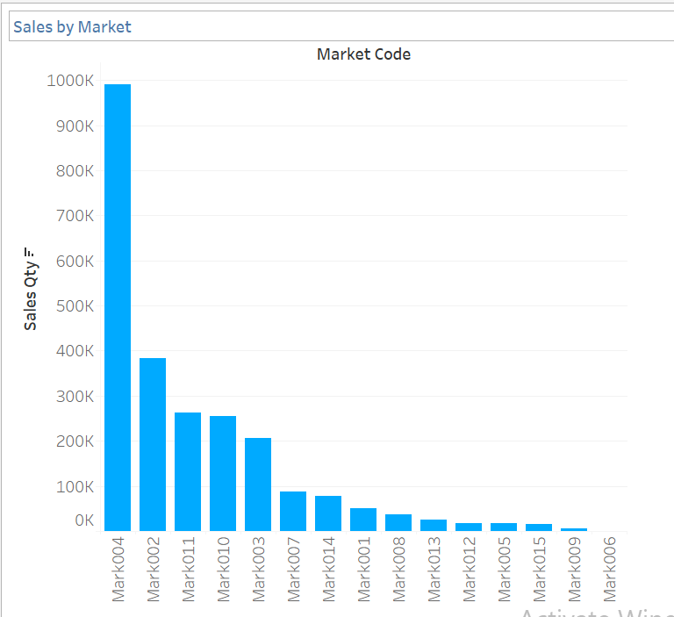
Key Insights
Bangalore(Mark006) is performing the worst in terms of Sales
While New Delhi (Mark004) , the headquarter seems to perform the best and outperform the rest of the market in terms of Sales.

Slide 8
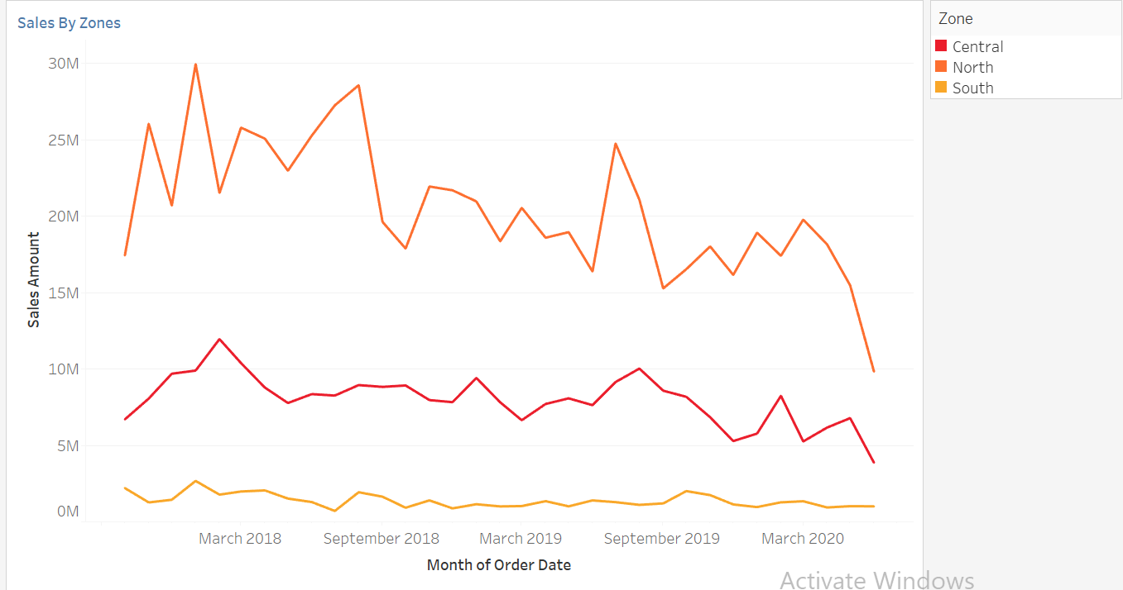
Key Insights
If we look at the revenue comparison by zones, we can observe that North region is doing the best while South region is needed to be focused on
But at the same time, we can observe the trend line is very irregular and going down at the end, starting from February-march 2020.

Slide 9
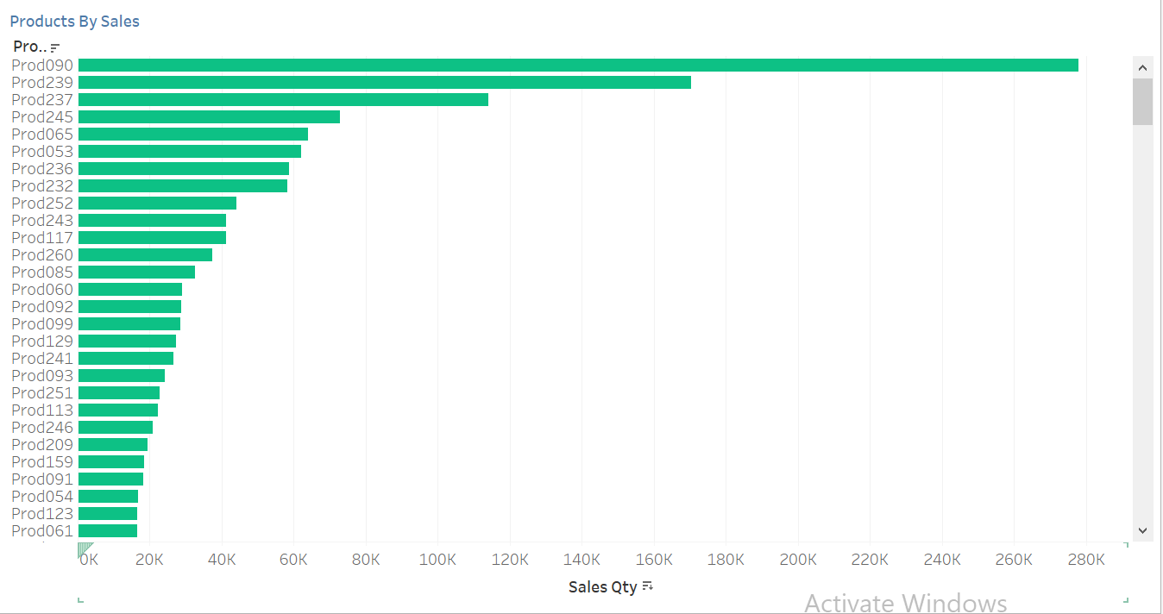
Key Insights
Here, The products are arranged according to their sales, we can see the Prod090 is the bestseller product of the company.

Slide 10
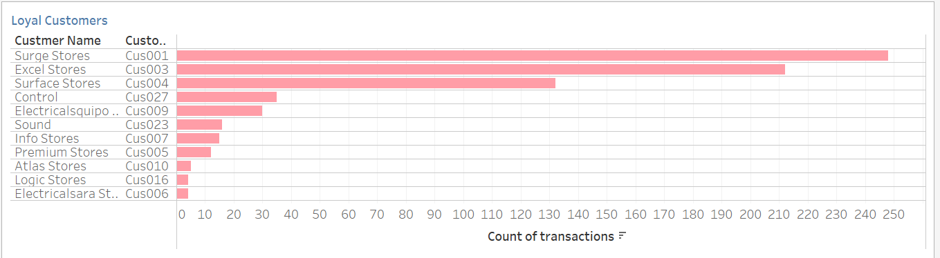
Key Insights
Here we can see our Loyal customers , Among all of them Surge Stores and Excel Stores has been our most frequent customers.

Slide 11
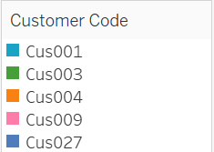
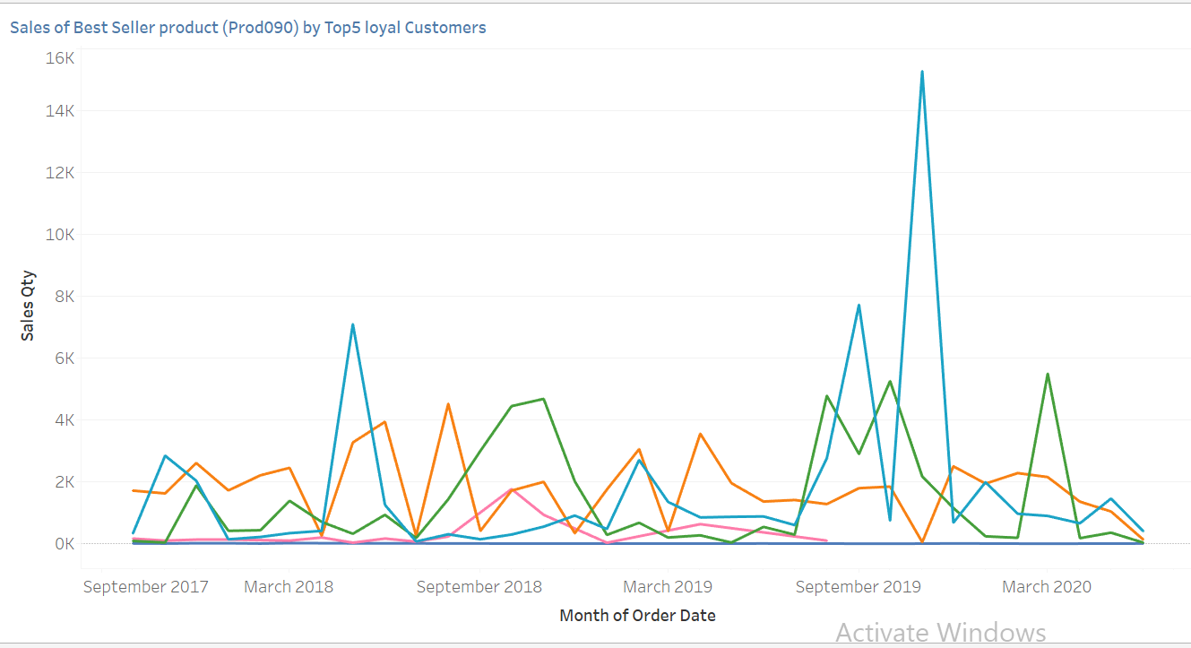
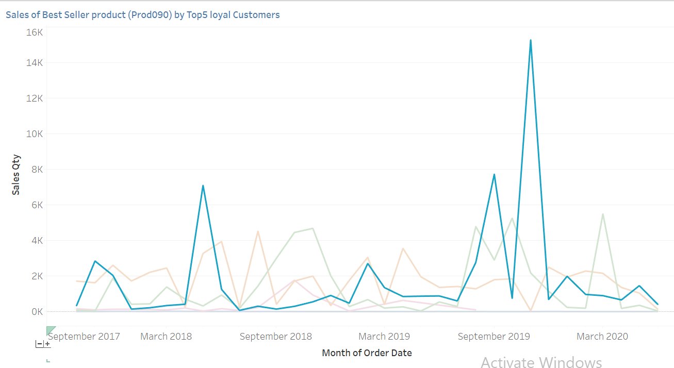
Key Insights
In this we can see the sales of prod090 by top5 loyal customers.
We can observe the behavior for each of the 5 customers separately too.
Like for Surge Stores we can observe a common buying behavior, they tend to buy prod090 in bulk amount.

Slide 12
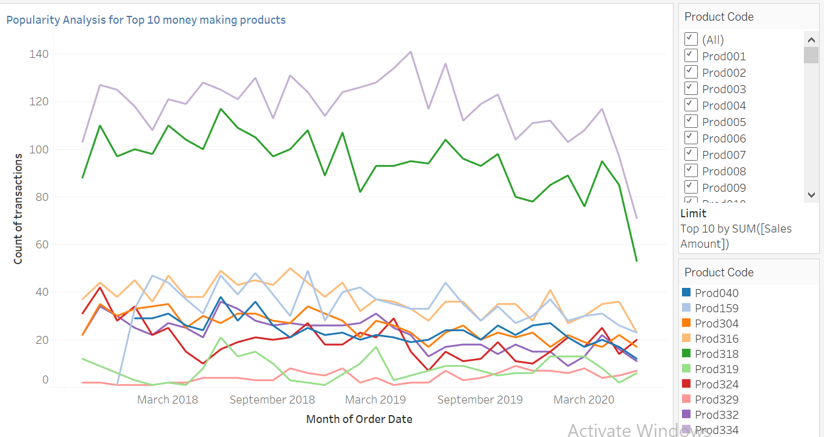
Key Insights
In this we can see the sales of Top 10 money-making products.
Even, in this we can see that prod334 and prod318 are most frequently brought.
But sales of these two products are also declining steeply.

Slide 13
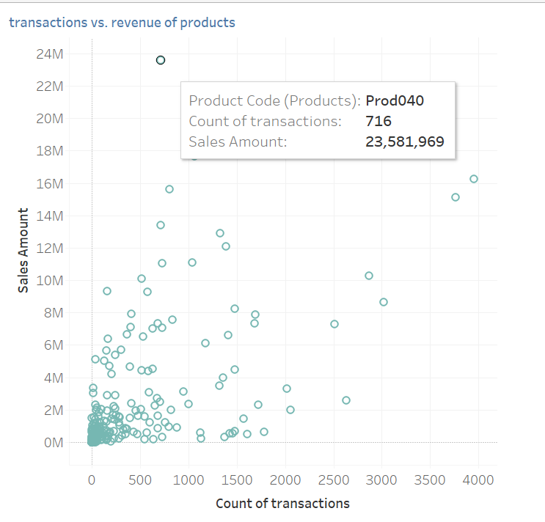
Key Insights
In this we can see products like prod040, they are brought less but generate high revenue.
We can focus on such products with a lesser number of transactions and large revenue to recover from the declining sales

Slide 14
Dashboard

Slide 15
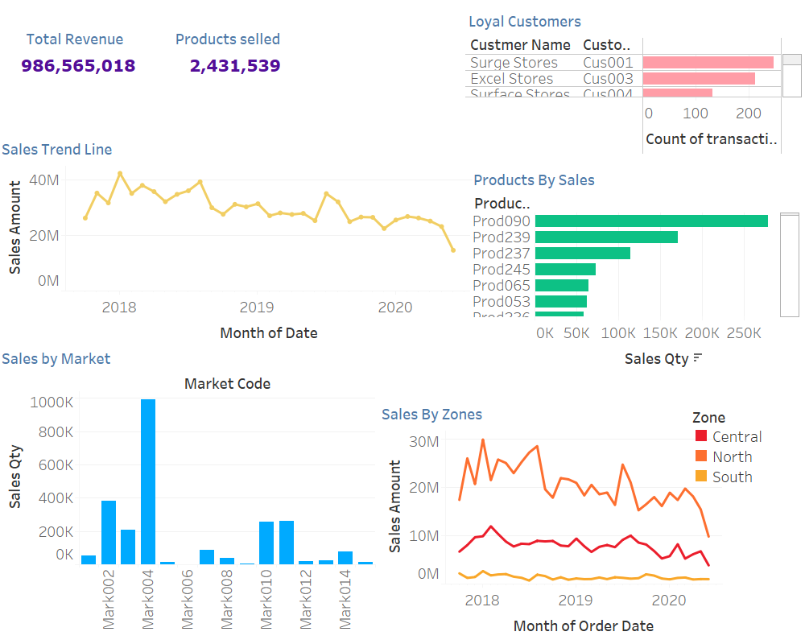

Slide 16
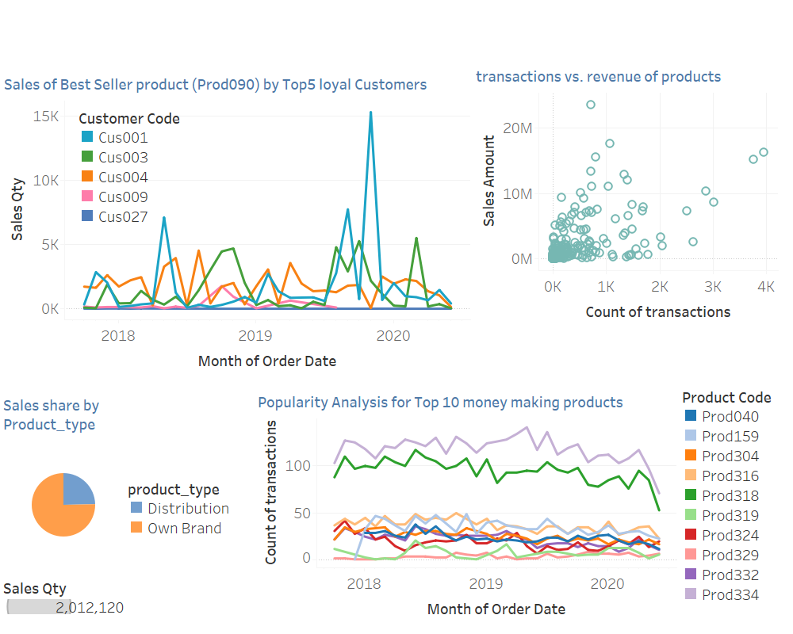

Slide 17
Conclusion and Next steps

Slide 18
Conclusion
The sales trend has been irregular, with a noticeable decline since July 2019.
Bangalore (Mark006) is the worst-performing market, while New Delhi (Mark004) is leading in sales.
The North region performs the best, while the South region needs more attention.
Prod090 is the bestseller, but key products like Prod334 and Prod318 are experiencing steep declines.
Loyal customers like Surge Stores and Excel Stores contribute significantly to revenue, but their purchasing patterns need to be maintained.
High-revenue, low-transaction products (e.g., Prod040) present an opportunity for growth

Slide 19
Next Steps and Recommendations
Target Underperforming Regions
Investigate why Bangalore and South Region sales are declining.
Strengthen marketing efforts and promotional campaigns in these areas.
Optimize Product Strategy
Focus on boosting sales of high-revenue, low-transaction products (e.g., Prod040).
Investigate the reason behind the decline of top-selling products (Prod334, Prod318) and implement corrective actions.
Leverage Loyal Customers
Strengthen relationships with key customers like Surge Stores and Excel Stores.
Offer loyalty programs, bulk discounts, or exclusive deals to increase repeat purchases.
Address Sales Seasonality
Analyze external factors affecting the irregular trend (e.g., economic downturns, competitor actions).
Implement dynamic pricing strategies or seasonal promotions to stabilize revenue.
Data-Driven Decision Making
Continuously monitor sales trends using the Tableau dashboard.
Conduct periodic reviews to adapt sales strategies based on real-time insights.

