Slide 1
B2B E-commerce Fraud Detection
Data Analysis Project- Shreya Asthana

Slide 2
Background
ABC Company, an e-commerce platform, processes thousands of orders daily.
It partners with multiple courier companies that charge based on order weight and delivery distance.

Slide 3
Objective
Verify if courier companies are billing ABC correctly for each shipment.

Slide 4
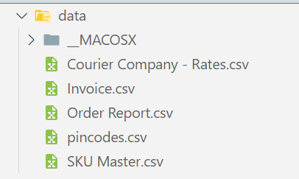
Data Overview
Internal Reports:
Website Order Report (Order IDs, SKUs).
SKU Master (Product weights).
Warehouse PIN Mapping (Delivery zones based on Pin code).
External Data:
Courier Invoices (AWB number, weight, zones, charges, shipment type).
Courier Rate Card (Fixed & additional charges per weight slab & delivery area).

Slide 5
Approach
Weight Verification:
Calculate total order weight using SKU Master.
Compare with the courier’s reported weight (rounded up to the nearest 0.5 kg).
Delivery Zone Validation:
Use warehouse-to-pin code mapping to check the correct zone.
Compare with the zone reported by the courier.
Billing Accuracy:
Recalculate charges using the official rate card (weight slab, zone, shipment type).
Compare with the actual billed amount in courier invoices.

Slide 6
Outcome
Order ID | Total Weight | Weight Slab | Delivery Zone As Per ABC | Expected Charge as per ABC | AWB Number | Total weight as per Courrier Company (KG) | Delivery Zone Charged by Courier Company | Billing Amount (Rs.) | Weight Slab Charged by Courier Company
2001827036 | 0.127 | 0.5 | e | 56.6 | 1.09112E+12 | 1.6 | b | 117.9 | 2
2001827036 | 0.15 | 0.5 | e | 56.6 | 1.09112E+12 | 1.6 | b | 117.9 | 2
2001827036 | 0.1 | 0.5 | e | 56.6 | 1.09112E+12 | 1.6 | b | 117.9 | 2
As seen in the data snapshot, the courier company:
Inflated weight slabs from 0.5 KG ➝ 2.0 KG 📦
Changed delivery zones, increasing charges 📍
Billed more than double the expected amount 💸

Slide 7
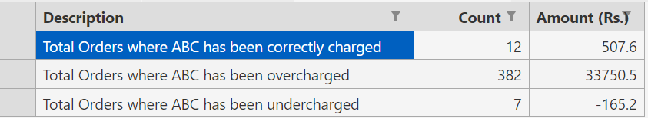
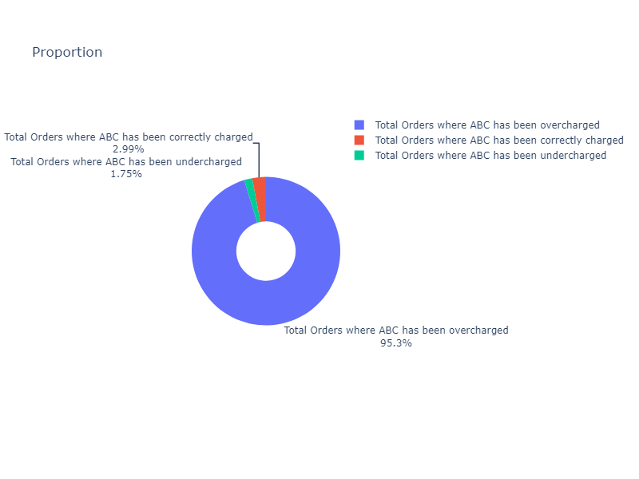
Outcome
95.3% of the orders are overpriced by the courier company, which is causing the ABC company continuous loss on each order.

Slide 8
Project Repository and tools
GitHub repository: https://github.com/shreya-asthana/b2bfrauddetection
Tools used:
Python ( Pandas , missingno, plotly ) – Data processing, visualization, and handling missing values
Jupyter Notebook – Interactive analysis and development environment

