Slide 1
🐞 BugSense
AI-Assisted Software Bug Tracking & Issue Management System
Software Engineering Group Project
Member 1: <Name> (<Roll No>) Member 2: <Name> (<Roll No>)

Slide 2
Problem Statement
▸ Bugs reported via e-mail / chat / spreadsheets get lost or duplicated
▸ Severity is judged inconsistently – critical bugs wait in the queue
▸ Work is assigned unevenly; some developers overloaded
▸ Managers cannot see which bugs block a release
▸ No history of who changed what → no accountability
▸ Goal: One system that manages the complete bug life cycle using sound SE practices
2

Slide 3
Objectives & Key Features
Bug Reporting
Severity & Priority
AI Triage
Smart Assignment
structured form, version found, target release
4 severities → P1–P4 rule
ML severity prediction + duplicate detection
skill + workload strategy
Life-cycle & Testing
Release Management
Dashboard & Kanban
Security & Audit
10-state machine, QA verify / reopen
readiness % and ship gate
charts, workload, drag-and-drop
RBAC, hashing, lockout, audit log
3

Slide 4
SDLC Model – Iterative Incremental (Agile)
Sprint 1
Sprint 2
Sprint 3
Requirements, SRS, design,
DB schema, authentication
Bug workflow, state machine,
assignment, AI module
Front-end, releases, analytics,
testing, documentation
▸ Why: working increment early, requirements refined after feedback, suits a 2-person team
▸ Why not Waterfall: no room for change after design (AI features evolved)
4

Slide 5
Requirements (SRS – IEEE 830)
Functional (16)
Non-functional (10)
▸ Register / login, 5 roles (RBAC)
▸ Report bug + AI severity
▸ Priority derivation
▸ Duplicate detection
▸ Manual / auto assignment
▸ Enforced life cycle
▸ Comments, history, notifications
▸ Releases + ship gate
▸ Search, dashboard, Kanban, audit log
▸ Security: PBKDF2, lockout, rate limit, CSP
▸ Performance: < 300 ms, DB indexes
▸ Usability: responsive, dark mode
▸ Reliability: FK / CHECK constraints
▸ Maintainability: layers, patterns, 63 tests
▸ Portability: any OS, Python 3.10+
▸ Accountability: audit log
5

Slide 6
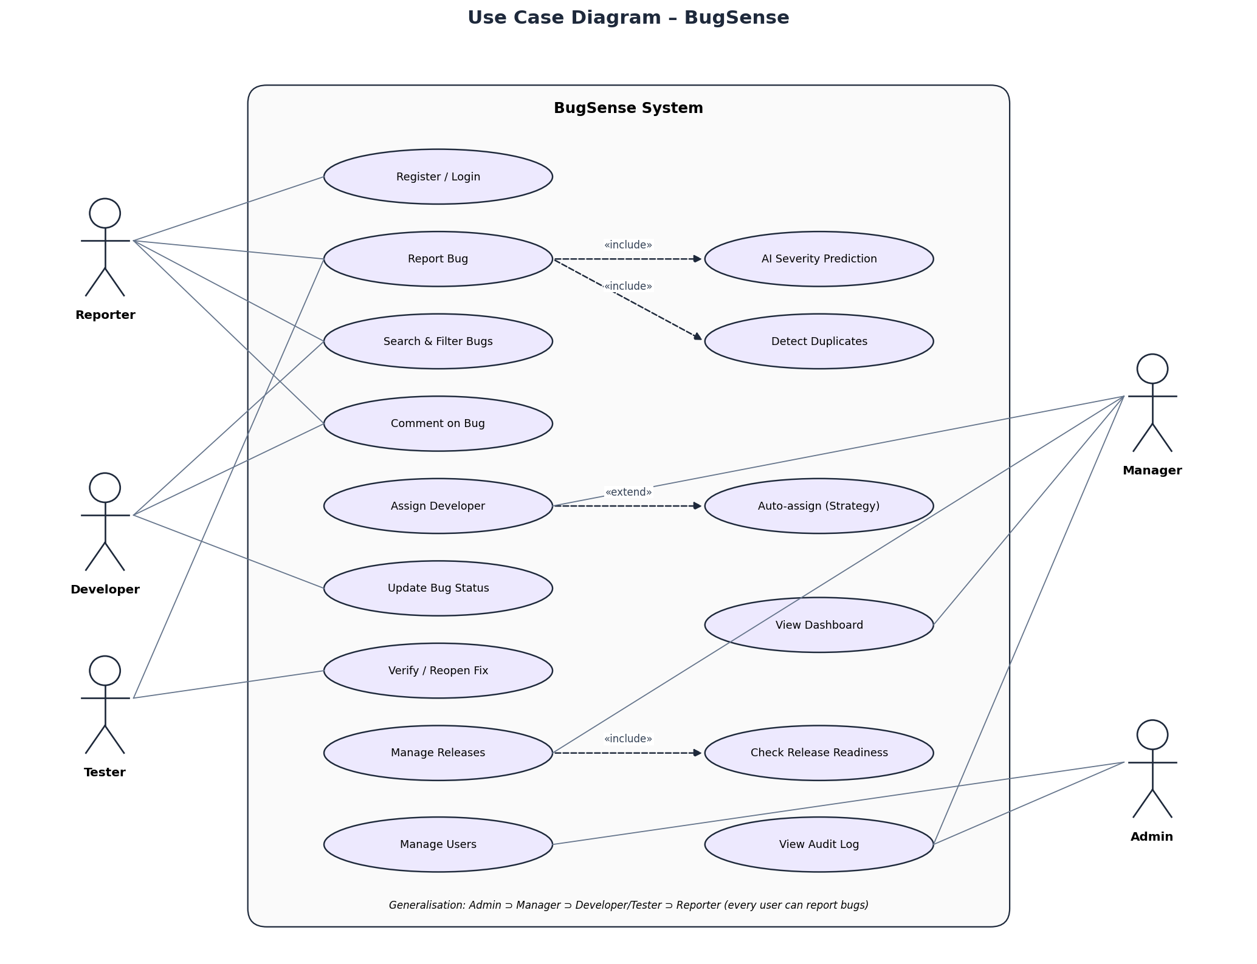
Use-Case Diagram
6

Slide 7
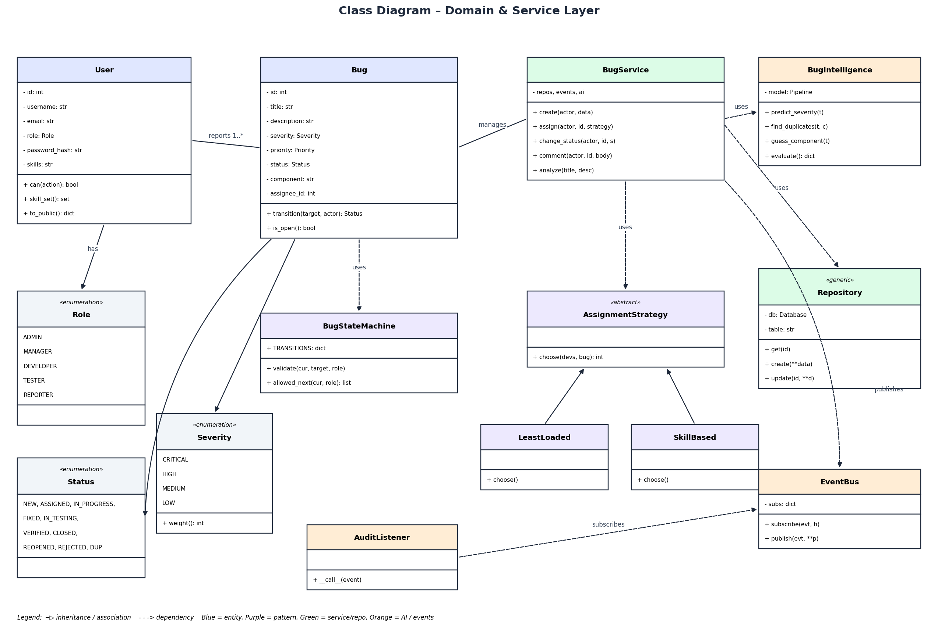
Class Diagram
7

Slide 8
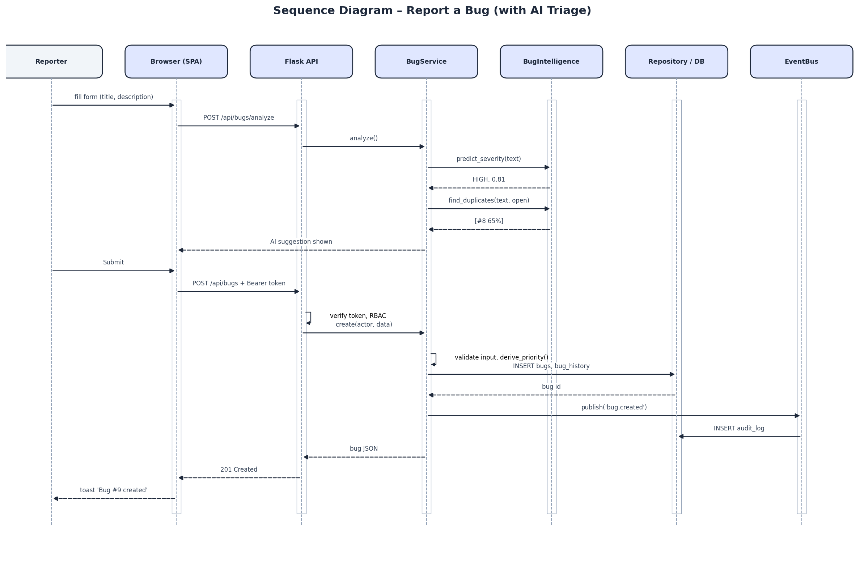
Sequence Diagram – Report a Bug
8

Slide 9
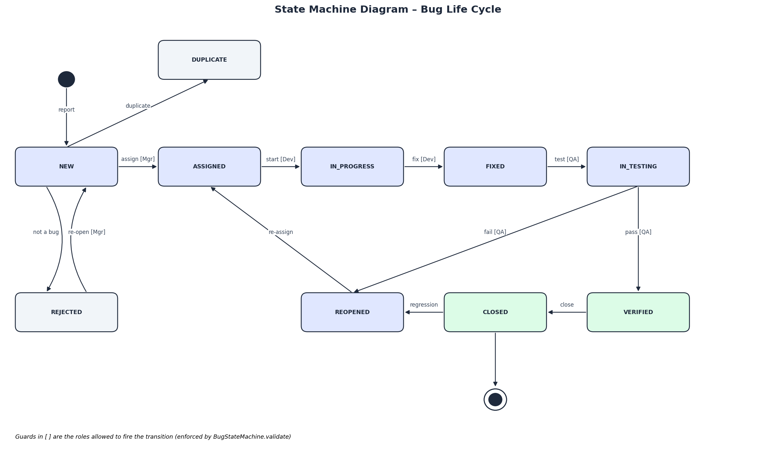
State Diagram – Bug Life Cycle
9

Slide 10
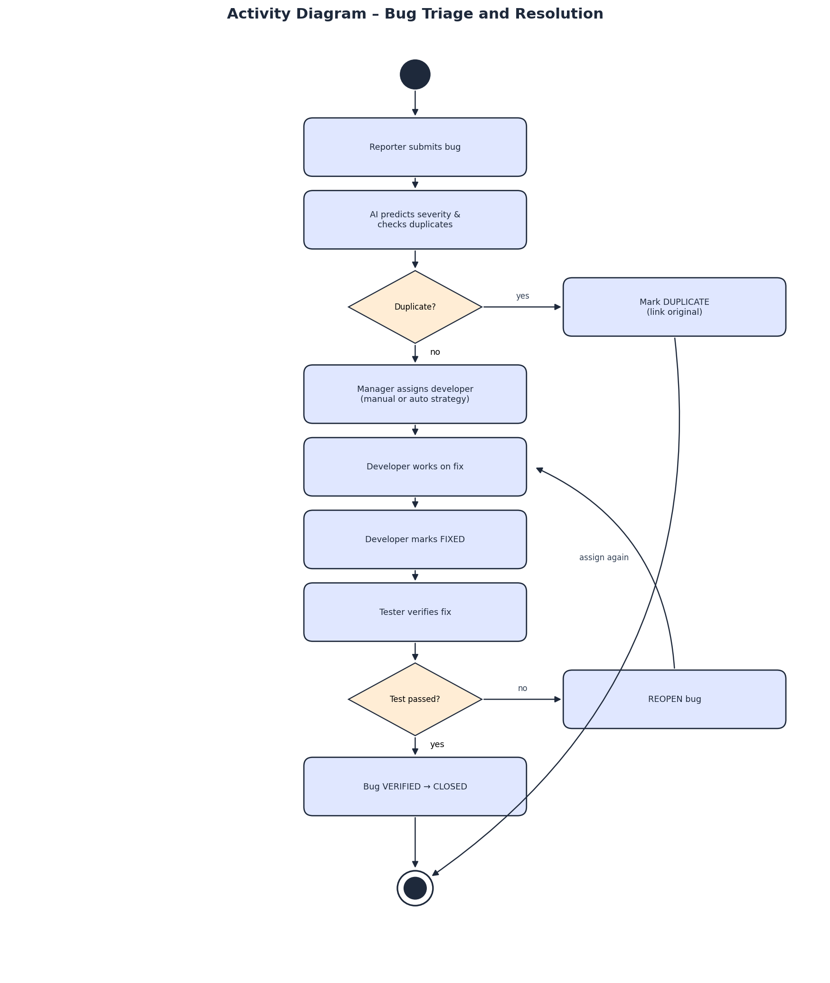
Activity Diagram – Triage & Resolution
10

Slide 11
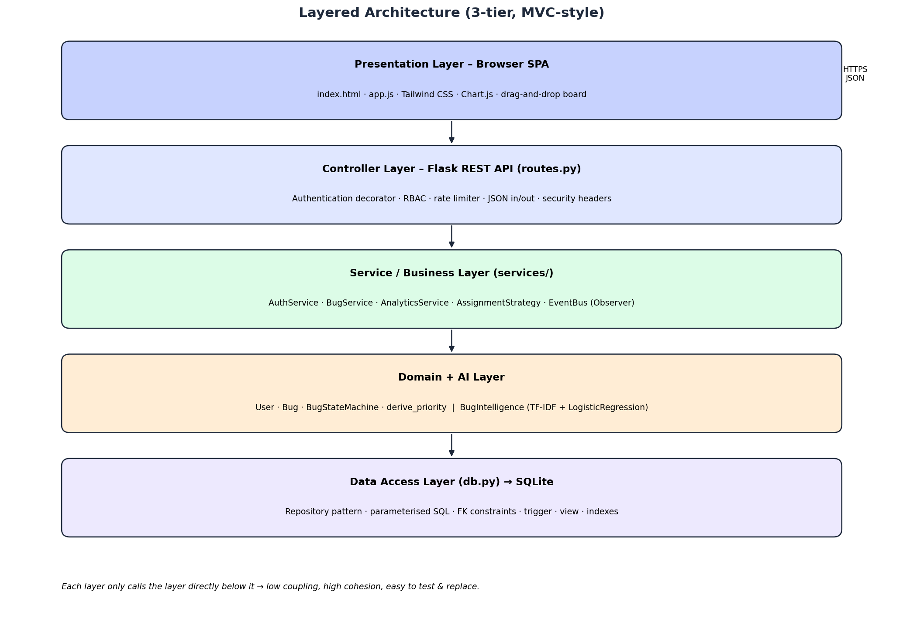
Architecture & Design Patterns
▸ Repository – data access
▸ Strategy – assignment
▸ State – life cycle
▸ Observer – audit/notify
▸ Factory – create_app
▸ Decorator – auth
▸ SOLID principles
11

Slide 12
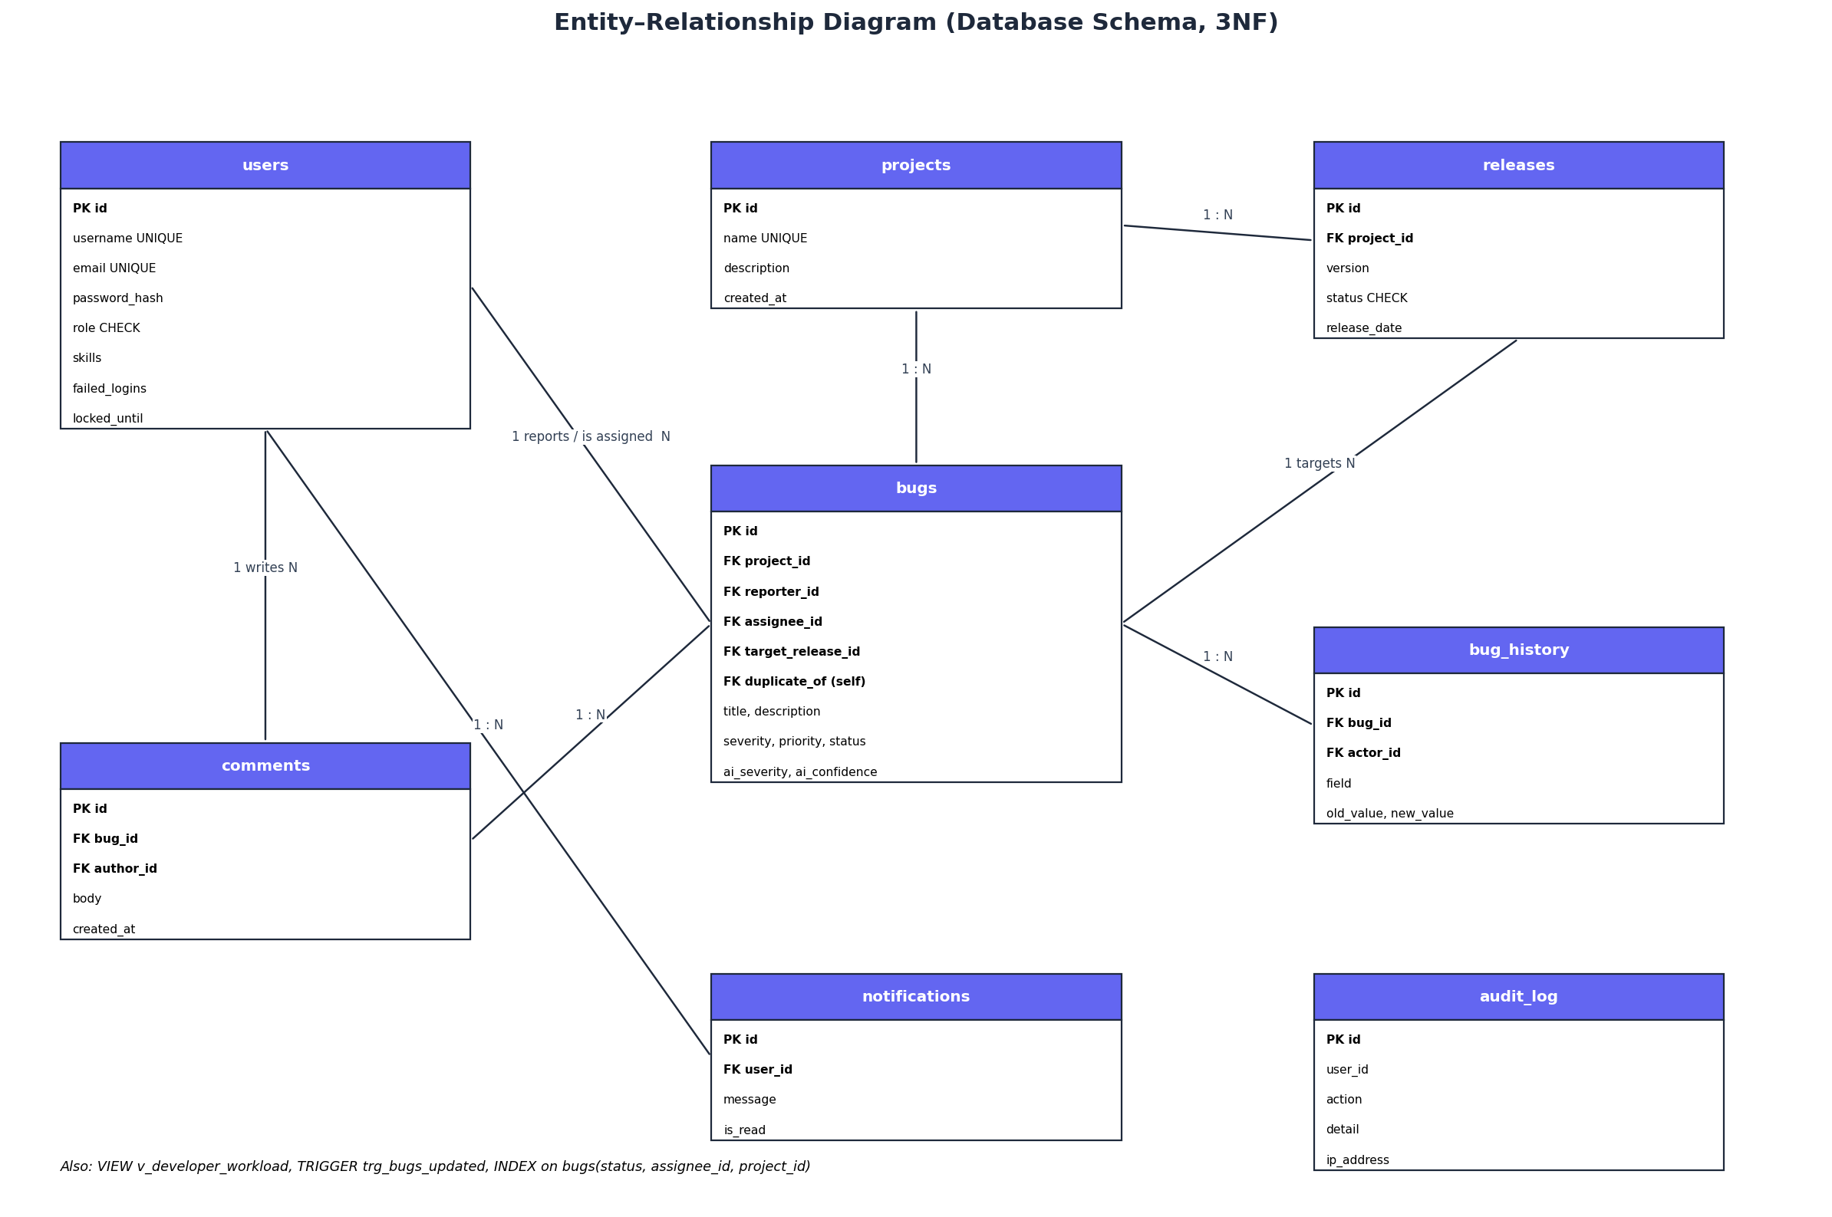
Database Design (3NF)
▸ 8 tables, FKs
▸ CHECK / UNIQUE
▸ 3 indexes
▸ Trigger
▸ View for workload
▸ Parameterised SQL
12

Slide 13
AI / ML Module
▸ Severity classifier: TF-IDF (word + char n-grams) → Logistic Regression
▸ Safety rules: 'crash', 'data loss', 'SQL injection' → CRITICAL
▸ Duplicate detection: cosine similarity ≥ 0.45 vs open bugs
▸ Smart assignment: score = 10·skill_match − workload
▸ Human-in-the-loop: user can override; AI/human agreement shown on dashboard
▸ Evaluation: stratified 5-fold cross-validation, beats random baseline; improves as data grows
13

Slide 14
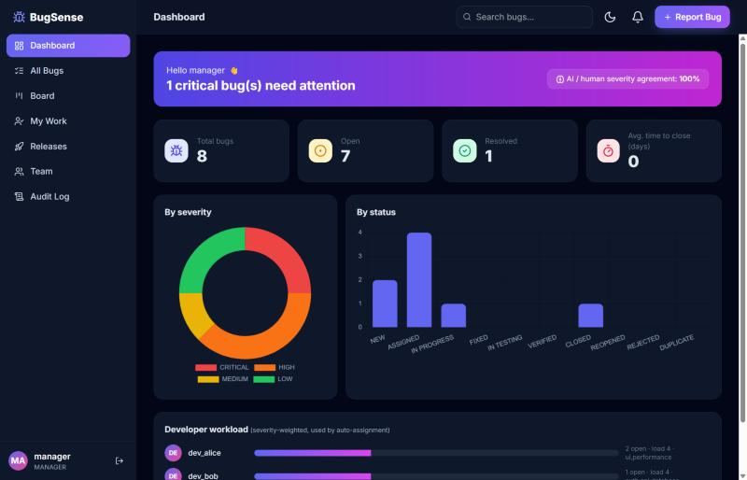
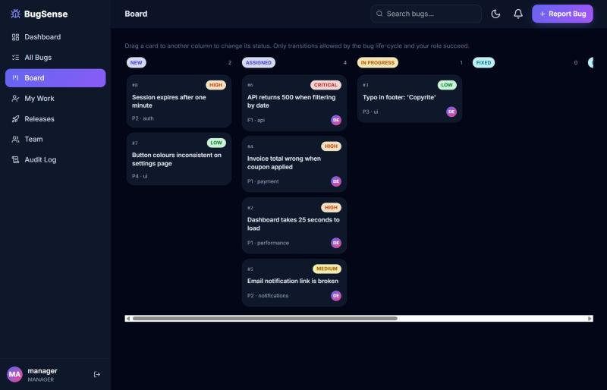
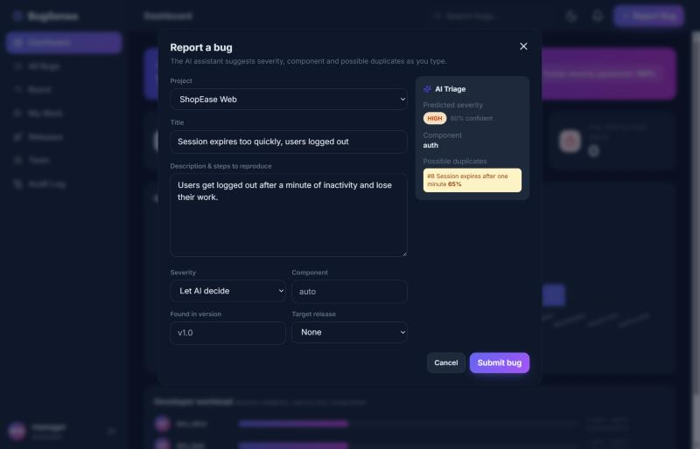
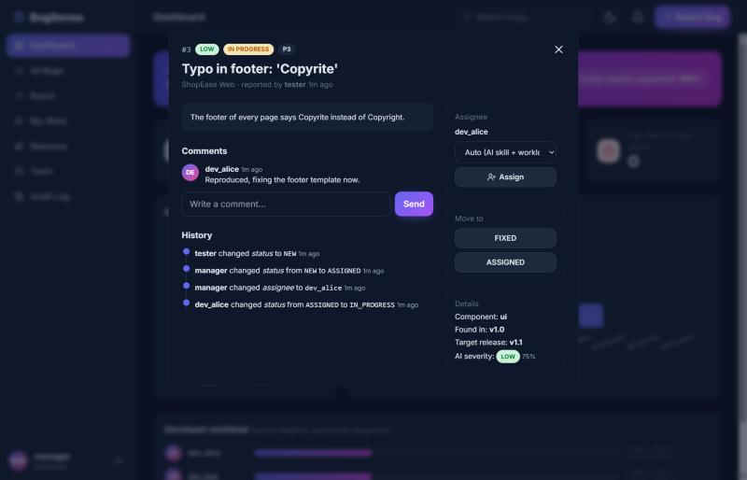
Implementation – Screens
14

Slide 15
Security & Testing
Security (STRIDE)
Testing – 63 tests, all pass
▸ PBKDF2-SHA256 salted hashes
▸ HMAC-signed expiring tokens
▸ RBAC on every endpoint
▸ Lockout after 5 failures
▸ Rate limiting (429)
▸ SQLi: parameterised queries
▸ XSS: escaping + CSP
▸ Audit log with IP
▸ Unit: state machine, rules, security, AI
▸ Integration: services + SQLite
▸ System: black-box REST API, end-to-end
▸ Techniques: BVA, equivalence classes, state-transition, security
▸ Traceability matrix FR → test
15

Slide 16
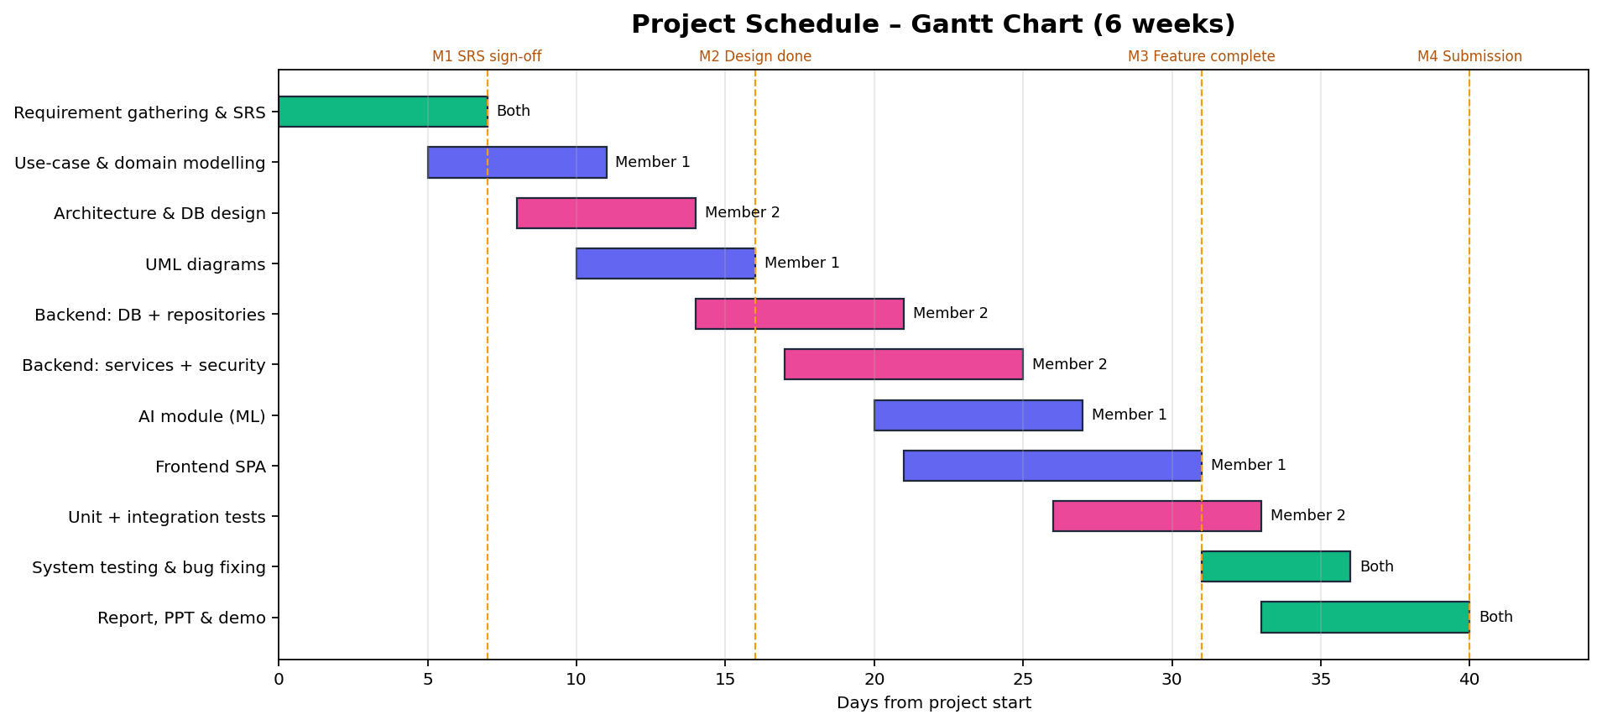
Project Planning
▸ Member 1: requirements, UML, AI, front-end Member 2:|architecture, DB, back-end, security, tests
16

Slide 17
Maintenance, Future Scope & Conclusion
▸ Corrective: regression test for every fix
▸ Adaptive: SQLite → PostgreSQL by changing only db.py; Docker/cloud
▸ Perfective: e-mail/Slack listener, attachments, Git/CI integration
▸ Preventive: retrain ML on real data, dependency updates, refactoring
▸ Conclusion: all required features delivered with a full SDLC – SRS, UML, architecture, OOP, security, testing, planning
17

Slide 18
Thank You
Questions? · Live demo: python -m bugtracker.app

