Slide 1
ArogyaNova
+
An Intelligent, Object-Oriented Prescription Management System
OOM Course Project · Under the guidance of Dr. K.M Pooja
Shreya Kumbar · IIT205178
Anamika Chauhan · IIT2025151
Soumili Ghosh · IIT2025163
Notes:
Introduce the team and the project: a full-stack prescription management system designed and built with object-oriented methodology.

Slide 2
Paper prescriptions fail patients and doctors
Illegible & lost
Handwritten records cause dosage errors and disappear between visits.
No safety net
Nothing checks for dangerous drug–drug combinations before issuing.
Blind follow-up
Doctors cannot see whether patients actually took their medicines.
Our goal
Digitise the full lifecycle: draft → AI safety check → issue → schedule → dose logging → analytics
Enforce clinical rules inside the objects themselves, so illegal actions are impossible
Serve four roles — Doctor, Patient, Pharmacist, Administrator — through one secure GUI

Slide 3
We followed the OOAD process end to end
1
2
3
4
5
6
Analyse
Actors & use cases
Model
Class & ER diagrams
Behaviour
Sequence, state, activity
Design
Layers, SOLID, patterns
Build
Python + TypeScript
Verify
54 automated tests
Why object-oriented?
A prescription has rules that must always hold — an issued prescription must never be silently edited. Procedural code scatters these checks across every screen. In our design the rule lives inside the Prescription class, the only code allowed to change its own status. Correctness comes from structure, not discipline.

Slide 4
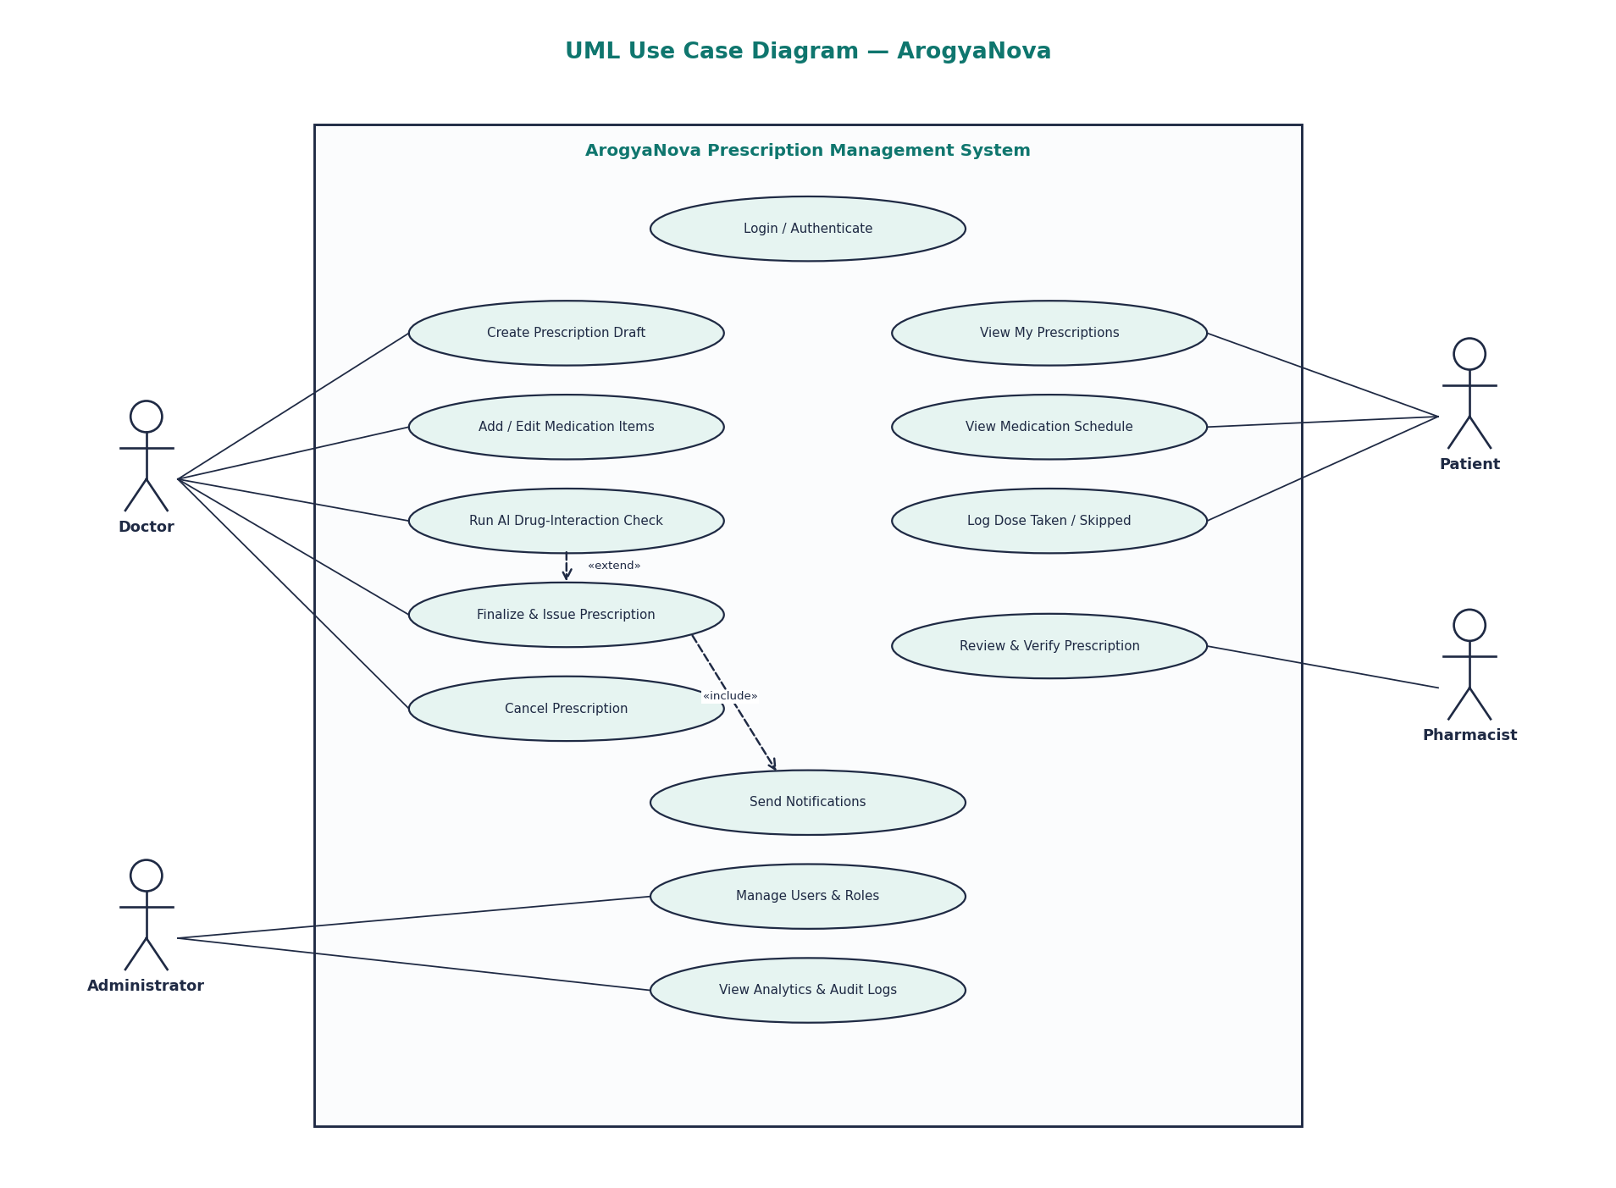
Use cases: four actors, one system
Doctor authors, checks, finalises and cancels prescriptions
Patient views schedule and logs each dose
Pharmacist reviews and verifies
Administrator manages users and audits
«include»: finalising always notifies; «extend»: AI check is optional

Slide 5
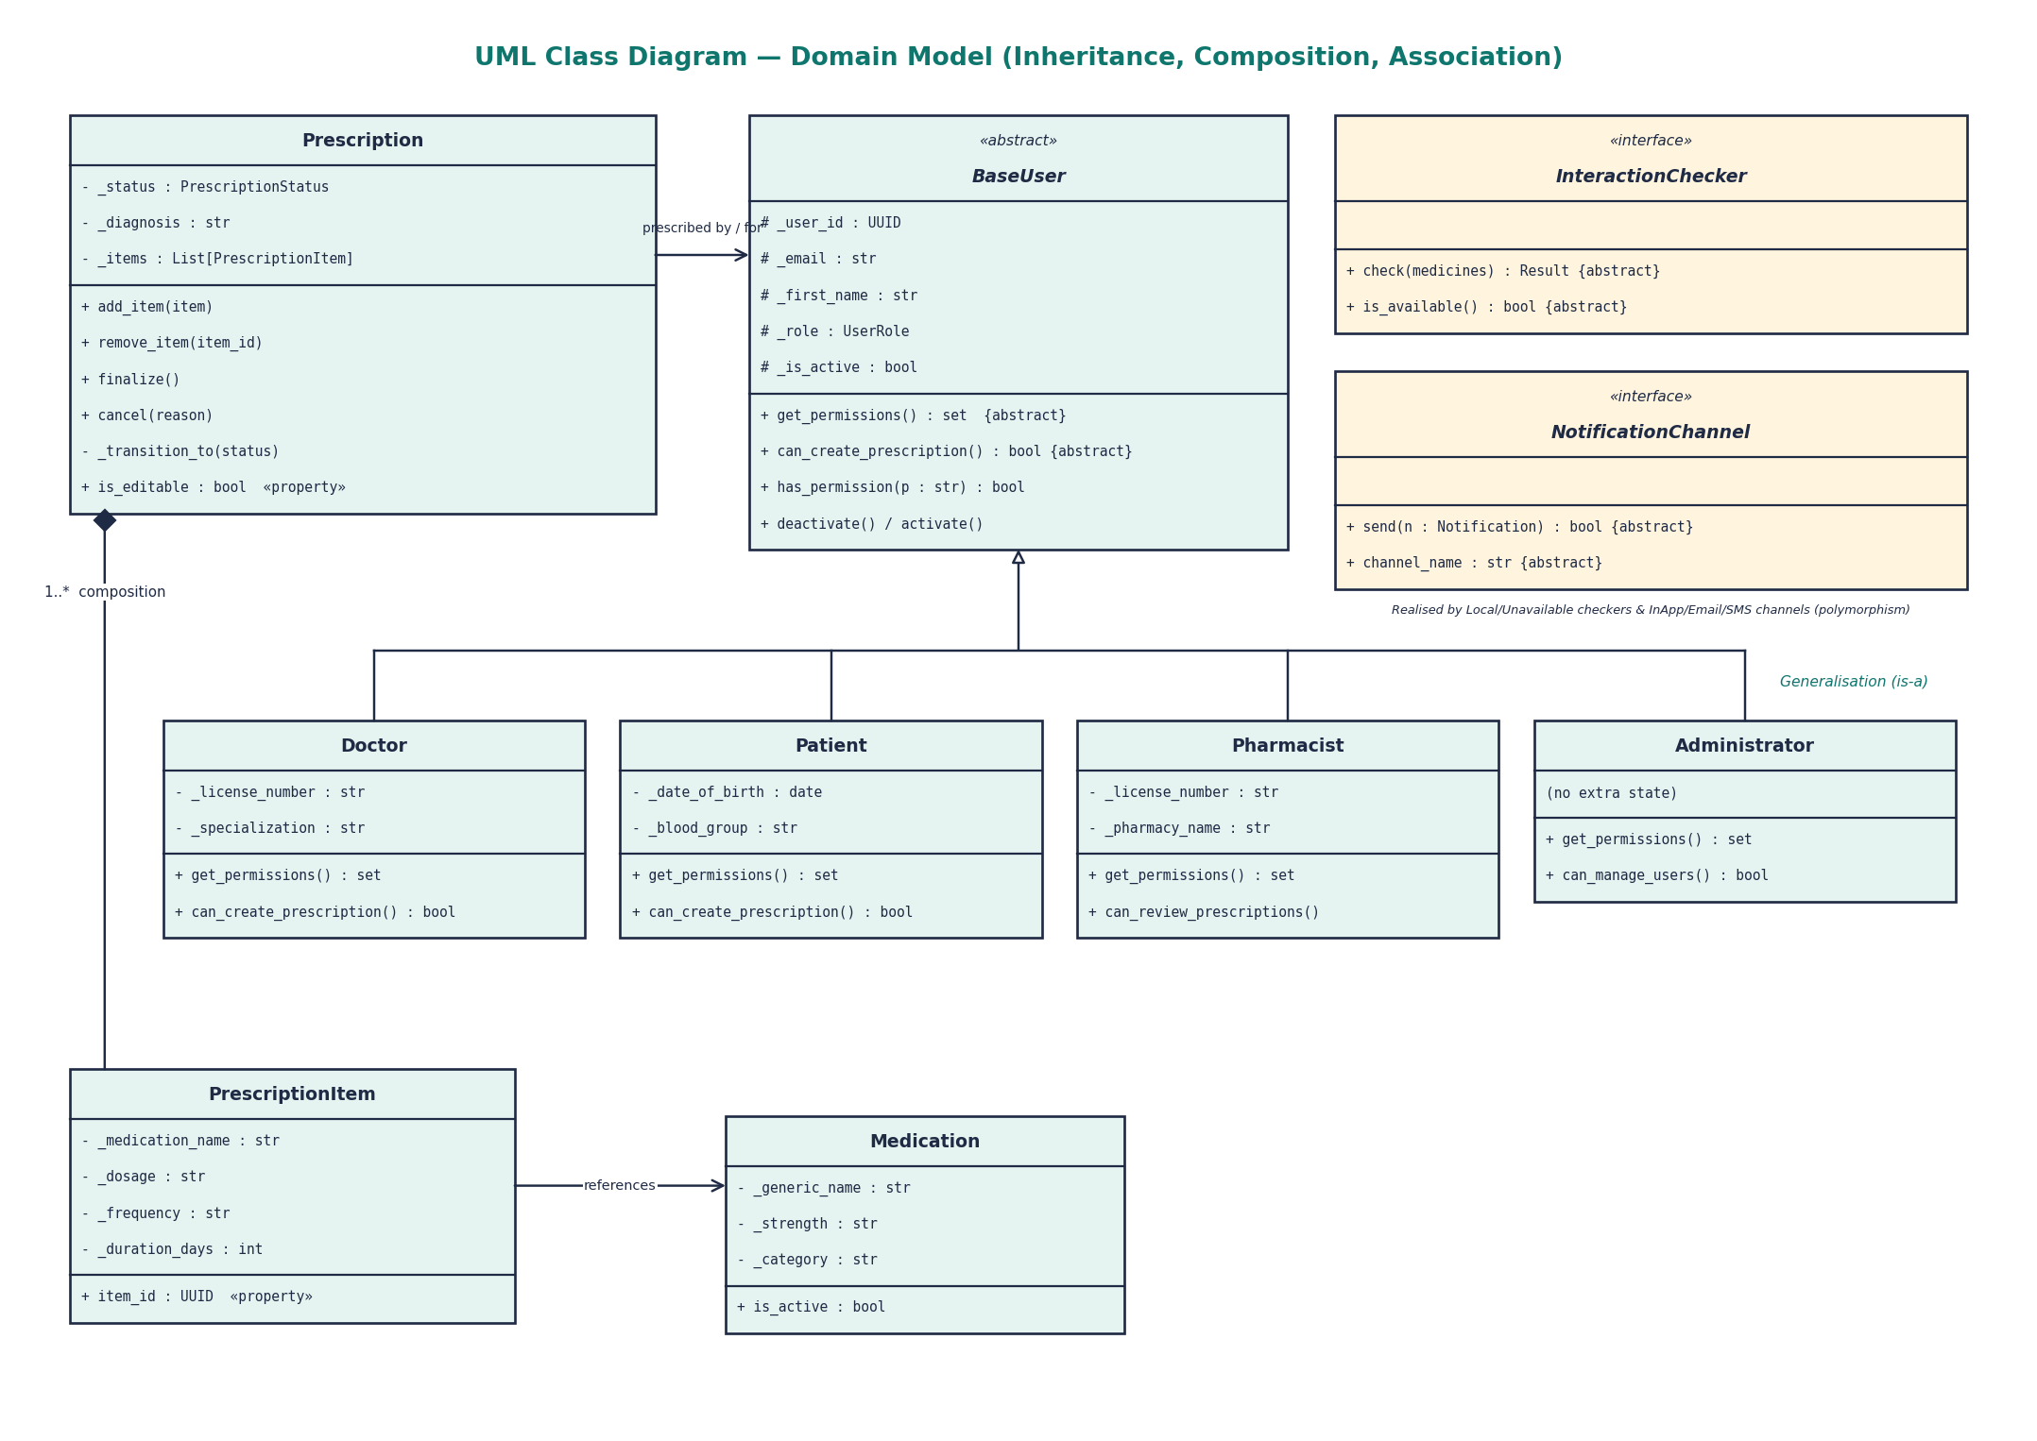
Class diagram: the domain model

Slide 6
All four OOP pillars live in real, tested code
Encapsulation
Prescription keeps _status and _items private. Read-only @property access; changes only via add_item(), finalize(), cancel().
Abstraction
BaseUser, BaseRepository[T], InteractionChecker, OCRProvider and NotificationChannel are ABCs with @abstractmethod contracts.
Inheritance
Doctor, Patient, Pharmacist and Administrator extend BaseUser and reuse its constructor via super().__init__().
Polymorphism
has_permission() returns different answers per role; NotificationService calls send() on in-app, email and SMS channels alike.

Slide 7
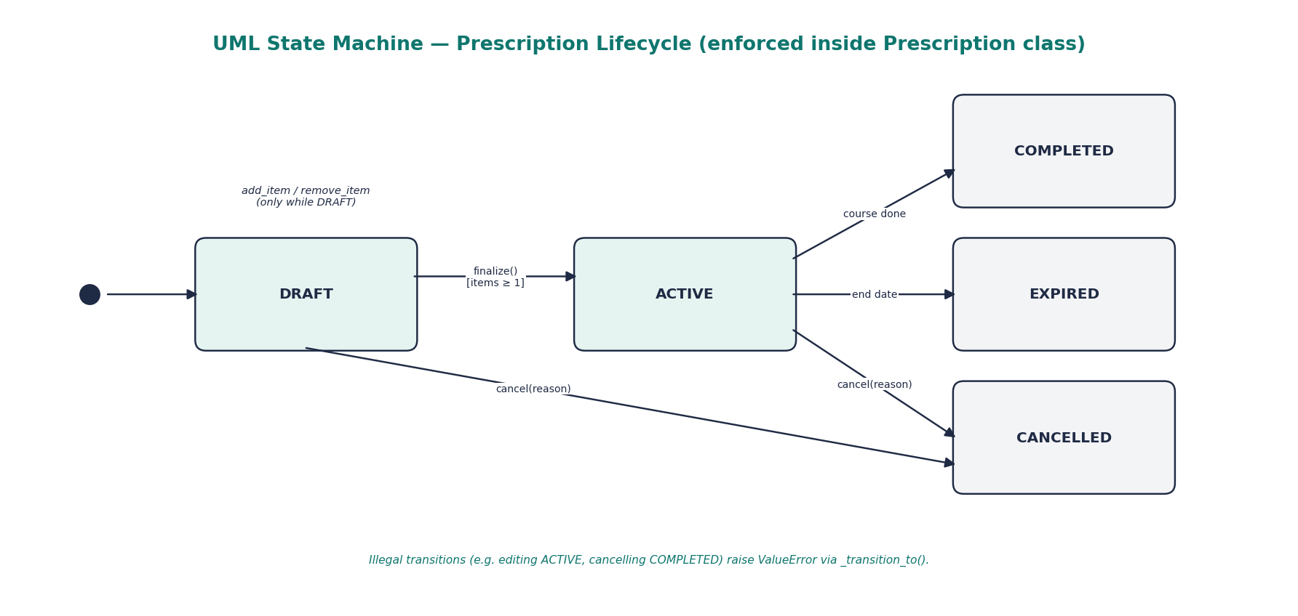
Encapsulation enforces the prescription lifecycle
class Prescription:
@property
def status(self):
return self._status # read-only
def add_item(self, item):
if not self.is_editable:
raise ValueError("Cannot add items…")
self._items.append(item)
def finalize(self):
if not self._items:
raise ValueError("needs ≥1 medication")
self._transition_to(ACTIVE)
Allowed moves stored in _VALID_TRANSITIONS
Illegal moves raise ValueError
items returns a defensive copy

Slide 8
Beyond the pillars: relationships and language features
Composition
Prescription ◆— PrescriptionItem (cascade delete)
Aggregation
NotificationService holds injected channels
Association
Prescription → Patient, Doctor; Item → Medication
Generics
BaseRepository(ABC, Generic[T])
Enums
UserRole, PrescriptionStatus, InteractionSeverity
Data classes
Frozen Notification value object, OCRResult

Slide 9
SOLID principles and design patterns
S
Each class has one job
Pattern | Where
Repository | repositories/base.py
Strategy | InteractionChecker / OCRProvider
State | Prescription._VALID_TRANSITIONS
Observer | NotificationService → channels
Null Object | Unavailable* providers
Dependency Injection | FastAPI Depends(), constructors
Template Method | has_permission() → get_permissions()
O
New channel = new subclass
L
Any role substitutes BaseUser
I
Small focused interfaces
D
Services depend on abstractions

Slide 10
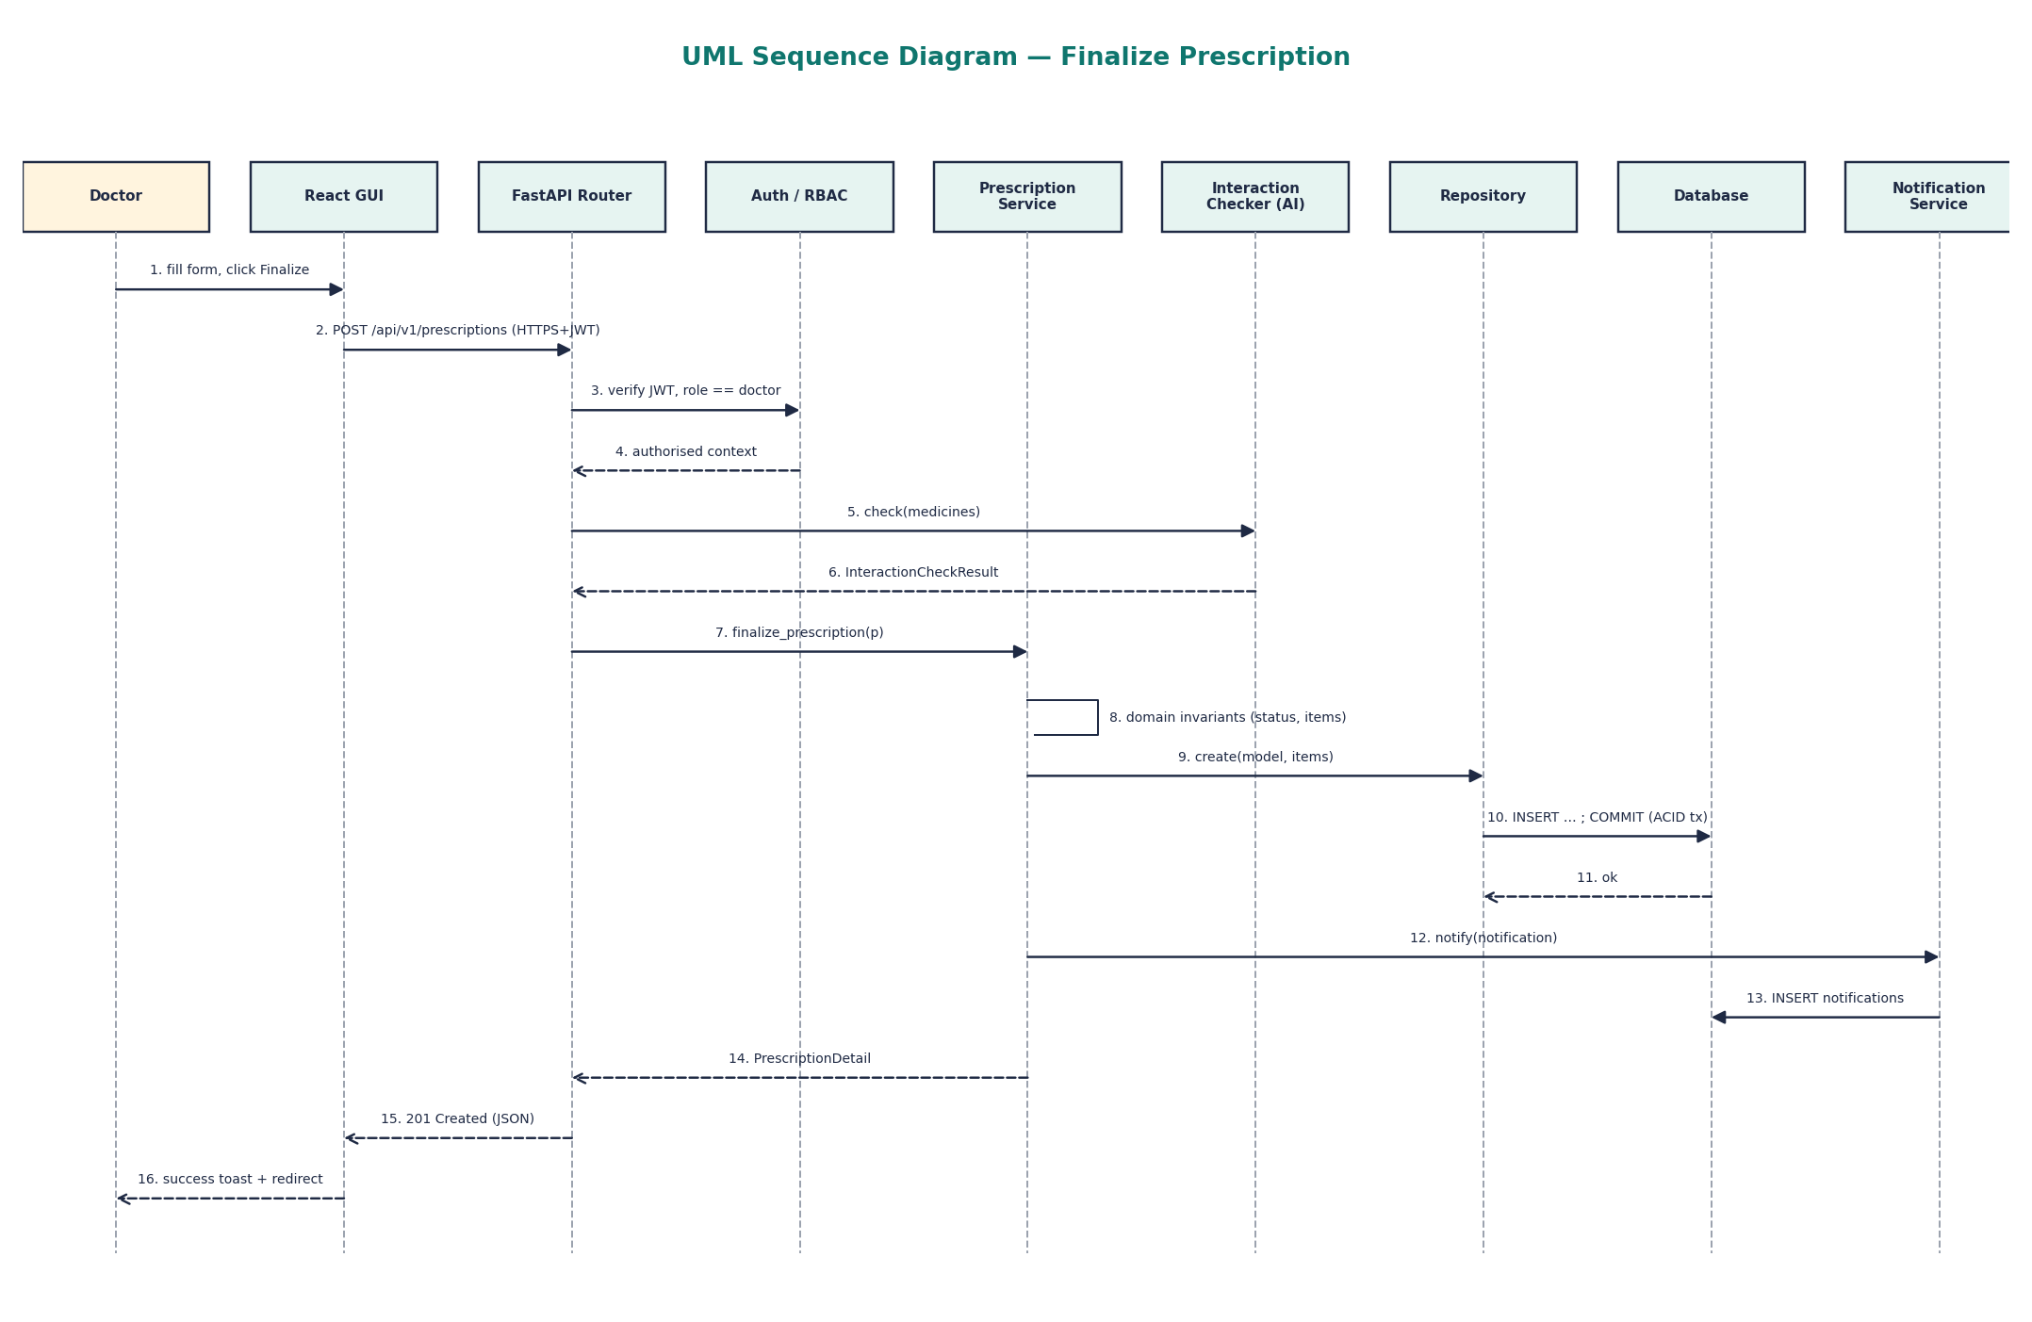
Sequence: how objects collaborate to finalise

Slide 11
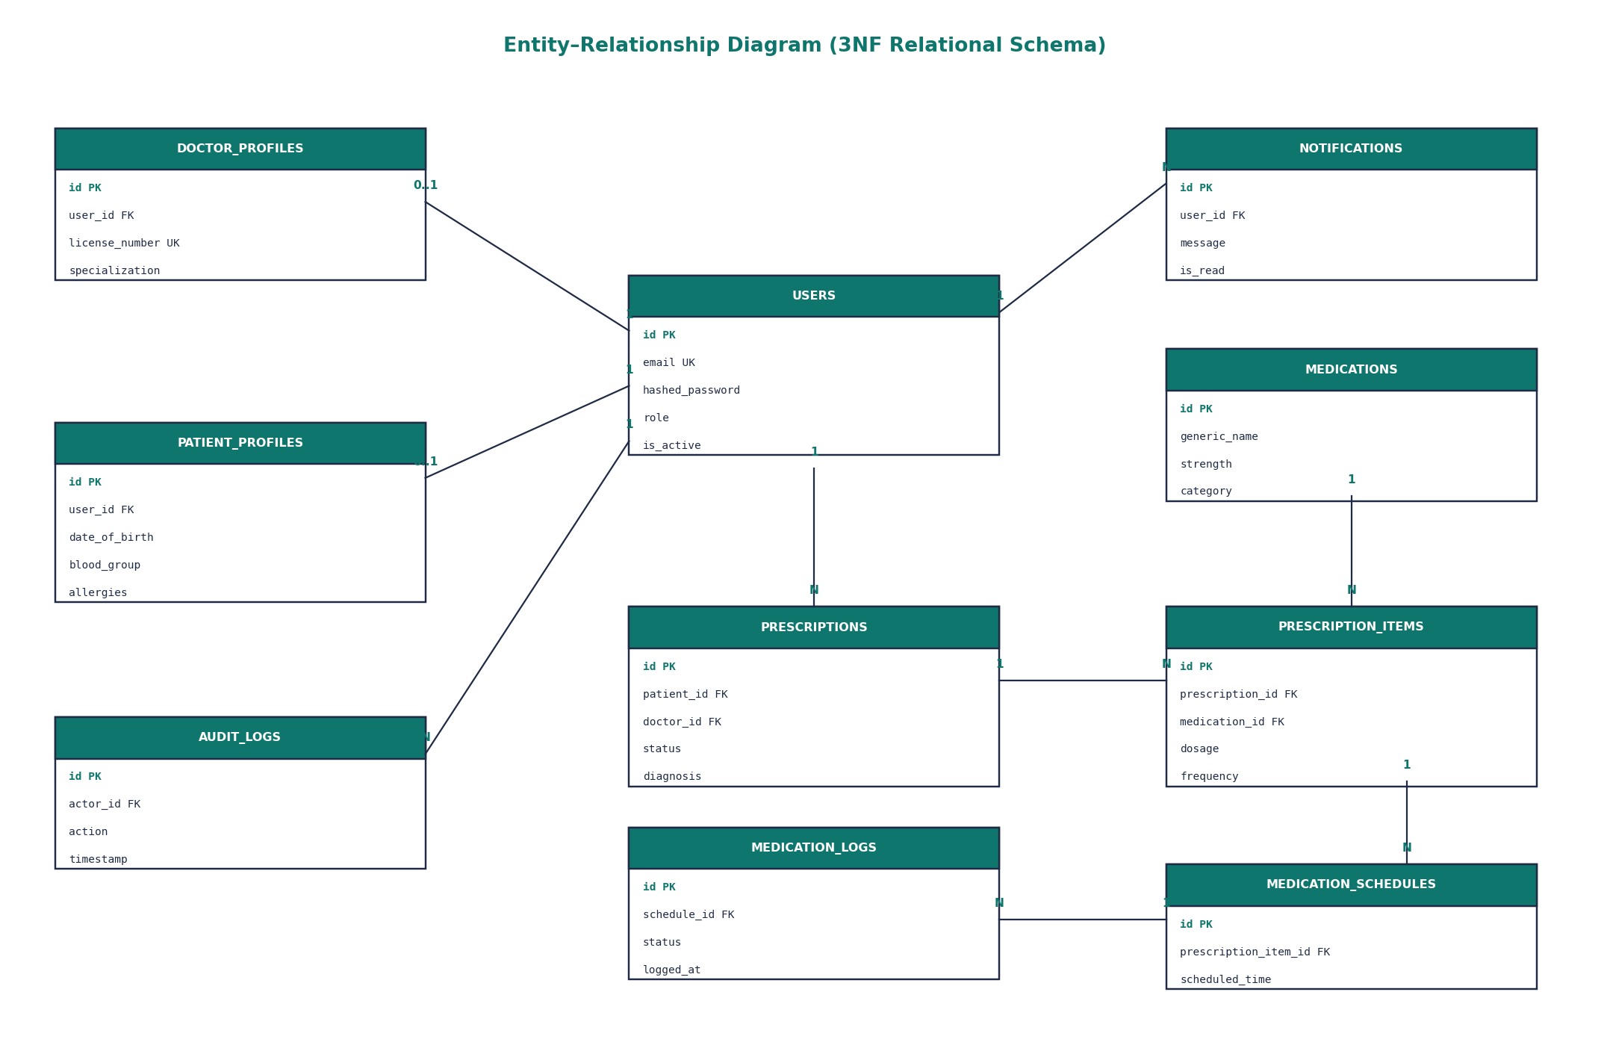
DBMS: a normalised relational schema
10 tables in 3NF; UUID primary keys, foreign keys, unique constraints
SQLAlchemy 2.0 async ORM maps tables ↔ classes
Finalise = one ACID transaction (items + schedule)
Eager loading avoids N+1 queries
SQLite for dev, PostgreSQL in Docker; Alembic migrations

Slide 12
Computer networks and cybersecurity
Networks
Security (OWASP-aligned)
Client–server REST API over HTTP/TCP
JSON payloads, proper status codes (201, 401, 403, 422)
Ports 5173 (GUI), 8000 (API), 5432 (DB)
CORS restricts callers to the GUI origin
Async ASGI server handles concurrent connections
Auto-generated OpenAPI docs at /docs
Argon2id password hashing, unique salts
JWT in HttpOnly, SameSite cookies
Role-based + object-level access control
Security headers: X-Frame-Options, nosniff
ORM parameterised queries, Pydantic validation
Secrets from environment, not code

Slide 13
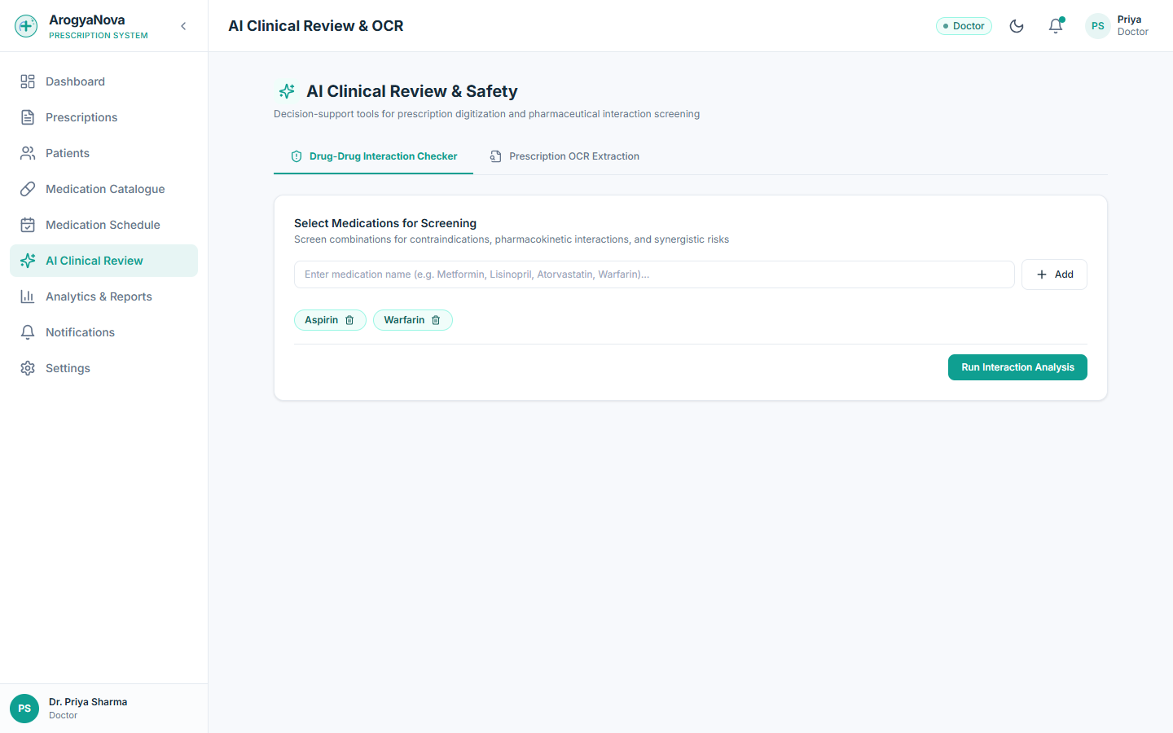
AI: explainable clinical decision support
Interaction checker
Rule-based expert system: medicine pairs → severity + explanation (e.g. warfarin + aspirin → bleeding).
Prescription OCR
Tesseract LSTM engine extracts text; parser finds names, strengths, frequency.
Adherence analytics
Taken ÷ logged × 100 → Good / Needs Attention / Poor.

Slide 14
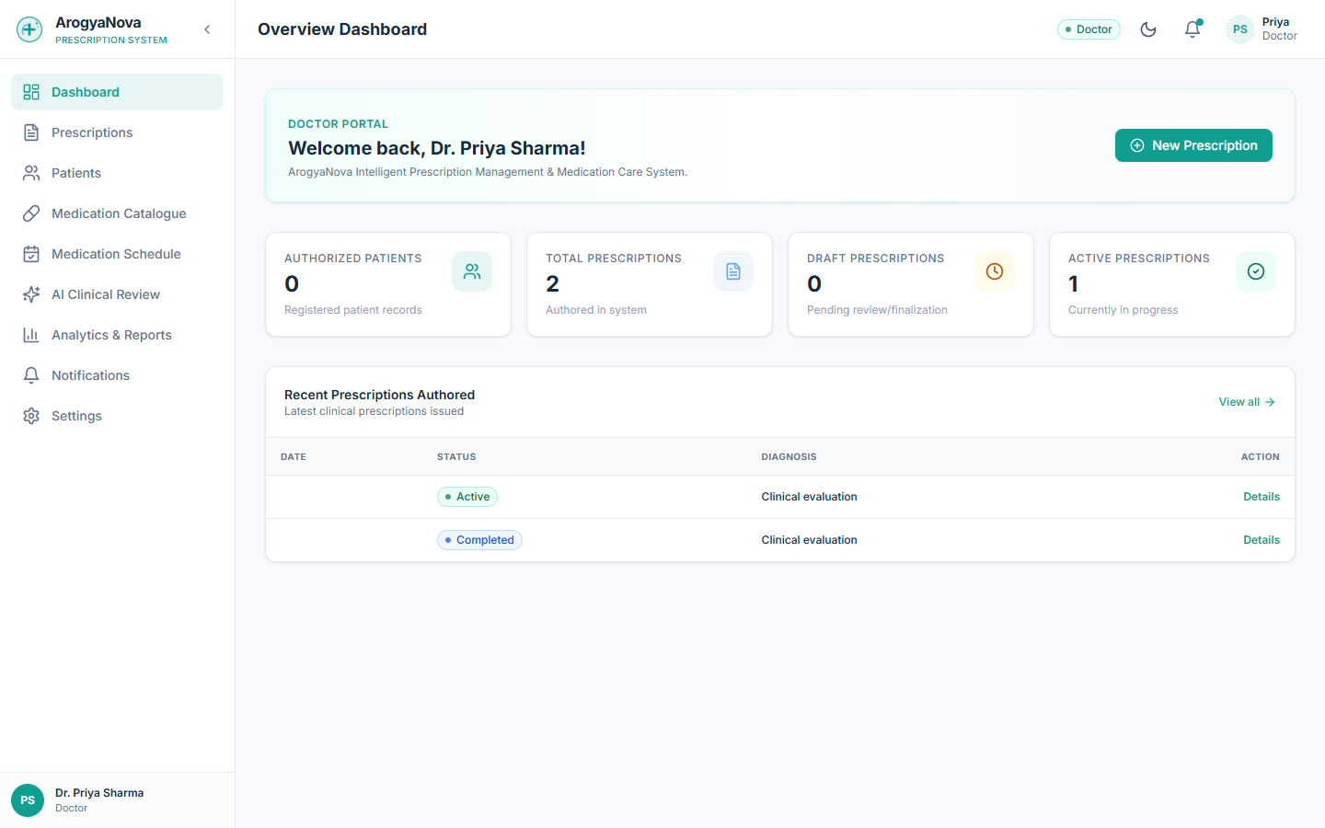
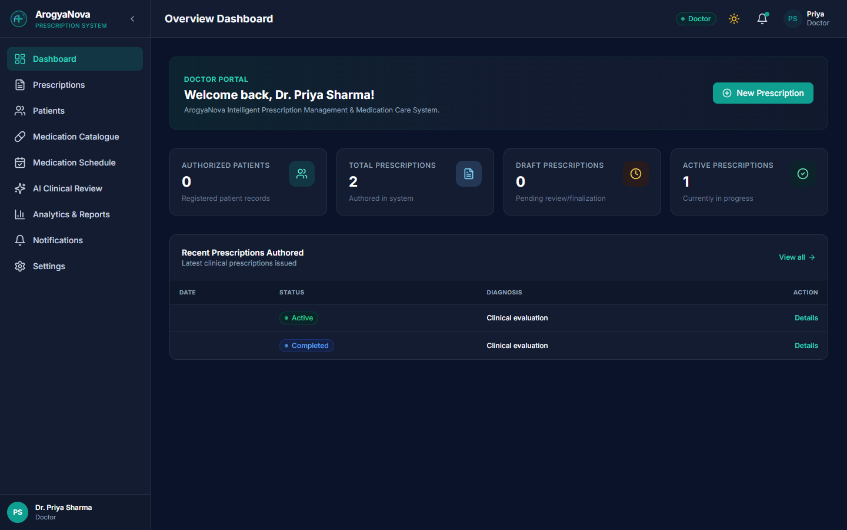
Graphical user interface
React 19 + TypeScript SPA · role-based navigation · light & dark themes · charts with Recharts · one-click demo logins
Components encapsulate UI state; props are their public interface; AuthContext & ThemeContext provide shared services.

Slide 15
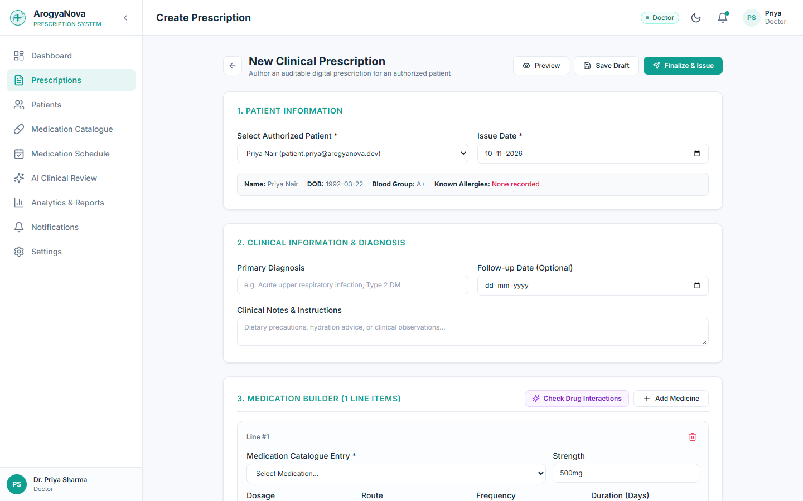
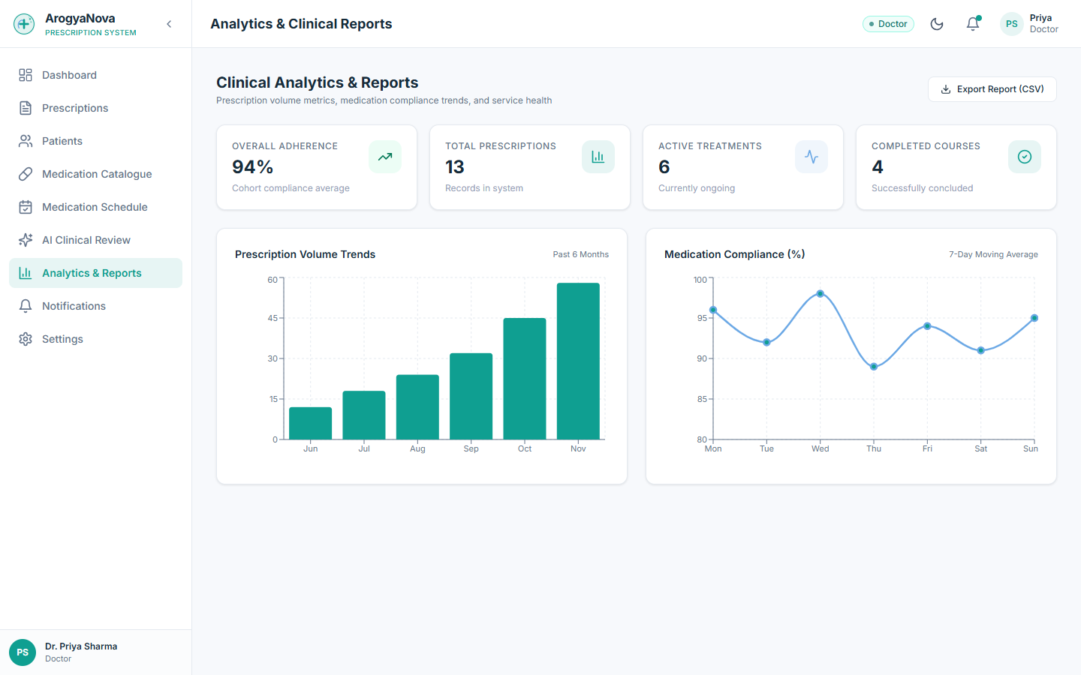
Prescription workflow screens
Create prescription with medication builder and AI check
Analytics: prescription trends and adherence

Slide 16
Testing: rules verified automatically
54
automated tests passing
Bug found and fixed during testing: the patient list returned users without loading related profiles, causing a server error under async SQLAlchemy. Eager-loading all profiles fixed it.

Slide 17
Conclusion & future scope
OOM made illegal clinical actions structurally impossible, and integrated DBMS, networks, security and AI cleanly.
Next: ML model to predict missed doses · licensed interaction database behind the same interface · WhatsApp/push channels as new subclasses · digital signatures · mobile app on the same API.

Slide 18
Thank you
Questions? · Live demo: http://localhost:5173 (demo logins on the sign-in page)
Shreya Kumbar (IIT205178) · Anamika Chauhan (IIT2025151) · Soumili Ghosh (IIT2025163)

