Slide 1
Efficient Data Mining and Information Extraction
Shreya Manepalli
Dept. of Computer Science, PES University, Bangalore

Slide 2
Introduction
GKN Aerospace generates a substantial volume of unstructured data annually, comprising
reports, documents, and images.
In an era where data plays a pivotal role in shaping strategies and innovations, extracting valuable insights from unstructured data has become paramount.
Time-consuming data entry tasks, manually processing large volumes of unstructured data, including reports, documents, and images, posed significant challenges for GKN Aerospace.
There is a need for an efficient and automated approach to handle diverse data sources.

Slide 3
Objective
During my internship at GKN Aerospace, my primary focus was on data mining and the efficient extraction of information from PDF or Word files and images into databases using Python.
This work encompasses three distinct projects. The projects undertaken aimed to overcome the challenges of manual data processing and pave the way for enhanced data analysis and visualization.

Slide 4
Non-Conformance Reports (NCRs) Data Extraction

Slide 5
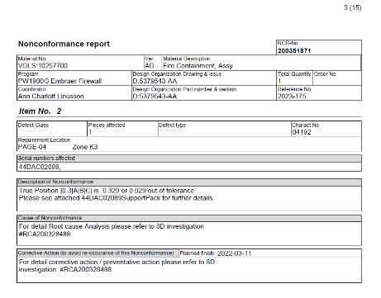
What are Non Conformance Reports?
Non-Conformance Reports (NCRs) are crucial documents that record instances of
non-compliance with quality standards or deviations from specified requirements.

Slide 6
Project Overview: The primary objective of this project was to develop a Python script to extract specific data from Non-Conformance Reports (NCRs) generated and analyzed by the SPE Team at GKN Aerospace.
The script aims to automate the data extraction process, as the NCRs contain
unstructured data which used to be manually retrieved for analysis. The extracted data will be organized into an excel file, making it suitable for data analytics.
The final output of the script is a consolidated Excel file containing organized data from all
NCRs processed during the operation. The output file can be used for further data analytics and insights, enabling more efficient decision-making and process improvements.

Slide 7
Output

Slide 8
Working of the code
The Python script accepts user input to determine whether the input is a single file or a folder containing multiple NCR PDF files
The script utilizes the "tabula" library to extract tabular data from the NCR PDF files. For each PDF file, the script reads all tables on every page and stores them in separate sheets within an intermediate Excel file.
The extracted data from each PDF file is organized into separate sheets within the Excel file based on the drawing number associated with each report.
The script appends the extracted data from each PDF file into the corresponding sheets in the output Excel file. For each NCR, the script appends the item number, description of
non-conformance, character number, defect type, measured value, and deviation value.

Slide 9
Color Codes Extraction from Images for the Fokker Plant

Slide 10
Project Overview
The objective of the second project is extract colors and associated codes from the pdf’s containing images about airplane wings. These color codes and numbers are present in
specific formats within the images and these are now stored systematically into Excel files which can be used for further data analysis.

Slide 11
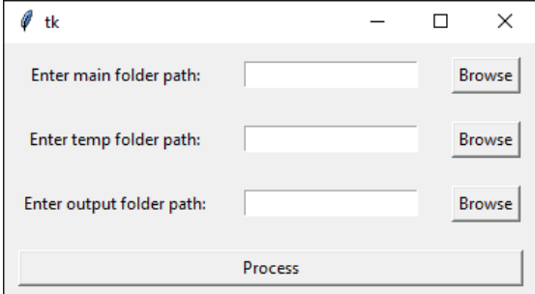
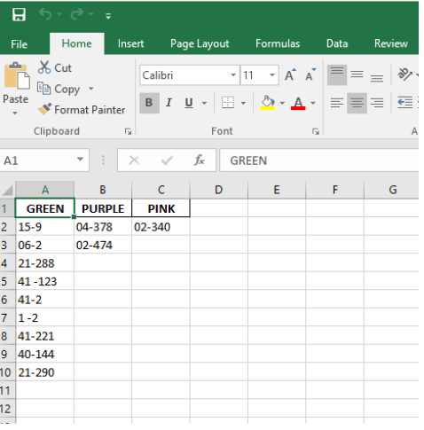
Output
The final output of the script is a set of Excel files, each corresponding to a PDF file processed during the operation. Each Excel file contains color codes as column headers and the associated numbers as values. The generated Excel files can be further analyzed and utilized for various purposes, such as data visualization and insights.

Slide 12
Working of the code
The Python script first takes the main parent folder containing PDF files as the input. It utilizes
the "fitz" library to convert each PDF file into images.
The converted images are stored in an intermediate output folder, preserving the same folder structure as the original PDF files.
The images are then chunked into smaller regions to enhance readability and to isolate specific
Information.
The Python script uses the "easyocr" library to read text from the cropped image chunks. For
each chunk, the script processes the text to identify color codes and their associated numbers.
The Python script generates an Excel file for each PDF file processed, containing extracted color
codes and numbers. The Excel file is saved in the final output folder, named after the original
PDF file.

Slide 13
Generalized Data Mining from PDF and Word Documents

Slide 14
Project Overview
The objective of this project is to create generalized data mining algorithms capable of efficiently capturing diverse data elements such as tables, equations, relevant text, figure/table captions, and images from PDF and Word documents. By providing a versatile solution that can be adopted by anyone within the organization.

Slide 15
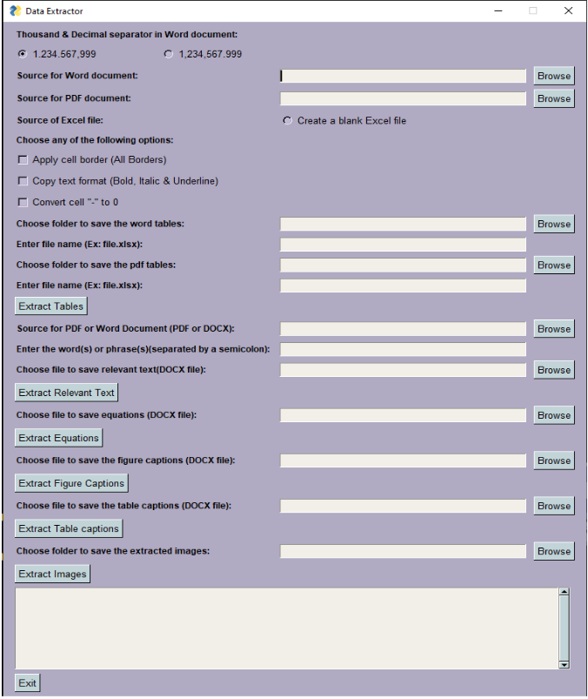

Slide 16
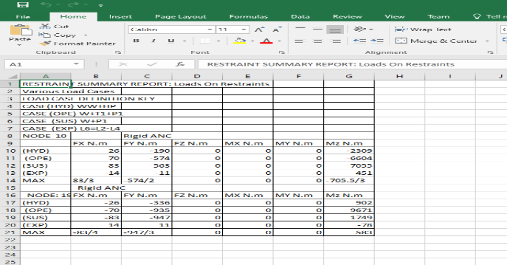
OUTPUT
Tables Extracted into an excel file

Slide 17
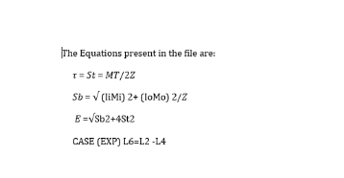
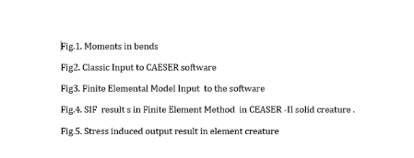
2) Equations Extracted into a Word Document
3) Figure Captions Extracted into a Word Document

Slide 18
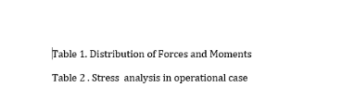
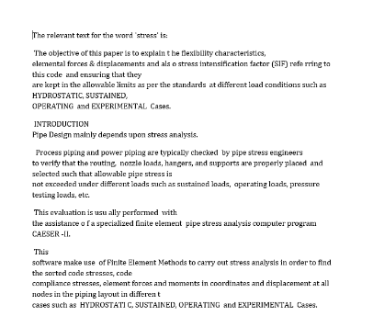
4) Table Captions Extracted into a Word Document
5) Relevant text based on user input Extracted into a Document

Slide 19
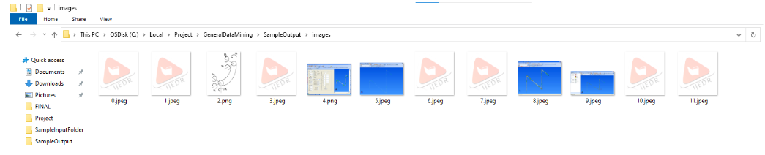
6) All Images present in the pdf/word Extracted into a Folder

Slide 20
Working of the code
The GUI takes pdf’s and word files as an input. The tables from each file are extracted into excel files which can be used for further analysis. The user can enter multiple words or phrases and text relevant to that keyword is extracted into a document. Similarly there is an option to extract all the equations, figure captions, table captions, and images from the files provided by the user as an input.
The tool is built using Python and relies on several libraries for different functionalities, such as PyPDF2 and fitz for PDF processing, docx2txt and docx for Word document processing, tabula and pandas for table extraction, and OpenPyXL for Excel manipulation.

Slide 21
Benefits
Significant time savings by automating manual data entry processes.
Enhanced data analytics to gain deeper insights into various products and processes.
Standardized and structured data storage for easy retrieval and analysis.
Streamlined workflows for quality control and visual inspection tasks.

Slide 22
THANK YOU

