Slide 1
Efficient Data Mining and Information Extraction
Shreya Manepalli
Dept. of Computer Science, PES University, Bangalore

Slide 2
Introduction
GKN Aerospace generates a substantial volume of unstructured data annually, comprising
reports, documents, and images.
In an era where data plays a pivotal role in shaping strategies and innovations, extracting valuable insights from unstructured data has become paramount.
Time-consuming data entry tasks, manually processing large volumes of unstructured data, such as reports, documents, and images, posed significant challenges for GKN Aerospace.
There is a need for an efficient and automated approach to handle diverse data sources.

Slide 3
Objective
My primary focus was on data mining and the efficient extraction of information from PDF or Word files and images into databases using Python.
The main aim was to overcome the challenges of manual data processing and pave the way for enhanced data analysis and visualization.

Slide 4
Non-Conformance Reports (NCRs) Data Extraction

Slide 5
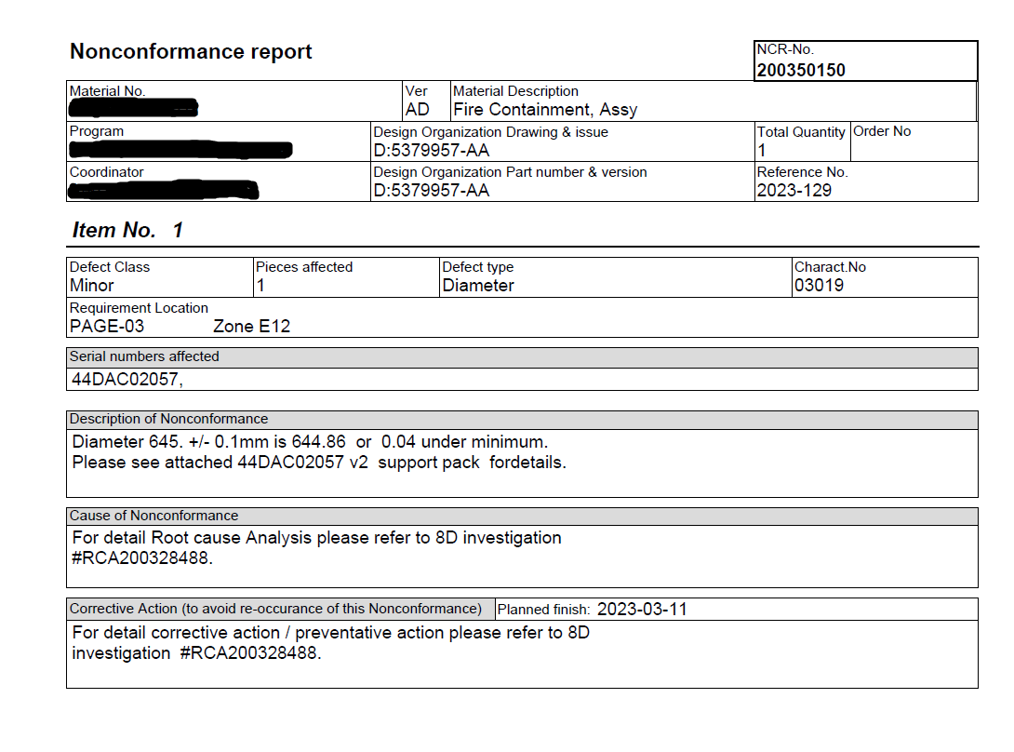
What are Non Conformance Reports?
Non-Conformance Reports (NCRs) are crucial documents that record instances of non-compliance with quality standards or deviations from specified requirements.

Slide 6
Project Overview
The primary objective of this project was to develop a Python script to extract specific data from NCR’s.
The script aims to automate the data extraction process from NCRs that contain unstructured data which used to be manually retrieved for analysis.
The extracted data will be organized into an excel file, making it suitable for data analytics.
The final output of the script is a consolidated Excel file containing organized data from all NCRs processed that can be used for further data analytics and insights.

Slide 7
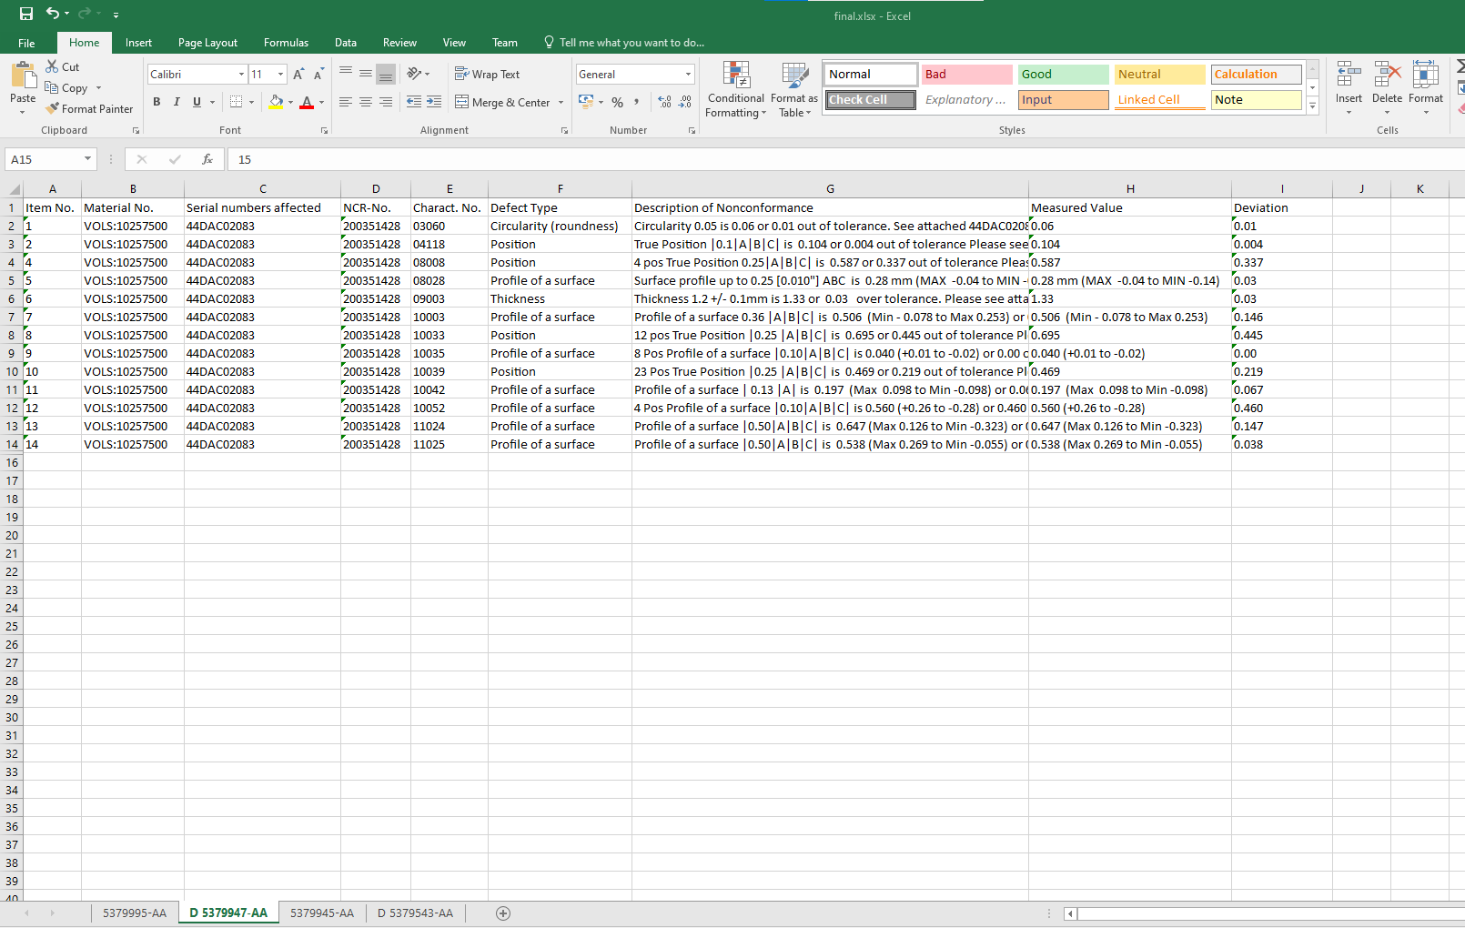
Output

Slide 8
Working of the code
The Python script accepts user input as a single file or a folder containing multiple NC Reports.
The script utilizes the "tabula" library to extract tabular data from the NCR PDF files.
For each PDF file, the script reads all tables on every page and stores them in separate sheets within an intermediate Excel file.
The extracted data from each PDF file is organized into separate sheets within the Excel file based on the drawing number associated with each report.
The script appends the extracted data from each PDF file into the corresponding sheets in the output Excel file

Slide 9
Color Codes Extraction from Images for the Fokker Plant

Slide 10
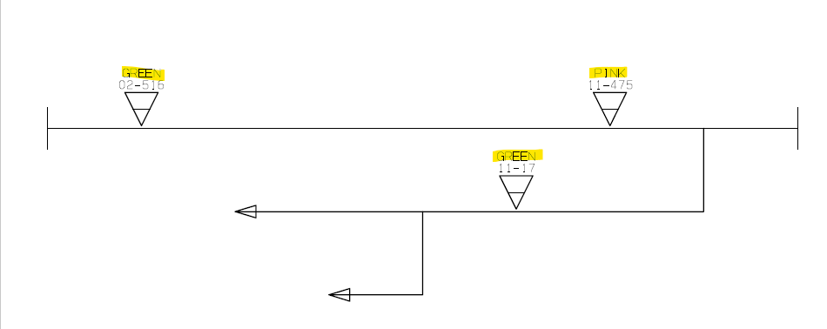
Project Overview
The objective of this is to extract colors and associated codes from the pdf’s containing images about wire harness.
These color codes and numbers present in the images are now stored systematically into Excel files which can be used for further data analysis.

Slide 11
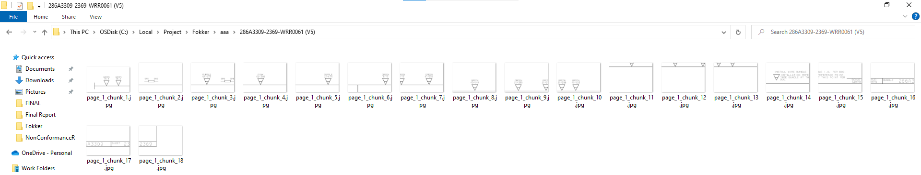
Working of the code
The Python script first takes the main parent folder containing PDF files as the input. It utilizes
the "fitz" library to convert each PDF file into images.
The images are then chunked into smaller regions to enhance readability and to isolate specific Information.
Folder consting of the image chunks of one file

Slide 12
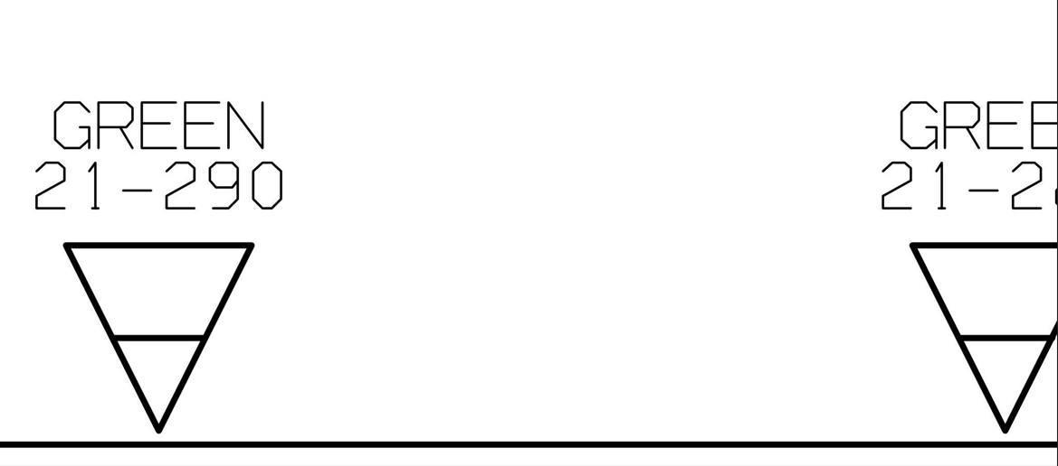

Due to chunking we can face these kind of issues
How did we handle that?
Using padding, Padding is a term relevant to image processing as it refers to the amount of pixels added to an image when it is being processed by the kernel of a CNN.
The Python script uses the "easyocr" library to read text from the cropped image chunks. For each chunk, the script processes the text to identify color codes and their associated numbers.
The Python script generates an excel file for each PDF processed, containing the extracted colour codes and their numbers.
Before Padding
After Padding

Slide 13
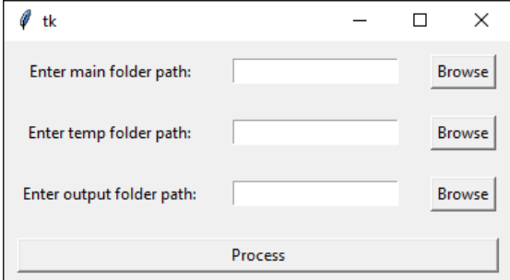
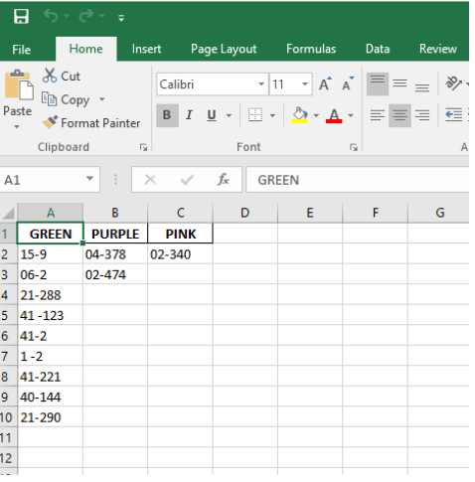
Output
The final output of the script is a set of Excel files, each corresponding to a PDF file processed during the operation.
Each Excel file contains color codes as column headers and the associated numbers as values.
The generated Excel files can be further analyzed and utilized for various purposes, such as data visualization and insights.

Slide 14


Problems faced and how did we overcome them
Image data extraction is a very heavy and time consuming process.
Initially the time taken to process one such file was 15 minutes as it had to convert each pdf to an image, then chunk it and extract the colors as well as their associated codes.
How did we tackle this issue and reduce the time taken to process?
Threading: This allows you to have different parts of your program run concurrently.
Multithreading: Multiple threads are generated at the same time by a single process running on a single core. So using this data from multiple chunks is read at once.
The overall time to process each file was now reduced to 6 minutes
Can we reduce the time further?
Yes, using multiprocessing. Using this, multiple threads run across multiple cores at the same time.
The overall time to process each file was now reduced to 3 minutes
Time taken to chunk
Total time taken

Slide 15
Generalized Data Mining from PDF and Word Documents

Slide 16
Project Overview
The objective of this project is to create generalized data mining algorithms capable of efficiently capturing diverse data elements such as tables, equations, relevant text, figure/table captions, and images from PDF and Word documents.
This is a versatile solution that can be adopted by anyone within the organization.

Slide 17
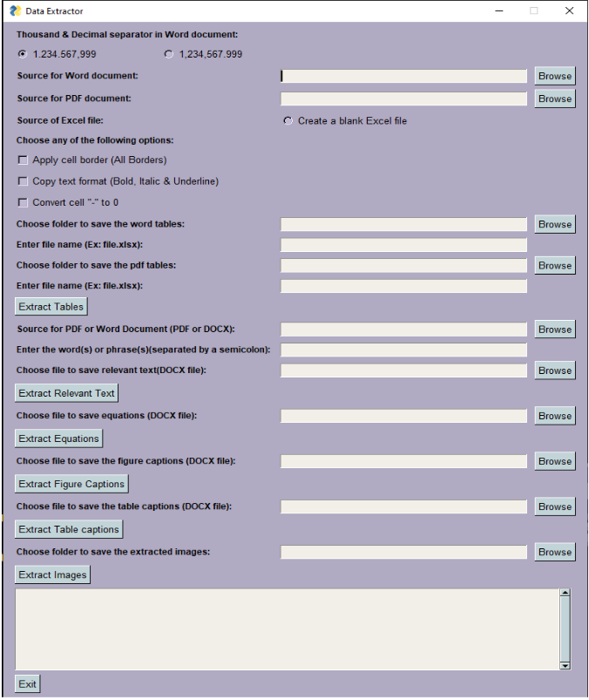

Slide 18
Working of the code
The GUI takes pdf’s and word files as an input.
The tables from each file are extracted into excel files which can be used for further analysis.
The user can enter multiple words or phrases and text relevant to that keyword is extracted into a document.
Similarly there is an option to extract all the equations, figure captions, table captions, and images from the files provided by the user as an input.
The tool is built using Python and relies on several libraries for different functionalities, such as PyPDF2 and fitz for PDF processing, docx2txt and docx for Word document processing, tabula and pandas for table extraction, and OpenPyXL for Excel manipulation.

Slide 19
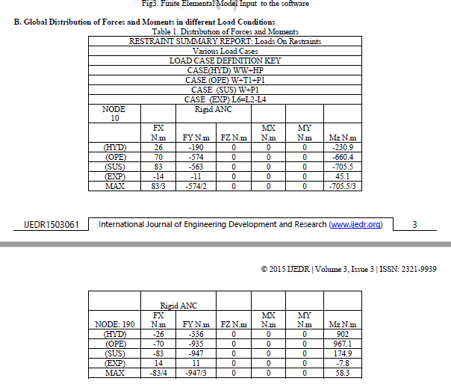
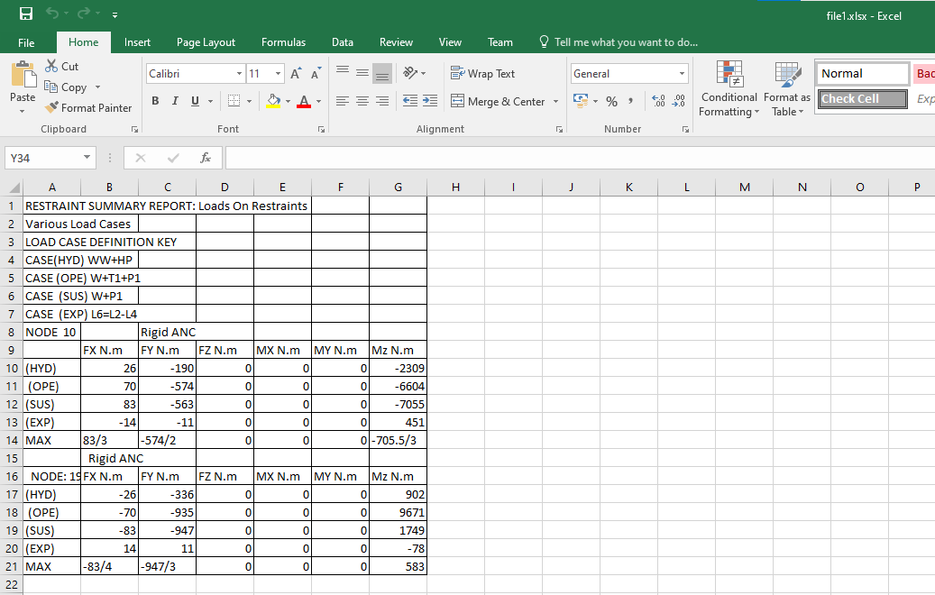
OUTPUT
1) Tables Extracted into an excel file

Slide 20
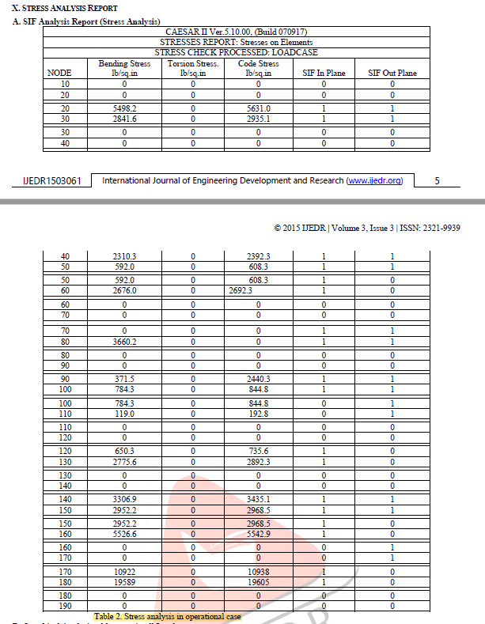
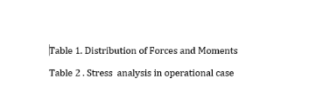
2) Table Captions Extracted into a Word Document

Slide 21
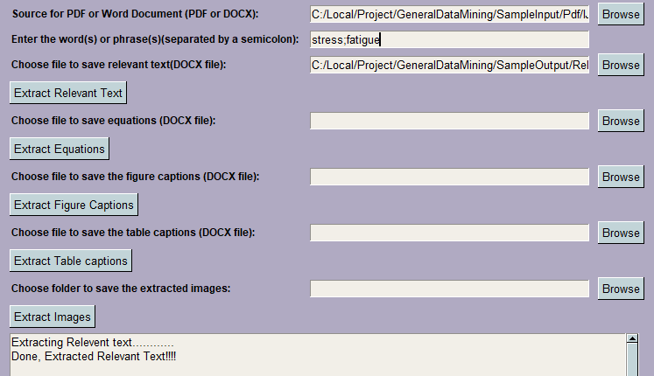
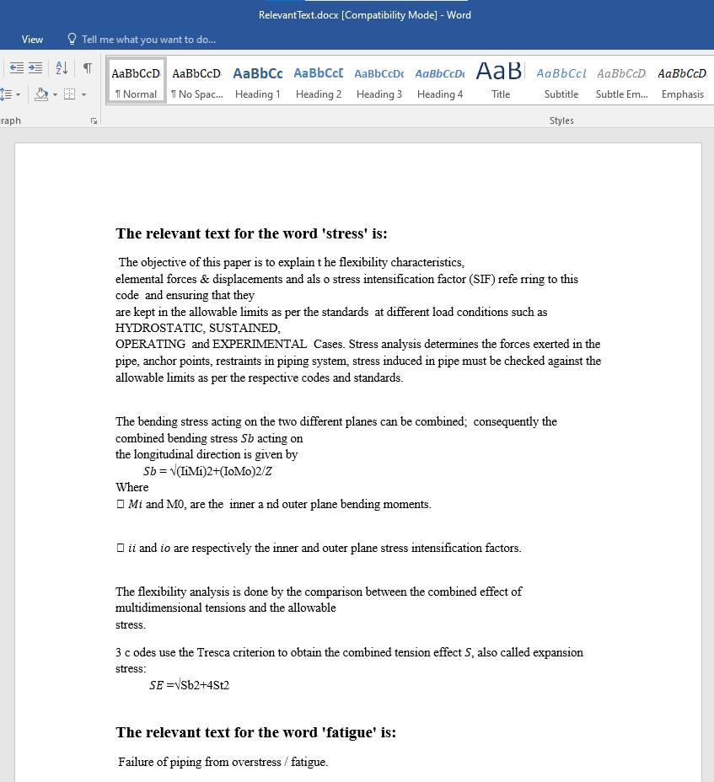
3) Relevant text based on user input Extracted into a Document

Slide 22
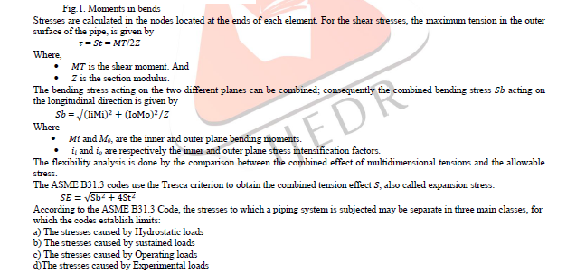
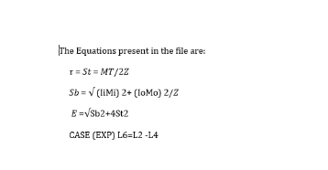
4) Equations Extracted into a Word Document

Slide 23
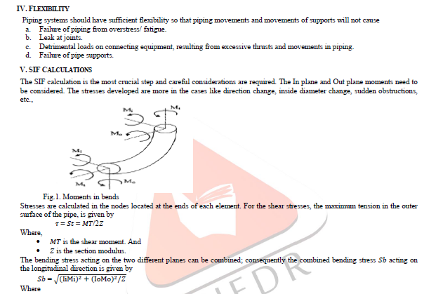
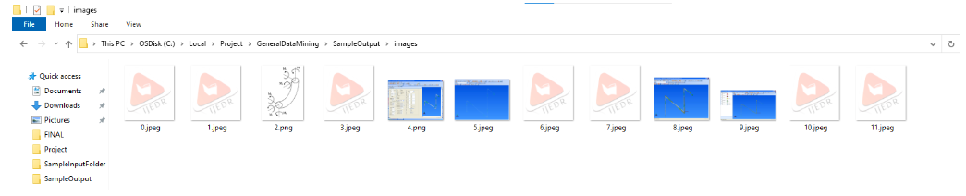
5) All figures present in the pdf/word Extracted into a Folder

Slide 24
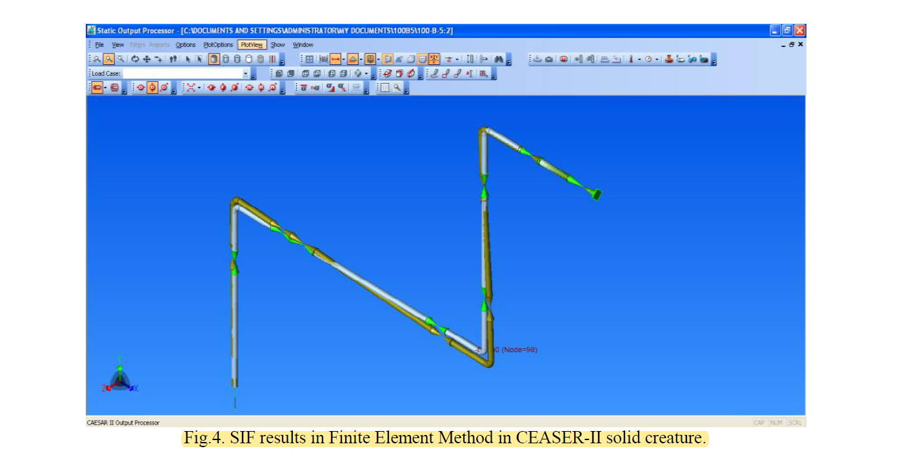
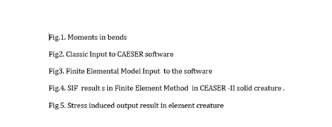
6) Figure Captions Extracted into a Word Document

Slide 25
Benefits
Significant time savings by automating manual data entry processes.
Enhanced data analytics to gain deeper insights into various products and processes.
Standardized and structured data storage for easy retrieval and analysis.
Large volume of files can be processed at once.
Streamlined workflows for quality control and visual inspection tasks.

Slide 26
Limitations
Extraction of coordinates from graph images. Specifically from scatter plots and line plots.
Usage of deep learning techniques instead of easyocr library in python
Development of a web crawler.

Slide 27
Future Scope
Extraction of coordinates from graph images can be done using deep leaning techniques using Pytesseract where you can train the model on multiple images. This enables us to achieve a much higher accuracy as well.
Developing a web crawler which is capable of mining the data available on the web server rather than only mining the data available locally.
Integrating these projects with the company’s data management system can streamline the entire data entry process.

Slide 28
Summary
These projects contributed significantly to data handling efficiency, data analytics.
Automation reduced the manual data processing efforts, saving valuable time.
These extraction algorithms can be applied across various domains with minimum changes.

Slide 29
THANK YOU

