Slide 1
Nano-Coated Electrodes Simulation
A software-based approach to study nano-coated electrodes in batteries

Slide 2
Objective
To simulate and analyze the properties of nano-coated electrodes for enhanced performance in energy storage systems.
Focus:
Energy Density
Degradation Analysis

Slide 3
Methodology
1. Define materials: Graphene, Carbon Nanotubes, Metal Oxides.
2. Simulate energy density using numerical formulas.
3. Analyze degradation over 100 charge/discharge cycles.
4. Visualize results using bar and line plots.

Slide 4
Tools and Libraries
Programming Language: Python
Libraries:
- numpy: Numerical computation
- matplotlib: Data visualization
- pandas: Data handling (optional)
IDE: Visual Studio Code

Slide 5
Code Structure
1. simulation.py:
- Logic for energy density and degradation analysis.
2. visualization.py:
- Functions to create bar and line plots.
3. main.py:
- Integrates simulation and visualization modules.

Slide 6
Sample Outputs
1. Bar Chart: Energy density comparison of different nano-coatings.
2. Line Plot: Degradation analysis over 100 cycles.

Slide 7
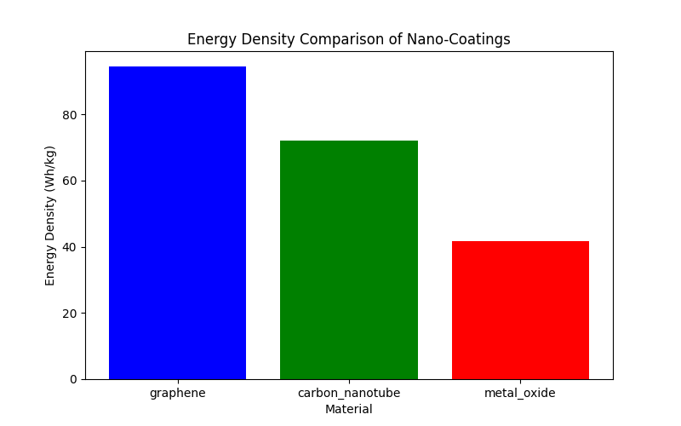
The figure below shows the Energy Density Comparison Of Different Nano-Coatings

Slide 8
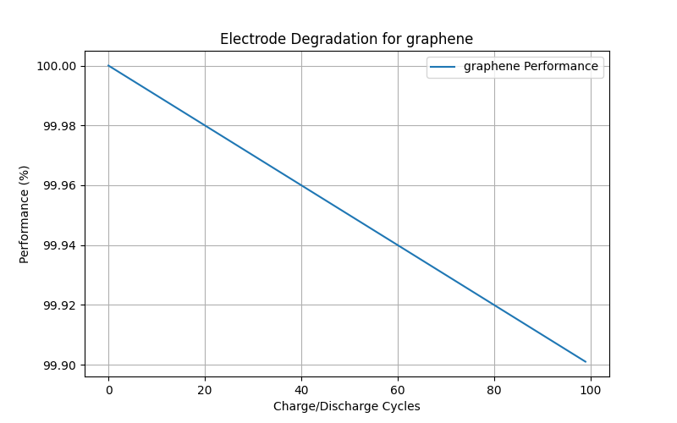
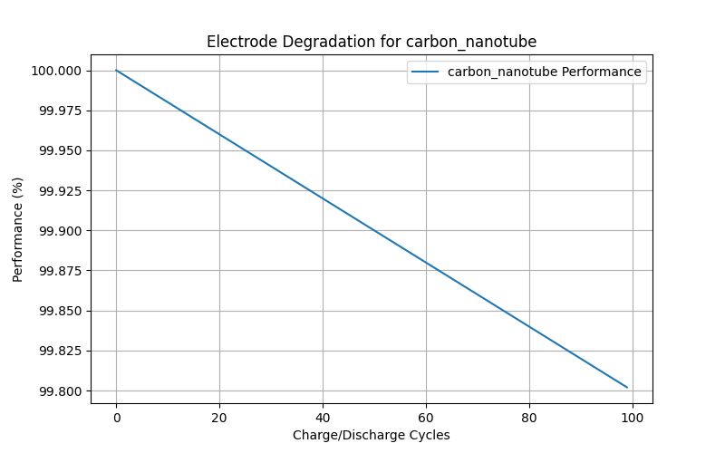

Slide 9
Conclusion
The simulation provides insights into the performance of nano-coated electrodes:
a)Graphene shows the highest energy density and lowest degradation.
b) Software-based approach saves time and cost for initial research.
Future Scope:
->Can include more materials and compare them
->Factor in temperature and other conditions.

