Slide 1



FINAL PROJECT PRESENTATION
Global Energy Transition & Climate Impact Dashboard
An Interactive Data Visualization Dashboard using Our World in Data (OWID) Energy & CO₂ Datasets
Presented by: Shreya Mishra | B.Tech- CSE(DS) | Ajay Kumar Garg Engineering College

Slide 2


What We’ll Cover
Agenda for today’s final project presentation
01
Introduction
05
Dashboard Features
02
Problem Statement
06
Key Insights
03
Project Objectives
07
Conclusion
04
Dataset Description
08
Live Demonstration

Slide 3
Global Energy Transition
The growing demand for clean and sustainable energy has made energy transition one of the world's most important challenges. Countries are increasingly investing in renewable energy to reduce dependence on fossil fuels and mitigate climate change.
However, understanding the relationship between energy consumption, renewable adoption, carbon emissions, and climate impact requires analyzing large and complex datasets.
This project transforms these datasets into interactive visual dashboards that support data-driven decision-making.
220+ Countries
25 Years (2000–2024)
Multiple Energy Indicators
Climate Intelligence
Source: OWID dataset — approximate figures for context

Slide 4
Problem Statement
!
i
Existing Problems
Our Solution
⚠️ Large datasets
⚠️ Complex analysis
⚠️ Poor comparison
⚠️ Manual preprocessing
✅ Interactive dashboard
✅ Data integration
✅ Sustainability insights
✅ Easy comparison

Slide 5
Project Objectives
What the dashboard is designed to achieve
1
Interactive Dashboard — Develop an interactive Tableau dashboard for global energy analytics.
2
Multi-Level Visualization — Analyze renewable energy adoption across countries.
3
Comparative Analysis — Compare primary energy consumption and energy mix..
4
Emission Study — Study CO₂ emissions and carbon intensity.
5
Visualization — Visualize historical contributions to global warming.
6
Navigation and Filter — Enable interactive exploration through filters and dashboard navigation.

Slide 6

Dataset Description
+
Source: Our World in Data
(Energy & CO₂ Database (2000–2024))
Energy Dataset
CO2 Dataset
Key Variables
Country
Year
Renewable Share
Primary Energy Consumption
CO2 Emission
CO2 Per Capita
Carbon Intensity Electricity
Greenhouse Gas Emissions
Temperature Change Contribution
Left Join
Final Integrated Dataset

Slide 7
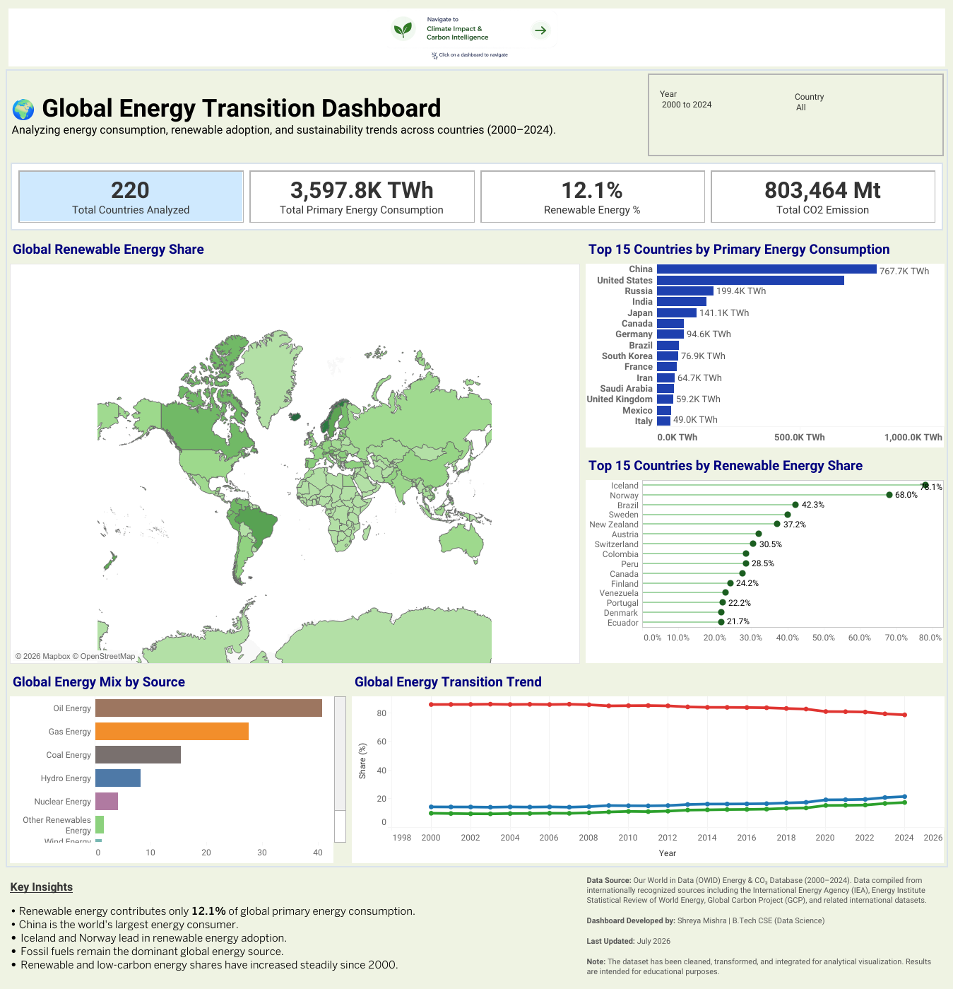
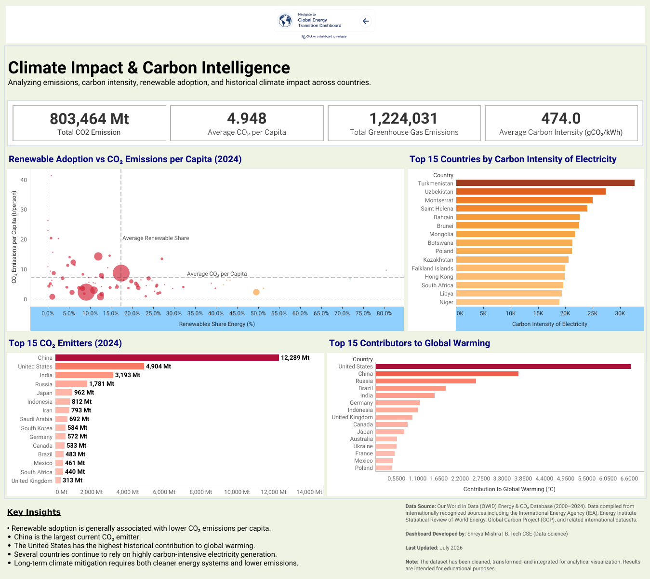
Dashboard Features
Dashboard 1
Dashboard 2
KPIs: Countries Analyzed Primary Energy Consumption Renewable Energy % Total CO₂ Emissions
Visualizations: Map, Bar charts, Lollipop chart, line graph
Filters: Year, Country
Navigation to Dashboard 2
Various Interactions
KPIs: Total CO₂ Emissions Average CO₂ per Capita Total Greenhouse Gas Emissions Average Carbon Intensity
Visualizations: Bubble chart, Bar chart
Navigation to Dashboard 2
Various Interactions

Slide 8
Key Insights
Energy Transition
🌱 Renewable energy contributes only 12.1% of global primary energy consumption. ⚡ China is the world's largest energy consumer. 🌍 Iceland and Norway lead renewable energy adoption. 🛢 Fossil fuels remain the dominant global energy source.
Climate Intelligence
☁ Higher renewable adoption generally corresponds with lower CO₂ emissions per capita. 🏭 China is the largest current CO₂ emitter. 🌎 The United States has the highest historical contribution to global warming. ⚡ Several countries continue to rely on highly carbon-intensive electricity generation.

Slide 9
Conclusion
☁
CO2 and GHG Analysis
⚡
Energy Consumption
Interactive
Decision Support
Dashboard
🌱 Renewable Energy
📈 Sustainability
🌍
Country Comparison
📊
Business Intelligence
Supporting smarter, data-driven decisions for a sustainable energy future

Slide 10
Live Dashboard Demonstration
Geographic and comparative views of the data
Link
https://public.tableau.com/app/profile/shreya.mishra1905/viz/Global_Energy_Transition_Dashboard/GlobalEnergyTransitionDashboard?publish=yes
Thank You

