Slide 1

Personality Prediction from social media
Presented by:
Shreya Mishra
Sushant Mishra

Slide 2

Introduction to concept
A Machine learning oriented project aimed at detecting the personality traits of a person through the use of social media using Big Five Personality Traits as the basic model. The average time spent by the user on the Social networking can give a vivid example of how accurately and precisely we can detect the personal traits of an individual.

Slide 3

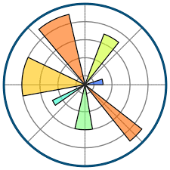




Technical stack for the model

