Slide 1
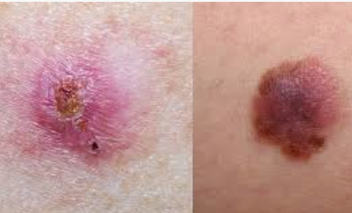
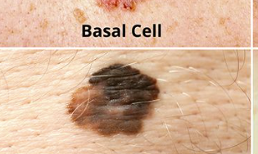
Transfer Learning for Multi-Class Skin Cancer Detection using Deep Convolutional Neural Networks

Slide 2
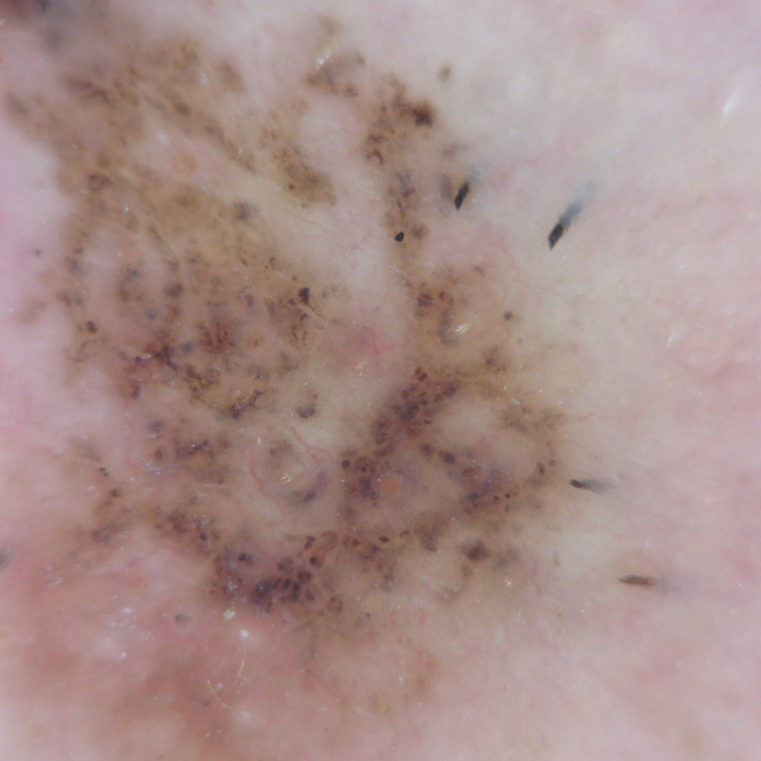
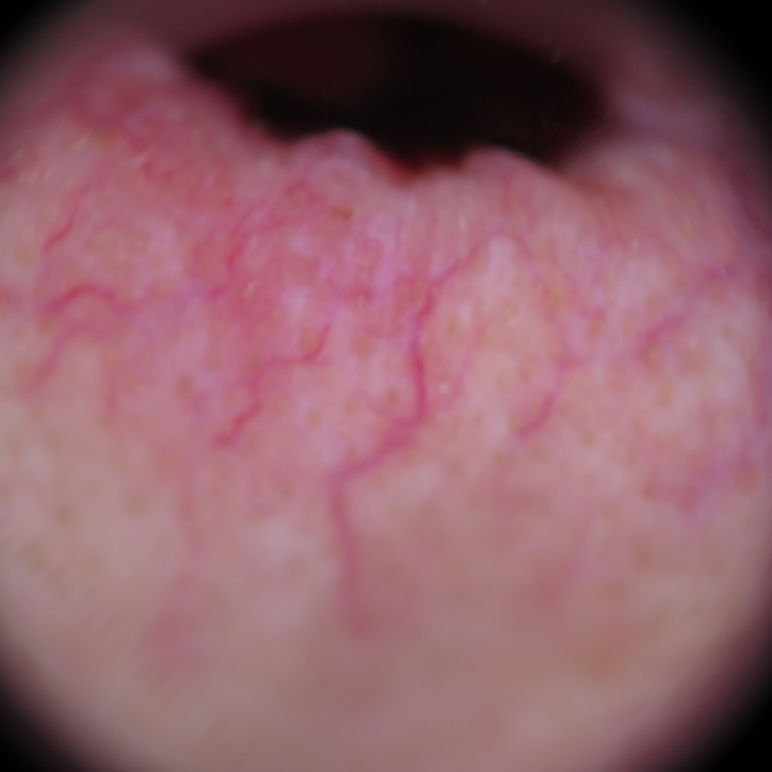
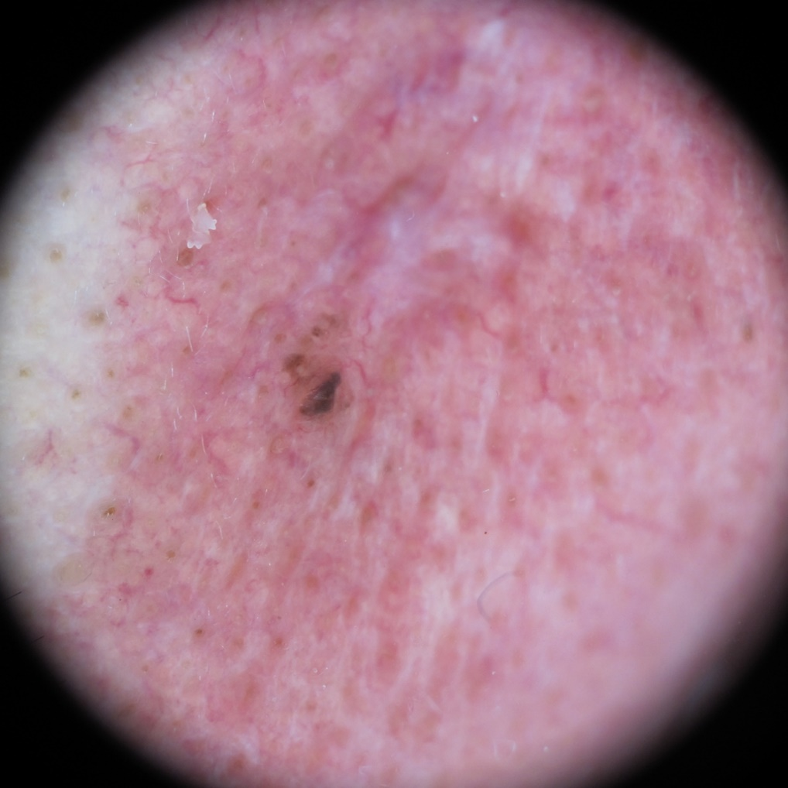
1. Basal Cell Carcinoma
Basal cells are found at the bottom of the epidermis — the outermost layer of skin.
Basal cells produce new skin cells as old ones die.
BCC most often occurs when DNA damage from exposure to ultraviolet (UV) radiation from the sun or indoor tanning triggers changes in basal cells in the outermost layer of skin (epidermis), resulting in uncontrolled growth.
BCCs may ooze, crust, itch or bleed. The lesions commonly arise in sun-exposed areas of the body.
Basal cell carcinoma is quite common. The number of reported cases in the U.S. has steadily increased.
- An estimated 3.6 million Americans are diagnosed with BCC each year.
- More than one out of every three new cancers are skin cancers, and the vast majority are BCCs.

Slide 3
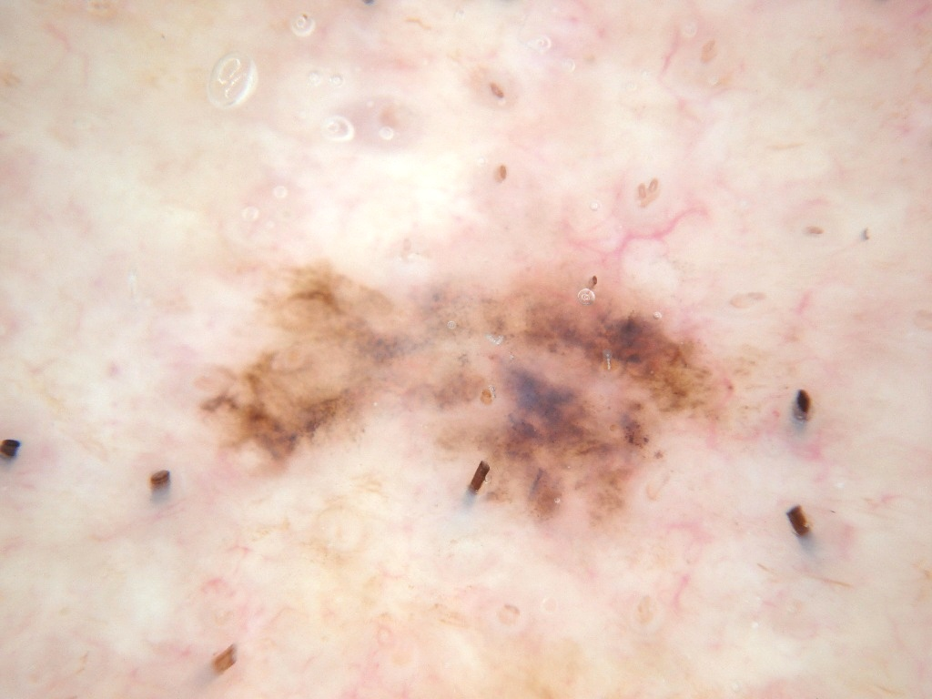
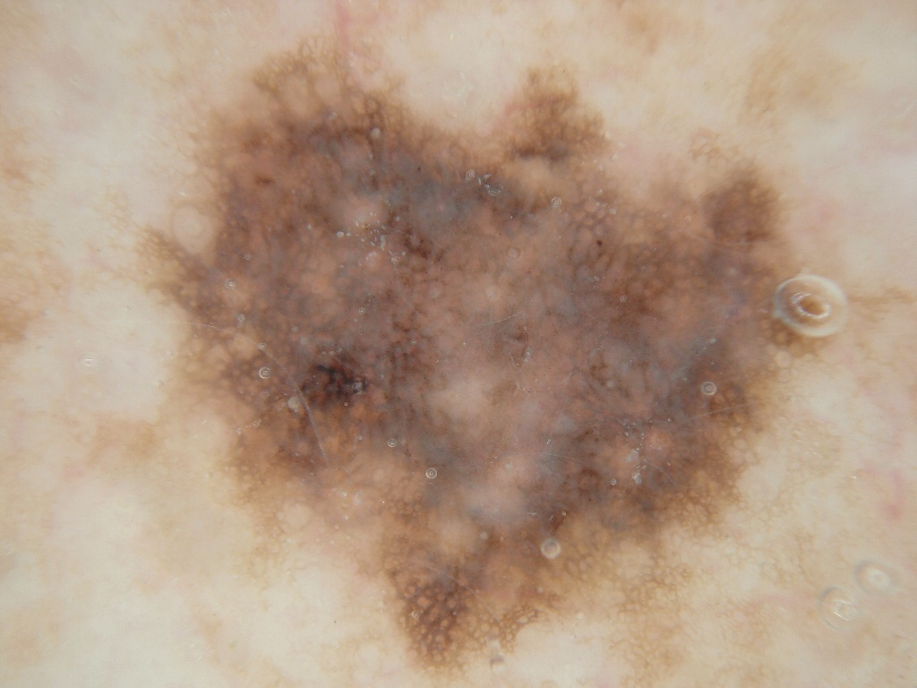
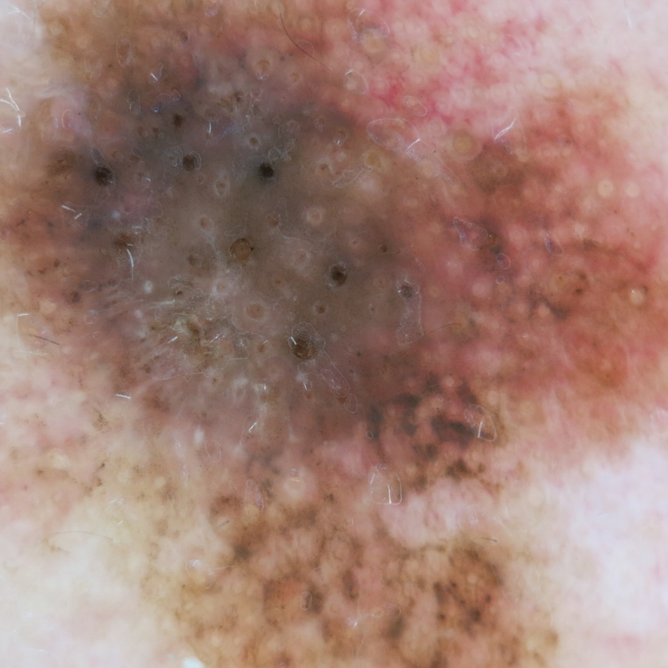
2. Melanoma
Melanoma,(black tumour) the most serious type of skin cancer, develops in the cells (melanocytes) that produce melanin — the pigment that gives your skin its color.
Melanoma occurs when the pigment-producing cells that give color to the skin become cancerous.
Symptoms might include a new, unusual growth or a change in an existing mole.
Melanomas can occur anywhere on the body.
Melanoma accounts for only about 1% of skin cancers but causes a large majority of skin cancer deaths.

Slide 4
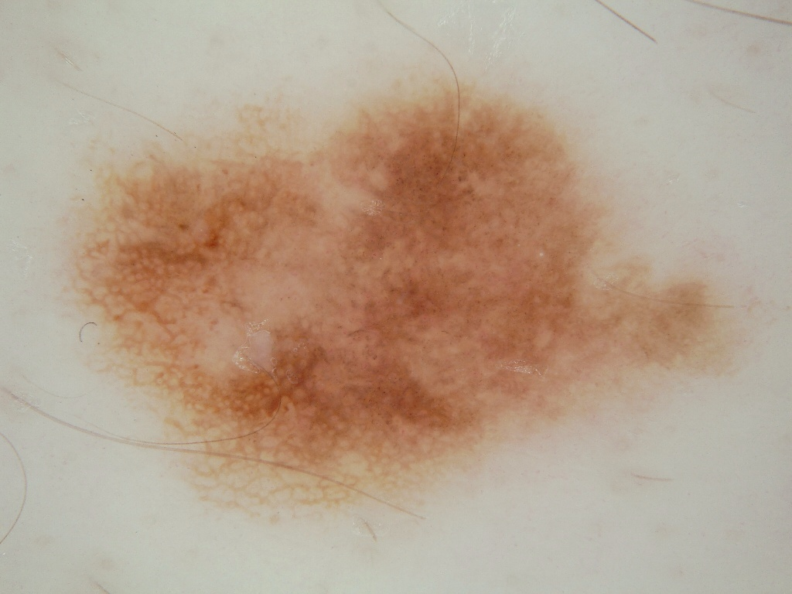
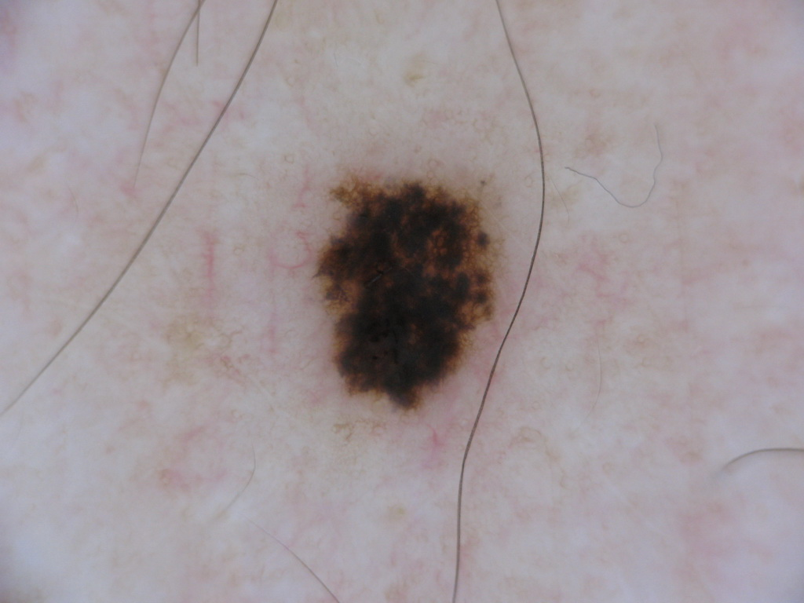
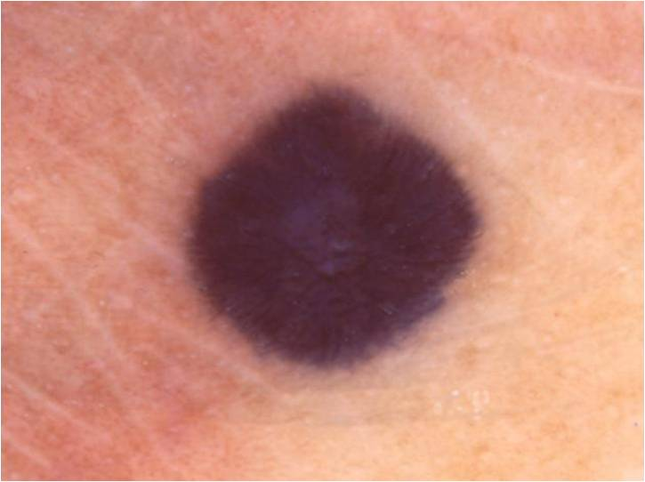
3. Nevus
Nevus is basically a mole on skin that is formed by a cluster of melanocytes (cells that make a substance called melanin, which gives color to skin and eyes).
In most cases, a nevus is benign and doesn't require treatment. Rarely, they turn into melanoma or other skin cancers. A nevus that changes shape, grows bigger or darkens should be evaluated for removal.

Slide 5
WHY TRANSFER LEARNING: 1. Pre-trained Models and Feature Extraction Pre-trained Models: Transfer learning involves leveraging models that have been pre-trained on large and diverse datasets (like ImageNet). These models have already learned to extract a wide range of features from images, which are often applicable to many different types of image recognition tasks, including skin cancer detection. Feature Extraction: In skin cancer detection, important features include textures, colors, and patterns in the skin images. Pre-trained models have learned to recognize and extract these features effectively. By using these models as a starting point, you can benefit from their ability to capture complex patterns in images, which is crucial for distinguishing between various types of skin lesions. 2. Efficiency and Reduced Training Time Training a deep CNN from scratch requires a significant amount of computational resources and time, as the model needs to learn features from the raw image data. This is particularly challenging for skin cancer detection due to the need for high accuracy and the potentially large and diverse dataset. 3. Performance and Accuracy Accuracy: Since skin cancer detection involves differentiating between multiple classes (e.g., benign and malignant lesions), the ability of transfer learning models to recognize fine-grained features helps improve classification accuracy. These models have learned useful hierarchical features that contribute to better classification performance compared to models trained from scratch. 4. Scarcity of Data(Limited Data): In medical imaging, acquiring a large, labeled dataset can be challenging due to the need for expert annotations and patient privacy concerns. Transfer learning helps mitigate this issue by making effective use of limited data.

Slide 6
Why MobileNetv2?
MobileNet-v2 is a convolutional neural network that is 53 layers deep. We can load a pretrained version of the network trained on more than a million images from the ImageNet database

Slide 7
PROJECT HIGHLIGHTS: 1. Detected 3 types of skin cancer from Skin Lesion images using Transfer Learning MobileNetV2 architecture with 12,295 Skin Lesion images Basal Cell Carcinoma : 3273 images, Nevus (Benign) : 4550 images, Melanoma : 4472 images 2. For classifying Basal Cell Carcinoma, Nevus and Melanoma classes architecture of pretrained network MobileNetV2 used. 3. Customized MobileNetV2 Network attained testing accuracy of 96.94%.

Slide 8
OBJECTIVES: 1. Develop a Skin Cancer Classification System - Create and implement a deep learning system that accurately identifies three major types of skin cancer (melanoma, basal cell carcinoma, and squamous cell carcinoma) from skin lesion images. Explore transfer learning techniques to leverage pre-trained convolutional neural networks 2. Evaluate System Performance: Assess the developed classification system using standard metrics like accuracy sensitivity, and area under the ROC curve (AUC). 3. Document Methodology and Results Document the entire process of developing, training, and evaluating the deep learning model. 4. Explore Augmentation Strategies Explore data augmentation techniques to enhance the model's ability to generalize to different skin lesion variations and conditions. Investigate how augmenting the training data with variations like rotations, flips, and color adjustments impacts classification performance. 5. Consider Computational Efficiency: Optimize the deep learning model for computational efficiency without compromising classification accuracy. Evaluate the trade-offs between model complexity and inference speed to ensure practical deployment in real-world clinical settings. 6. Address Class Imbalance: - Address any imbalance in the distribution of skin cancer types in the dataset. Investigate methods such as class weighting, oversampling, or undersampling to improve the model's ability to correctly classify underrepresented classes.

Slide 9
Dataset: Dataset : ISIC Skin Cancer site (International Skin Imaging Collaboration (ISIC) https://challenge.isic-archive.com/data/ Dataset Details Dataset Name : ISIC Skin Cancer Images (Basal Cell Carcinoma vs Melanoma vs Nevus) Number of Class : 3 Number/Size of Images : Total : 12445 (555 MB) Training : 12295 Testing : 150 Basal Cell Carcinoma : 3273 images, Nevus (Benign) : 4550 images, Melanoma : 4472 images

Slide 10
CODE OUTLINE: 1. Importing Libraries: - The code starts by importing necessary libraries like pandas, numpy, cv2, os, tqdm, random, etc. These are used for data handling, image processing, machine learning, and visualization. 2. Mounting Google Drive: - The code mounts Google Drive to access and load image data from specific directories. 3. Loading Images: - Images from directories (`Basal_cell_carcinoma`, `Melanoma`, `Nevus`) are loaded and displayed as sample images using `matplotlib.pyplot`. 4. Data Preparation: - Images are loaded, resized to 224x224 pixels, converted to arrays, and appended to `data`. Corresponding labels (0 for Basal Cell Carcinoma, 1 for Melanoma, 2 for Nevus) are stored in `labels`. 5. Data Randomization: - Data and labels are shuffled randomly to ensure a balanced distribution in training and testing datasets. 6. Train-Test Split: - The dataset is split into training and testing sets with an 80:20 ratio. Image data is normalized by dividing by 255. 7. Image Augmentation: - Augmentation techniques like rotation, zoom, and horizontal shift are applied to increase dataset diversity and improve model generalization.

Slide 11
8. Model Building: - Transfer learning is used with MobileNetV2 as a base model. Additional layers are added for classification. The model is compiled with categorical cross-entropy loss and Adam optimizer. 9. Training the Model: - The model is trained using `fit()` method on augmented data with specified batch vi size and epochs. Callbacks like ModelCheckpoint and ReduceLROnPlateau are used for model saving and learning rate adjustment. 10. Saving and Loading the Model: - Trained model weights are saved and loaded for further evaluation. 11. Evaluation Metrics: - The model's performance is evaluated using confusion matrix, classification report, and ROC curves for multi-class classification. 12. Testing with New Data: - Test data is prepared similarly to training data and used to predict classes. Images are resized, preprocessed, and predictions are made using the trained model. 13. Prediction on New Images: - Finally, new images are loaded, preprocessed, and fed into the model for prediction of Basal Cell Carcinoma, Melanoma, or Nevus.

Slide 12
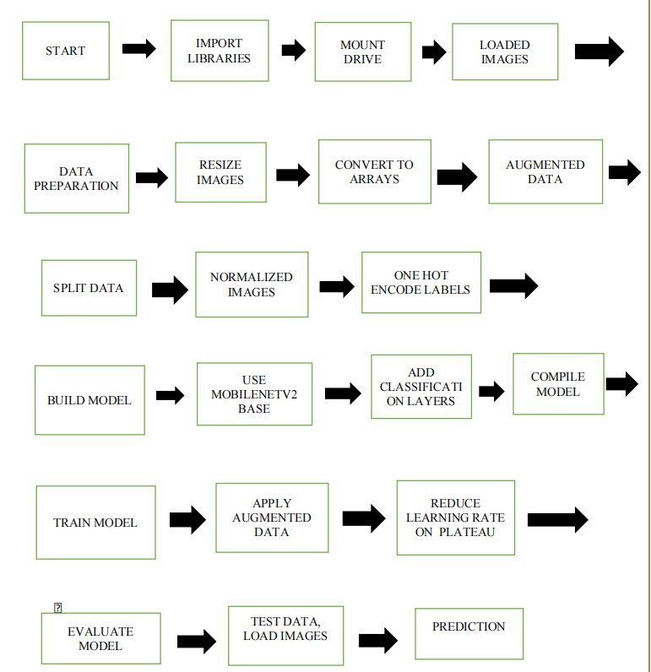
Flowchart

Slide 13
Project Flow for Skin Cancer Classification
Importing Libraries:
Import necessary libraries like cv2, PIL, tensorflow.keras, and others required for image processing, deep learning, and data handling.
Loading and Preprocessing the Dataset:
Step 1: Load images from different directories corresponding to three classes (Basal Cell Carcinoma, Melanoma, Nevus).
Step 2: Resize images to (224, 224) to match the input size for the MobileNetV2 model.
Step 3: Convert images to NumPy arrays and append them to data, while appending the corresponding class label (0, 1, 2) to labels.
Saving and Loading Processed Data:
Step 4: Convert the data and labels lists into NumPy arrays and save them as .npy files for later use.
Shuffling Data:
Step 5: Shuffle the data and labels using np.random.shuffle() to ensure the dataset is mixed for better training performance.
Splitting the Dataset:
Step 6: Split the dataset into training and testing sets (80% training, 20% testing).
Data Normalization:
Step 7: Normalize the pixel values of the images by dividing them by 255 (since pixel values range from 0 to 255).
Step 8: Convert the labels into one-hot encoded vectors using to_categorical() for multi-class classification.

Slide 14
Image Augmentation:
Step 9: Apply augmentation techniques (rotation, zoom, shift, etc.) using ImageDataGenerator to increase dataset diversity and improve model generalization.
Building the CNN Model (MobileNetV2):
Step 10: Use the MobileNetV2 pre-trained model as the base model, without the top classification layers.
Step 11: Add custom layers on top of the base model:
Global average pooling.
Dense layers (256 units, then 64 units) with ReLU activation and dropout layers for regularization.
A final dense layer with 3 units (for 3 classes) and a softmax activation for multi-class classification.
Model Callbacks:
Step 12: Define callbacks like ModelCheckpoint to save the best model based on validation loss, and ReduceLROnPlateau to reduce the learning rate when validation performance plateaus.
Model Compilation and Training:
Step 13: Compile the model using the Adam optimizer and categorical_crossentropy loss function.
Step 14: Train the model using the augmented training data for a specified number of epochs, with real-time validation on the test set.
Saving and Loading the Best Model:
Step 15: After training, load the best-performing model weights saved by ModelCheckpoint.
Step 16: Save the best model into a .h5 file for future use.
Evaluating the Model:
Step 17: Evaluate the model on the test set and print the accuracy.
Predicting and Plotting the Confusion Matrix:
Step 18: Use the trained model to predict class probabilities for the test set.
Step 19: Convert the predicted probabilities and true labels into class labels.
Step 20: Generate and plot a confusion matrix to visualize the model's performance on each class.
Converting the Model to TensorFlow Lite (Optional):
Step 21: Convert the saved .h5 model to TensorFlow Lite format for deployment on mobile or edge devices.

Slide 15
Results We have achieved following RESULTS for detection of Skin Cancers. Performance Metrics Test Accuracy : 97.47% Precision : 97% Sensitivity (BCC) : 100% Sensitivity (Melanoma) : 96% Sensitivity (Nevus) : 98% F1-score : 98% AUC : 0.99

Slide 16
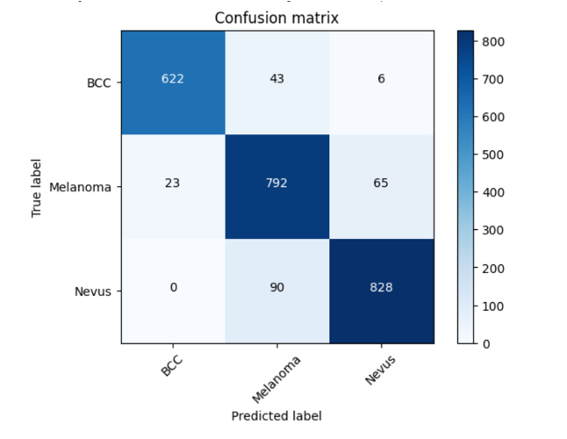
CONFUSION MATRIX:
BCC:
Correctly classified as BCC: 622 instances.
Misclassified as MELANOMA: 43 instances.
Misclassified as NEVUS: 6 instances.
MELANOMA:
Correctly classified as MELANOMA: 792 instances.
Misclassified as BCC: 23 instances.
Misclassified as NEVUS: 65 instances.
NEVUS:
Correctly classified as NEVUS: 828 instances.
Misclassified as MELANOMA: 90 instances.

Slide 17
Steps of the Flask App: 1. User accesses the homepage (index.html).
User uploads an image.
The app saves the image and makes predictions using the loaded model_v1.h5.
A Grad-CAM heatmap is generated to visualize important image regions.
The prediction and heatmap are displayed on the results page (predict.html).

Slide 18
Project Flow 1. Model Training and Preparation: previously trained a deep learning model (MobileNetV2) for skin cancer classification using images of three classes (Basal Cell Carcinoma, Melanoma, Nevus). The trained model is saved as model_v1.h5 in the models folder. 2. File Structure Overview: models: Contains model_v1.h5 (your trained skin cancer detection model). static/css: Holds CSS files (main.css and style.css) for the frontend appearance. templates: Contains HTML templates (index.html for the homepage and predict.html for the results page). app.py: The main Flask app that routes the web requests, loads the model, and serves the web interface. heatmap.py: Generates Grad-CAM heatmaps to visualize model predictions. 3. Flask App Execution: app.py initializes the Flask application and loads the pre-trained model. GPU usage is disabled to ensure the model runs on the CPU. Routes are defined for serving web pages and handling image uploads for predictions.

Slide 19
4. Main Flow: Homepage (/): The app starts by displaying the index.html page where users can upload skin lesion images. Image Upload and Prediction (/predict): When a user uploads an image via the form on the homepage, it is securely saved in the uploads folder. The image is resized, normalized, and passed to the loaded model for prediction. The model outputs the predicted skin condition (Basal Cell Carcinoma, Melanoma, or Nevus) with confidence percentages. A Grad-CAM heatmap is generated to highlight the image regions that contributed to the prediction, providing visual interpretability of the model's decision. Displaying Results (predict.html): The predicted results and Grad-CAM heatmap are displayed on the predict.html page. The heatmap visually shows where the model focused while making the prediction. 5. Frontend Files: CSS Files (static/css): 6.HTML Templates (templates): index.html: Contains the form where users can upload images. predict.html: Displays the predicted result along with the Grad-CAM heatmap.

Slide 20
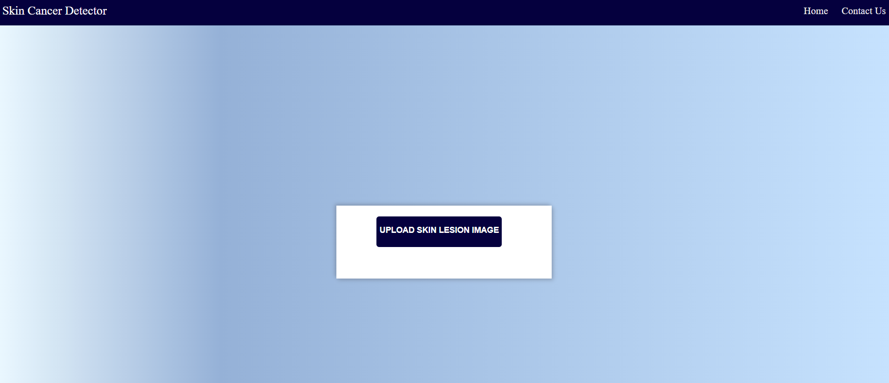

Slide 21
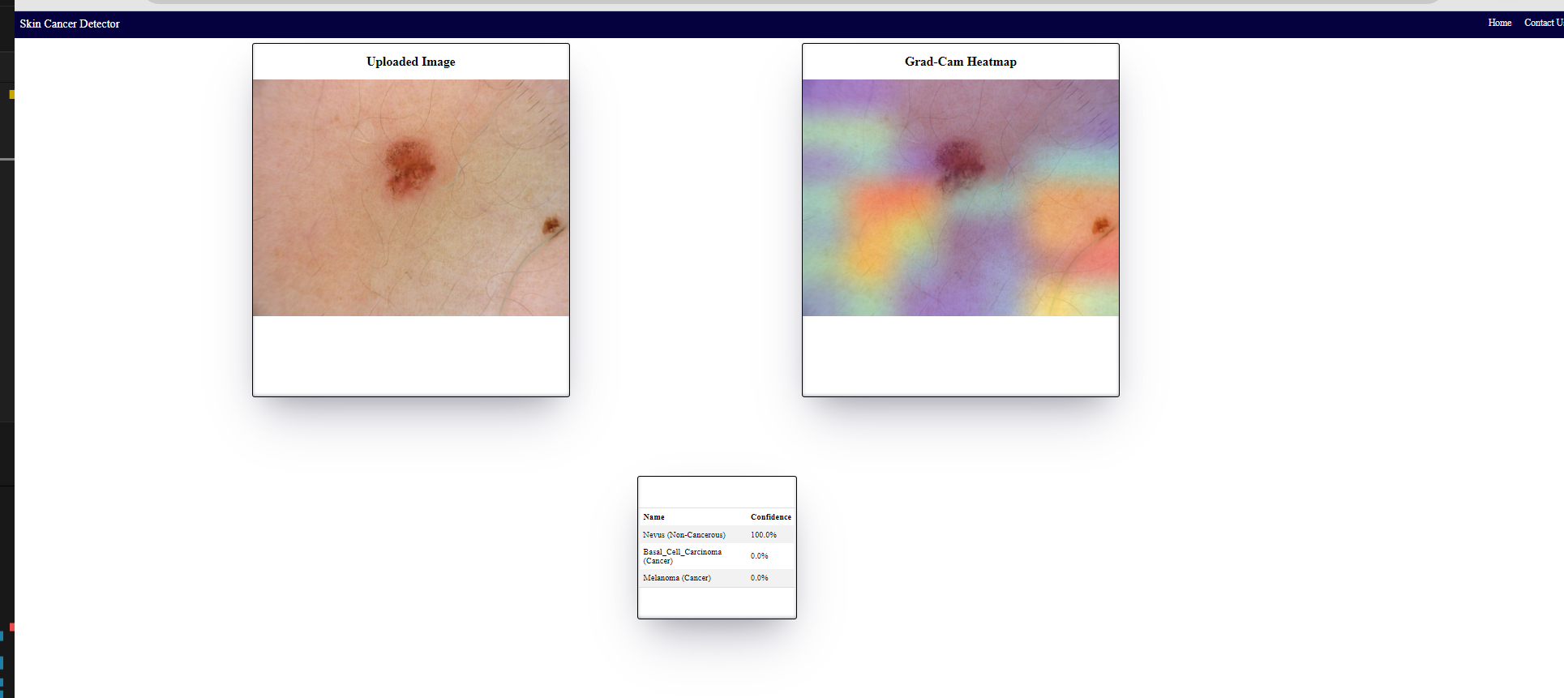
.

Slide 22
About Grad-CAM Heatmap Grad-CAM is a CNN model explanation technique which helps in visualizing the regions of the image where the CNN model is looking at for classification. In this technique, gradients flows through the last convolution layer to produce a coarse localization map highlighting the important regions in the image for predicting the concept. It is based on the research paper – https://arxiv.org/abs/1610.02391

Slide 23
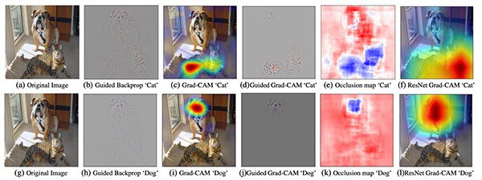
Grad-CAM (Gradient-weighted Class Activation Mapping) is a visualization technique used to understand where a deep learning model, particularly a convolutional neural network (CNN), is focusing its attention when making a prediction. It helps interpret the decisions made by the model by producing a heatmap that highlights important regions in an input image. How Grad-CAM Works— Forward Pass: The input image is passed through the network, and the model makes a prediction. Gradient Calculation: Compute the gradient of the class score with respect to the feature maps of the last convolutional layer. This gradient indicates how changes in the feature maps would affect the class score.

Slide 24
Additional scope of work: 1) Skin Cancer Detection Flask Web App Using Python and MySQL database-- (skin cancer detection flask web app -the entire flow of the web app by showcasing different users view like admin, doctor, and nurse. Also dashboard for admin users, nurse can upload and check for model prediction where he/she will serve as a maker whereas doctor will be checker or reviewer of model's prediction and give his/her feedback based on which we can further computer vision deep learning skin cancer model.)

Slide 25
Literature References The following are referred journals from the preliminary literature review. https://www.ncbi.nlm.nih.gov/pmc/articles/PMC8705277/#:~:text=AI%20can%20be%20of%20use,better%20outcomes%20of%20skin%20cancer https://ieeexplore.ieee.org/document/10051378 https://ieeexplore.ieee.org/document/8641762 https://jmai.amegroups.org/article/view/8241/html

Slide 26
Thank you !! 2022AA05455 Shreya Kshirsagar

