Slide 1
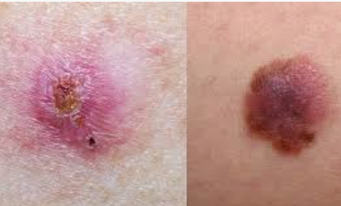
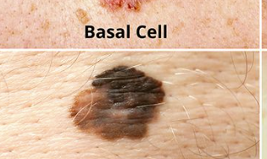
Transfer Learning for Multi-Class Skin Cancer Detection using Deep Convolutional Neural Networks

Slide 2
PROJECT HIGHLIGHTS: 1. Detected 3 types of skin cancer from Skin Lesion images using Transfer Learning MobileNetV2 architecture with 12,295 Skin Lesion images (Basal Cell Carcinoma : 3273 images, Nevus (Benign) : 4550 images, Melanoma : 4472 images). 2. For classifying Basal Cell Carcinoma, Nevus and Melanoma classes architecture of pretrained network MobileNetV2 used. 3. Customized MobileNetV2 Network attained testing accuracy of 96.94%.

Slide 3
Dataset: Dataset : ISIC Skin Cancer site (International Skin Imaging Collaboration (ISIC) https://challenge.isic-archive.com/data/ Dataset Details Dataset Name : ISIC Skin Cancer Images (Basal Cell Carcinoma vs Melanoma vs Nevus) Number of Class : 3 Number/Size of Images : Total : 12445 (555 MB) Training : 12295 Testing : 150

Slide 4
OBJECTIVES: 1. Develop a Skin Cancer Classification System - Create and implement a deep learning system that accurately identifies three major types of skin cancer (melanoma, basal cell carcinoma, and squamous cell carcinoma) from skin lesion images. Explore transfer learning techniques to leverage pre-trained convolutional neural networks, focusing on achieving high performance, robust generalization to new data, and efficient computation. 2. Evaluate System Performance: Assess the developed classification system using standard metrics like accuracy sensitivity, and area under the ROC curve (AUC). Compare the system’s .performance against existing methods and benchmarks in skin cancer detection. 3. Document Methodology and Results Document the entire process of developing, training, and evaluating the deep learning model. 4. Explore Augmentation Strategies Explore data augmentation techniques to enhance the model's ability to generalize to different skin lesion variations and conditions. Investigate how augmenting the training data with variations like rotations, flips, and color adjustments impacts classification performance. 5. Consider Computational Efficiency: Optimize the deep learning model for computational efficiency without compromising classification accuracy. Evaluate the trade-offs between model complexity and inference speed to ensure practical deployment in real-world clinical settings. 6. Address Class Imbalance: - Address any imbalance in the distribution of skin cancer types in the dataset. Investigate methods such as class weighting, oversampling, or undersampling to improve the model's ability to correctly classify underrepresented classes.

Slide 5
CODE OUTLINE: 1. Importing Libraries: - The code starts by importing necessary libraries like pandas, numpy, cv2, os, tqdm, random, etc. These are used for data handling, image processing, machine learning, and visualization. 2. Mounting Google Drive: - The code mounts Google Drive to access and load image data from specific directories. 3. Loading Images: - Images from directories (`Basal_cell_carcinoma`, `Melanoma`, `Nevus`) are loaded and displayed as sample images using `matplotlib.pyplot`. 4. Data Preparation: - Images are loaded, resized to 224x224 pixels, converted to arrays, and appended to `data`. Corresponding labels (0 for Basal Cell Carcinoma, 1 for Melanoma, 2 for Nevus) are stored in `labels`. 5. Data Randomization: - Data and labels are shuffled randomly to ensure a balanced distribution in training and testing datasets. 6. Train-Test Split: - The dataset is split into training and testing sets with an 80:20 ratio. Image data is normalized by dividing by 255. 7. Image Augmentation: - Augmentation techniques like rotation, zoom, and horizontal shift are applied to increase dataset diversity and improve model generalization.

Slide 6
8. Model Building: - Transfer learning is used with MobileNetV2 as a base model. Additional layers are added for classification. The model is compiled with categorical cross-entropy loss and Adam optimizer. 9. Training the Model: - The model is trained using `fit()` method on augmented data with specified batch vi size and epochs. Callbacks like ModelCheckpoint and ReduceLROnPlateau are used for model saving and learning rate adjustment. 10. Saving and Loading the Model: - Trained model weights are saved and loaded for further evaluation. 11. Evaluation Metrics: - The model's performance is evaluated using confusion matrix, classification report, and ROC curves for multi-class classification. 12. Testing with New Data: - Test data is prepared similarly to training data and used to predict classes. Images are resized, preprocessed, and predictions are made using the trained model. 13. Prediction on New Images: - Finally, new images are loaded, preprocessed, and fed into the model for prediction of Basal Cell Carcinoma, Melanoma, or Nevus.

Slide 7
WHY TRANSFER LEARNING: 1. Pre-trained Models and Feature Extraction Pre-trained Models: Transfer learning involves leveraging models that have been pre-trained on large and diverse datasets (like ImageNet). These models have already learned to extract a wide range of features from images, which are often applicable to many different types of image recognition tasks, including skin cancer detection. Feature Extraction: In skin cancer detection, important features include textures, colors, and patterns in the skin images. Pre-trained models have learned to recognize and extract these features effectively. By using these models as a starting point, you can benefit from their ability to capture complex patterns in images, which is crucial for distinguishing between various types of skin lesions. 2. Efficiency and Reduced Training Time Training Time: Training a deep CNN from scratch requires a significant amount of computational resources and time, as the model needs to learn features from the raw image data. This is particularly challenging for skin cancer detection due to the need for high accuracy and the potentially large and diverse dataset. 3. Performance and Accuracy Accuracy: Since skin cancer detection involves differentiating between multiple classes (e.g., benign and malignant lesions), the ability of transfer learning models to recognize fine-grained features helps improve classification accuracy. These models have learned useful hierarchical features that contribute to better classification performance compared to models trained from scratch. 4. Scarcity of Data Limited Data: In medical imaging, acquiring a large, labeled dataset can be challenging due to the need for expert annotations and patient privacy concerns. Transfer learning helps mitigate this issue by making effective use of limited data.

Slide 8
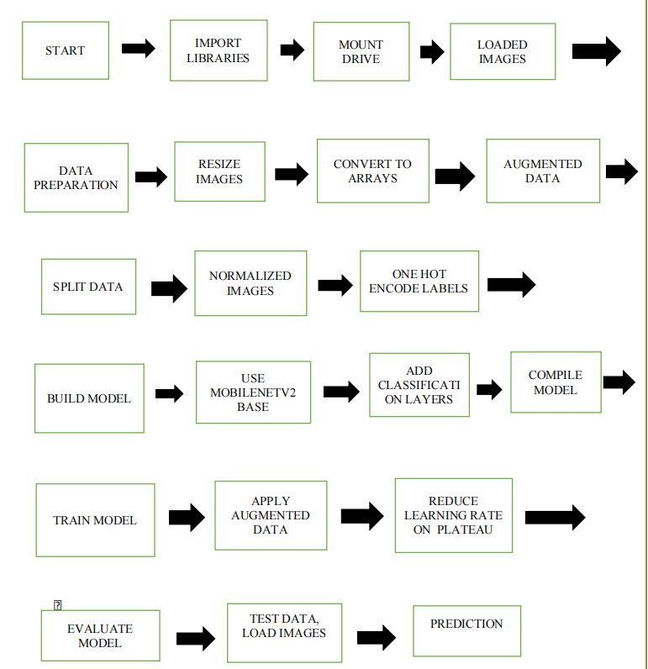
Flowchart

Slide 9
Results We have achieved following RESULTS for detection of Skin Cancers. Performance Metrics Test Accuracy : 97.47% Precision : 97% Sensitivity (BCC) : 100% Sensitivity (Melanoma) : 96% Sensitivity (Nevus) : 98% F1-score : 98% AUC : 0.99

Slide 10
Why MobileNetv2?
MobileNet-v2 is a convolutional neural network that is 53 layers deep. We can load a pretrained version of the network trained on more than a million images from the ImageNet database

Slide 11
About Grad-CAM Heatmap Grad-CAM is a CNN model explanation technique which helps in visualizing the regions of the image where the CNN model is looking at for classification. In this technique, gradients flows through the last convolution layer to produce a coarse localization map highlighting the important regions in the image for predicting the concept. It is based on the research paper – https://arxiv.org/abs/1610.02391

Slide 12
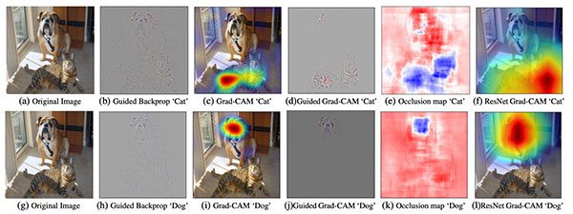
Grad-CAM (Gradient-weighted Class Activation Mapping) is a visualization technique used to understand where a deep learning model, particularly a convolutional neural network (CNN), is focusing its attention when making a prediction. It helps interpret the decisions made by the model by producing a heatmap that highlights important regions in an input image. How Grad-CAM Works— Forward Pass: The input image is passed through the network, and the model makes a prediction. Gradient Calculation: Compute the gradient of the class score with respect to the feature maps of the last convolutional layer. This gradient indicates how changes in the feature maps would affect the class score.

Slide 13
Output: Flask based web app (HTML PAGE)
Upload skin lesion image
Name confidence
Melanoma 100%
Basalcell carcinoma 0%
Nevus 0%

Slide 14
Additional scope of work: 1) Skin Cancer Detection Flask Web App Using Python and MySQL database-- (skin cancer detection flask web app -the entire flow of the web app by showcasing different users view like admin, doctor, and nurse. Also dashboard for admin users, nurse can upload and check for model prediction where he/she will serve as a maker whereas doctor will be checker or reviewer of model's prediction and give his/her feedback based on which we can further computer vision deep learning skin cancer model.)

Slide 15
Thank you !! 2022AA05455 Shreya Kshirsagar

