Slide 1

Sprocket Central Pty Ltd
Data analytics approach
Shreya Shetty Atmakuri

Slide 2
Agenda
Introduction
Data Exploration
Model Development
Interpretation

Slide 3
Introduction
Recommending top customers to target from the new customer list of 1000 customers.
Outline:
Sprocket Central is a bikes & cycling accessories company.
The KPMG Data Analytics consulting team is provided with 3 datasets, related to customer and their transaction details, to recommend which new customers can be targeted to boost their business.
Datasets provided:
Customer Demographic
Customer Address
Transactions

Slide 4
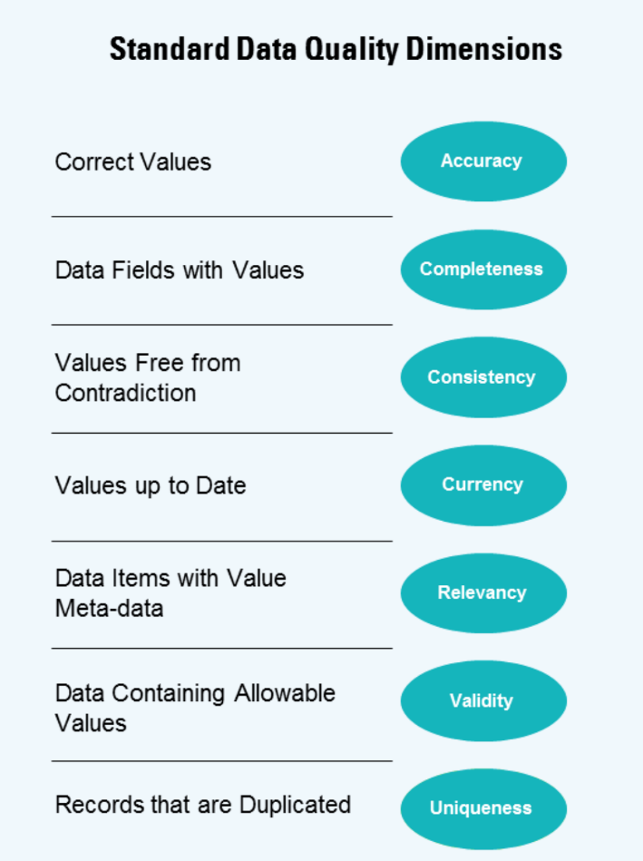
Data Exploration
Data Quality check
Standard Data Quality Dimensions | Customer Demographic | Customer Address | Transaction
Accuracy | DOB: unrealistic
Completeness | Job title: missing values Age: missing column |  | Online order: missing values Brand: missing values
Consistency | Gender: inconsistent | State: inconsistent
Relevancy | Default column: remove
Validity |  |  | Product first sold date: format

Slide 5
Data Exploration
Data Clean-up: Actions taken
Name of the dataset | Actions taken
Customer Demographic | - Filter non-realistic date from DOB column - Gender column has multiple representations for a value, they must be made uniform - The rows having gender=’U’ have missing DOB and Tenure, they can be dropped - Drop the ‘default’ column
Customer Address | - Replace the multiple representations of states with the state code.
Transactions | - A few rows have a set of missing values (brand, product_line, product_class, product_size, standard_cost, product_first_sold_date), they can be dropped - The ‘product_first_sold_date’ column must be changed to date datatype.

Slide 6
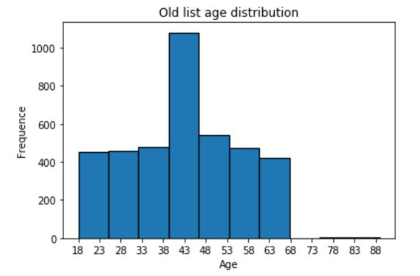
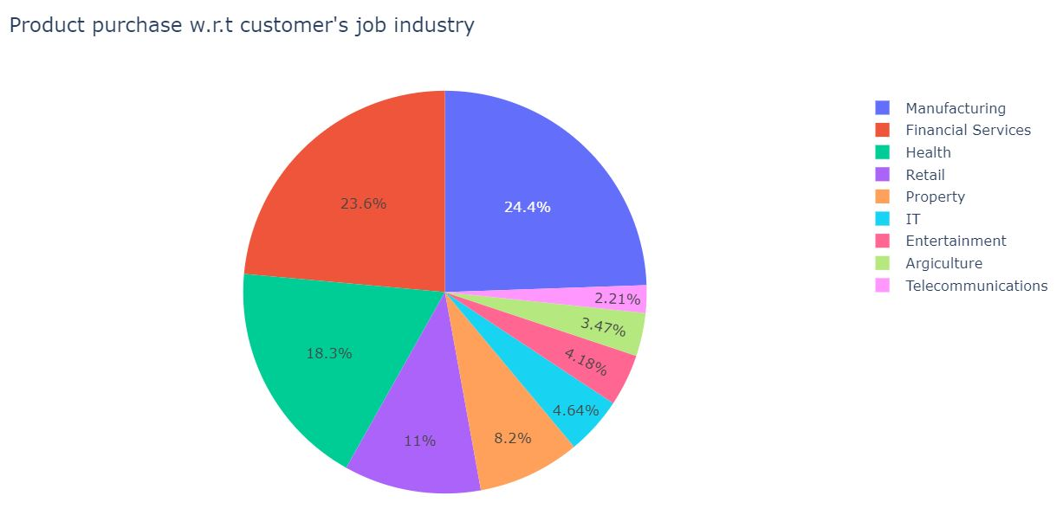
Data Exploration
Customer age distribution
Customer’s job industry
Majority of the customers are aged between 38-48.
The lowest age observed is 18 while the highest is around 90.
48% of the customers belong to the Manufacturing and Financial service industry.

Slide 7
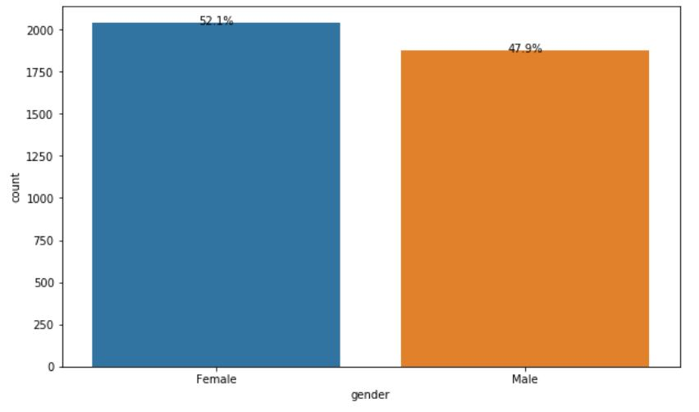
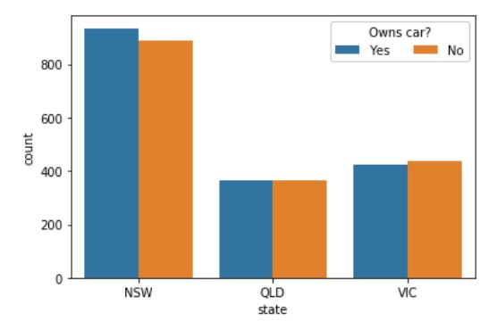
Data Exploration
Gender wise purchases
Ratio of cars owned in each state
Gender does not seem to be a major purchase decision factor.
Female purchases exceed male by around 4%.
Most of the customers reside in NSW with certainly more than 50% of the population owning a car.

Slide 8
Model Development
RFM analysis for Customer classification
RFM stands for recency, frequency and monetary- RFM segmentation is a way to identify group of target customers to increase revenue.
The model shows customer engagement with the company in the three mentioned categories.
Approach:
Perform RFM analysis on the existing database
Select the top customers based on their RFM scores (RFM score = [444, 443, 434, 344, 433, 343, 334, 333])
Analyze this dataset to find decision factors for targeting customers from the new list.

Slide 9
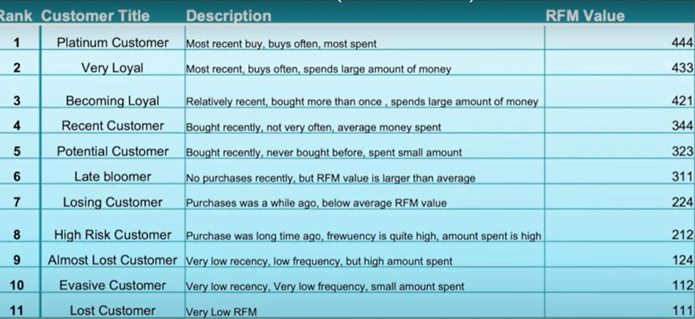
Model Development
RFM table used for customer classification

Slide 10

Interpretation
Target customers
The top customers are the ones who purchased recently, bought frequently and tend to spend more during their visits.
We filter through the top customers depending on their RFM scores listed previously.

Slide 11
Thank You.

