Slide 1
Recommender System using Collaborative Filtering
-Shreya Arun

Slide 2
Introduction
Recommender systems are widely used in various industries to personalize the user experience and provide relevant recommendations to users.
Collaborative filtering is one of the most popular techniques used in recommender systems, as it is able to make personalized recommendations by analyzing the historical interactions of users.

Slide 3
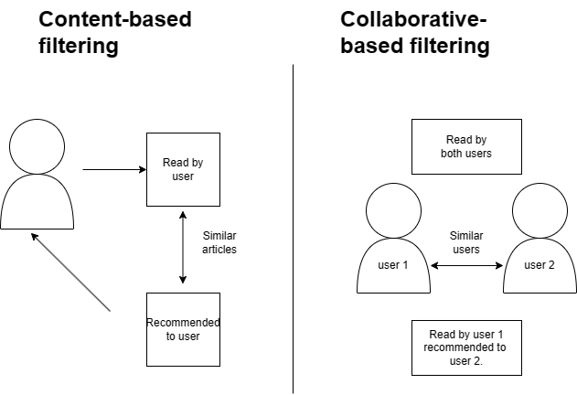

Slide 4
Collaborative filtering
Collaborative Filtering is a type of recommender system that predicts a user's interest by collecting preferences from many users.
Collaborative filtering uses a matrix to map user behavior for each item in its system. Various metrics then measure the distance between points as a means of calculating user-user and item-item similarity.
Collaborative filtering methods build a model based on users past behavior and use decisions made by current and other users and is used to predict items that the user may be interested in.

Slide 5
Methodology
Data preparation
Create Rating Matrix
Normalize the matrix
Compute SVD
Print similar movies
Compute cosine similarity

Slide 6
Mathematical part
 | M1 | M2 | M3 | M4 | M5 | M6 | M7
A | 4 |  |  | 5 | 1
B | 5 | 5 | 4
C |  |  |  | 2 | 4 | 5
D |  | 3 |  |  |  |  | 3
Similarity of users
Centred cosine similarity
Normalize ratings
Rating Predictions
SVD

Slide 7
Centred Cosine Similarity
It is to find similar users
STEPS
Normalize the ratings-Subtract Row mean
Sum of the normalized ratings is zero.
Find similarity between users
Sim(U1,U2)=r_U1.r_U2/|r_U1||r_U2|
Sim(A,B)=0.09 and Sim(A,C)=-0.56

Slide 8
Rating Predictions
Prediction of user x and movie r_(xi)
Weighted average ranking
r_(xi)=sum(sim(x,y)r_(yi))/sum(sim(x,y))
Mainly for dimensionality reduction
The elements of this matrix are the ratings given by the users
Rows representing users and columns for items.
A= U ∑ V^T
Singular Value Decomposition(SVD)

Slide 9


=[U] [∑] [V’]
Neglect smallest value from ∑,take the respective rows and column vectors from U and V’
1 1 0 0
3 3 3 0 0
4 4 0 0
5 5 0 0
0 2 0 4 4
0 0 0 5 5
0 1 0 2 2

Slide 10
To find similar user take a rating by user1 as a row matrix and the V matrix and dot product them to get a row matrix.
Taking the highest value from the matrix and deciding the user 1 similarities with other users by using the same method.

Slide 11
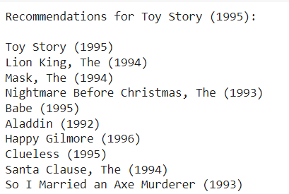
Output
https://colab.research.google.com/drive/1SP1r-J5vJ1-d6cd6AMV1bW_HJRMjh99T#scrollTo=94JZicEAWPVP

