Slide 1
KRISHNA ENGINEERING, Ghaziabad, UP
Department of Information Technology
Project Presentation (IV Sem), Session 2022-23
TYPING ACCURACY CHECKER
Project Guide: Ms. Sarika Tyagi Assistant Professor | Shreya Saxena (2101610130057)

Slide 2
Contents
Introduction
Hardware & Software Requirement
Code
Screenshots
References

Slide 3
Introduction
Python is a computer programming language often used to build websites and software, automate tasks, and conduct data analysis.
Python is a general-purpose language, meaning it can be used to create a variety of different programs and isn't specialized for any
specific problems. It was created by Guido van Rossum, and released in 1991.
Python is a dynamic, interpreted (bytecode-compiled) language. There are no type declarations of variables, parameters, functions,
or methods in source code. This makes the code short and flexible, and you lose the compile-time type checking of the source code.
Python is a easy to use language for the beginners and with the help of this language we have created this project.
In this Python project , we are going to build an exciting project through which you can check and even improve your typing speed.
For a graphical user interface, we are going to use the pygame library which is used for working with graphics.
This project checks for the accuracy of the written text and also shows the speed and words per min.
With the help of this you can not only improve your typing speed but can also get a check about the accuracy of the words.

Slide 4
Hardware & Software Requirement:
Python IDLE 3.8.3
Pygame package: The pygame library is a cross-plateform set of python modules which is used to create video games.
Background.jpg – A background image we have used in our program.
Icon.png – An icon image that we have used as a reset button.
Sentences.txt – This text file is contain a list of sentences separated by a new line.
Speed typing.py – The main program file that contains all the code.
Typing-speed-open.png – The image to display when starting game.

Slide 5
Code
import pygame
from pygame.locals import *
import sys
import time
import random
# 750 x 500
class Game:
def __init__(self):
self.w=750
self.h=500
self.reset=True
self.active = False
self.input_text=''
self.word = ''
self.time_start = 0
self.total_time = 0
self.accuracy = '0%‘

Slide 6
self.results = 'Time:0 Accuracy:0 % Wpm:0 '
self.wpm = 0
self.end = False
self.HEAD_C = (255,213,102)
self.TEXT_C = (240,240,240)
self.RESULT_C = (255,70,70)
pygame.init()
self.open_img = pygame.image.load('type-speed-open.png')
self.open_img = pygame.transform.scale(self.open_img, (self.w,self.h))
self.bg = pygame.image.load('background.jpg')
self.bg = pygame.transform.scale(self.bg, (500,750))
self.screen = pygame.display.set_mode((self.w,self.h))
pygame.display.set_caption('Type Speed test')
def draw_text(self, screen, msg, y ,fsize, color):

Slide 7
font = pygame.font.Font(None, fsize)
text = font.render(msg, 1,color)
text_rect = text.get_rect(center=(self.w/2, y))
screen.blit(text, text_rect)
pygame.display.update()
def get_sentence(self):
f = open('sentences.txt').read()
sentences = f.split('\n')
sentence = random.choice(sentences)
return sentence
def show_results(self, screen):
if(not self.end):
#Calculate time
self.total_time = time.time() - self.time_start
#Calculate accuracy
count = 0

Slide 8
for i,c in enumerate(self.word):
try:
if self.input_text[i] == c:
count += 1
except:
pass
self.accuracy = count/len(self.word)*100
#Calculate words per minute
self.wpm = len(self.input_text)*60/(5*self.total_time)
self.end = True
print(self.total_time)
self.results = 'Time:'+str(round(self.total_time)) +" secs Accuracy:"+ str(round(self.accuracy)) + "%" + ' Wpm: ' + str(round(self.wpm))
# draw icon image
self.time_img = pygame.image.load('icon.png')
self.time_img = pygame.transform.scale(self.time_img, (150,150))

Slide 9
#screen.blit(self.time_img, (80,320))
screen.blit(self.time_img, (self.w/2-75,self.h-140))
self.draw_text(screen,"Reset", self.h - 70, 26, (100,100,100))
print(self.results)
pygame.display.update()
def run(self):
self.reset_game()
self.running=True
while(self.running):
clock = pygame.time.Clock()
self.screen.fill((0,0,0), (50,250,650,50))
pygame.draw.rect(self.screen,self.HEAD_C, (50,250,650,50), 2)
# update the text of user input
self.draw_text(self.screen, self.input_text, 274, 26,(250,250,250))
pygame.display.update()
for event in pygame.event.get():

Slide 10
if event.type == QUIT:
self.running = False
sys.exit()
elif event.type == pygame.MOUSEBUTTONUP:
x,y = pygame.mouse.get_pos()
# position of input box
if(x>=50 and x<=650 and y>=250 and y<=300):
self.active = True
self.input_text = ''
self.time_start = time.time()
# position of reset box
if(x>=310 and x<=510 and y>=390 and self.end):
self.reset_game()
x,y = pygame.mouse.get_pos()
elif event.type == pygame.KEYDOWN:
if self.active and not self.end:
if event.key == pygame.K_RETURN:
print(self.input_text)

Slide 11
self.show_results(self.screen)
print(self.results)
self.draw_text(self.screen, self.results,350, 28, self.RESULT_C)
self.end = True
elif event.key == pygame.K_BACKSPACE:
self.input_text = self.input_text[:-1]
else:
try:
self.input_text += event.unicode
except:
pass
pygame.display.update()
clock.tick(60)
def reset_game(self):
self.screen.blit(self.open_img, (0,0))

Slide 12
pygame.display.update()
time.sleep(1)
self.reset=False
self.end = False
self.input_text=''
self.word = ''
self.time_start = 0
self.total_time = 0
self.wpm = 0
# Get random sentence
self.word = self.get_sentence()
if (not self.word): self.reset_game()
#drawing heading
self.screen.fill((0,0,0))
self.screen.blit(self.bg,(0,0))
msg = "Typing Accuracy Checker"

Slide 13
self.draw_text(self.screen, msg,80, 80,self.HEAD_C)
# draw the rectangle for input box
pygame.draw.rect(self.screen,(255,192,25), (50,250,650,50), 2)
# draw the sentence string
self.draw_text(self.screen, self.word,200, 28,self.TEXT_C)
pygame.display.update()
Game().run()

Slide 14
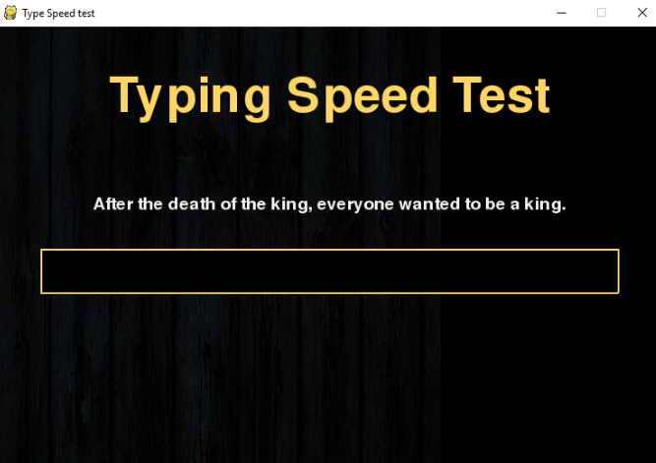
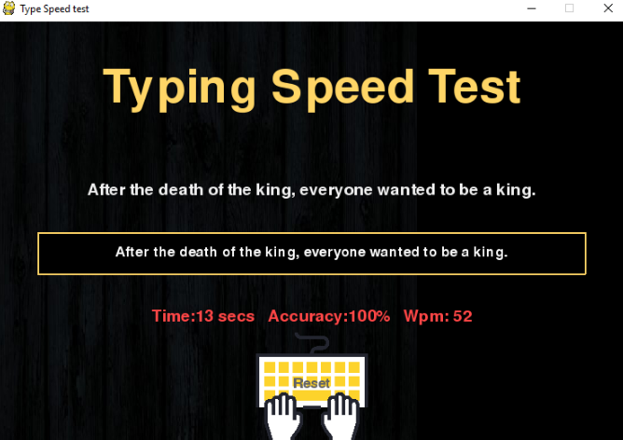
Screenshots

Slide 15
References
https://wikipedia.org
https://projectgurukul.org
https://www.javapoint.com
https://www.skyfilabs.com
https://www.pinterest.nz

Slide 16
Thank You !

