Slide 1

A Project Presentation for the Degree of Bachelor in Computer Engineering
Hand Sign Detection System For Deaf and Dumb People
Group Member Name:
Name: 1)Riddhi Mukkawar
2)Srushti Bhasme
3)Shreya Thakur
Dr. D. Y. Patil Institute Of Technology, Pimpri, Pune
Department Computer Engineering
GUIDE: Name: Mr. Dinesh Bhadane
Designation: Assistant Professor
A.Y 2023-2024
‹#›

Slide 2
Table of Contents
Introduction
Challenges
Objectives
Literature Survey
Problem Statement
Solution Proposed
Requirement Analysis
Algorithm/Methods
Results
Conclusion
Future Work
References
‹#›

Slide 3
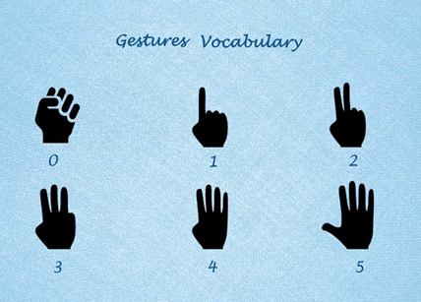
INTRODUCTION
Nowadays pattern recognition and gesture recognition are the growing fields of research.
Being a significant part in non-verbal communication hand gestures are playing vital role in our daily life.
Hand Gesture recognition system provides us an innovative, natural, user friendly way of interaction with the computer which is more familiar to the human beings.
There are many ways to interact with a computer nowadays including voice searches and voice assistant.
But what if the user is mute and is unable to speak.
Therefore, we are working on a system that can recognise hand gestures for deaf and dumb people.
‹#›

Slide 4
CHALLENGES
We faced challenge in collecting the dataset having the features required by us.
Also while training the model, the model was having low accuracy due to background noise.
The trained model was having low accuracy due to the similarities in the hand gestures and they were difficult to recognise.
‹#›

Slide 5
OBJECTIVE
●To publish review and research paper
●To detect and devise the problems faced by deaf and dumb people and find a solution for the same.
●To build a cost effective and easy to use system for deaf and dumb people.
●To design and implement a complete system that can detect , recognize and intercept the hand gestures through computer vision in real time .
‹#›

Slide 6
LITERATURE SURVEY
Sr. No. | Paper Name | Description | Publication Date
01 | Hypertuned Deep Convolutional Neural Network for Sign Language Recognition | This study is about sign language translation into text; this technology is for those experiencing difficulty in communicating. | April 30, 2022
02 | OpenHands: Making Sign Language Recognition Accessible with Pose-based Pretrained Models across Languages | The paper introduced OpenHands, a library where we take four key ideas from the NLP community for low-resource languages and apply them to sign languages for word-level recognition | February, 2022
‹#›

Slide 7
LITERATURE SURVEY
Sr. No. | Paper Name | Description | Publication Date
03 | Sign Language To Speech Translation Using Machine Learning | The aim is to get the deaf and mute people more involved to communicate and the idea of a camera-based sign language recognition system | July 07, 2022
04 | Detection of hand gestures with human computer recognition by using support vector machine | A low-cost approach based on human-computer interaction for predicting hand movements in real time. | April, 2022
‹#›

Slide 8
LITERATURE SURVEY
Sr. No. | Paper Name | Description | Publication Date
05 | Using Deep Learning in Sign Language Translation to Text | This study is about sign language translation into text; this technology is for those experiencing difficulty in communicating. | March 07, 2022
06 | Recognition of Hand Signs Based on Geometrical Features using Machine Learning and Deep Learning Approaches | This paper focuses on the usage of the American Sign Language (ASL) gestures and recognition of few action gestures using single hand. | 2021
‹#›

Slide 9
PROBLEM STATEMENT
Deaf and dumb people face many problems while interacting with the people around them.
They face the same problems while interacting with the computers.
The main objective of our project is to solve this problem in a cost effective and user friendly way.
‹#›

Slide 10
SOLUTION PROPOSED
The proposed solution makes use of Convolutional Neural Network for the recognition of gestures based on a hand Histogram.
The hand histogram will be a 256*256 binary image that will be set based on the skin colour of the user.
The model is trained for 28 gestures including 26 letters and 2 gestures. The CNN will learn each gesture and predict it.
‹#›

Slide 11
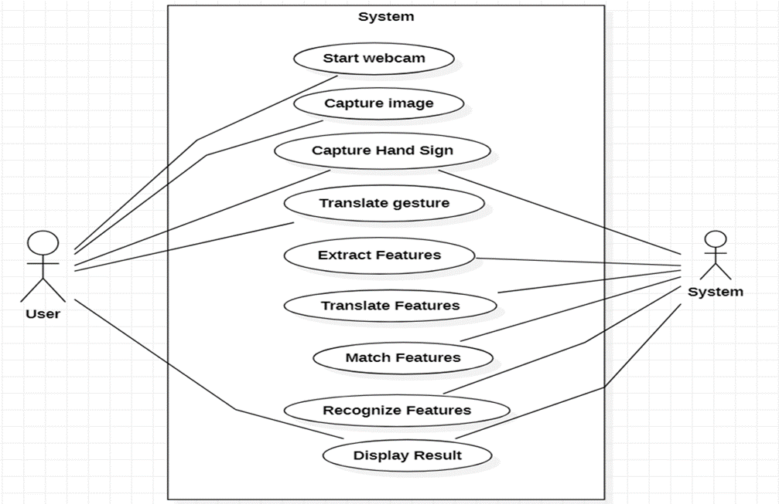
REQUIREMENT ANALYSIS UML DIAGRAM
‹#›

Slide 12
ALGORITHMS
●Step 1: Start
●Step 2: Acquire Image
●Step 3: Extract The Feature of Hand Signs
●Step 4: Compare With Stored Feature Of Extract
●Step 5: If Match Found
●Step 6: Output The Corresponding Display And Audio Signals
●Step 7: Stop
‹#›

Slide 13
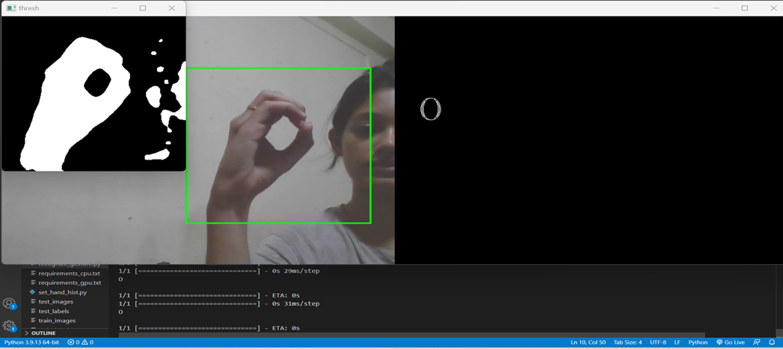
RESULT
‹#›

Slide 14
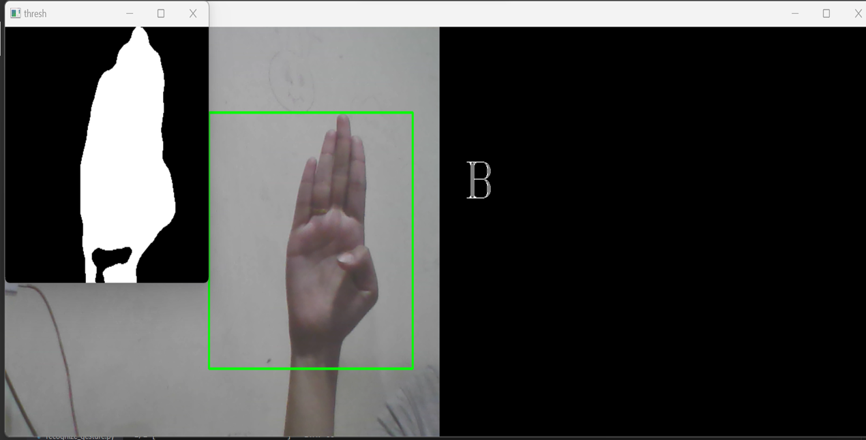
RESULT
‹#›

Slide 15
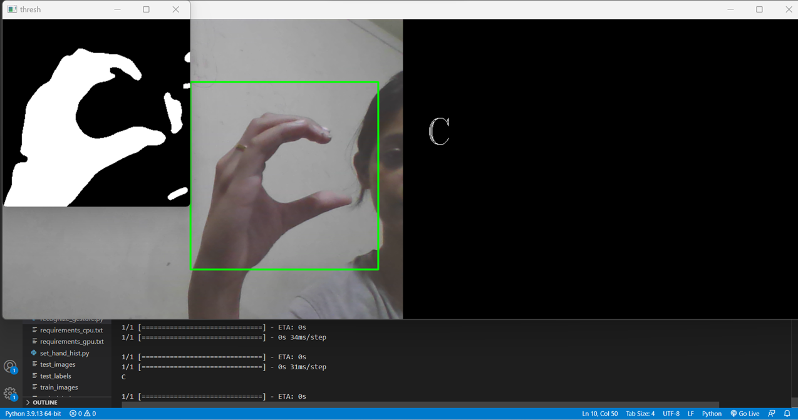
RESULT
‹#›

Slide 16
FUTURE SCOPE AND CONCLUSION
This module can be used by various systems and applications as an option for voice search by deaf and dumb people.
This module can also benefit deaf and dumb people in interacting with humans as well as computers.
Also, this module is user friendly and do not need any special experience for using it.
‹#›

Slide 17
REFERENCES
Abdul Mannan, Abdul Abbasi, Abdul Rehman Javed, Anam Ahsan, Thippa Reddy Gadekallu , and Qin Xin "Hypertuned Deep Convolutional Neural Network for Sign Language Recognition" April 2022 Hindawi Computational Intelligence and Neuroscience Volume 2022.
Carl Jose M. Guingab, Ron Andrew Relayo, Mark Joseph C. Sheng, John Ray D. Tamayo "Using Deep Learning in Sign Language Translation to Text" March 7, 2022 International Conference on Industrial Engineering and Operations Management Istanbul, Turkey
Joyeeta Singha , Karen Das “Indian Sign Language Recognition Using Eigen Value Weighted Euclidean Distance Based Classification Technique” .Assam Don Bosco University Guwahati, India
Peng Liu , Xiangxiang Li , Haiting Cui, Shanshan Li and Yafei Yuan “Hand Gesture Recognition Based on Single -Shot Multibox Detector Deep Learning “ 30 December 2019.
‹#›

Slide 18
REFERENCES
5. Aerpula Swetha, Vamja Pooja, Vundi Vedavyas, Challa Datha Venkata Naga Sai
Kiran, Sadu Sravani "Sign Language To Speech Translation Using Machine
Learning" July 2022 Journal of Engineering Sciences Vol 13 Issue 7
6. M. Madhiarasan, Partha Pratim Roy "A Comprehensive Review of Sign
Language Recognition : Different Types, Modalities, and Datasets" April 2022
Journal of Latex class files.
7. Phat Nguyen Huu and Tan Phung Ngoc “Hand Gesture Recognition Algorithm
Using SVM and HOG Model for Control of Robotic System”
8. Kulandai Josephine Julina Joseph, Sree Sharmila Thangaswamy "Recognition of
Hand Signs Based on Geometrical Feature using Machine Learning and Deep
Learning Approaches" 2021 Revista Argentina de Clínica Psicológica
‹#›

Slide 19
REFERENCES
9. Paulo Trigueiros, Fernando Ribeiro, Luís Paulo Reis "A comparison of
machine learning algorithms applied to hand gesture recognition" 2021.
10. Sura Abdulmunem Mohammed Al-Juboori, Hissah Almutairi, Rasha Almajed,
Amer Ibrahim, Hassan Muwafaq Gheni "Detection of hand gestures with
human computer recognition by using support vector machine" April 2022 Periodicals of Engineering and Natural Sciences Vol.10, No. 32
‹#›

Slide 20
THANK YOU
‹#›

