Slide 1

Internet Of Analyzers

Slide 2

Shreya Sharma
https://www.linkedin.com/in/shreya-sharma-8a0ba8100/
Priya Sharma
https://www.linkedin.com/in/priya-sharma-905475114/
Nikhil Kumawat
https://www.linkedin.com/in/nikhilkumawat03/

Slide 3

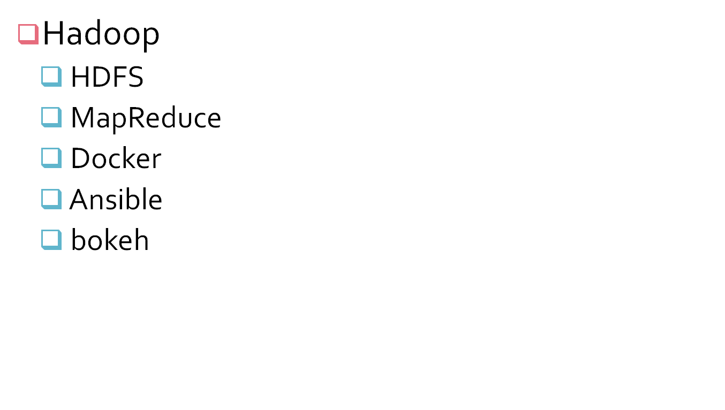

Slide 4

Extremely large datasets that are hard to deal with using Relational Databases
  Storage/Cost
  Search/Performance
  Analytics and Visualization
Need for parallel processing on hundreds of machines

Slide 5

Big Data:
Big data is a term used to describe the voluminous amount of unstructured and semi-structured data a company creates.
Data that would take too much time and cost too much money to load into a relational database for analysis.
Big data doesn't refer to any specific quantity, the term is often used when speaking about petabytes and exabytes of data.

Slide 6
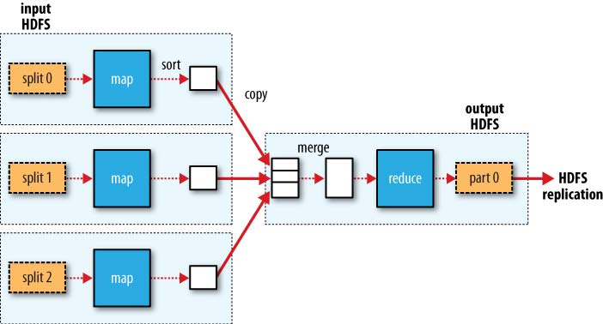
MapReduce data flow with a single reduce task

Slide 7

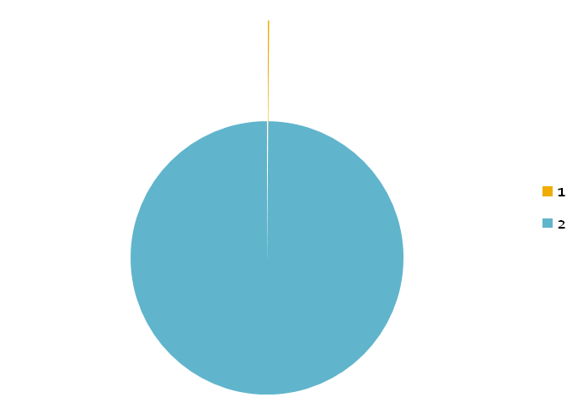
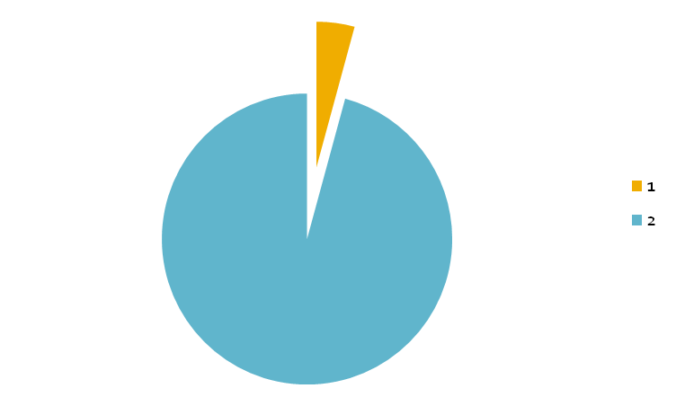
Year | Standard Hard Drive Size (in Mb)
1990 | 1370
2010 | 1000000
Year | Data Transfer Rate (Mbps)
1990 | 4.4
2010 | 100

Slide 8

The transfer speed is around 100 MB/s
A standard disk is 1 Terabyte
Time to read entire disk= 10000 seconds or 3 Hours!
Increase in processing time may not be as helpful because
  Network bandwidth is now more of a limiting factor
  Physical limits of processor chips have been reached

Slide 9

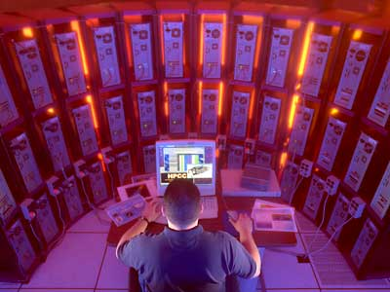
The obvious solution is that we use multiple processors to solve the same problem by fragmenting it into pieces.
Imagine if we had 100 drives, each holding one hundredth of the data. Working in parallel, we could read the data in under two minutes.

Slide 10

The key issues involved in this Solution:
Hardware failure
Combine the data after analysis
Network Associated Problems

Slide 11

Hardware Failure:
As soon as we start using many pieces of hardware, the chance that one will fail is fairly high.
Combine the data after analysis:
Most analysis tasks need to be able to combine the data in some way; data read from one disk may need to be combined with the data from any of the other 99 disks.

Slide 12


