Slide 1
CAREERS 4 U
Let’s Build Our Future Together

Slide 2
Our Team:
Y Vaishnavi
P Samhitha
Ch Shreya Reddy
(From VNR VJIET)

Slide 3
Our Project
We want to create an easily accessible portal for students, organizations, placement officers, and faculty that facilitates students to match jobs according to their respective profiles.

Slide 4

Home Page
In Home Page , a user can register and login and can find different organisations and colleges available on this platform.

Slide 5
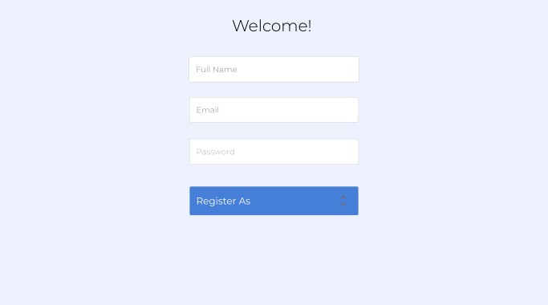
Register Page
Here, a user can enter details and
can register as a student or faculty
or placement officer/ spoc or
as an organization.

Slide 6
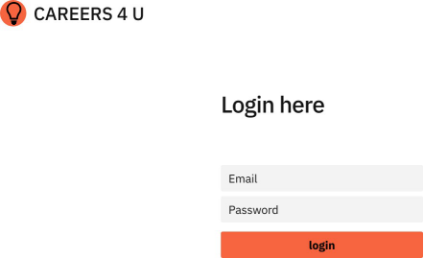
Login Page
A user can login here to go
to their respective profiles.

Slide 7
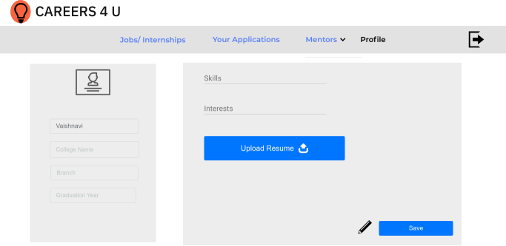
Student Profile
A student can fill
his/her information
and update their profile.

Slide 8
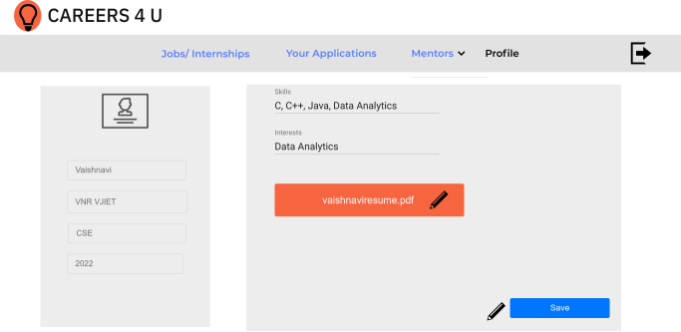
Updated Student Profile
This updated student
profile can be edited at
any time.

Slide 9
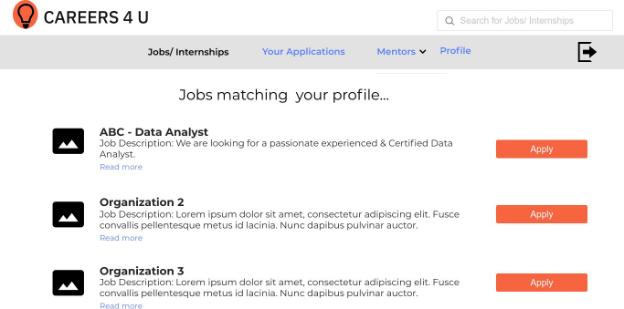
Jobs/ Internships
After setting up their
profiles, here students
can view the jobs or
internships matching
their profiles and can
apply for them.

Slide 10
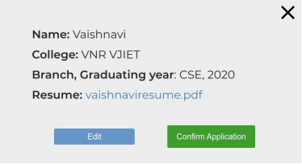
Application for Job/ Internship
This is a pop-up that comes up with all
the details of student after clicking
the apply button. Student can edit
the details if needed and can confirm
his/ her application.

Slide 11
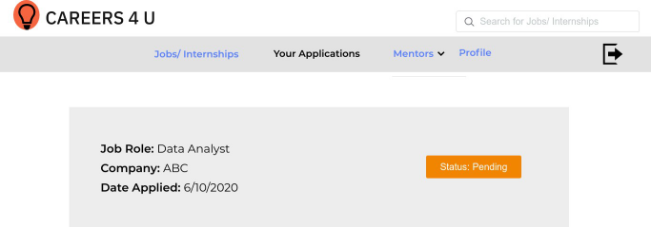
Jobs/ Internships applied for
Here, a student can
view the details of all the
previous jobs/ internships
applications along with
their status.

Slide 12
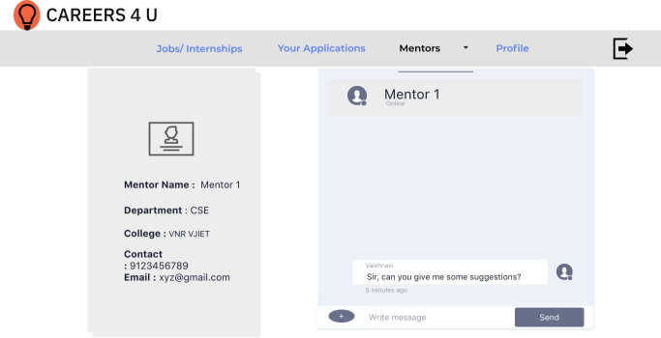
Faculty as Mentors
Each mentor is assigned
Some students. A student can
select one of the two mentors
assigned to get to a page like this
where they get all the contact
details of mentor and even a
direct chat option to interact.

Slide 13
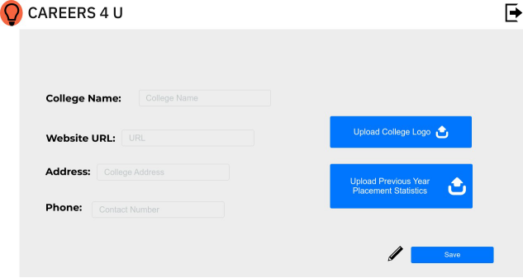
College Profile maintained by Placement officers/ SPOCS
A Placement officer/ SPOC
can maintain their college
profile and fill up this
information to update it.

Slide 14
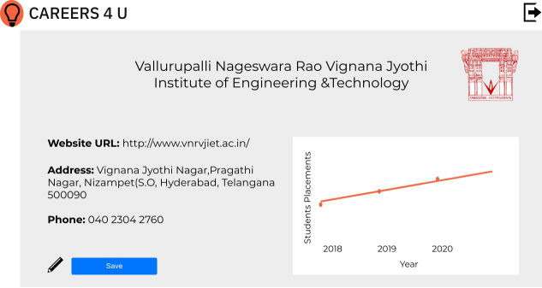
Uploaded College Profile
This updated college
profile can be edited
at any time.

Slide 15
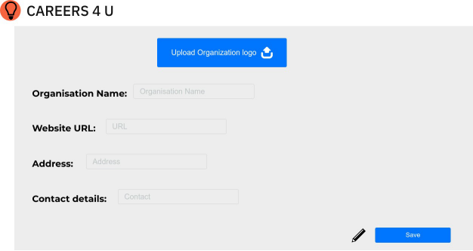
Organisation Profile
An Organisation person
can fill the information
about their company
and update the profile.

Slide 16
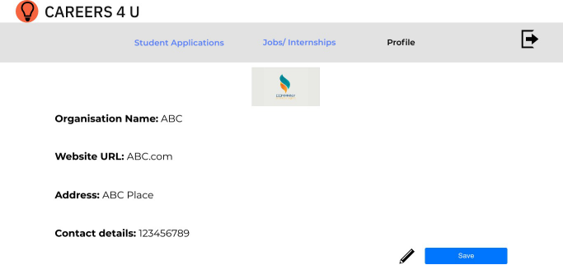
Uploaded Organisation Profile
The Updated Organisat
-ion profile which can
be edited anytime.

Slide 17
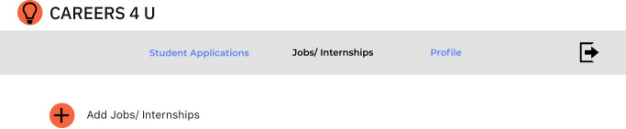
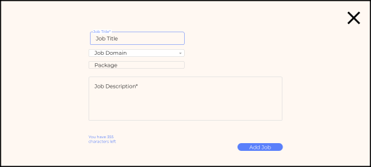
Jobs/Internships
When an organisation
wants to add any opportu
-nities, they can add the
details of that job/intern
-ship in this page and
publish them to students.

Slide 18
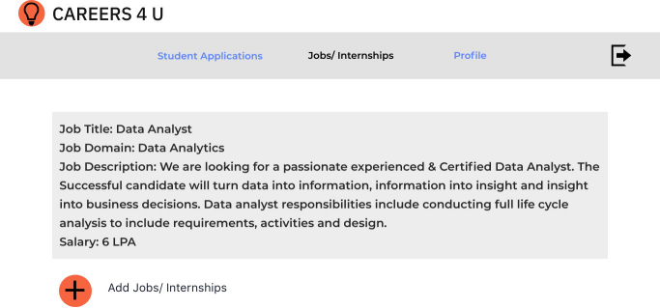
Uploaded Data In Jobs/Internships
These are the
jobs/ Internships
added by the organization.

Slide 19
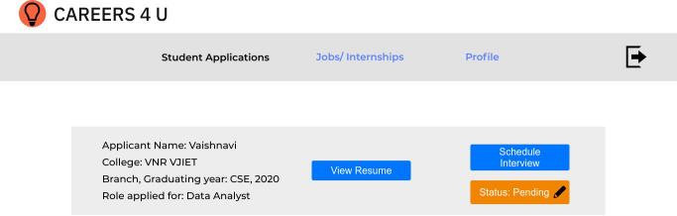
Student Applications
Applications received from different
Students for differents posts
can be seen here along with
their details like resume and
etc. They can also schedule
An interview and update the
status of application here.

Slide 20
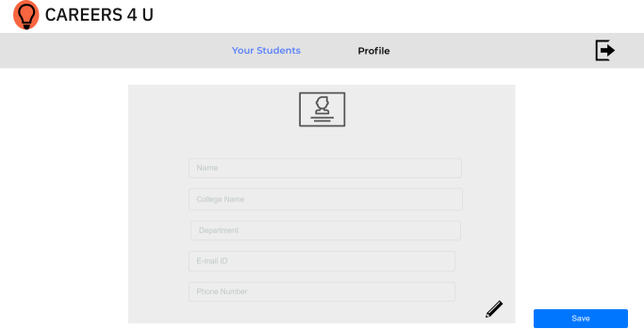
Mentor Profile
A mentor can fill
his/her information
and update the profile.

Slide 21
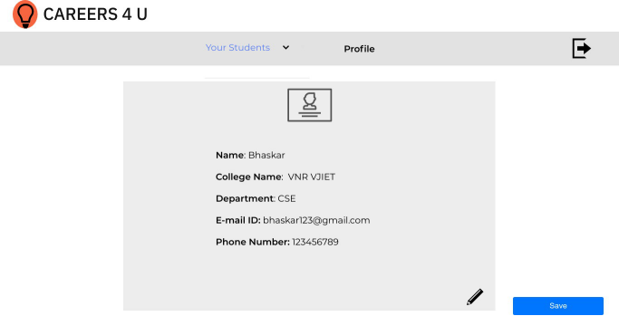
Uploaded Mentor Profile
Profile page of mentor
after uploading his/her
details. It can be edited
at any time. After editing
a click on save button
saves the details.

Slide 22
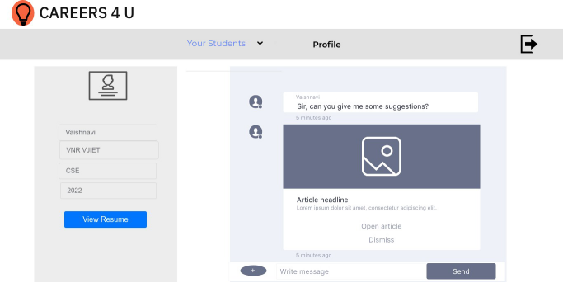
Students assigned for a Mentor
Mentor can click on Your
Students in the nav bar
and select the student
he/she want to among the
students assigned to them,
and see the details of
students and can also chat with them.

Slide 23

Home Page after logging in
From any page of the
entire site , the user
can come back to home
page by clicking on
CAREERS 4 U at top left ,
and can logout by
clicking on top right icon.

Slide 24
Conclusion
In this application :
Organisations can create profiles, post their jobs, internships and hire on the platform.
SPOCs & Placement officers can register and maintain their colleges’ profiles.
Students can register and find jobs/internships matching their profile.
Faculty can provide mentorship to students for applying to jobs on the platform.

Slide 25


