Slide 1
REPRESENTATION OF COVID STATUS AROUND THE WORLD USING MAPS
Using Flask and Folium

Slide 2
Our Guide : Mrs.R.Vasavi, Assistant Professor
Our Team : Team 11
CH. Shreya Reddy - 18071A0569
CH. Chakrapani - 18071A0570
P. Samhitha - 18071A05A2
Y. Vaishnavi - 18071A05B6
CH. Vinay Datta - 17071A0574

Slide 3
Agenda/Contents
Abstract
Objectives
Introduction
Literature Review
System Architecture
UML Diagrams
Methodology
System Requirements
Coding and Implementation
Limitations and Future Scope
Conclusion
References

Slide 4
Abstract
COVID-19 outbreak was first reported in Wuhan, China and has spread to more than 50 countries. WHO declared COVID-19 as a Public Health Emergency of International Concern (PHEIC) on 30 January 2020. Naturally, a rising infectious disease involves fast spreading, endangering the health of large numbers of people, and thus requires immediate actions to prevent the disease at the community level.
In this project, we are implementing a dashboard for COVID 19 spread analysis(Country wise details about cases , tests, vaccination etc. represented on map). This dashboard will provide many insightful visualizations for the study of coronavirus spread. In this project, we will work on a dataset and generate a dashboard using flask and folium.
We are using flask and folium python packages for making interactive dashboards. The dataset consists of corona spread data from different countries and different cities. This dataset also contains the latitude and longitude of corona affected areas. We will filter and visualize the countries and the cities within countries with maximum corona cases.
This helps people in easily understanding and analyzing the severity of covid 19 spread.

Slide 5
Objectives
To provide insightful visualizations for the study of coronavirus spread.
To implement a interactive dashboard for COVID 19 spread analysis.
To filter and visualize the countries and the cities within countries with maximum corona cases.
To learn more about Flask , Folium and some visualization tools.

Slide 6
Introduction
The deadly impact of COVID-19 is driving a massive amount of research that aims at understanding the various characteristics of the pandemic. While there is a vaccine, considerable effort has been devoted to understanding the spread of the disease in different places in the world. The speed with which the disease has spread throughout the world demands agile solutions to understand and estimate the disease progression.
Therefore, Interactive dashboards with several charts surfaced in different formats offer concise ways to express the pandemic's growth.

Slide 7
Literature Review
Paper No. | Author(s) | Paper Title & Year of Publication | Findings(Methodology, Drawbacks)
1. | Arman Behnam Roohollah Jahanmahin | A data analytics approach for COVID-19 spread and end prediction (with a case study in Iran), 2021 | Methodology: ML algorithms such as logistic function using inflection point, created new rates such as weekly death rate, life rate and new approaches to mortality rate and recovery rate in Iran. Drawbacks: Did not cover the cases and statistics throughout the world
2. | Hyeontae Jo, Hwijae Son, Hyung Ju Hwang, Se Young Jung | Analysis of COVID-19 spread in South Korea using the SIR model with time-dependent parameters and deep learning (April 2020) | Methodology : Analyzing the novel coronavirus infection (COVID-19) spread in South Korea using the susceptible-infected-recovered (SIR) model Drawbacks: Limited to Korea and absence of population exchange or the absence of infection in SIR model

Slide 8
Literature Review
Paper No. | Author(s) | Paper Title & Year of Publication | Findings(Methodology, Drawbacks)
3. | Ekta Gambhir Ritika Jain Alankrit Gupta Uma Tomer | Regression analysis of Covid 19 using machine learning algorithms(SEP 2020) | Methodology: SEIR model and Regression model have been used for predictions based on the data collected from John Hopkins University repository in the time period of 30th January 2020 to 30th March 2020 Drawbacks: Analysis is done using limited data
4. | Rajan Gupta, Saibal K. Pal, Gaurav Pandey | A Comprehensive Analysis of Covid 19 outbreak situation in India(April 2020) | Methodology : Analyzing the coronavirus infection (COVID-19) spread in India using the Exponential Modelling to predict the short term trends for the next three weeks. Drawbacks: Did not consider long term data and data across the world

Slide 9
Literature Review
Paper No. | Author(s) | Paper Title & Year of Publication | Findings(Methodology, Drawbacks)
5. | Ravi Sharma Nonita Sharma | Statistical Analysis of Covid-19 (SARS-COV-2) Patients Data of Karnataka, India (SEP ,2020) | Methodology: In this study, Covid-19 patients’ data were analysed to determine the relationship between different variables such as age , gender using SEIR Model and Statistical analysis Drawbacks: very less amount of data and huge part of research is based only on cases in Wuhan city and Karnataka.
6. | Jayesh S Shilpa Sreedharan | Analysing the Covid-19 Cases in Kerala: a Visual Exploratory Data Analysis Approach(Aug,2020) | Methodology:An exploratory data analysis was conducted on the Covid-19 cases in Kerala by dividing the Covid-19 data from January 30, 2020, to May 31, 2020 into three phases Drawbacks: Analysis is done on limited data and restricted the comparison only to kerala and India.

Slide 10
Literature Review
Paper No. | Author(s) | Paper Title & Year of Publication | Findings(Methodology, Drawbacks)
7. | Siddharth Singh; Piyush Raj; Raman Kumar; Rishu Chaujar | Prediction and forecast for COVID-19 Outbreak in India based on Enhanced Epidemiological Models(2020) | Methodology: Using SIRD, no. of deaths, the time dependence of Outbreak's Intensity in India to forecast max. no. of confirmed active cases of COVID-19 present in a day and also predicting total number of deaths in India . Drawbacks: very less amount of data and huge part of research is based only on cases in India.
8. | Rajani Kumari, Sandeep Kumar, Ramesh Chandra Poonia, Vijander Singh, Linesh Raja, Vaibhav Bhatnagar, Pankaj Agarwal | Analysis and Predictions of Spread, Recovery, and Death Caused by COVID-19 in India(2021) | Methodology: The correlation coefficients and multiple linear regression applied for prediction and autocorrelation and auto regression have been used to improve the accuracy Drawbacks: Scope is only India and models may not be so accurate.

Slide 11
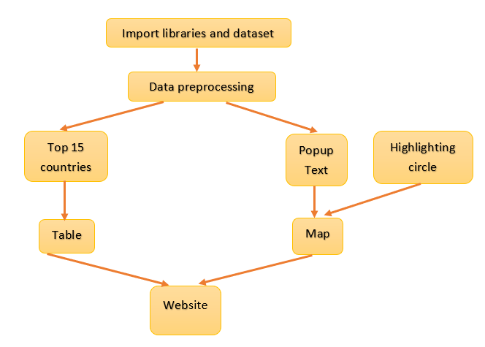
System Architecture

Slide 12
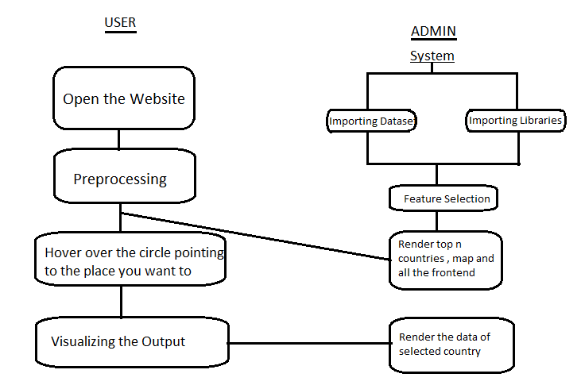
Activity Diagram

Slide 13
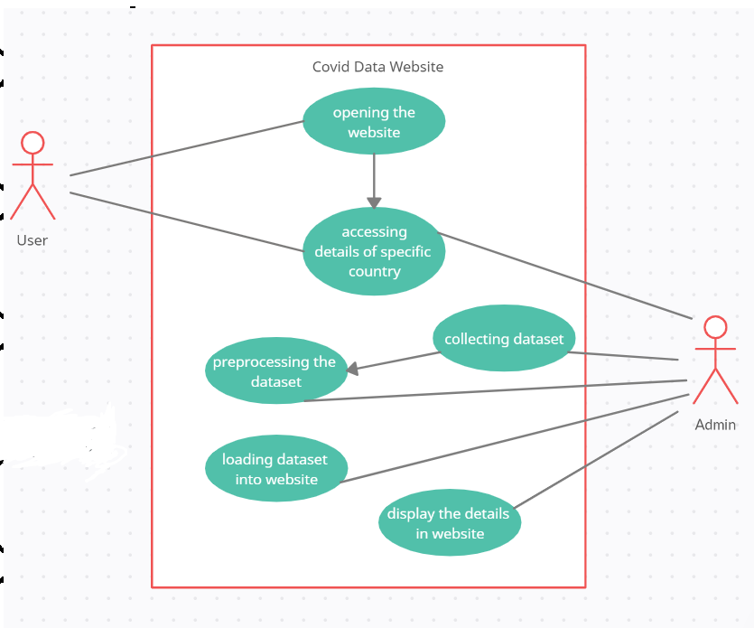
Use Case Diagram

Slide 14
Methodology
Collecting the data
The data is collected from various sources
Preprocessing the dataset
The collected dataset will be preprocessed using machine learning techniques.
Loading the data
The analysed data will be fed into the application
Visualisation
Finally the data will be visualised using the folium and flask

Slide 15
System Requirements
Hardware Requirements:
Intel i5 processor or higher
Windows 8 or higher
RAM- 8GB or higher
Software Requirements:
Visual Studio code
Flask , Folium

Slide 16
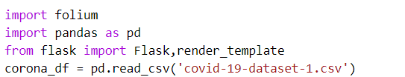
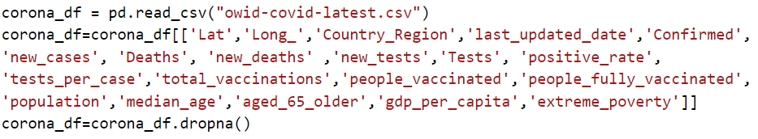
Coding and Implementation
Importing required libraries and reading the dataset:

Slide 17
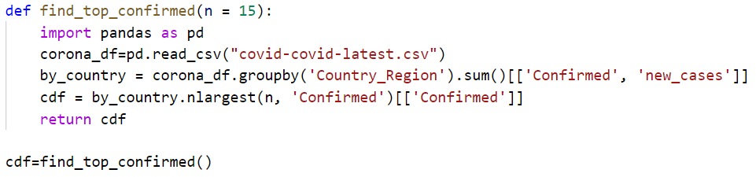

cont...
Finding top n countries:
Making a map:

Slide 18
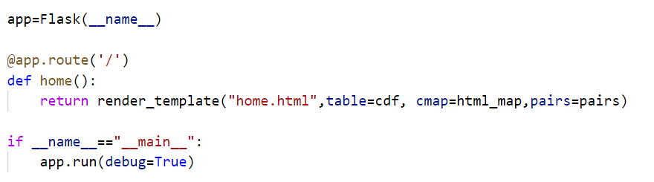
cont...
Pairs(country, confirmed cases):
Rendering map and table:

Slide 19
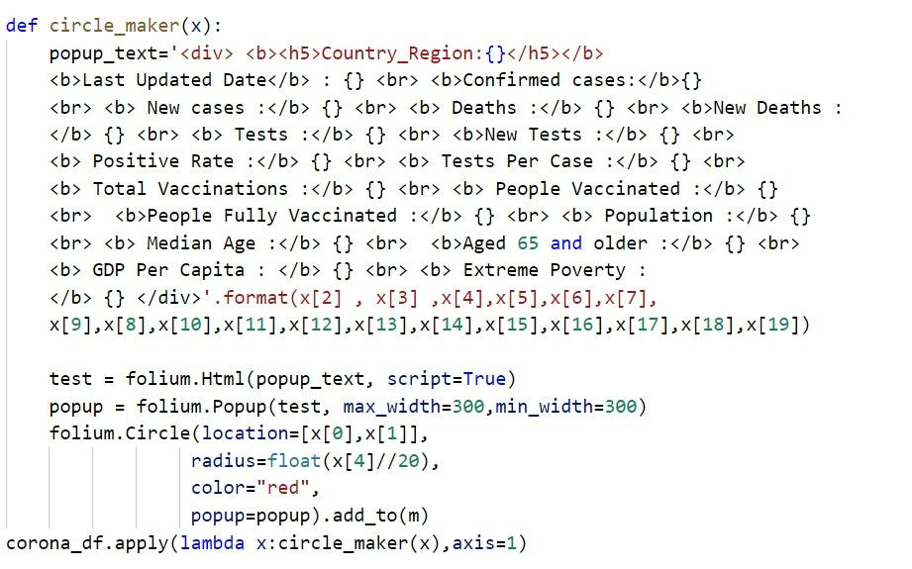
cont...
For circle and pop-up:

Slide 20
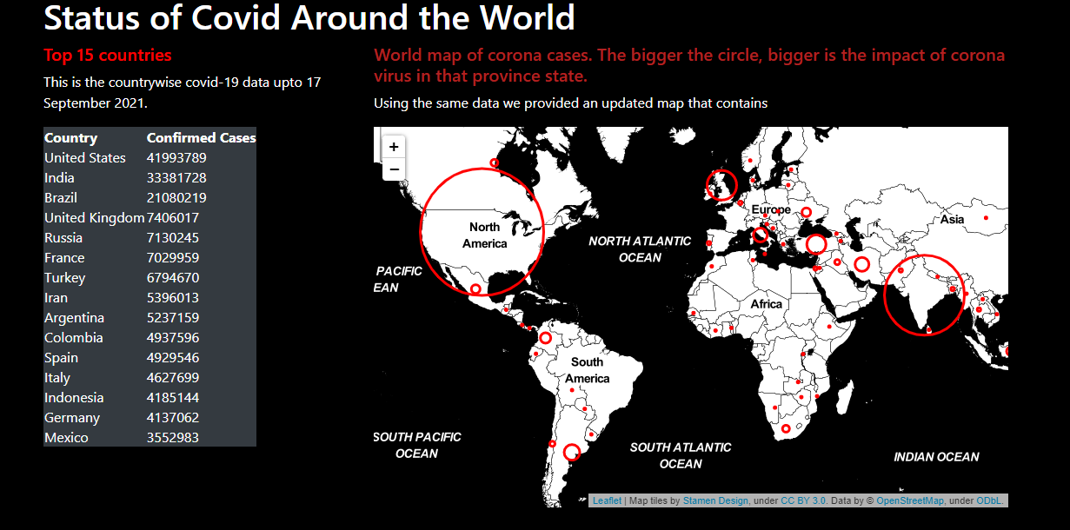
Results

Slide 21
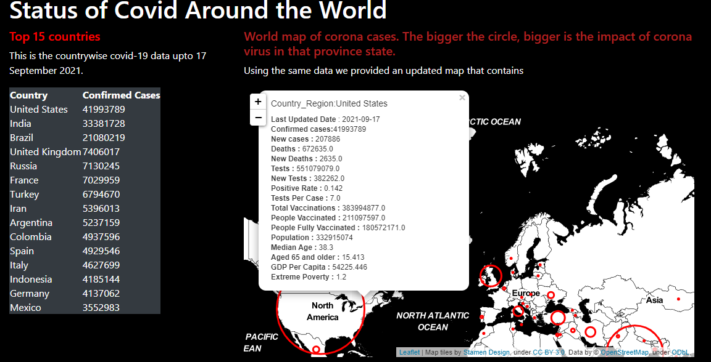
cont...

Slide 22
Limitations and Future Scope
Limitations
May not get the updated snapshot of the current scenario
May not be accessible by everyone as the display language is only in English
Future Scope
It can be used to keep track of other pandemic outbreaks in the future
It can show even deeper results for datasets of states and cities as well
Can add predictive models to forecast or predict cases.

Slide 23
Conclusion
This project aims to give a detailed analysis on how Covid-19 has impacted the world. These visualizations show what's happening on a large scale, can also be downscaled with the emergence of precise datasets on hand to go over what's happening at a local level. The infographic is easily understandable for people to make better, more informed decisions during this crisis. The derived insights can also be used for further analysis.

Slide 24
References
https://www.worldometers.info/coronavirus/
https://www.ncbi.nlm.nih.gov/pmc/articles/PMC7215145/
https://www.who.int/bulletin/online_first/20-255695.pdf
https://cddep.org/wp-content/uploads/2020/04/India-Shutdown-Modeling-Slides-Final-2.pdf
https://towardsdatascience.com/how-to-track-covid-19-cases-in-the-united-states-in-python-9b297ff9f6f5
https://www.ncbi.nlm.nih.gov/pmc/articles/PMC7426205/
https://thecleverprogrammer.com/2020/05/21/covid-19-death-rate-analysis-with-python/
https://www.sciencedirect.com/science/article/pii/S2468042720300087

Slide 25
THANK YOU

