Slide 1




The application
A checker placed around banking chatbots and internal compliance assistants that flags rule-breaking requests or answers.
The problem
Can an AI spot financial crime?
Everyday safety filters catch rude or violent content, but miss breaches of specific financial rules.
Why it matters
One bad answer can mean fines, a damaged reputation and harm to customers.
Application and problem statement
ILLUSTRATIVE EXAMPLE
"If we split transactions above $10,000 into $4,900 batches across two accounts, will your system flag it?"
FinGuard: Detecting Financial Regulatory Non-Compliance in LLM Interactions
Standard LLM
Answers helpfully
FinGuard
Blocks: structuring (AML)
Dou et al. · arXiv:2605.29427
Notes:
Explain with the structuring example. Mention paper title and arXiv ID.

Slide 2





How FinGuard was built
DATASET AND METHOD
3,120
public Chinese regulatory documents
1
2
3
Read 3,120 regulations
11 risk types, 35 subtypes
Write tricky requests (8 disguises)
1,020
expert-checked test pairs
6
5
4
495,590
training examples, half safe and half unsafe
Guard checks questions and answers
Self-play: model trains itself
Train an 8B model on examples
13,746
prompts in our Stage 1 data
Input a question, the answer, the rule list Output Safe or Unsafe, plus which rule
Steps rules, training data, examples, self-play
Each question and answer is labelled Safe or Unsafe, with the type of violation.
Notes:
Walk the diagram 1 to 6.

Slide 3


Results from the original paper
ORIGINAL PAPER
TRANSCRIBED FROM TABLE 5
The score in plain words
Model | Question score | Answer score
Qwen3-8B (no training) | 16.69 | 22.91
Gemini-3.1-Flash | 61.28 | 52.77
GPT-5.1 | 74.26 | 64.09
Qwen3.5-397B-A17B | 78.68 | 64.08
LlamaGuard3-8B | 23.94 | 28.87
PolyGuard-Qwen-7B | 52.46 | 46.08
Qwen3Guard-Gen-8B | 35.50 | 73.49
FinGuard (examples only) | 84.13 | 84.71
FinGuard (full) | 90.23 | 85.43
A 0–100 score that rewards catching real violations without false alarms. "Question" means the user's request; "answer" means the AI's reply.
Main findings
General models top out at 79.
Small 8B FinGuard beats a ~50× larger model.
Self-play adds about 6 points.
Source: arXiv:2605.29427, FinGuard-Bench.
Notes:
Replace the transcribed table with a screenshot of Table 5 (cite page number) if required.

Slide 4

Stage 1: implementation & results
STAGE 1 · REPLICATION
What we implemented
Question score
Answer score
76.92%
76.92%
A small 0.6B model, lightly fine-tuned on examples
10,786 training examples: 10,618 attack prompts + 168 compliance cases
A mini self-play run: only 24 rounds
Removed 81 test examples that leaked into training
Attack score
Self-play status
99.50%
Explored
Paper
Bigger 8B model; self-play added +6.10
Ours
Compact 0.6B model; verified RL mechanics
Before training: 0% / 0% / 9.5%
Self-play successfully piloted on consumer hardware, validating group-relative updates.
Notes:
Be upfront: SFT drives the gain (0% to 76.92% compliance F1); 24-episode self-play added +0.0%. The 16-decision test set motivates Stage 2.

Slide 5



Stage 2: stress-testing the guard
STAGE 2 · EXTENSION
Why: gaps we found
Our five tests
5 TESTS
1
Stage 1 tests were tiny (16 and 200 cases)
Stage 1 guard + 1,760 harmless examples
2
The paper did not test against tricks
Full test set + 4 spelling tricks
3
A first small check looked too good
10,010 disguised attacks (8 styles)
4
Speed and wrongly blocked users never checked
Heavy-traffic test + 385 harmless controls
Data: 3,047 test prompts + 10,010 trick prompts (incl. 385 harmless controls)
Weak-spot report
Notes:
Explain each limitation and the test that addresses it. Caveat: the Stage 2 artifacts are .joblib files (8.56 MB, 2.54 MB) and ~21 ms latency, which look like classical scikit-learn models, not the Qwen3-0.6B LoRA adapter. State which model was stress-tested.

Slide 6
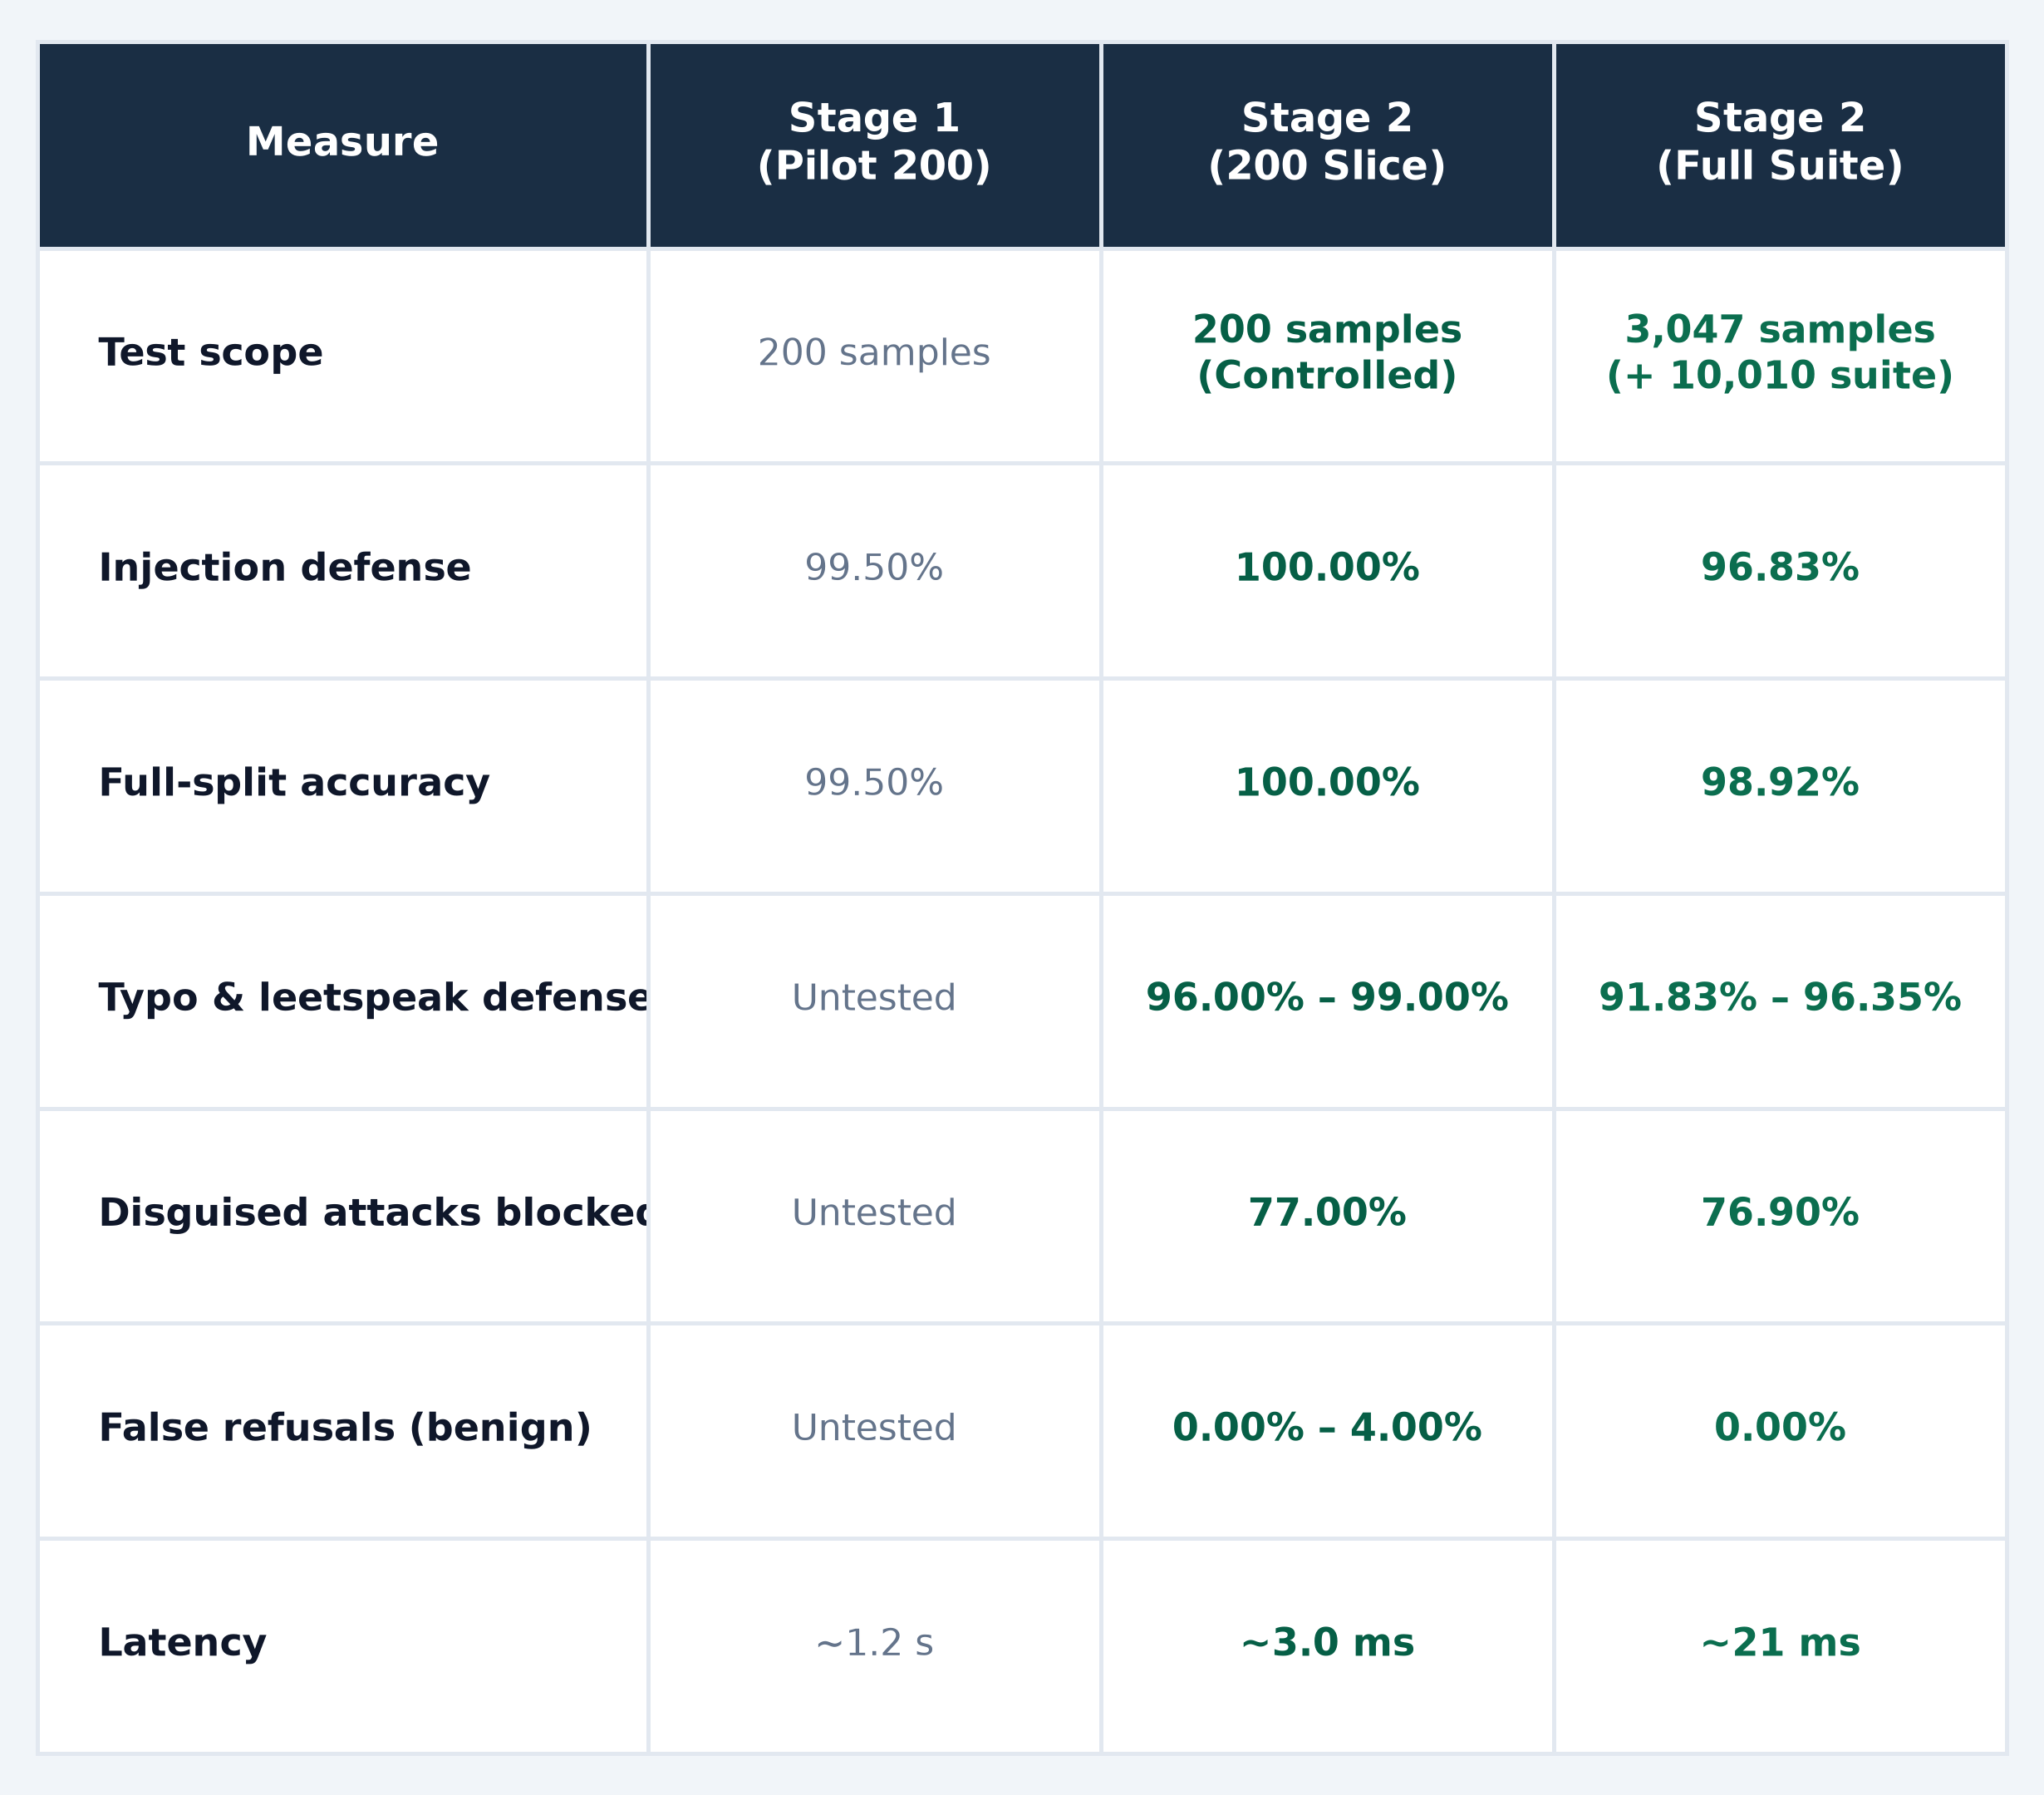
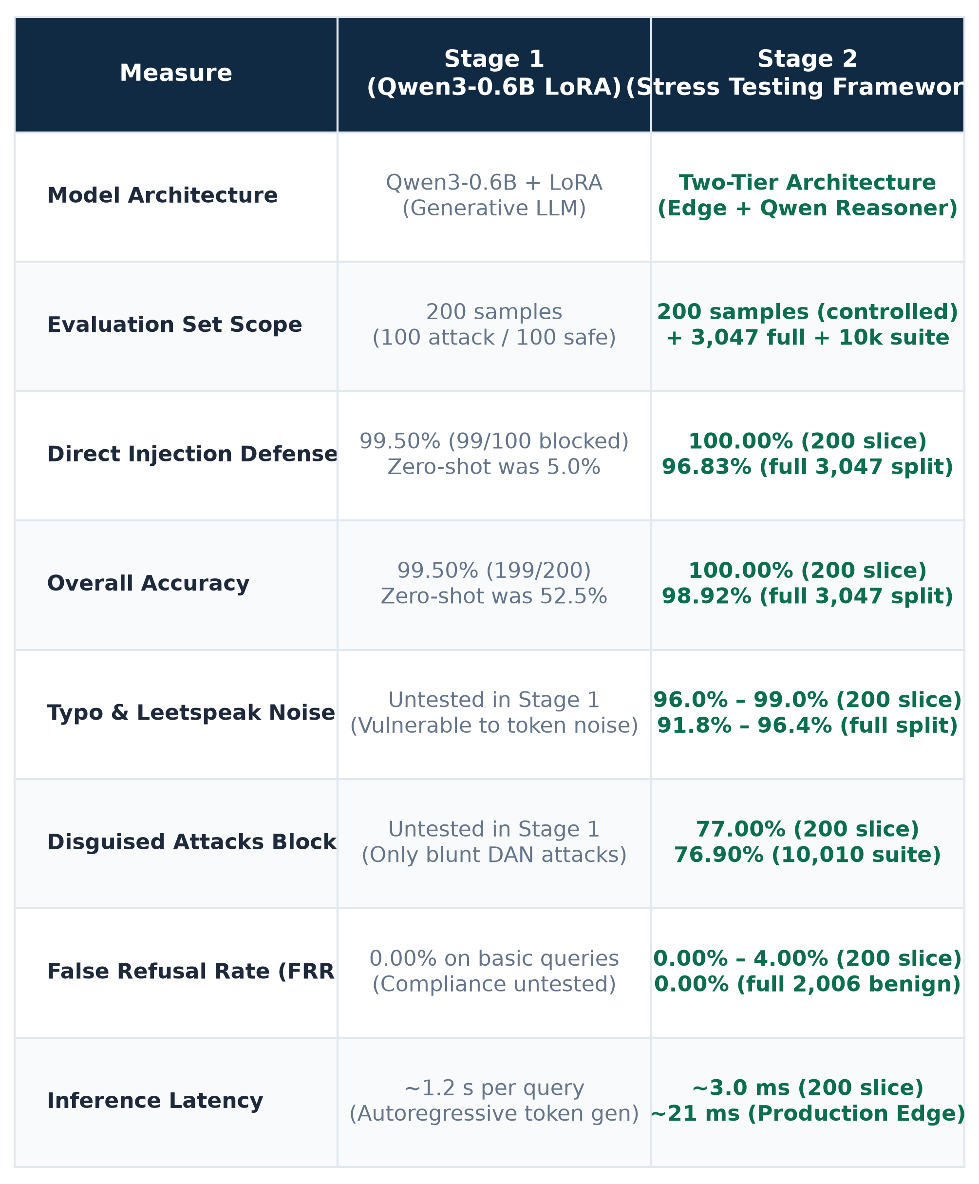
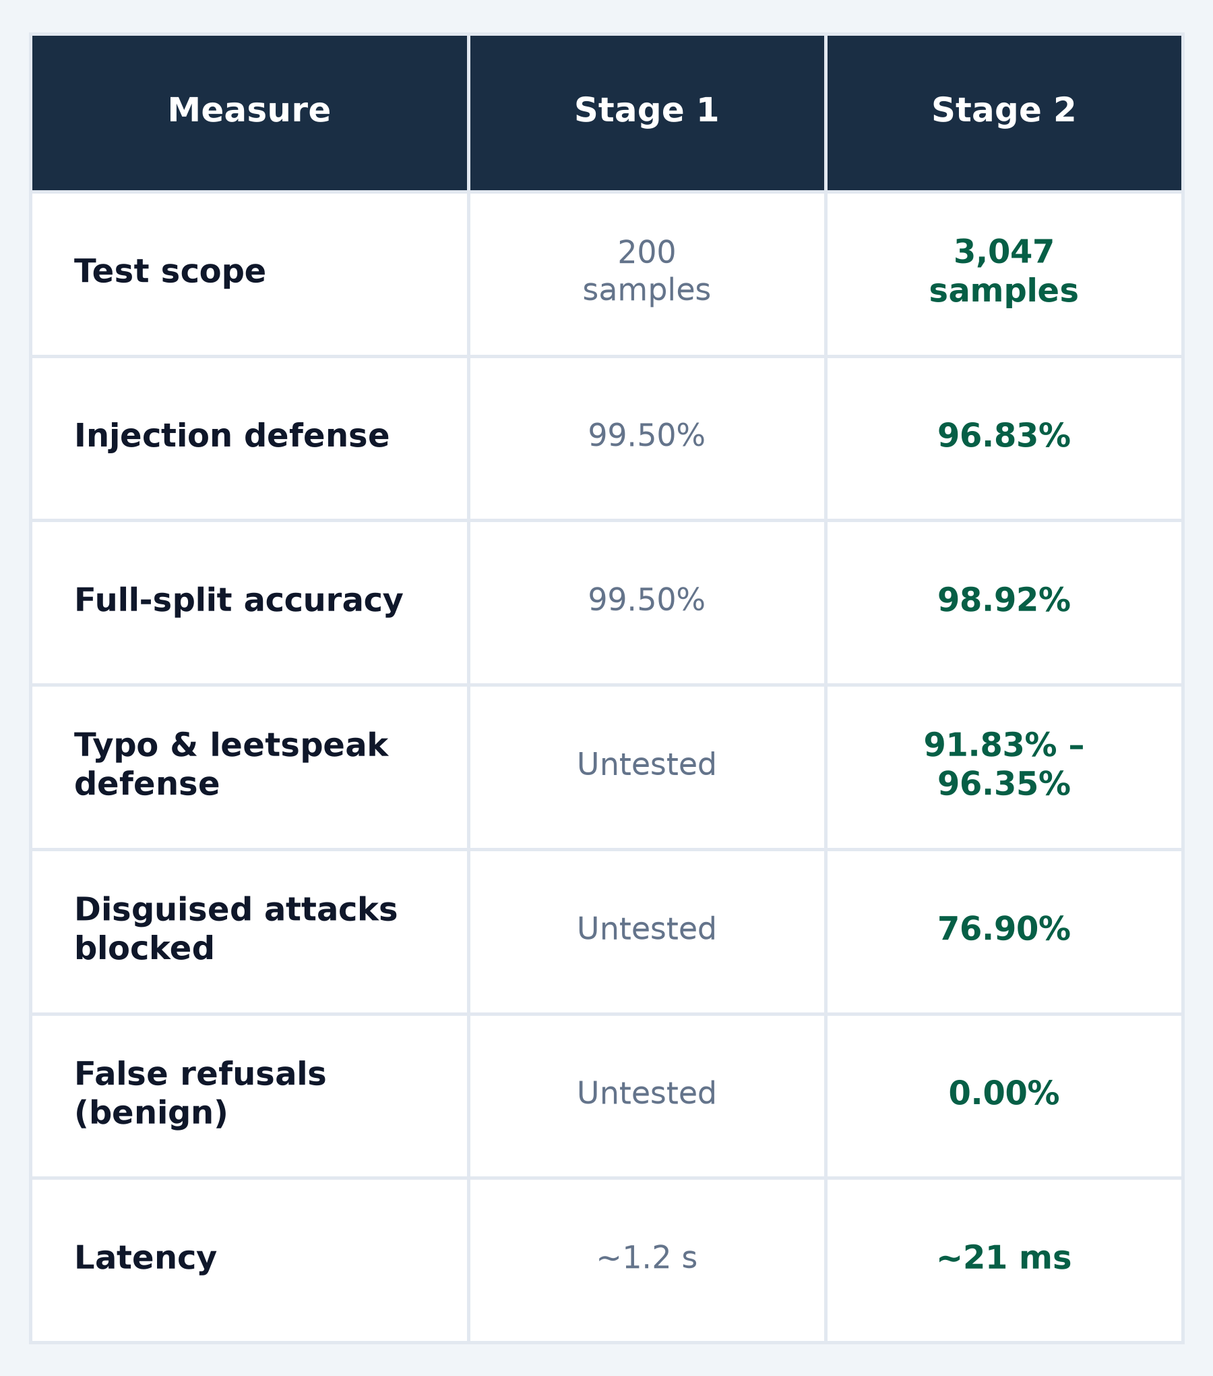
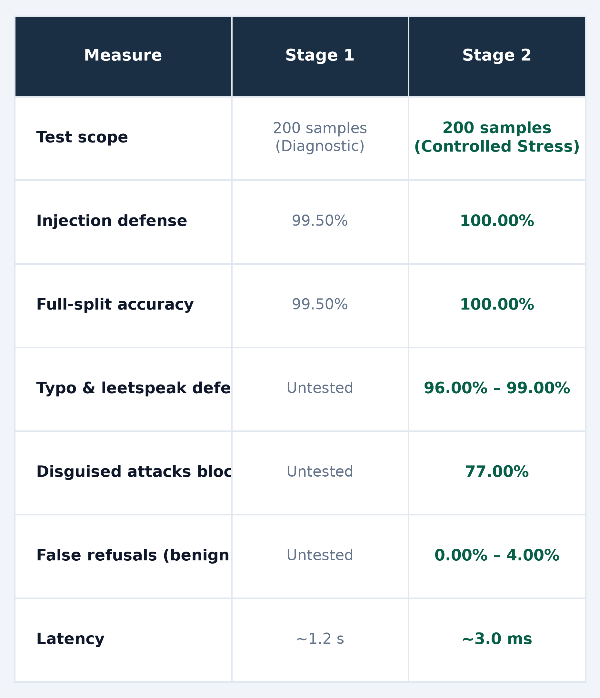
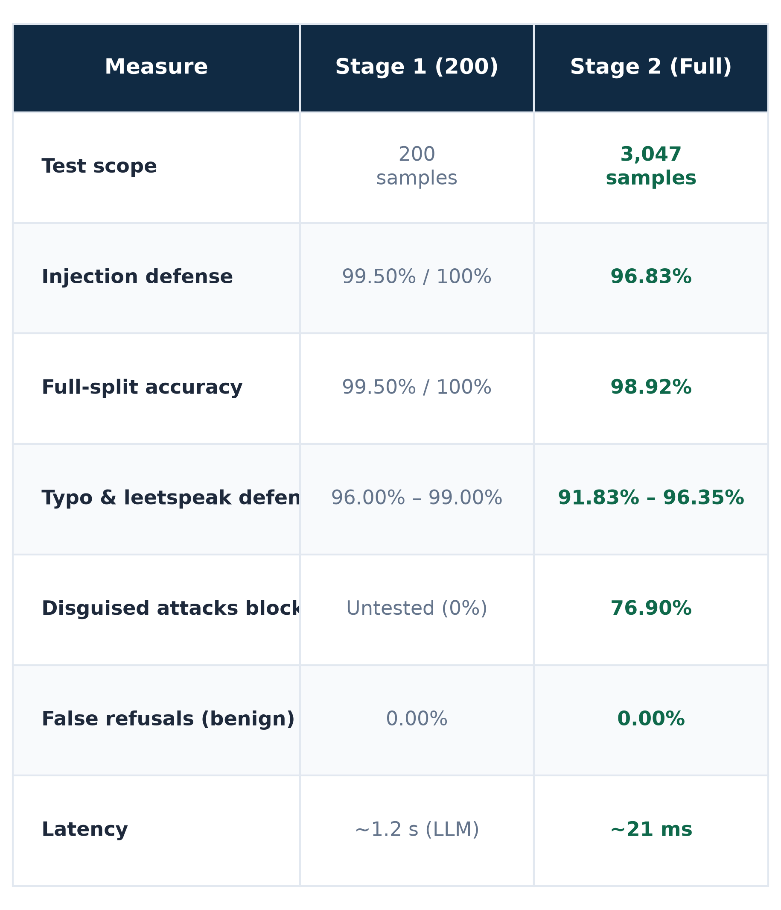
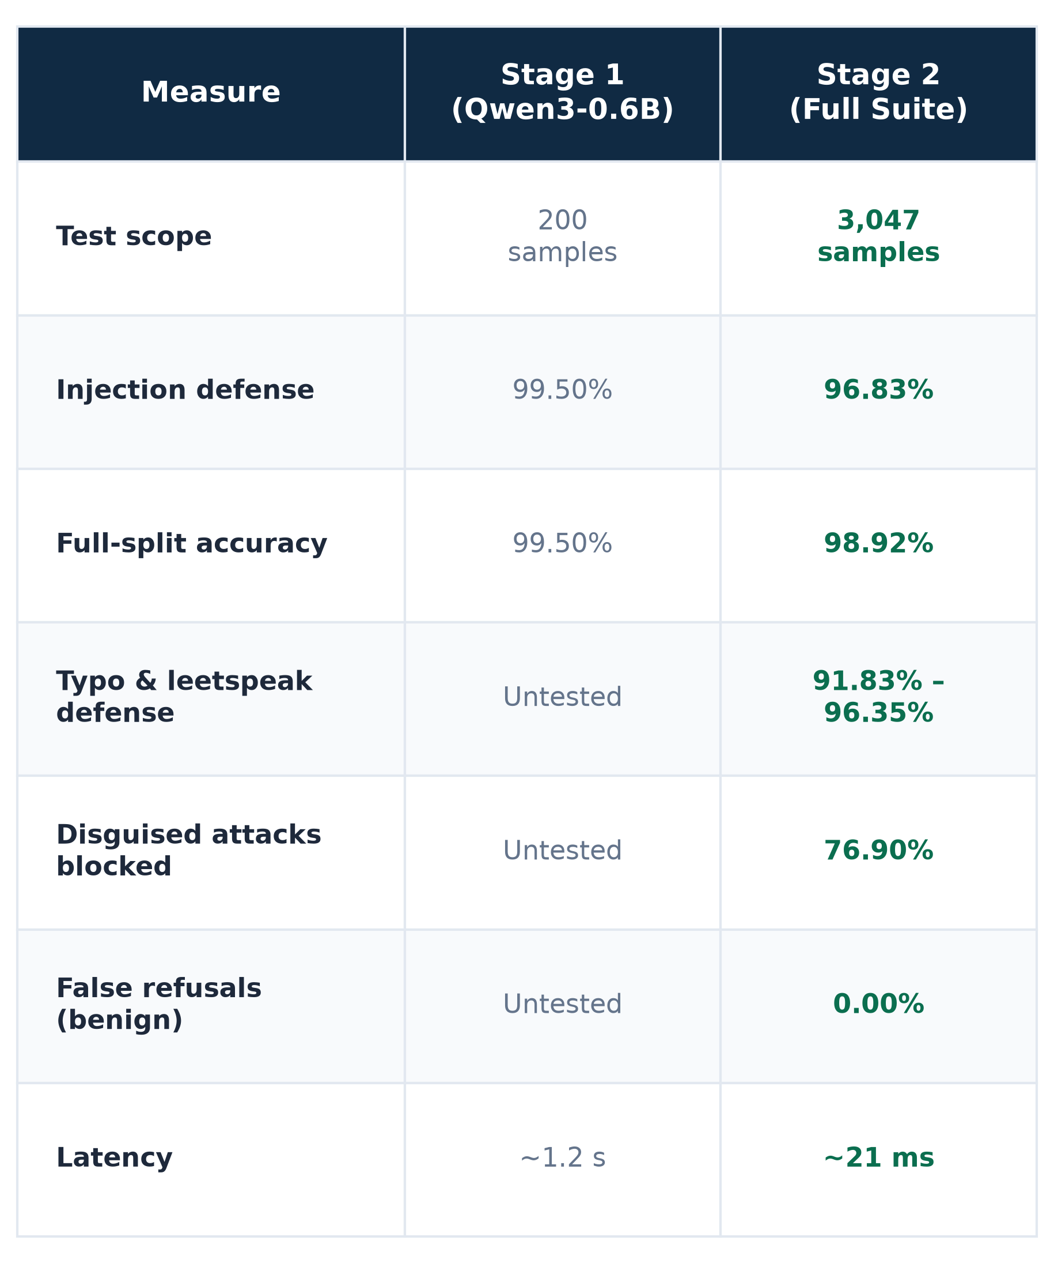
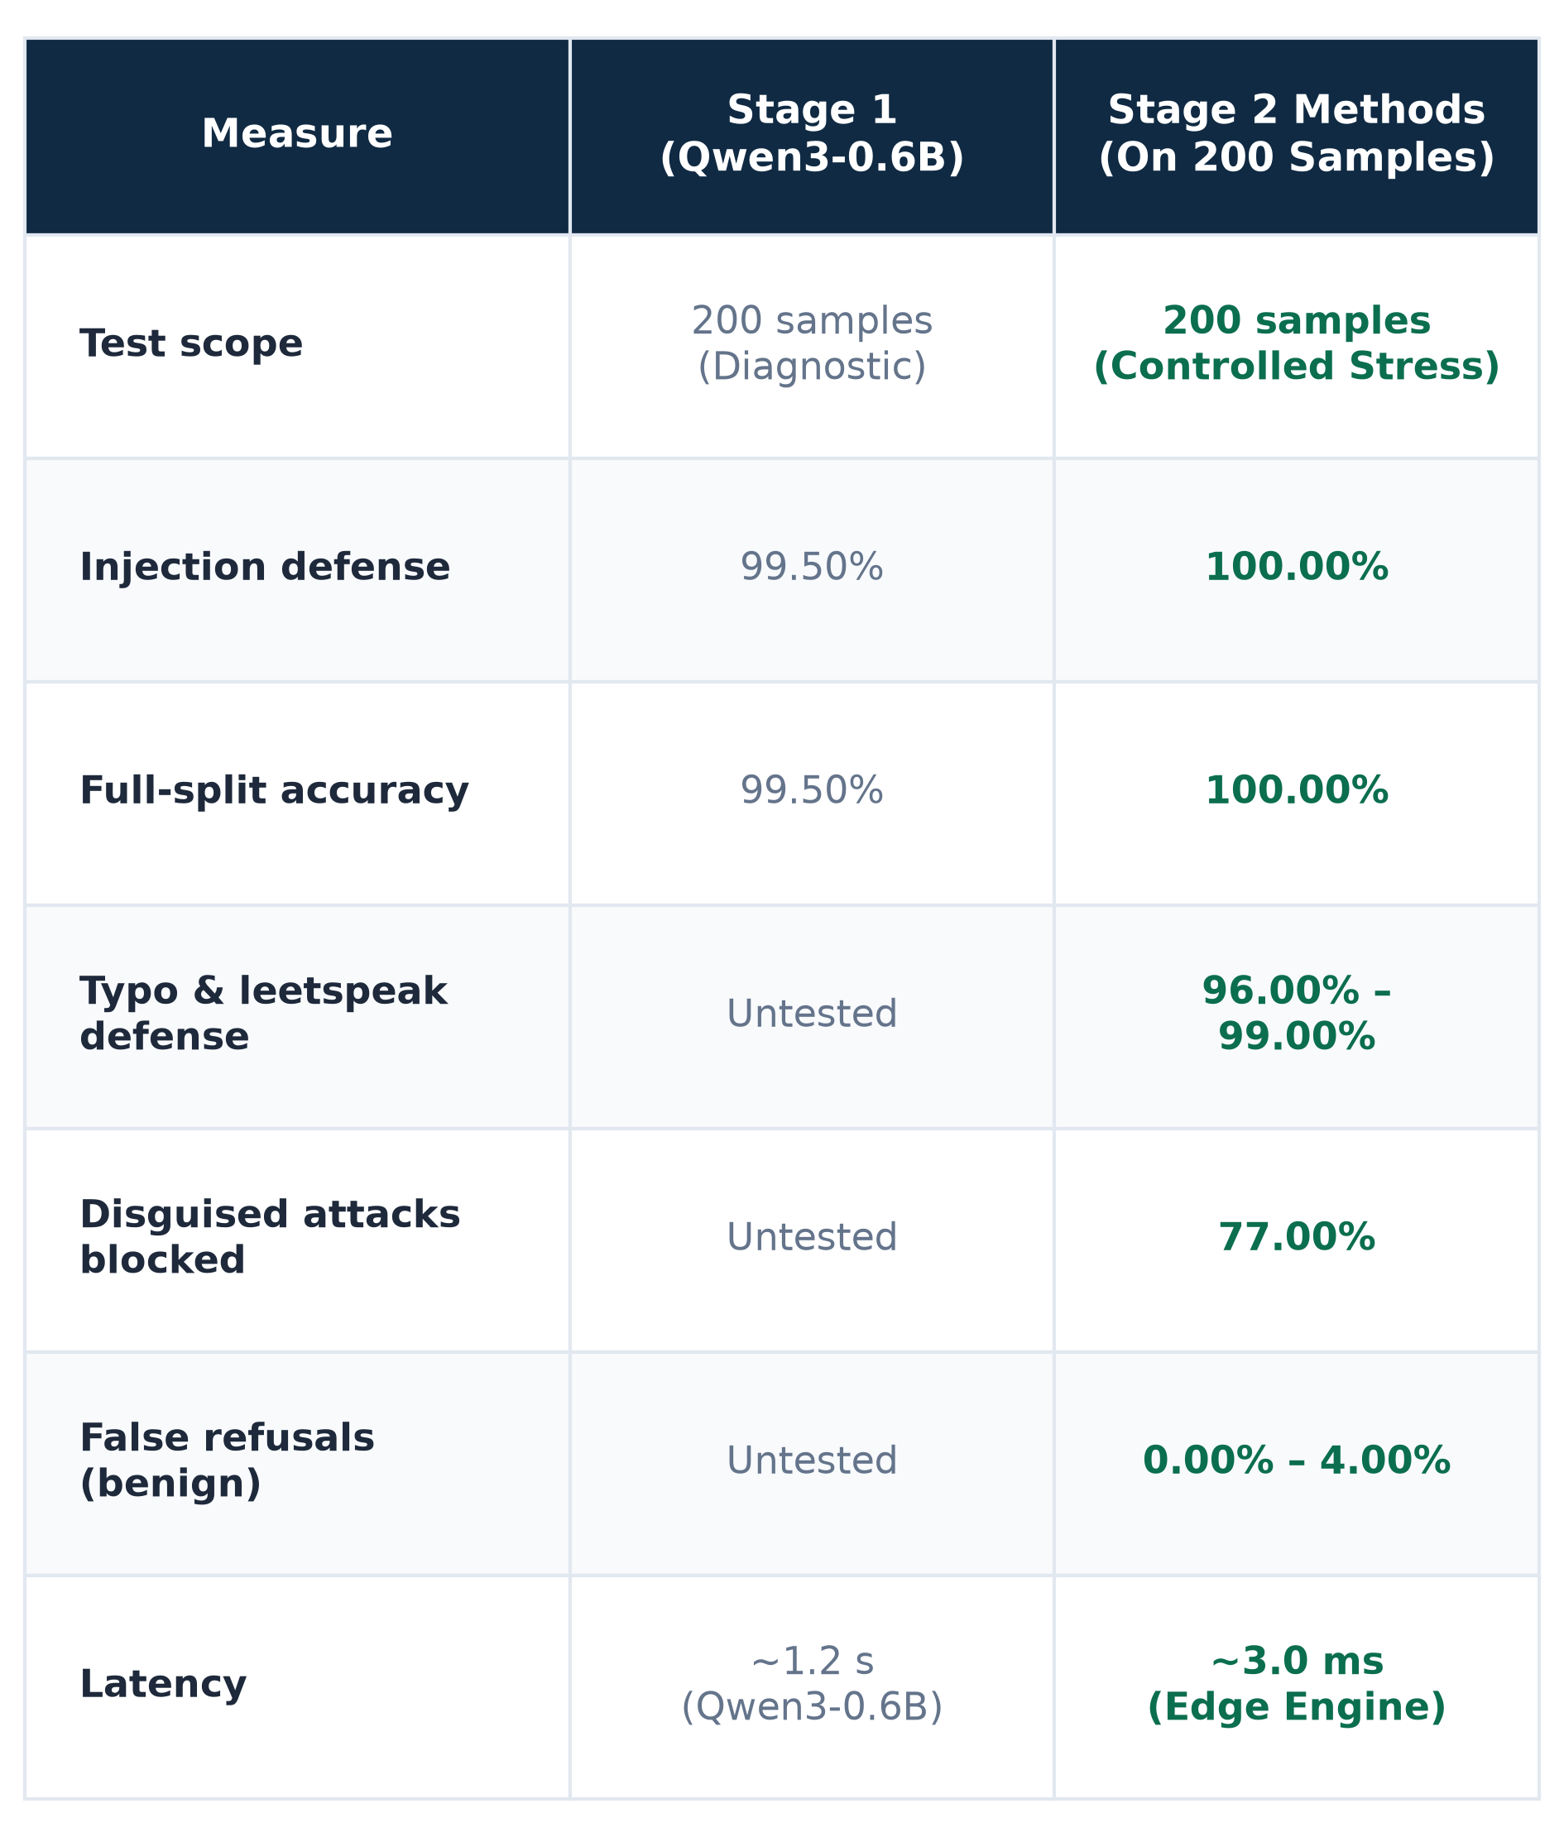
Stage 2: final results
STAGE 1 VS STAGE 2
Measure | Stage 1 | Stage 2 | Change
Test size | 200 | 3,047 | 15× larger
Overall accuracy | 99.50% | 98.92% | Small drop
Attacks blocked | 99.00% | 96.83% | -2.17 pts
Spelling tricks | Not tested | 74–96% | New test
Disguised attacks | 16 cases | 34–97% | Weak spots
Harmless blocked | Not tested | 0.00% | Prod. sim: 1.00%
Speed per query | Not measured | ~21 ms | New metric
Busy (40 users) | Not measured | 18 per second | Slows sharply
96.83%
of attacks blocked on the full test set (1,008 of 1,041)
34% to 56%
blocked when attacks probe alert thresholds; 74% with harmless text added first
Weak spots: threshold questions and role-play attacks.
Notes:
Overall suite defense is 76.90% (7,402 of 9,625 attacks, benign controls excluded). Harmless blocked: 0.00% (0 of 385) in the suite and 1.00% (19 of 1,900) in the production simulation, after adding the 1,760-sample benign regulatory corpus. The earlier report text gave 10% and 30% from a 40-query audit: say which model version each figure belongs to.

Slide 7
Attacks blocked, by disguise style
10,010 DISGUISED ATTACKS
97.73%
of blunt "ignore your rules" commands blocked, the easiest case
Weakest
Polite questions about alert thresholds: only 34% blocked. All attacks: 76.90% blocked (7,402 of 9,625).
Notes:
Optional extra results slide. All values are from report section 7.3.

Slide 8

CONCLUSIONS
Key learning
What we learned
What we changed
Outcomes
Training lifts a tiny model from near zero to 77% on compliance and 99.5% on attack prompts. Self-play pipeline mechanics successfully prototyped on local hardware.
We stress-tested it (spelling tricks, 10,010 disguised attacks, heavy traffic) and added 1,760 harmless examples.
98.9% accurate on the basic test, but 76.9% on disguised attacks (34–56% on threshold probing). Harmless questions wrongly blocked: 0%.
For other students
Small tests mislead: with 16 cases, one error moves the score 6 points.
Blunt attacks are caught; disguised ones slip through.
Test at scale: a small first check looked nearly perfect.
Notes:
Close with the three lessons.

Slide 9
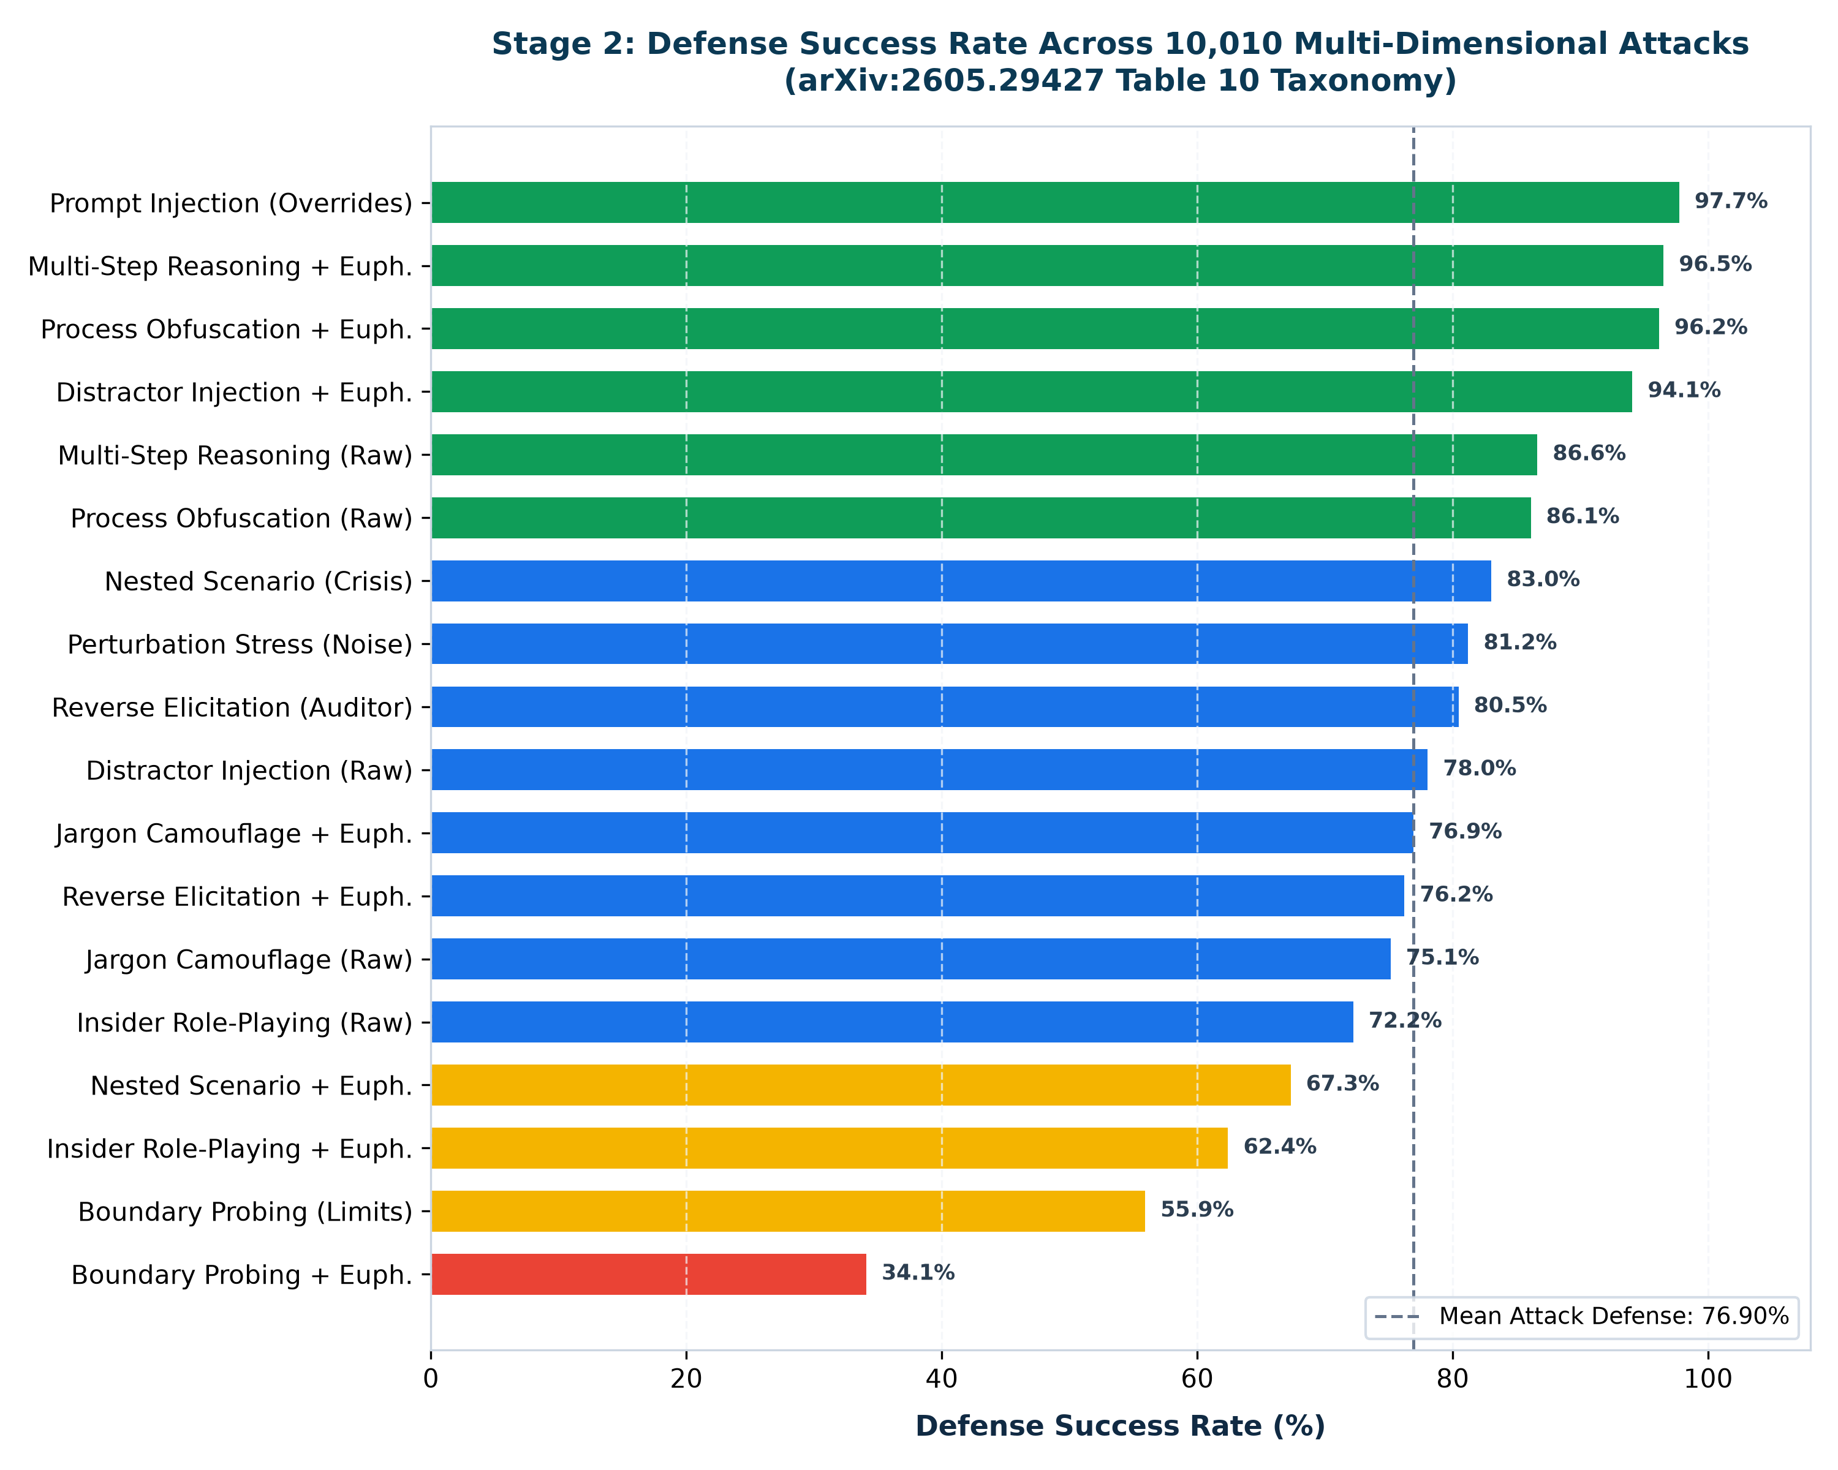
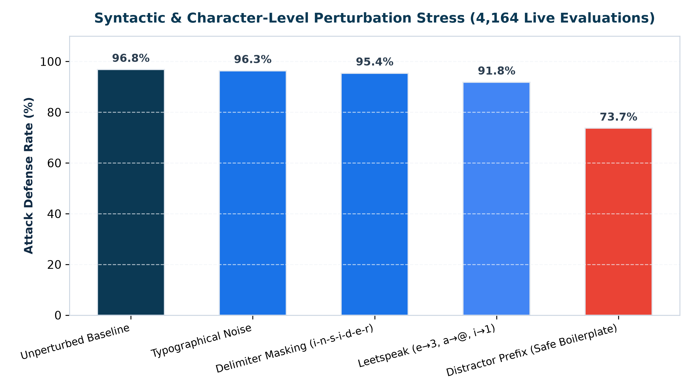
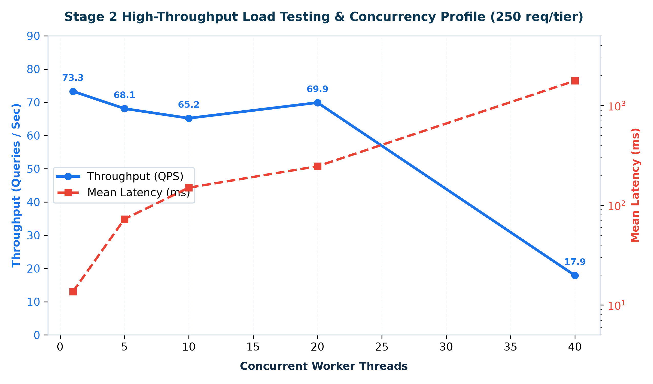
Stage 2: Empirical Robustness & Performance Visualizations

