Slide 1
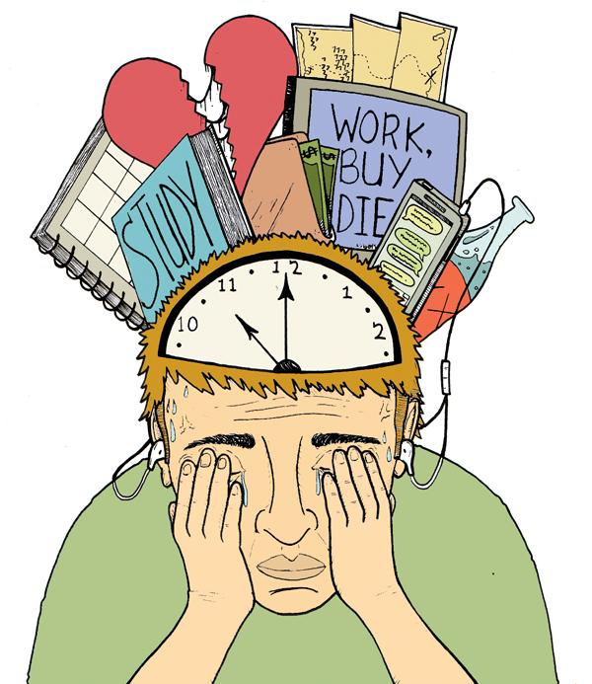

CAUSES OF STRESS AMONGST COLLEGE STUDENTS

Slide 2
INTRODUCTION
WHAT IS STRESS?
Stress is your body’s reaction to pressure from a certain situation or event. It can be a physical, mental, or emotional reaction.
We all deal with stress at some point in our lives. Maybe it’s the career, interpersonal relationships and financial issues etc. These are common triggers.
Not all stress is bad. It can make you more aware of things around you and keep you more focused. In some cases stress can give you strength and help you get more done.

Slide 3
ACUTE STRESS
Sometimes you can feel stressed for a short period of time. Usually it’s nothing to worry about. Like when you need to hand in a project, or you have to talk in front of a group of people. Maybe you feel “butterflies” in your stomach and the palms of your hands get sweaty.
These types of positive stressors are short-lived, and your body’s way of helping you, get through what could be a tough situation.

Slide 4
CHRONIC STRESS
If you let your stress spiral on for too long, it can have damaging effects on your physical, mental, and emotional health, especially if it becomes chronic. You need to be aware of the warning signs of chronic stress so you can take care of it.
Physical effects of chronic stress include:
Headache, Trouble sleeping or sleeping too much, Muscle pain or tension etc.
Emotional effects of chronic stress include:
Feeling you can’t get things done, moodiness, Anxiety, restlessness, lack of motivation, irritability etc.
Signs of stress overload include:
Panic attacks, feeling you’re under constant pressure, drinking, smoking or doing drugs, overeating, depression, withdrawal from family and friends etc.

Slide 5
A STUDY OF STRESS SOURCES AMONG COLLEGE STUDENTS IN TAIWAN
REF- Journal of Academic and Business Ethics
LITERATURE REVIEW
This paper was to investigate the sources of stress among college students in Taiwan. A questionnaire survey was conducted to collect research data. Research findings suggested that male students feel stronger stress from family factor than female ones; students in higher grades feel more stress from physical/mental, school, and emotional factors; students who take a student loan also feel more stress from physical/mental, school, and emotional factors than those who do not. 50.9% thought that their depression is caused by interpersonal relations. Among the causes of suicide or self-injury, relationship problems are the leading cause, followed by depression and academic stress. Thus, stress is the primary cause of suicide (or self-injury) among college/university students.

Slide 6
SOURCES OF STRESS AMONG COLLEGE STUDENTS
REF- CVCITC Research Journal
LITERATURE REVIEW
There are common stressors that affect college students: intrapersonal, interpersonal, academic and environmental stressors. The focus of this study is on the pressures affecting the college student in dealing with family, friends and significant persons. College students are prone to stress because of their transitional nature of adjustment to the rudiments of higher education program. This means that a sudden change of a secondary school environment that lacks the use of modern technology to the highly cognition level of learning resulted to stressful situations. As a result, they hardly comprehend with new lessons in classroom and experience cultural differences. To survive in the college environment, they need to cope with the standards of higher education – the fast-paced teaching-learning conditions and procedures. Earning high grades is a source of stress that affects them.

Slide 7
Perceived Academic Stress among Undergraduate Students in a Nigerian University
REF- Journal of Educational and Social Research
INTRODUCTION
The purpose of the study was to investigate the levels of perceived academic stress among undergraduate students in a University in Nigeria. Stress may be defined as any factor acting externally or internally, which makes adaptation to environment difficult and which induces increased effort on the part of the individual to maintain a state of equilibrium between self and the external environment. Academic stress refers to the unpleasant situations that occur due to the many demands made on the student in the form of examinations, maintaining healthy and academic, competing with peers, meeting the academic expectations of teachers and parents as well as own academic expectations. Stress is an unavoidable phenomenon in students’ lives.

Slide 8
METHODOLOGY
The study is done through quantitative research method.
Quantitative research is the process of collecting and analyzing numerical data. This type of research collects information from potential audience using sampling methods and sending out online surveys, online polls, questionnaire etc. This method collects quick, reliable and accurate data. There is wider scope of data analysis.

Slide 9
In carrying out this research, data were collected from 50 students through survey by making a suitable questionnaire ( google form). There were total 7 statements and the students were supposed to provide data about their age, location and gender also.
The responses were based on 5 options:
Strongly disagree
Disagree
Neutral
Agree
Strongly agree
Prior to obtaining consent, the purpose of the study was communicated well in advance to ensure that the students’ participation in the research was voluntary.

Slide 10
PURPOSE- CAUSES OF STRESS AMONGST COLLEGE STUDENTS
Students suffer from stress because of the ACADEMIC PRESSURE whereby they are involved in tackling very difficult assignment. Also parents and teachers exert a lot of pressure on student to perform better. This makes them to work tirelessly; a situation that ends up creating stress.
Some students find it difficult to accept the fact that they are moving to college, as the ENVIRONMENT there is very different from that of school. This even causes home sicknesses among the majority of the students.

Slide 11
PEER RELATIONSHIPS; have been considered to cause stress, as they apply huge amount of pressure on behaviour, dressing code, music choice of friends among other factors.
FINANCIAL STRESS; Research indicates that students also get stressed because of lack of money. They tend to worry more about raising money for their tuition fee and scholarships.
UNHEALTHY COMPETITION; When the healthy competition among students turns unhealthy which raises eyebrow that brings feelings of resentment and jealousy ends up adding stress to the student.

Slide 12
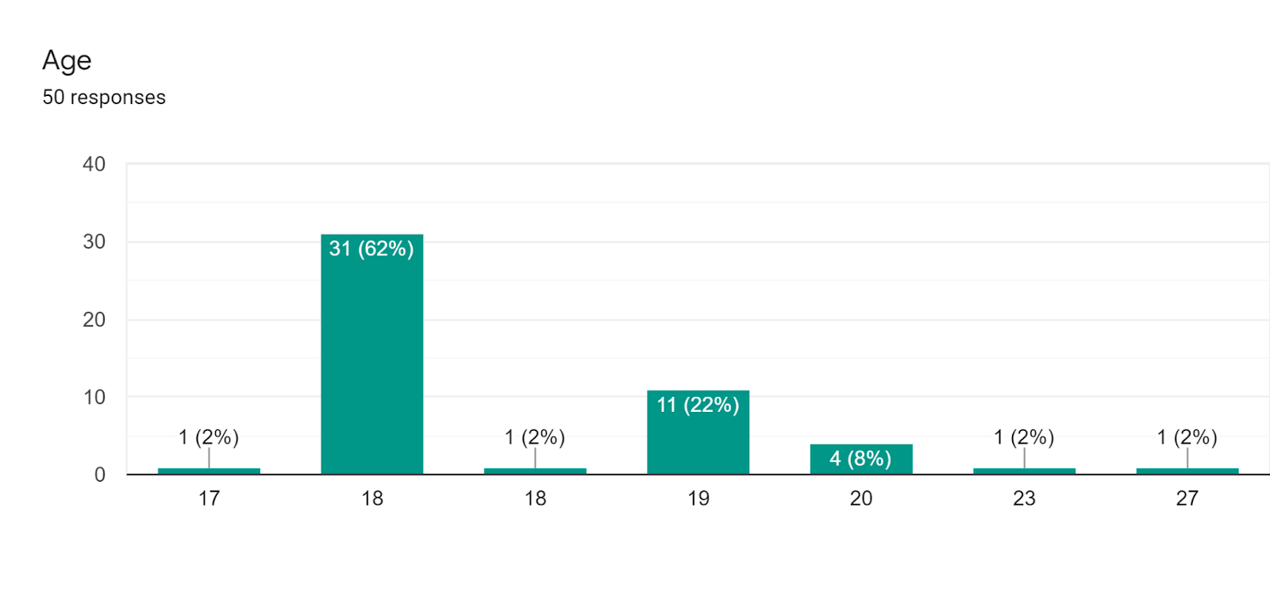
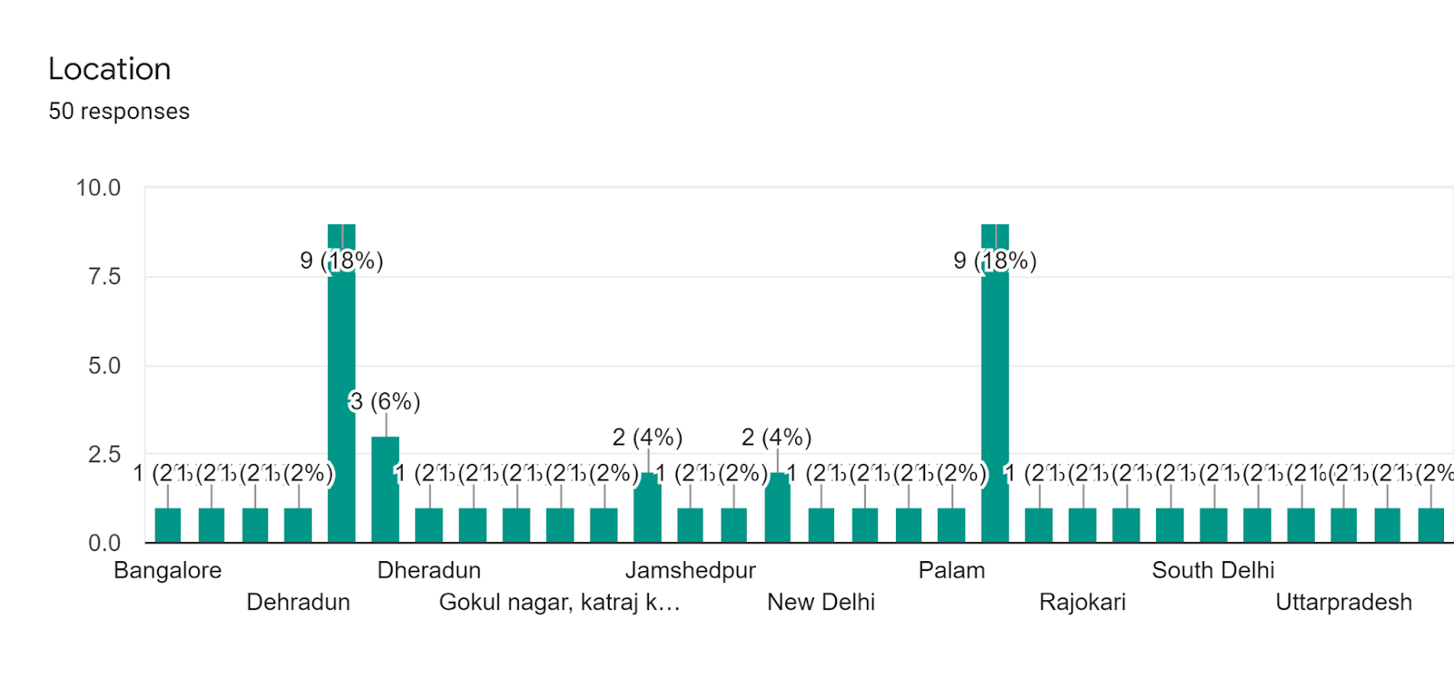
RESULT

Slide 13
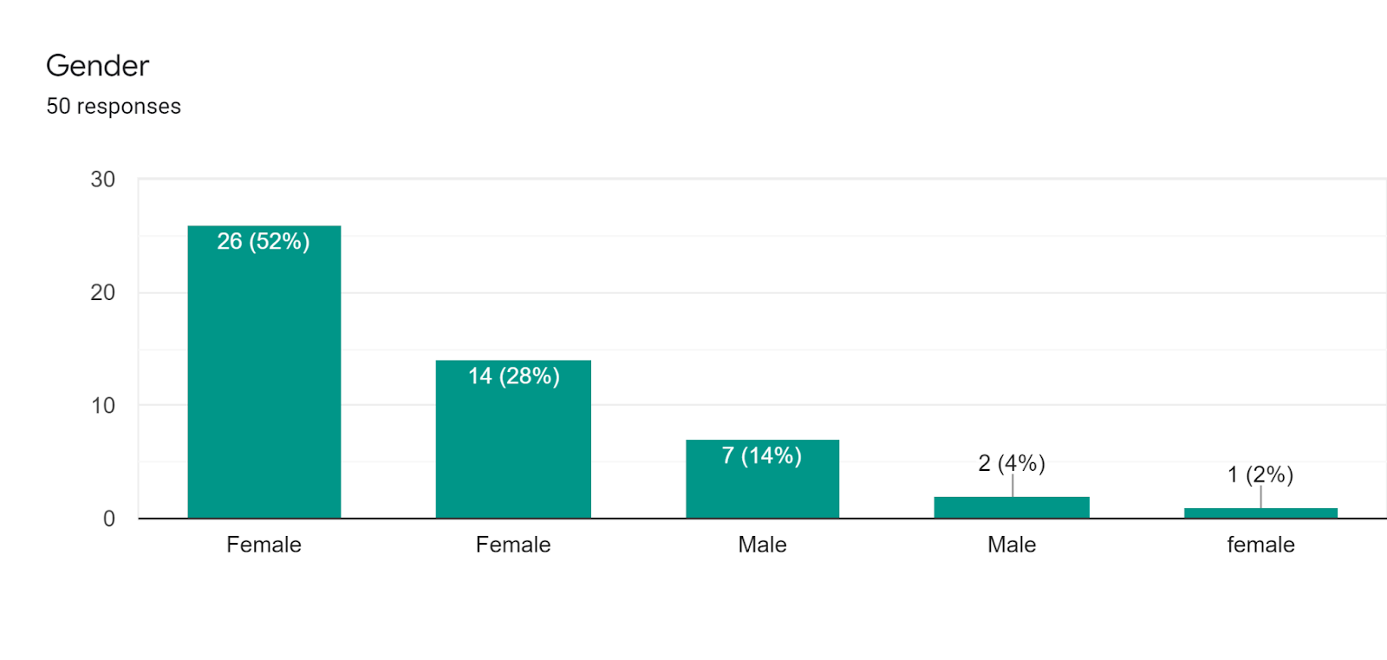
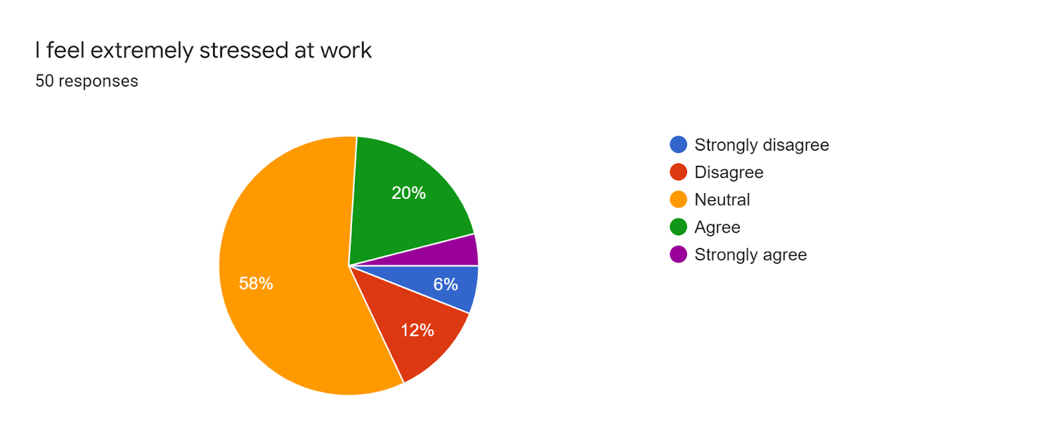

Slide 14
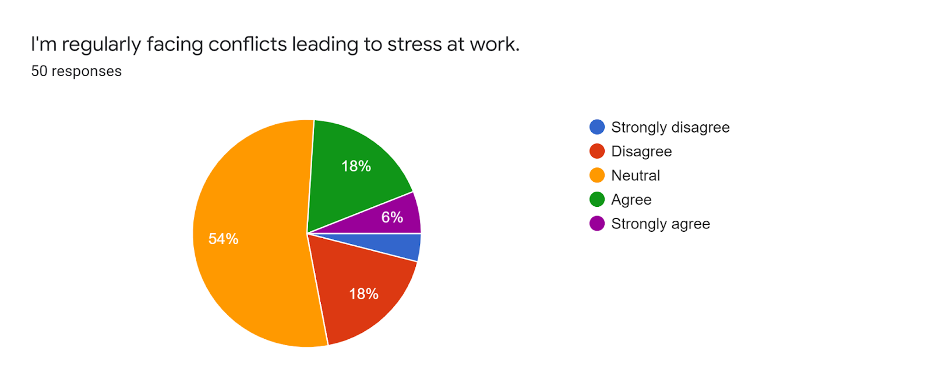
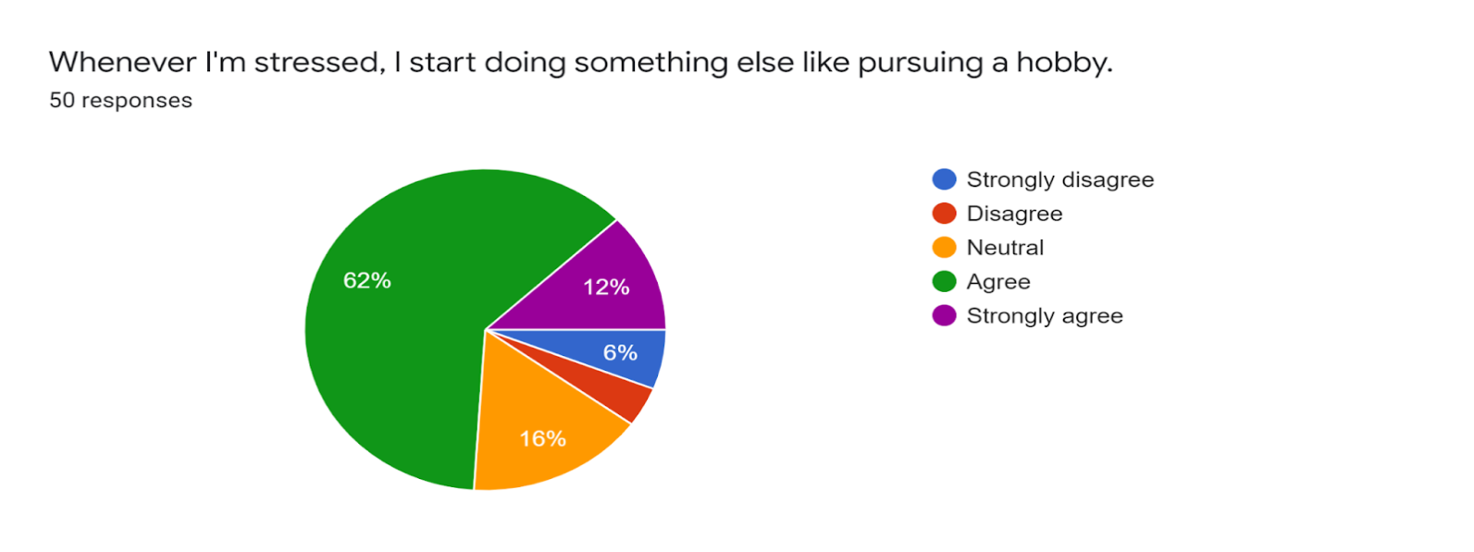

Slide 15
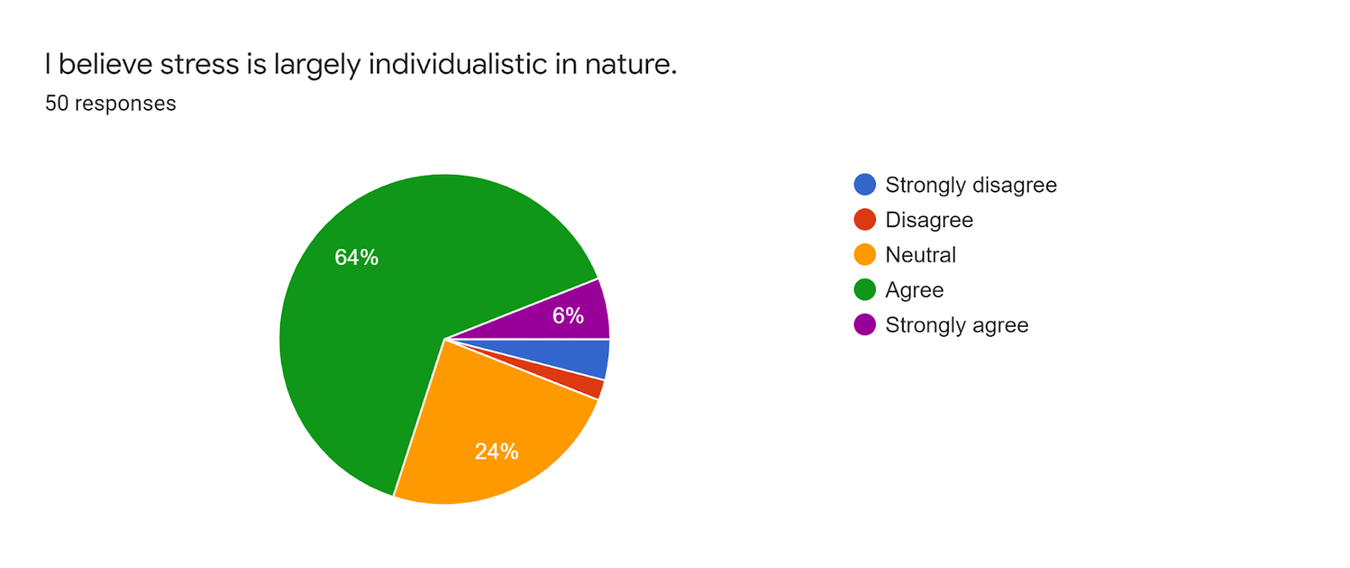
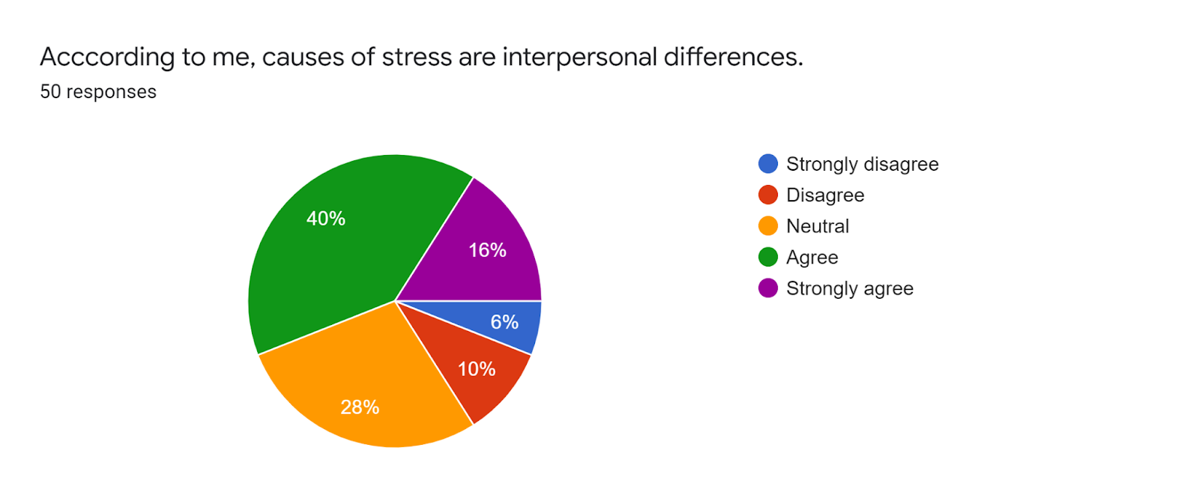

Slide 16
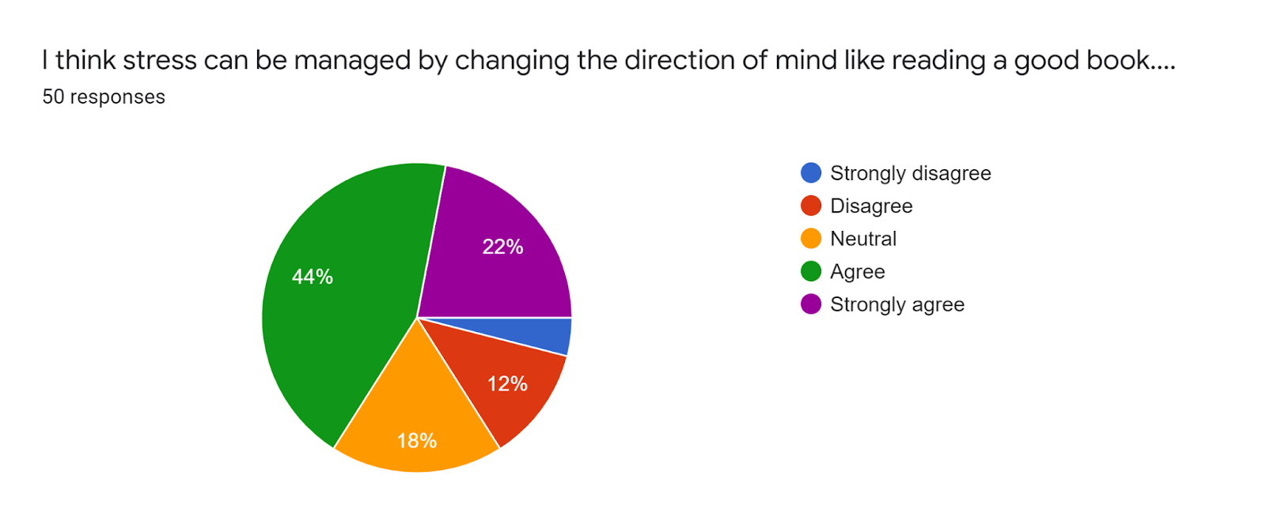
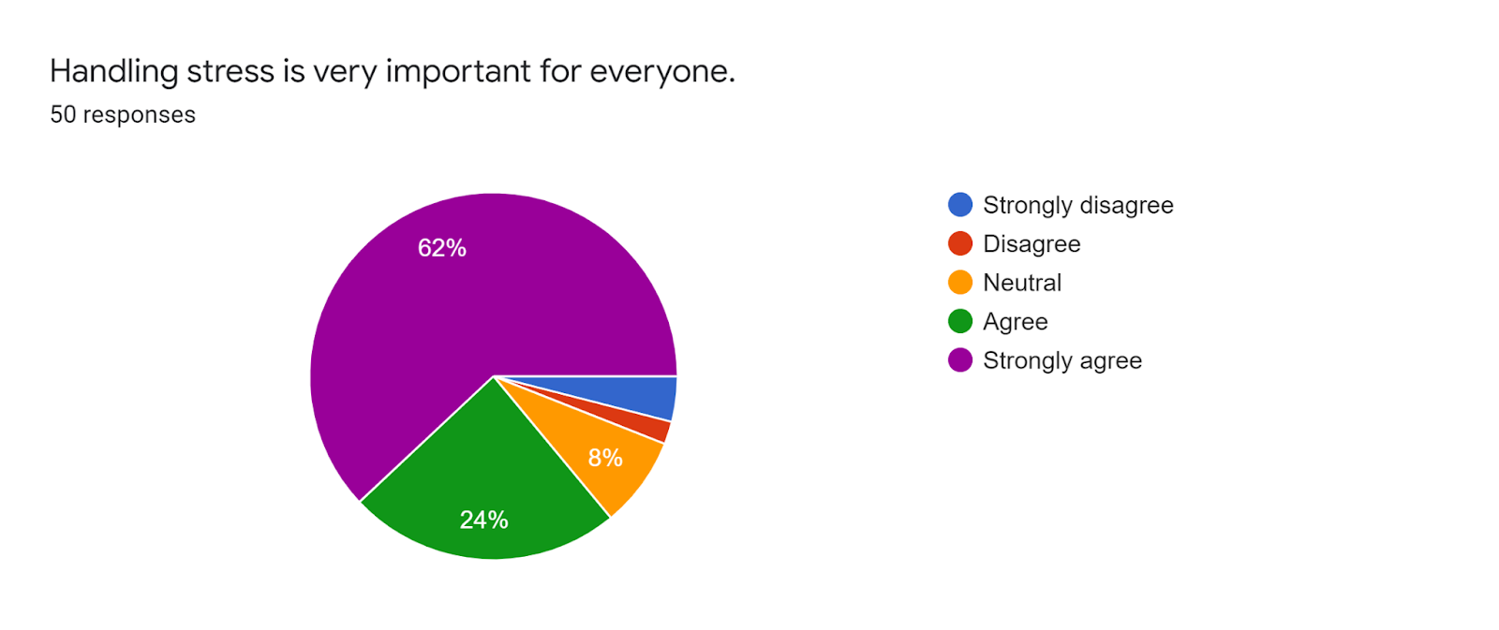

Slide 17
CONCLUSION
The following observations were made through survey:
Majority students were from New Delhi.
There were total 41 females and 9 males whose response were recorded.
Majority students were 18 years old whereas the minority were of age 17, 23 and 27.
20% of the population in the survey felt extremely stressed at work.
18% were facing conflicts leading to stress at work.
62% agreed with pursuing a hobby when stressed.
64% believed stress is largely individualistic in nature.
40% felt stress was caused by interpersonal differences.
62% believed, handling stress is very important for everyone.

Slide 18
BIBLIOGRAPHY
https://www.smulweb.nl/blog/post/18-common-causes-stress-students
https://www.questionpro.com/blog/quantitative-research/
https://scholar.google.com/
Stress - Why It Happens and Common Causes (webmd.com)

Slide 19
THANK YOU

