Slide 1


JUMBLED WORDS
LEVEL: BEGINNER

Slide 2
INSTRUCTIONS
All the words in this game are related to the basics of database.
Before the time gets up “NOTE THE ANSWER YOU HAVE GOT”.
Note the answers in a sequence.
KINDLY FOLLOW THE ABOVE RULES AS IT WILL HELP YOU TO GO TO THE NEXT LEVEL

Slide 3


UETLP
HINT :- It is used to refer a row of a table

Slide 4
UOCMNL
HINT :- It is also known as an attribute or a field.

Slide 5
TYTEIN
HINT :- It is an object that exists.

Slide 6
SEYK
HINT :- Primary, super, candidate, foreign are some of its examples.

Slide 7
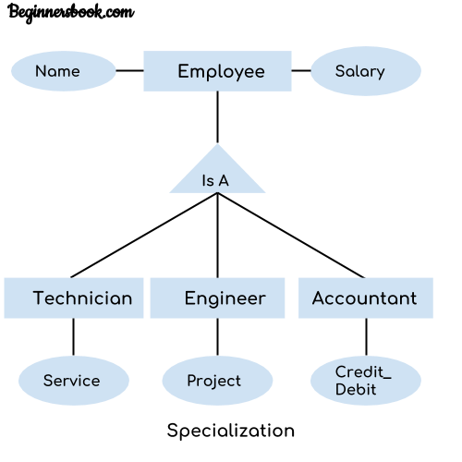
OTZLPCEISAIAN
HINT :-

Slide 8
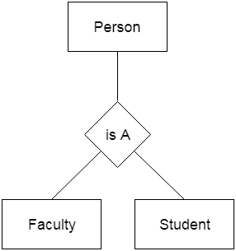
OIIZENGERALATN
HINT :-
HINT :-

Slide 9

CONGRATULATIONSS!! U HAVE SUCCESSFULLY CLEARED THIS LEVEL!
Now we hope that you have noted the answers sequentially.
Here is your code for the next level:
1st letter of each word.
Followed by 123
THIS CODE HAS TO BE ENTERED IN THE SPACE
PROVIDED IN CODE HUB FOR LEVEL 1.
BEST OF LUCK!!

