Slide 1
Setting up the Lab
(AWS/GCP & Terraform)

Slide 2
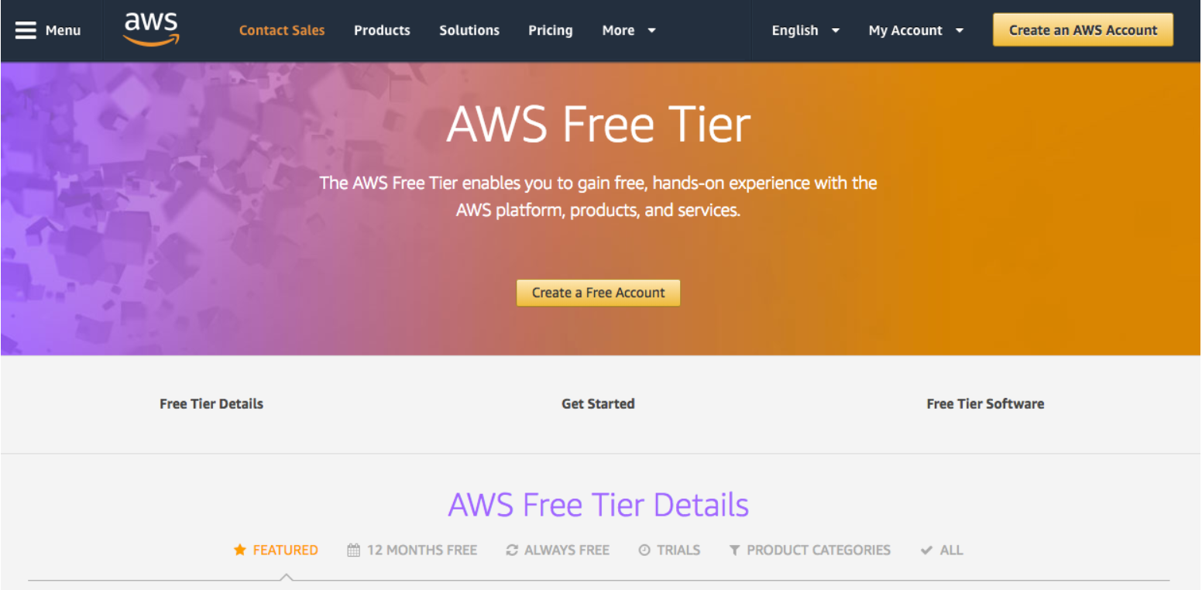
Setting up LAB
Create a new AWS Account.
Begin the course

