Slide 1
Terraform variables
Session 9

Slide 2
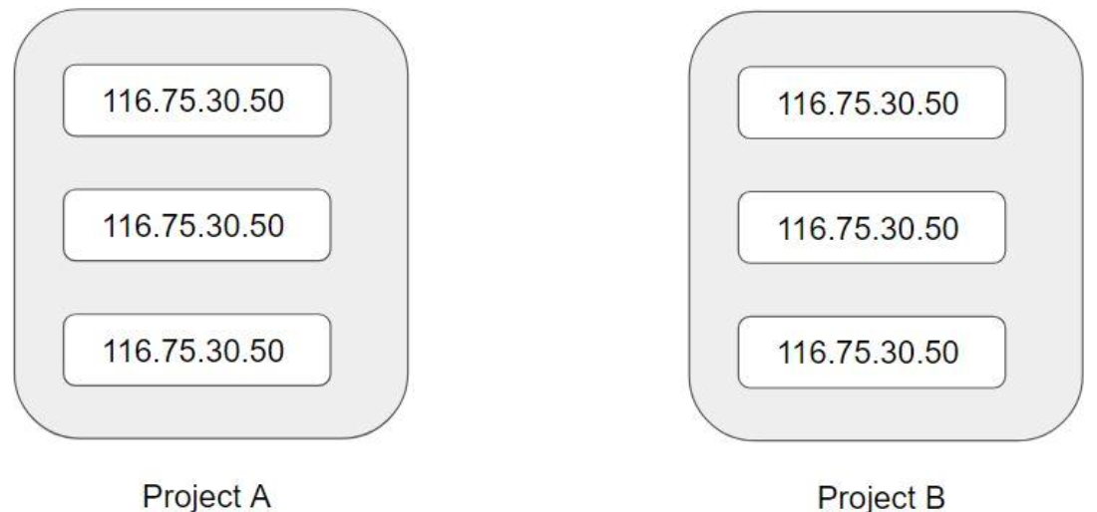
Terraform variables
Repeated static values can create more work in the future.

Slide 3
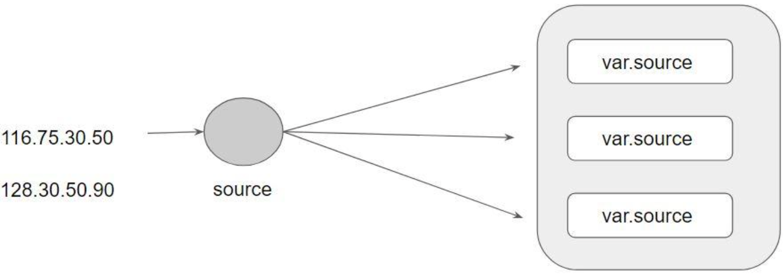
Terraform Variables
Terraform Variables allows us to centrally define the values that can be used in multiple terraform configuration blocks.

Slide 4
Approach for Variable Assignment
Variables in Terraform can be assigned values in multiple ways.
Some of these include:
Environment variables
Command Line Flags
From a File
Variable Defaults

Slide 5
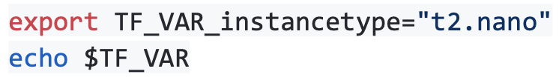
Environment Variables
Environment Variables:

Slide 6
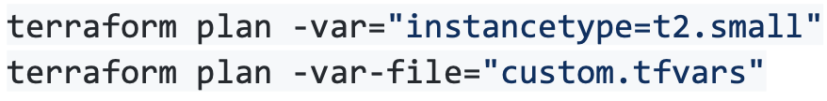
Command Line Flags
Command Line Flags:

Slide 7

Terraform.tfvars
From a File (terraform.tfvars)

Slide 8
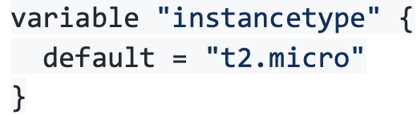
Variable Defaults
Variable Defaults:

