Slide 1
Providers and Resources
Day 2

Slide 2
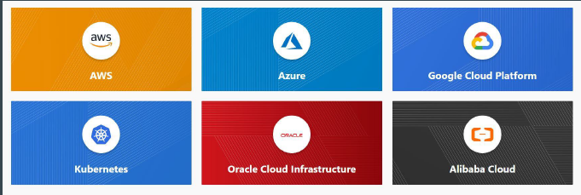
Basics of Providers
Terraform supports multiple providers.
Depending on what type of infrastructure we want to launch, we have to use appropriate providers accordingly.

Slide 3
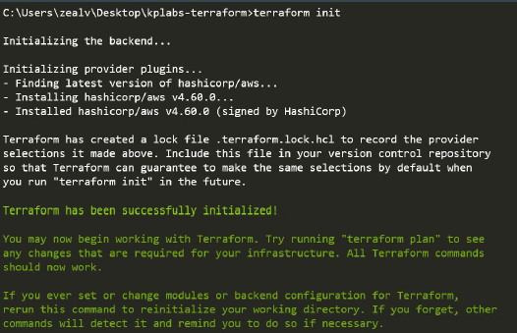
Learning 1 - Provider Plugins
A provider is a plugin that lets Terraform manage an external API.
When we run terraform init, plugins required for the provider are automatically downloaded and saved locally to a .terraform directory.

Slide 4
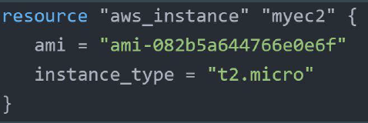
Learning 2 - Resource
Resource block describes one or more infrastructure objects
Example:
● resource aws_instance
● resource aws_alb
● resource iam_user
● resource digitalocean_droplet

Slide 5
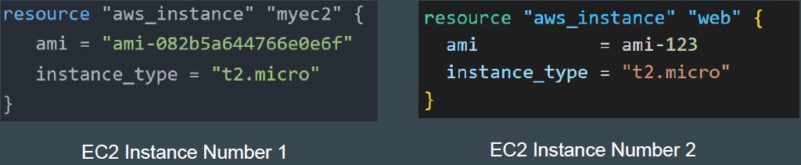
Learning 3 - Resource Blocks
A resource block declares a resource of a given type ("aws_instance") with a given local name ("myec2").
Resource type and Name together serve as an identifier for a given resource and so must be unique.

Slide 6
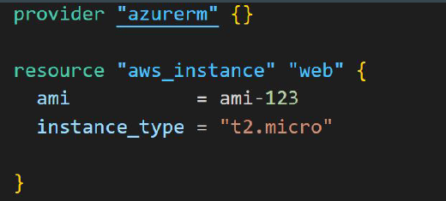
Point to Note
You can only use the resource that are supported by a specific provider.
In the below example, provider of Azure is used with resource of aws_instance

