Slide 1
Deploying Infrastructure with Terraform
(Create First EC2 instance)

Slide 2
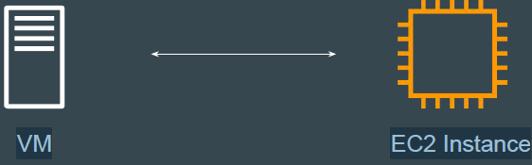
Revising the Basics of EC2
EC2 stands for Elastic Compute Cloud.
In-short, it's a name for a virtual server that you launch in AWS.

Slide 3
First EC2 Instance
When you want to launch a resource in AWS, there are three important considerations.
How will you authenticate to AWS?
Which region the resource needs to be launched.
Which resource you want to launch.

Slide 4
Basics of Authentication and Authorization
Authentication is the process of verifying who a user is.
Authorization is the process of verifying what they have access to
Example:
Alice is a user in AWS with no access to any service.

Slide 5
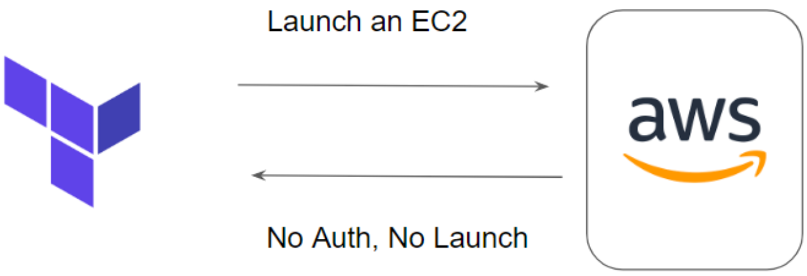

Slide 6
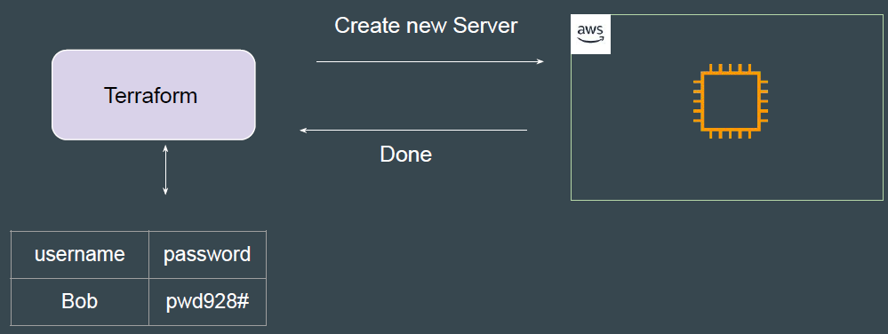
Terraform needs access credentials with relevant permissions to create and manage the environments.

Slide 7
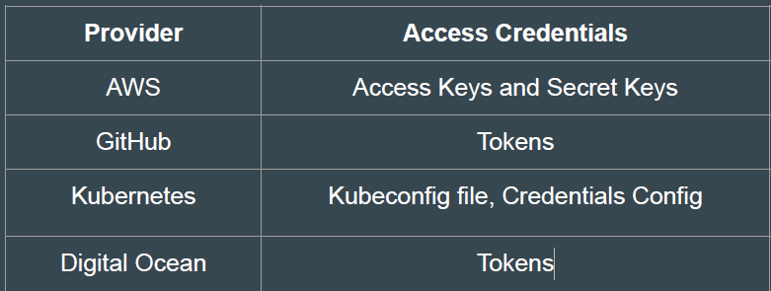
Access Credentials
Depending on the provider, the type of access credentials would change.

Slide 8
Virtual Machine Configuration
A Virtual Machine would have it’s own set of configurations.
● CPU
● Memory
● Storage
● Operating System
While creating VM through Terraform, you will need to define these.

