Slide 1
State File
TF state file

Slide 2
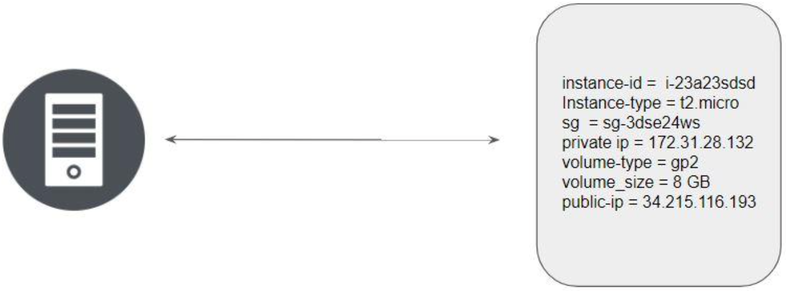
Overview of State Files:
Terraform stores the state of the infrastructure that is being created from the TF files.
This state allows terraform to map real-world resources to your existing configuration.

Slide 3
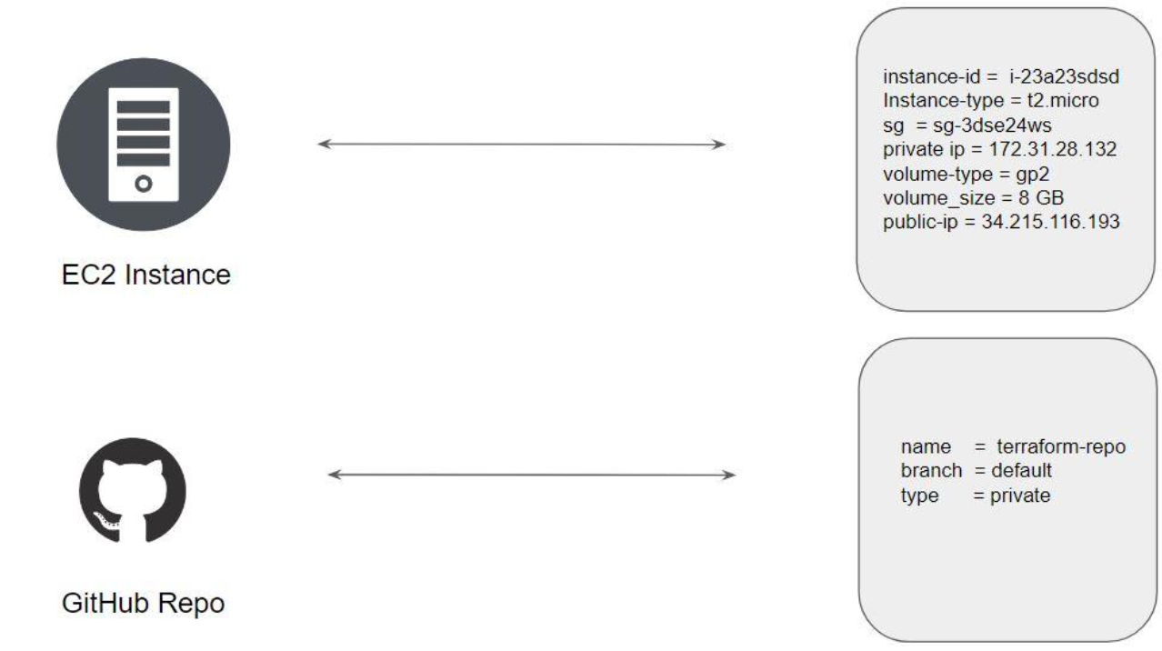
State File
Multiple resources in Terraform will have a separate block with the state file.

Slide 4
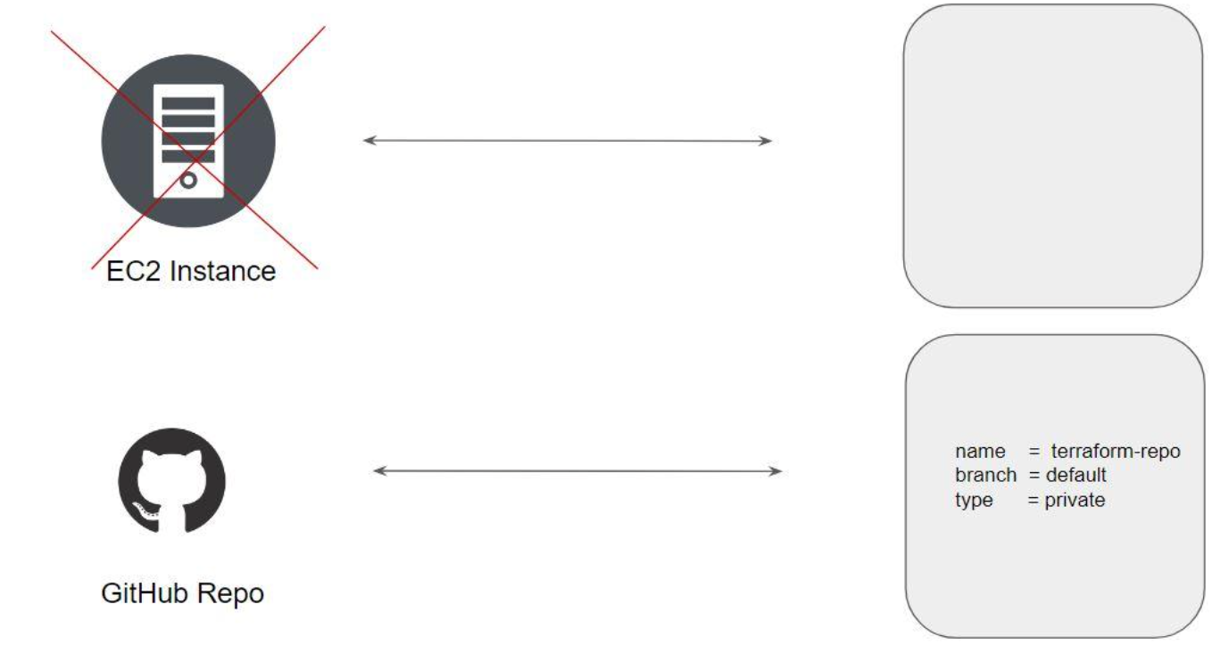
State File
Whenever a resource is removed, its corresponding entry under the state file is also removed.

Slide 5
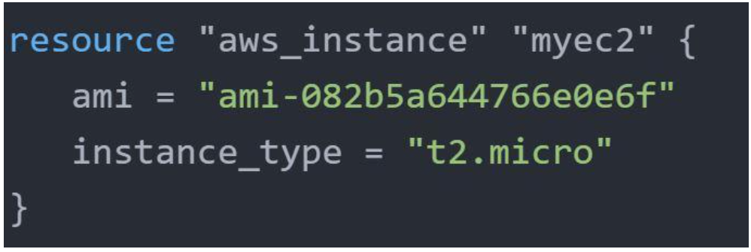
Desired State
Terraform's primary function is to create, modify, and destroy infrastructure resources to match the desired state described in a Terraform configuration

Slide 6
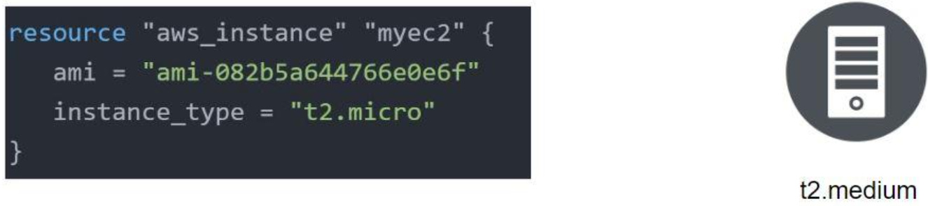
Current State
The current state is the actual state of a resource that is currently deployed.

Slide 7
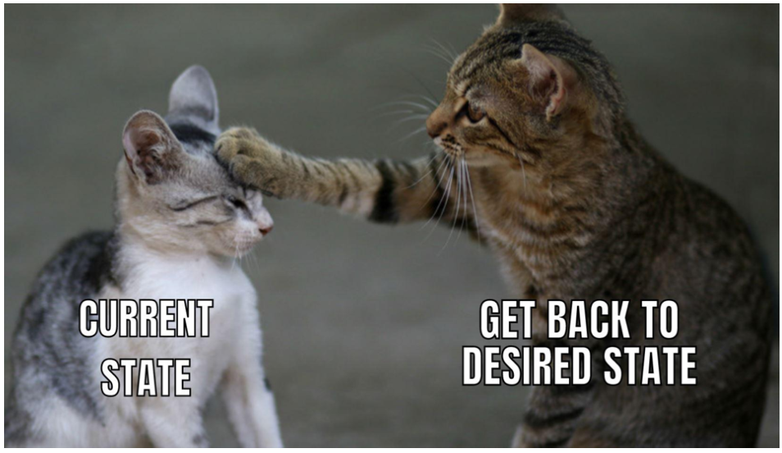
Important Pointer
Terraform tries to ensure that the deployed infrastructure is based on the desired state.
If there is a difference between the two, terraform plan presents a description of the changes necessary to achieve the desired state.

