Slide 1
HashiCorp Certified Terraform Associate 2024
Day 1

Slide 2
Traditional IT & Challenges

Slide 3
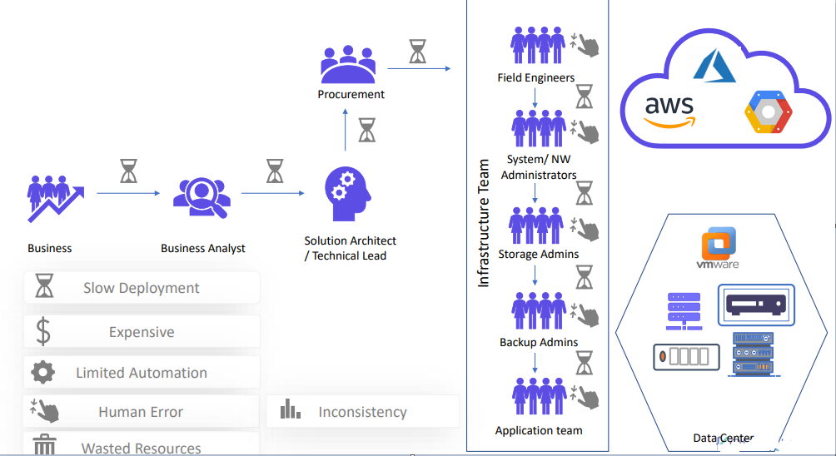

Slide 4
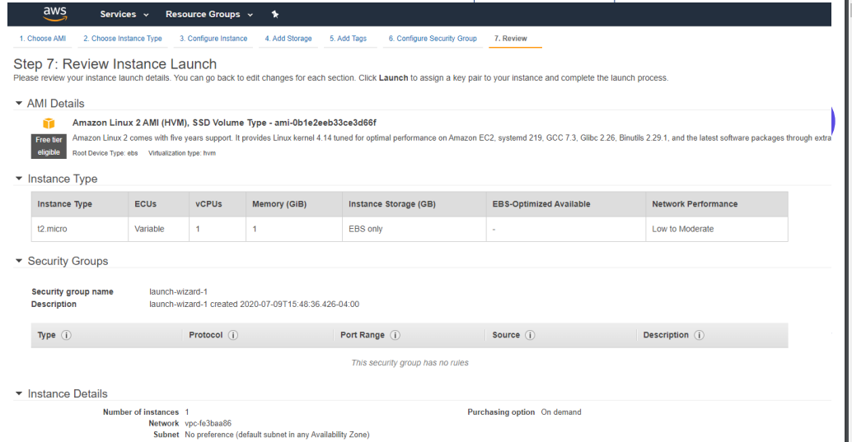

Slide 5
Understanding the Basics
There are two ways in which you can create and manage your infrastructure:
● Manually approach.
● Through Automation

Slide 6
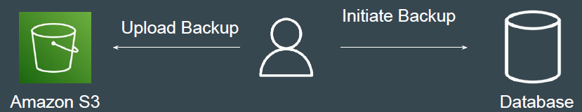
Work Requirement: Database Backup
I was assigned a task to take database backup every day at 10 PM and the backup had to be stored in Amazon S3 Storage with appropriate timestamp.
● db-backup-01-01-2024.sql
● db-backup-02-01-2024.sql
Initially due to lack of time, I used to manually take DB backup at 10 PM and upload it to S3.

Slide 7
Learning from this Work Requirement
If a particular task has to be done in an repeatable manner, it MUST be automated.
Points to Note:
1. Depending on the type of task, the tools for automation will change.
2. There are wide variety of Tools & Technologies used for Automation like Ansible, CloudFormation, Terraform, Python etc.

Slide 8
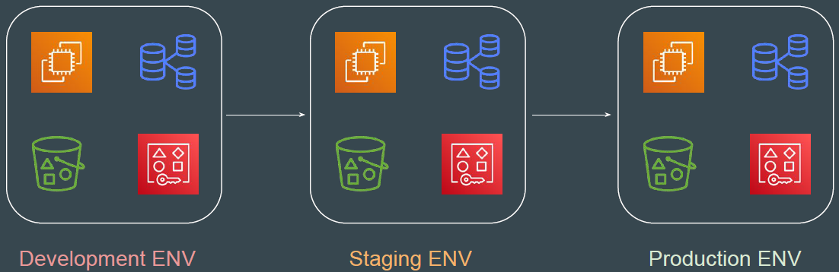
Example of a Single Service
Set of resources (Virtual Machine, Database, S3, AWS Users) must be created
with exact similar configuration in Dev, Stage and Production environment.

Slide 9
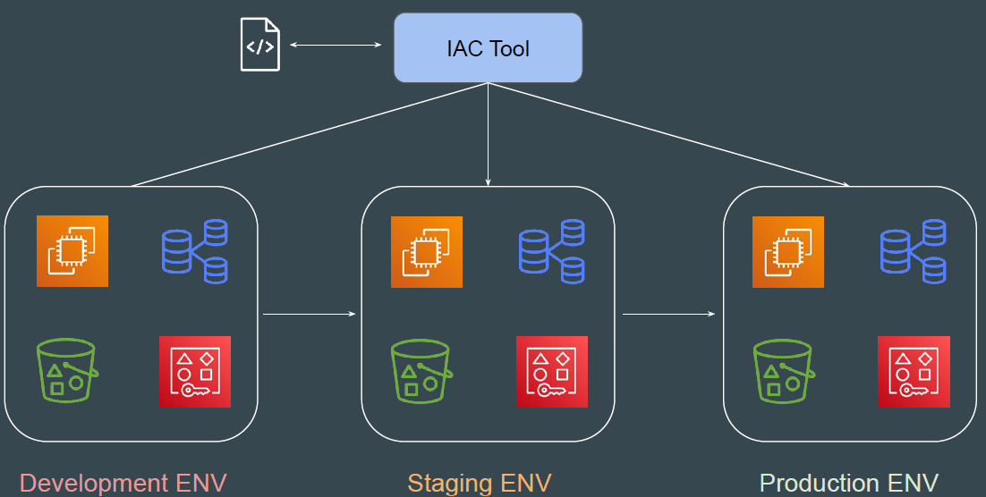
Example of a Single Service - Automated Way

Slide 10
Benefits of Infrastructure As Code
There are several benefits of designing your infrastructure as code:
● Speed of Infrastructure Management.
● Low Risk of Human Errors.
● Version Control.
● Easy collaboration between Teams.

Slide 11
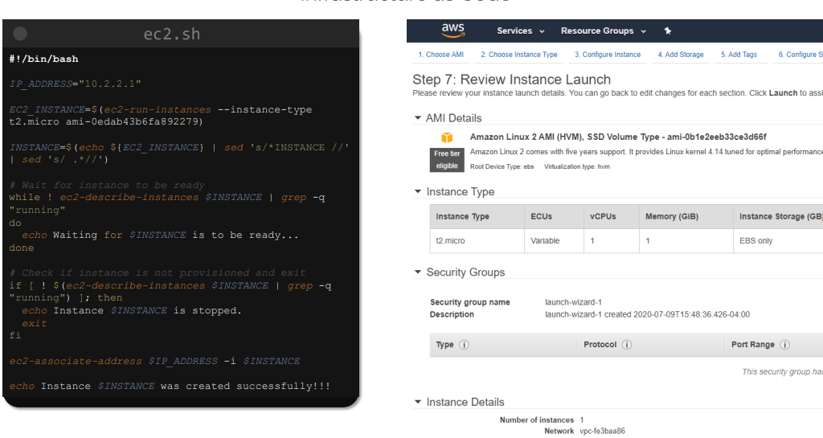
Infrastructure as Code

Slide 12
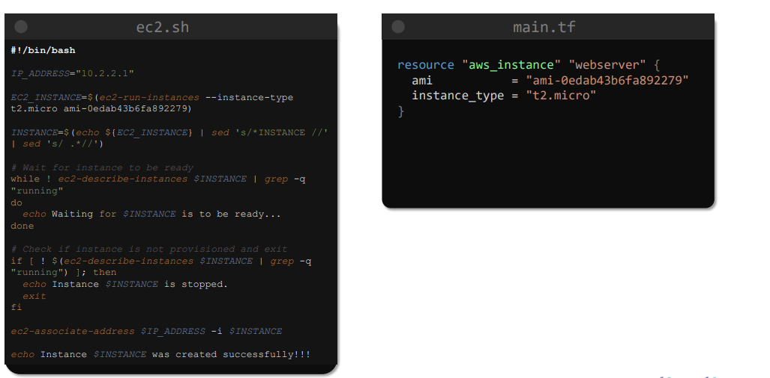
Infrastructure as Code

Slide 13
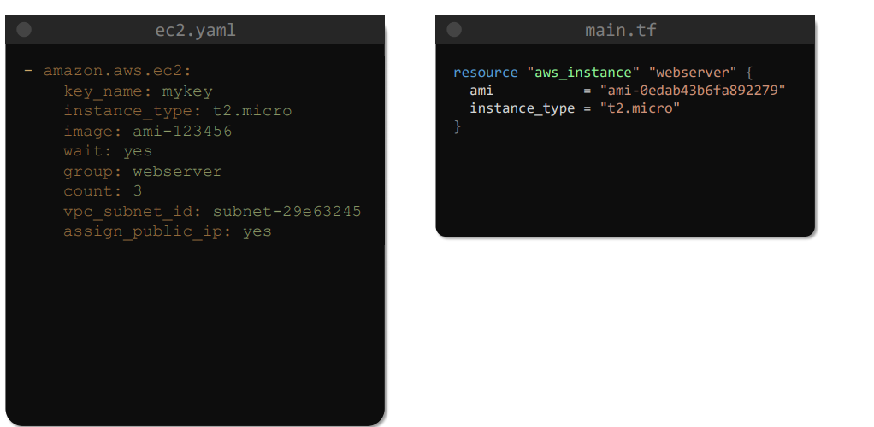
Infrastructure as Code

Slide 14
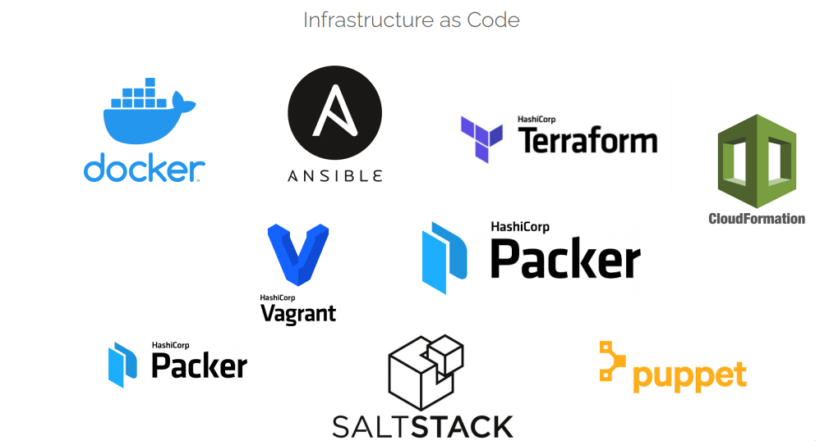
Infrastructure as Code

Slide 15
Infrastructure as Code

Slide 16
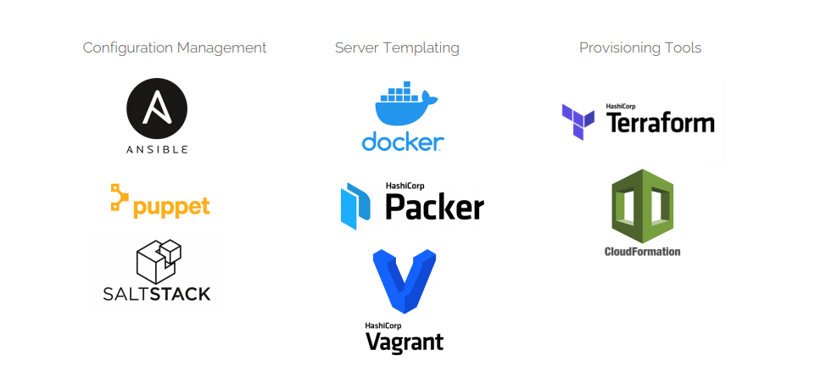
Types of IAC Tools

Slide 17
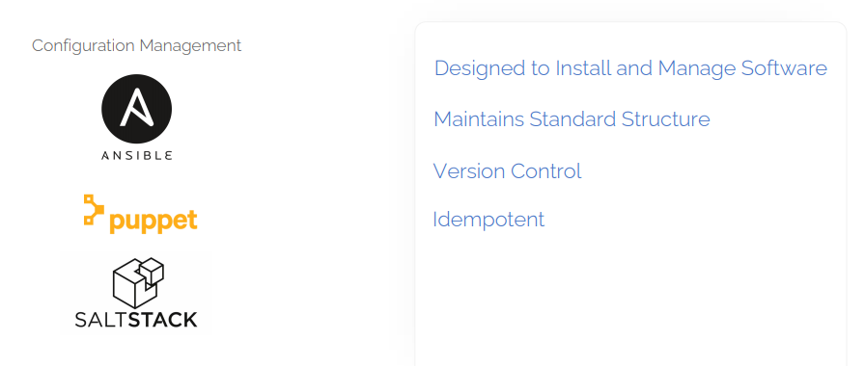
Types of IAC Tools

Slide 18
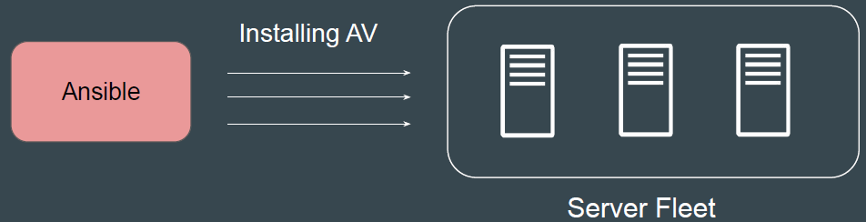
Configuration Management
Configuration Management tools are primarily used to maintain desired configuration of systems (inside servers)
Example: ALL servers should have Antivirus installed with version 10.0.2

Slide 19
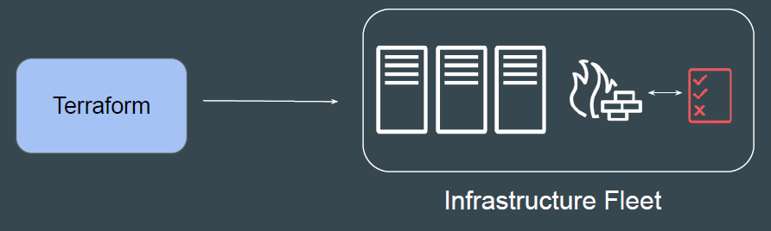
Infrastructure Orchestration
Infrastructure Orchestration is primarily used to create and manage infrastructure environments.
Example: Create 3 Servers with 4 GB RAM, 2 vCPUs. Each server should have firewall rule to allow SSH connection from Office IPs.

Slide 20
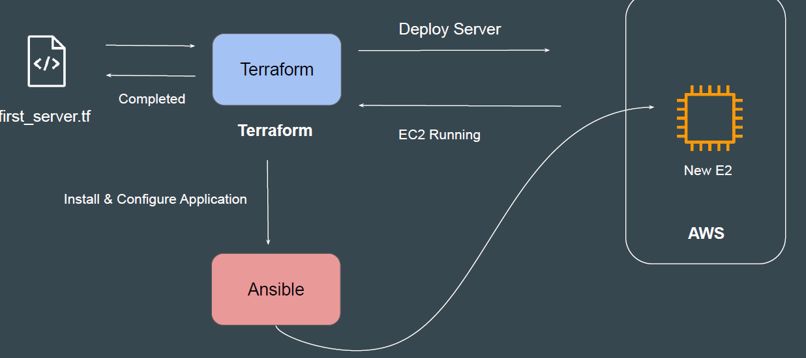
IAC & Configuration Management = Friends

Slide 21
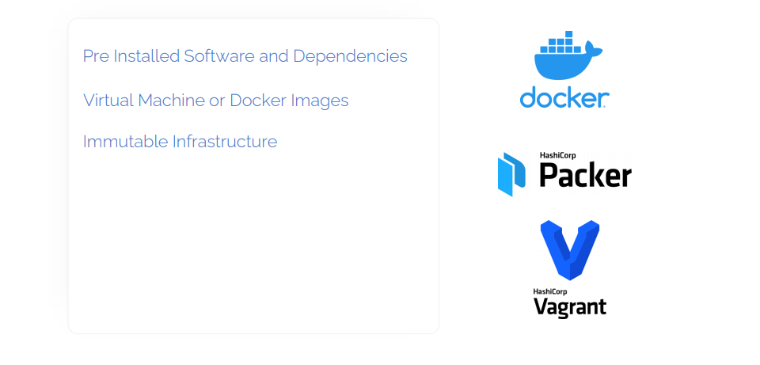
Server Templating Tools

Slide 22
How to choose IAC Tool?
i) Is your infrastructure going to be vendor specific in longer term ? Example AWS.
ii) Are you planning to have multi-cloud / hybrid cloud based infrastructure ?
iii) How well does it integrate with configuration management tools ?
iv) Price and Support

Slide 23
Use-Case 2 - Requirement of Organization 2
1. Organization is based on Hybrid Solution. They use VMware for on-premise setup; AWS, Azure and GCP for Cloud.
2. Official support is required in-case if IAC tool has any issues.

Slide 24
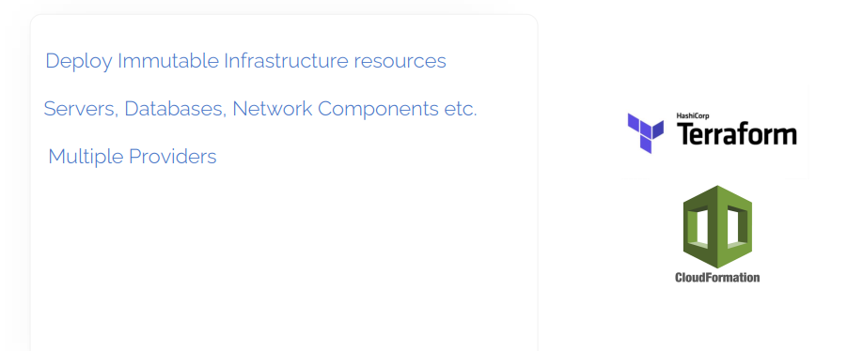
Provisioning Tools

Slide 25
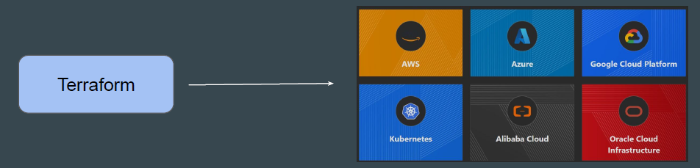
Amazing Terraform
One of the great benefits of Terraform is that it supports thousands of providers.
Once you learn Terraform Core concepts, you can write code to create and manage infrastructure across all the providers.

Slide 26

Overview of Terraform Certification
Terraform has become of the most popular and widely used tools to create and manage infrastructure and one of the defacto IAC tools for DevOps.
HashiCorp has released the official Terraform certification to certify students related to core Terraform concepts and skills.

Slide 27
What Does this Course Cover?
We start this course of Terraform from absolute scratch and then we move ahead with advance topics.
We cover ALL the topics of the official exams

Slide 28
Clarification Regarding AWS Platform
Aim of this course is to learn Core Concepts of Terraform and not AWS.
We use very basic AWS services like Virtual Machine, AWS users to demonstrate and Learn the Core Terraform concepts.
The Terraform structure and concepts remain SAME irrespective of platform.
We have hundreds of users from different platform like Azure who have completed this course and are actively implementing Terraform for different platforms..

Slide 29
Installing Terraform in detail

Slide 30

Overview of Installation Process
Terraform installation is very simple.
You have a single binary file, download and use it.

