Slide 1
Data Types for Variables
Session 10

Slide 2
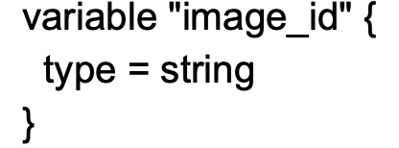
Overview of Type Constraints
The type argument in a variable block allows you to restrict the type of value that will be accepted as the value for a variable
If no type constraint is set then a value of any type is accepted.

Slide 3
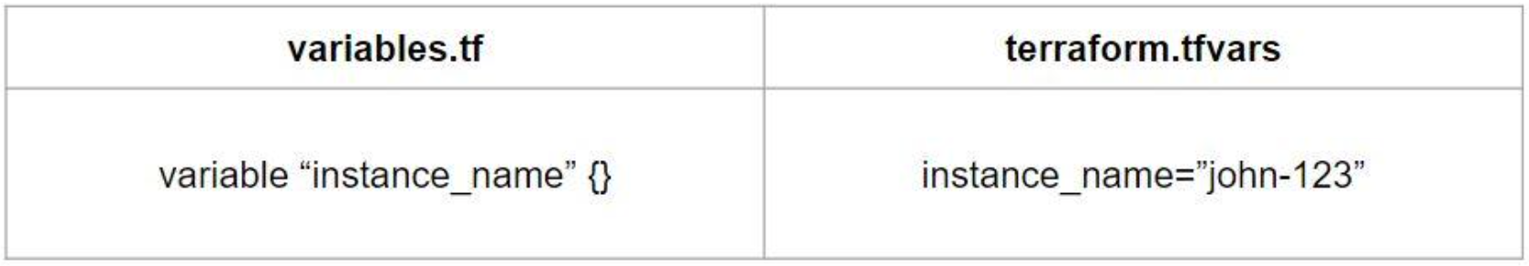
Use case
Every employee in Medium Corp is assigned an Identification Number.
Any resource that an employee creates should be created with the name of the identification number only.

Slide 4
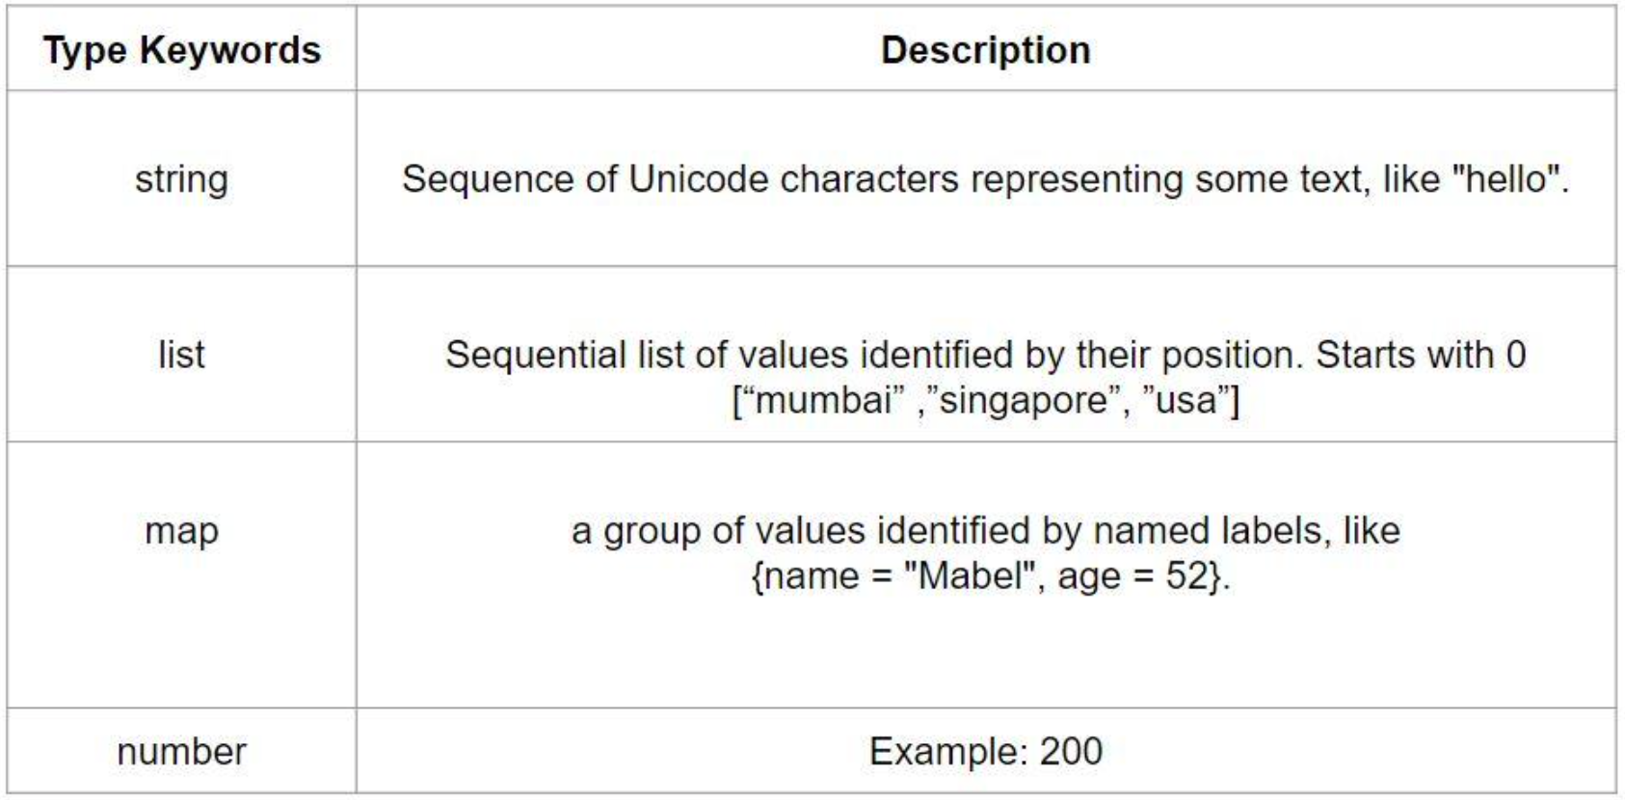
Overview of Data Types

