Slide 1
Provider Versioning
Session 7

Slide 2
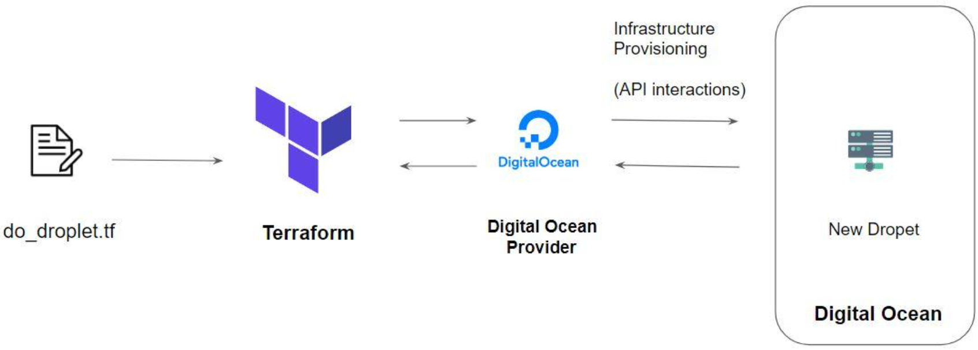
Overview of Provider Architecture

Slide 3

Provider Versioning
Provider plugins are released separately from Terraform itself.
They have a different set of version numbers.

Slide 4
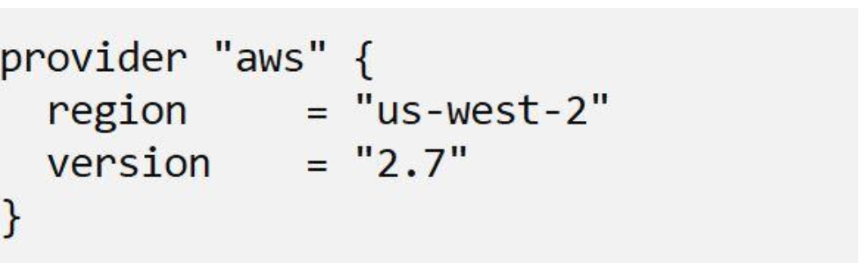
Explicitly Setting Provider Version
During terraform init, if the version argument is not specified, the most recent provider will be downloaded during initialization.
For production use, you should constrain the acceptable provider versions via configuration, to ensure that new versions with breaking changes will not be automatically installed

Slide 5
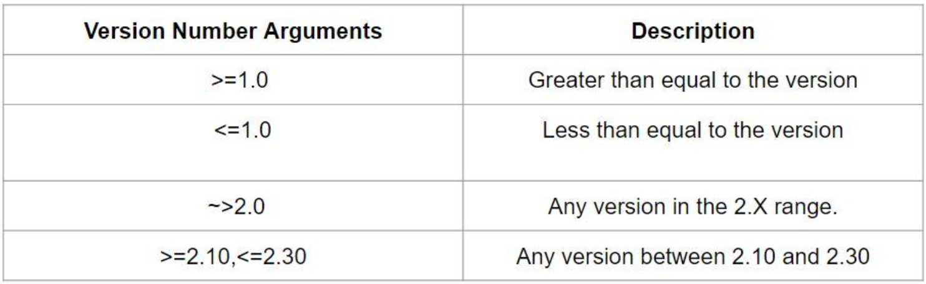
Arguments for Specifying the provider
There are multiple ways of specifying the version of a provider.

