Slide 1
Count Parameter
Session 11

Slide 2
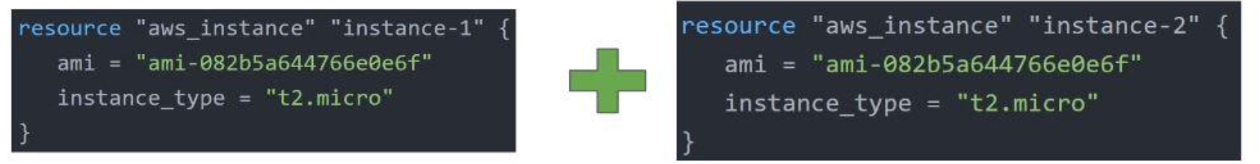
Overview
The count parameter on resources can simplify configurations and let you scale resources by simply incrementing a number.
Let’s assume, you need to create two EC2 instances. One of the common approaches is to define two separate resource blocks for aws_instance.

Slide 3
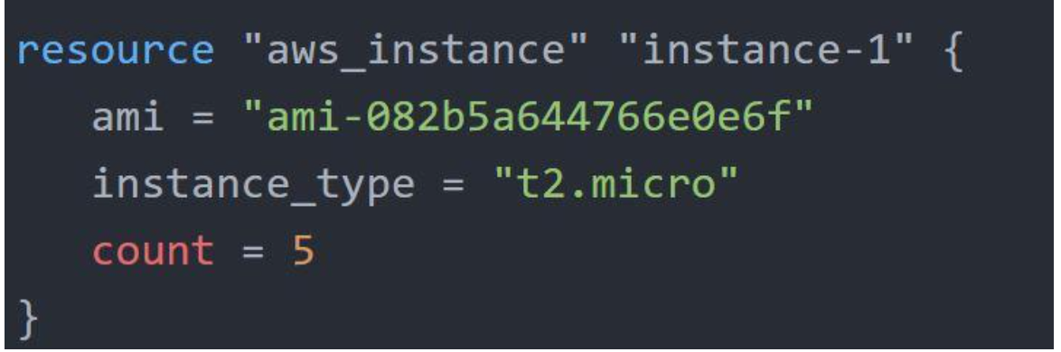
Overview
With the count parameter, we can simply specify the count value and the resource can be scaled accordingly.

Slide 4
Count Index
In resource blocks where the count is set, an additional count object is available in expressions, so you can modify the configuration of each instance.
This object has one attribute:
count.index — The distinct index number (starting with 0) corresponding to this instance.

Slide 5
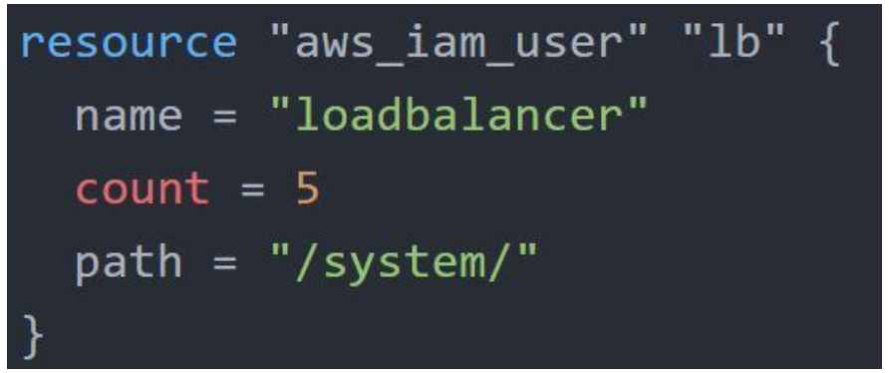
Challenges with Count Parameter
With the below code, terraform will create 5 IAM users. But the problem is that all will have the same name.

Slide 6
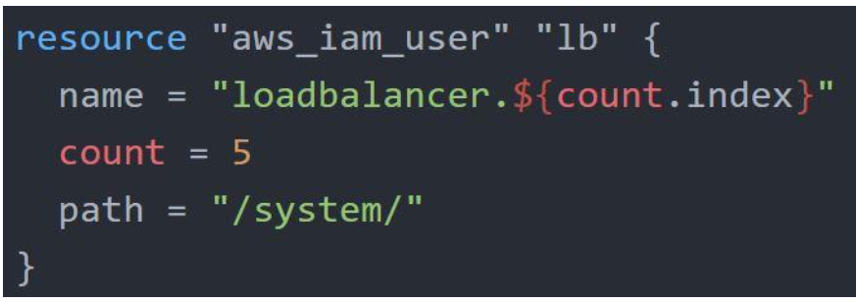
Solution

Slide 7
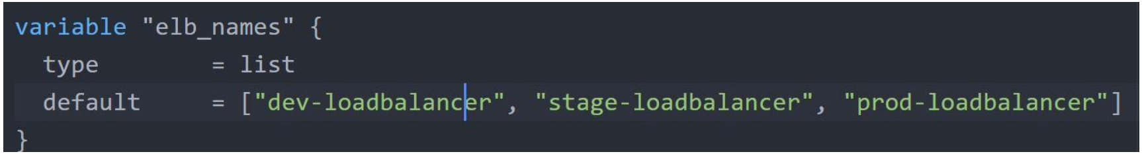
Challenge with Default Count Index
Having a username like loadbalancer0, loadbalancer1 might not always be suitable.
Better names like dev-loadbalancer, stage-loadbalancer, prod-loadbalancer is better.
count.index can help in such a scenario as well.

