Slide 1
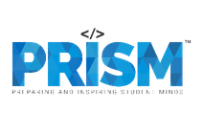
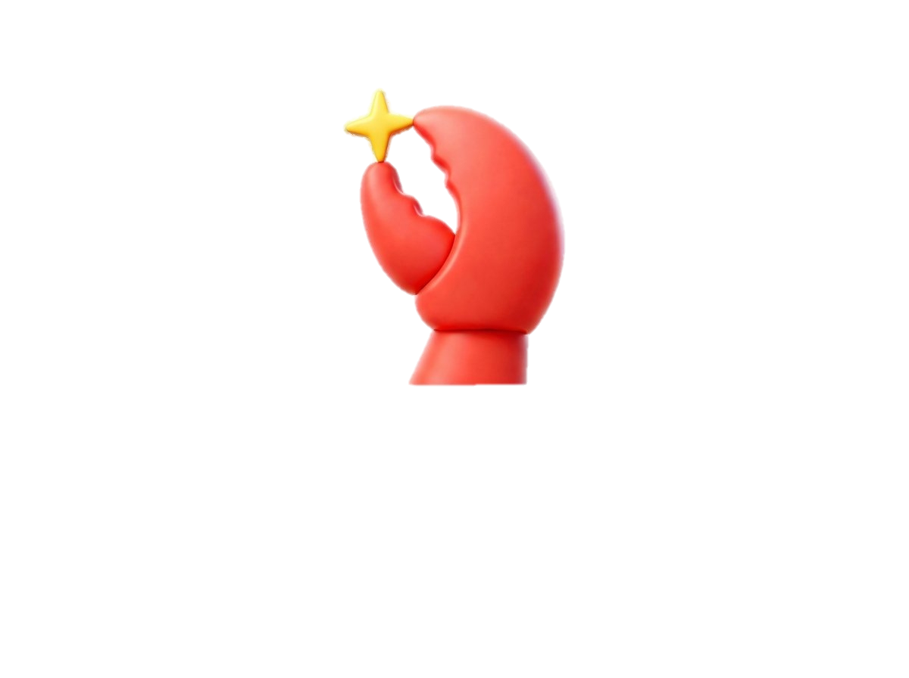
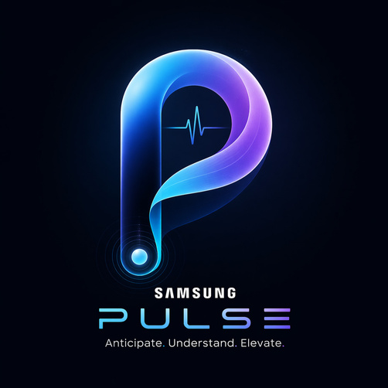
| Tech Management, SRI-B
CLASH OF THE
CLAWS
RVCE_LIFECANVAS STUDIOS
PULSE
Predictive User-Life Syncronization Engine
Theme 2: Daily Utility
Shreya Prasad
Sachethan Inchal

Slide 2
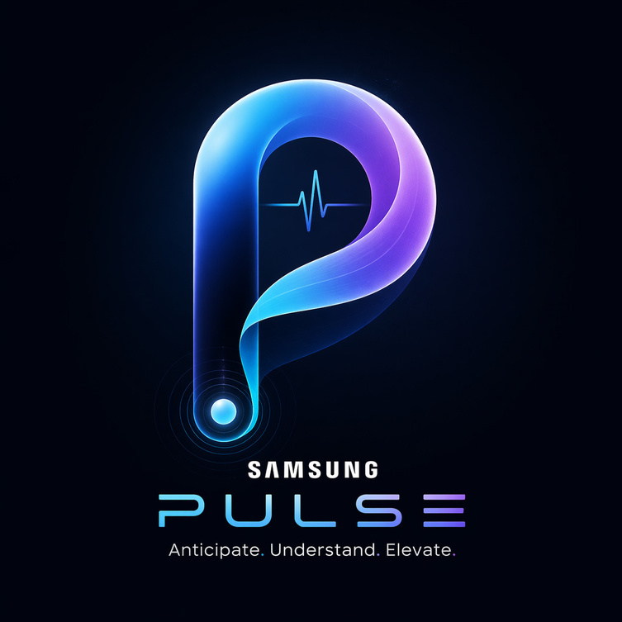
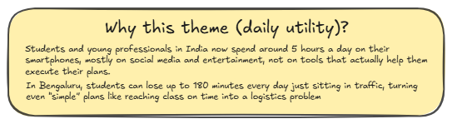
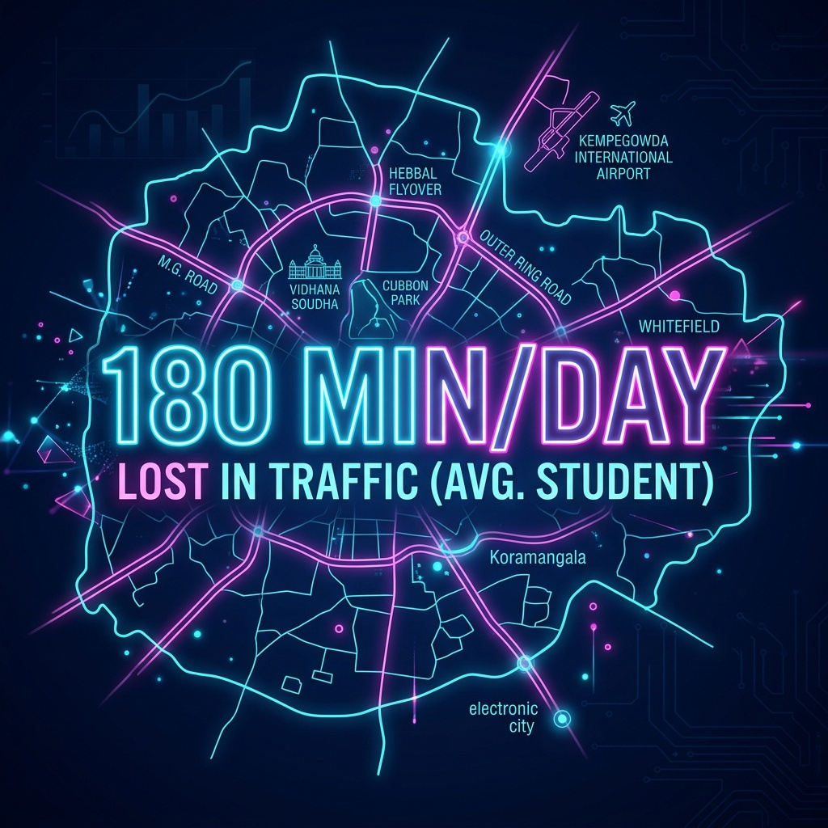
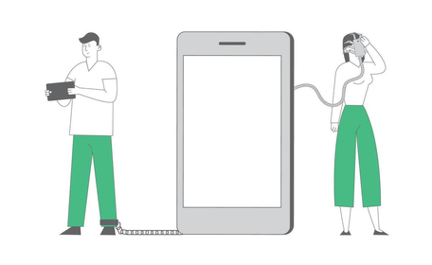

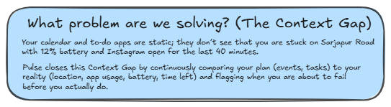

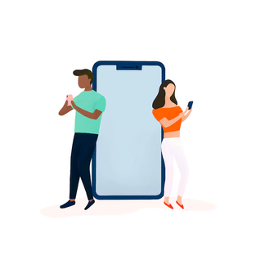
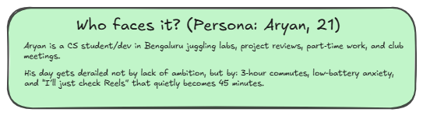

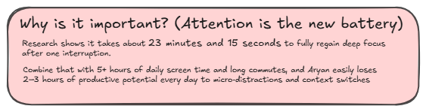
Problem Statement
23 Minutes & 15 Seconds: The average time it takes to regain deep focus after one digital interruption (UC Irvine Study).
150+ Times: How often the average user checks their phone daily, mostly subconsciously.
40% "Friction Rate": The probability of task failure when context (traffic/battery) deviates from the plan.

Slide 3






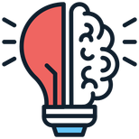

Idea
Current Solution & Gaps
STATIC
GENERIC
Existing solutions
What’s missing / broken
The opportunity (where Pulse fits)
Calendars & to-do apps (Google Calendar, Notion, Tasks): Great at storing events and lists, but they only reflect what you planned, not what is actually happening around you in real time.
Screen-time & focus apps (Digital Wellbeing, Focus Mode, app blockers): They track usage and enforce timers, but they rely on manual schedules and static limits that don’t adapt to traffic, battery, or sudden plan changes.
Wellness / digital well-being apps (popular in India): They offer mindfulness, mood tracking, or generic “reduce screen time” advice, but they don’t integrate with your calendar, commute, and battery context to protect a specific day’s plan
Build a context-aware, on-device Guardian that listens to live signals—location, app usage, calendar, battery, time-to-destination—and computes a Risk Score for each upcoming commitment.
Instead of waiting for Aryan to open an app, Pulse runs a continuous heartbeat loop that intervenes when risk spikes:
“Leave now or you’ll be 18 minutes late to lab.”
“Lock Instagram for 30 minutes; you’re entering your only deep-work block today.”
“Draft and queue your ‘running late’ message if ETA slips beyond 10 minutes.”
This is the gap: no daily utility app today acts as a proactive co-pilot that protects your actual day from being derailed by micro-distractions and urban friction.
These tools are blind to context: they don’t know that you have lab at 2 PM, you’re 9 km away in peak Bengaluru traffic, and your phone is at 11% while you scroll Reels.
They are reactive and manual: you must set the focus sessions, app limits, or routines yourself, and they rarely adapt mid-day when your schedule slips or a meeting runs over.
They optimize metrics, not outcomes: screen-time apps aim to reduce minutes on phone, not to ensure “Aryan reached on time” or “Aryan protected 90 minutes of deep work for his deadline.”
mANUAL

Slide 4
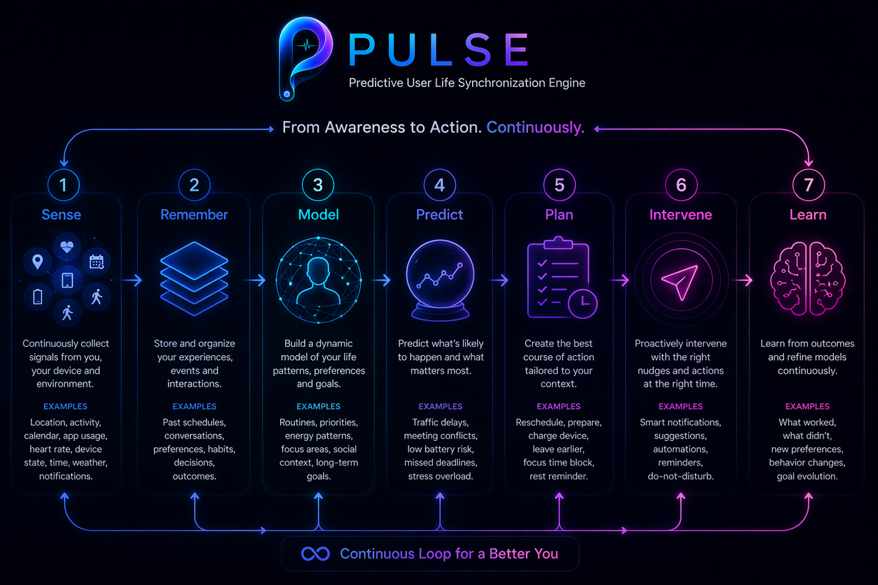
Idea
Our Solution
Pulse is a proactive Digital Twin on your phone that predicts when your day is about to fall apart—and fixes it before you feel the damage.
Every few minutes, a background Heartbeat Loop quietly re-checks your reality: traffic, battery, apps, calendar, and time left. Event Driven arcitecture is implemented to trigger heartbeat on battery change, ETA change,etc
A 5-agent AI swarm behaves like microservices in your brain: one agent understands context, one scores risk, one plans, one intervenes, one reflects.
At night, a Reflection cycle learns from the day (what you ignored, where you were late, when you doomscrolled) and updates your personal “Soul” model, so tomorrow it behaves more like you and less like a generic productivity app
Ask Pulse: At any moment, you can pull the system forward with a simple question—“Can I finish this assignment before my 6 PM lab?”—and Pulse runs the same agents on demand to answer with a realistic, context-aware plan instead of a generic suggestion
Notification Agent: A dedicated notification agent sits between Android’s notification stream and your attention, turning noisy pings into curated, context-aware alerts using notification-listener and assistant capabilities with user-granted permission
Pulse’s digital twin is a live, mini-map of your day that shows where you are, where you’re supposed to be, and how “at risk” each upcoming event is based on traffic, battery, and app usage. Instead of a static calendar, you see a color-coded timeline that updates in real time as your reality drifts from your plan

Slide 5
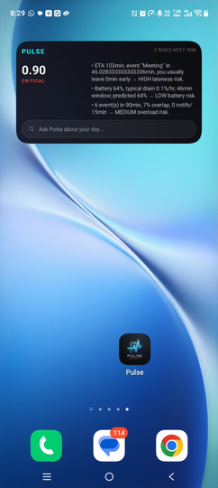
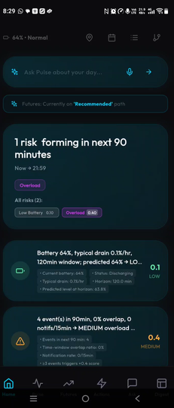
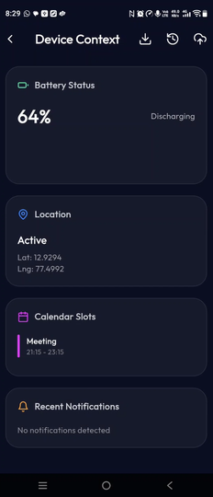
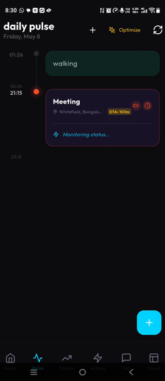
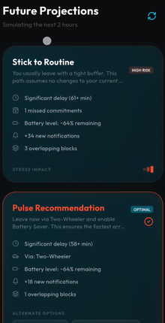
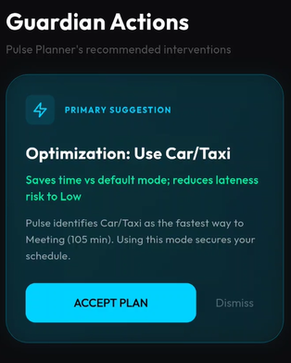
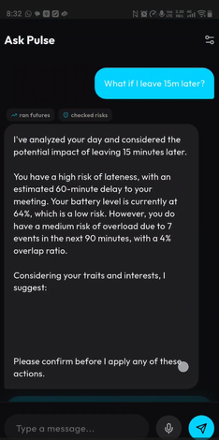
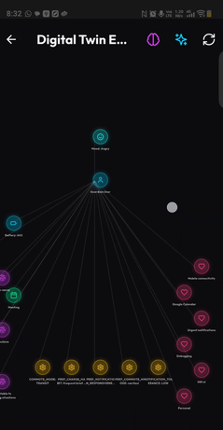
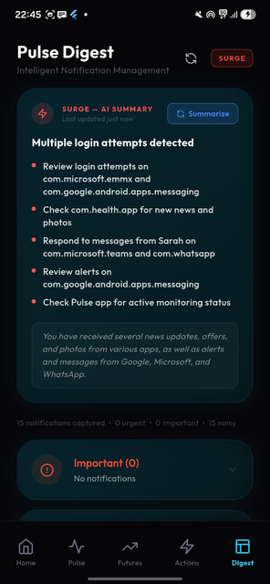
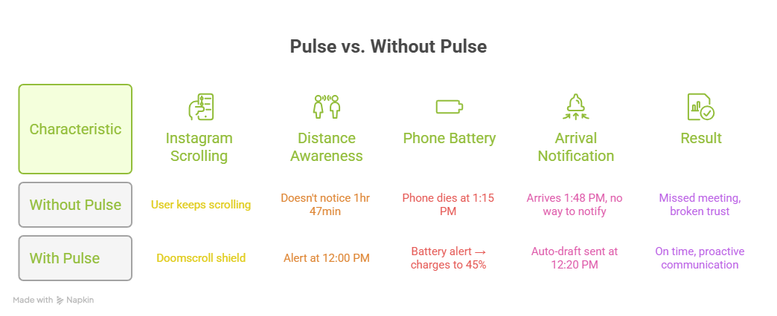
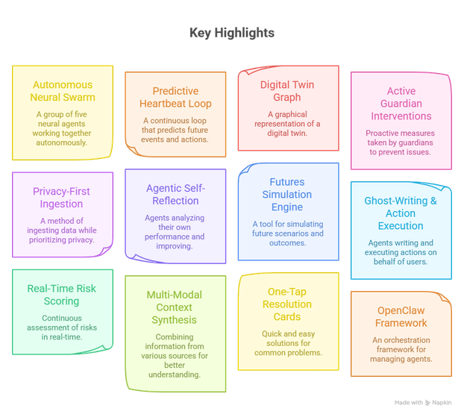
Idea
Demo/Product Walkthrough
Implementation of recommended action
Asking questions about risks, updating digital twin, updating daily pulse in natural language
Pulse reads your notifications And provides summaries in case you can’t read all your notifications
Home screen widget for easy access
Dashboard showing risks predicted
Device Context ingested for prediction
Daily Timeline showing risks for the day
Future projection of multiple scenarios in your day
View your digital twin

Slide 6
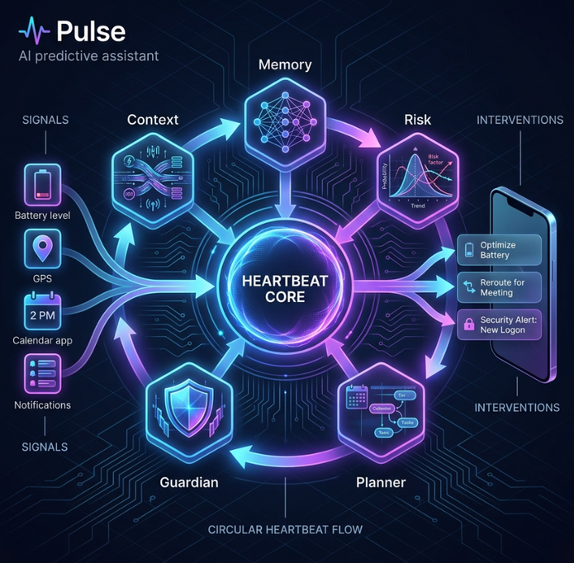
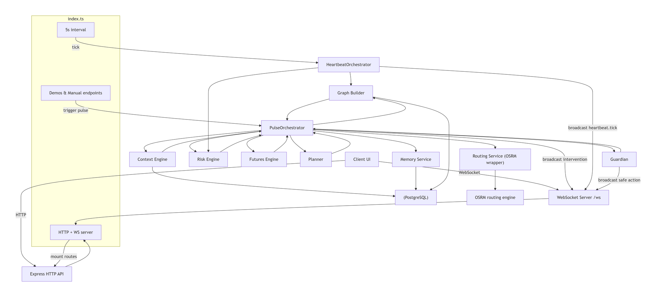
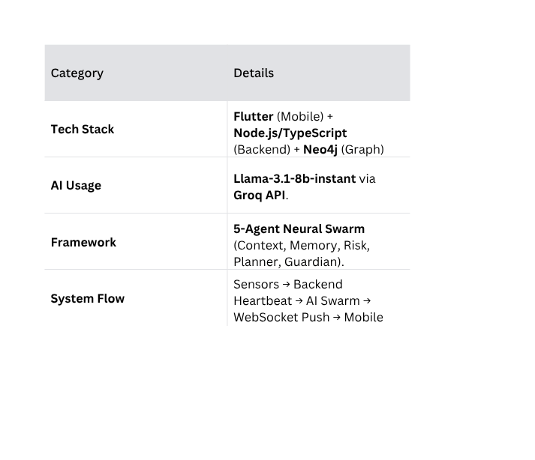
Idea
Tech & Architecture
Pulse is a predictive digital twin that syncs a Flutter-based sensor array with a TypeScript "Heartbeat" server. It utilizes a low-latency Llama-3.1 swarm (via Groq) to cross-reference real-time telemetry—location, battery, and notifications—against historical behavioral patterns stored in Neo4j. Governed by a SOUL.md safety framework, this 5-agent system anticipates operational failures like transit delays or focus fragmentation, pushing real-time "Next Best Move" interventions directly to the user as actionable UI cards.

Slide 7

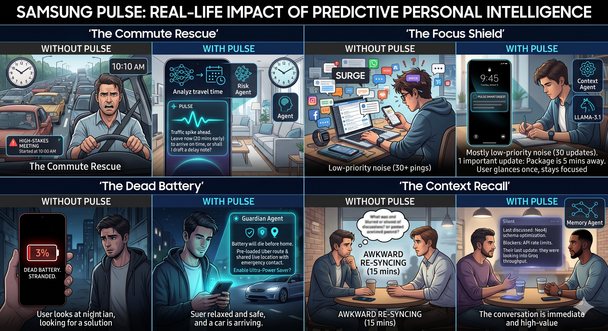
Idea
Impact & Use cases

Slide 8
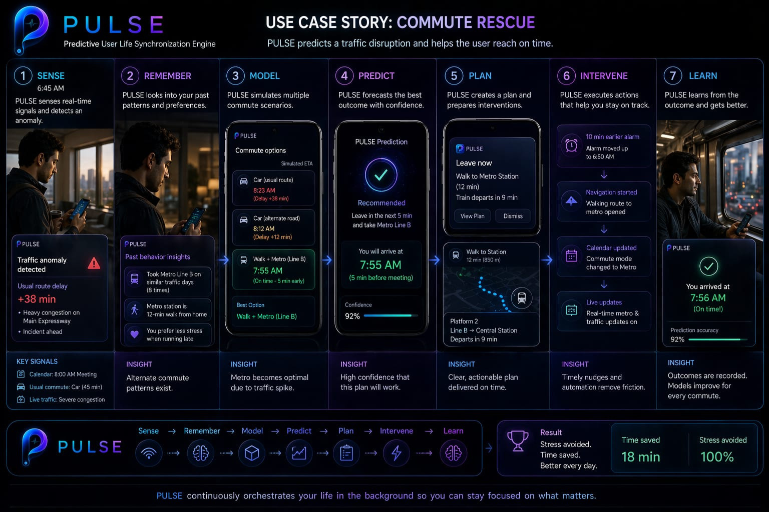
Idea
Impact & Use cases

Slide 9
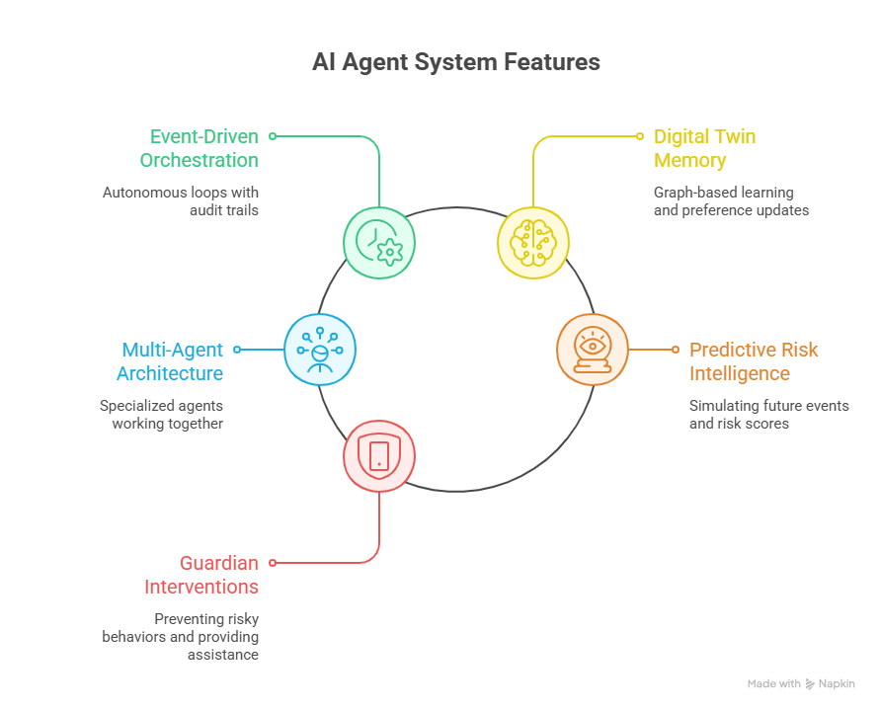
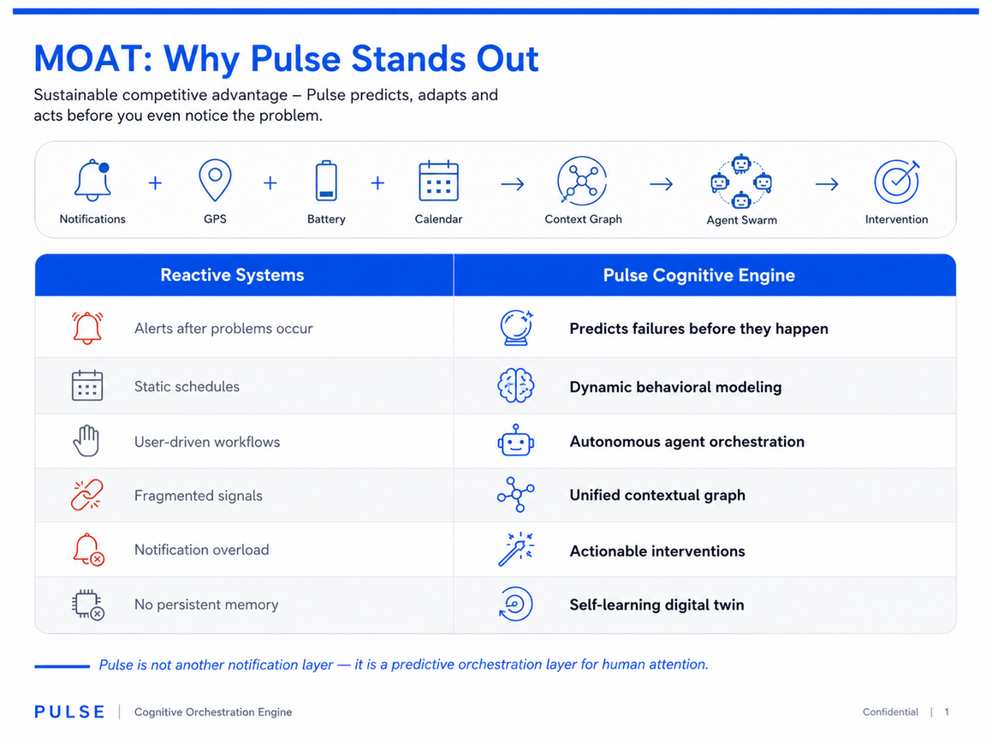
Idea
Differentiation

Slide 10
Idea
Demo Link
Project link
https://github.com/Shreya5619/Pulse
Demo Video link
https://github.com/Shreya5619/Pulse/blob/main/Video%20Project%203.mp4

Slide 11
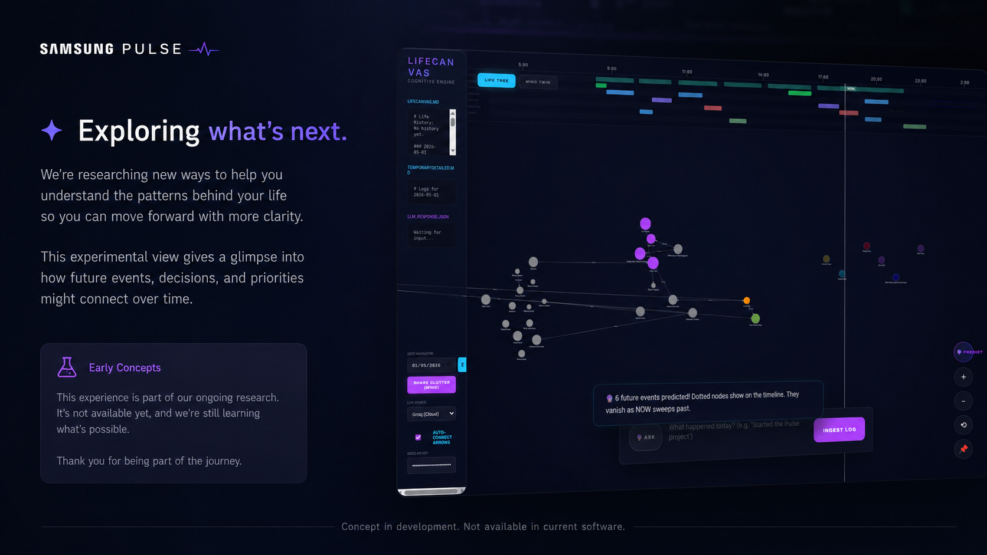

Idea

