Slide 1
QUIZ-GAME
BY
HARSH BHOOTRA and
SHREYA HARKAWAT

Slide 2
AIM
To build an application program to reduce the manual work for managing the Students, Examination, Results, Marks.
The valuable data/information can be stored for a longer period with easy accessing and manipulation of the same.

Slide 3
MODULE:
There will be given 4-5 modules. The modules are,
To Start the game
To View the highest score
To Reset the score
Help
Quit the game

Slide 4
TOOLS TO RUN A PROGRAM:
SOFTWARE REQUIREMENTS:
HARDWARE REQUIREMENTS:
Processor
Operating System
Text Editor
RAM
Hard Disk
Monitor
Keyboard and Mouse

Slide 5
FEATURES:
Accuracy in work and well designed reports.
Decrease the load of the person involves in existing manual system.
Easy & Fast retrieval of information.
Creating & Changing issues at ease.
User accounts to control the access and maintain security, ETC…

Slide 6
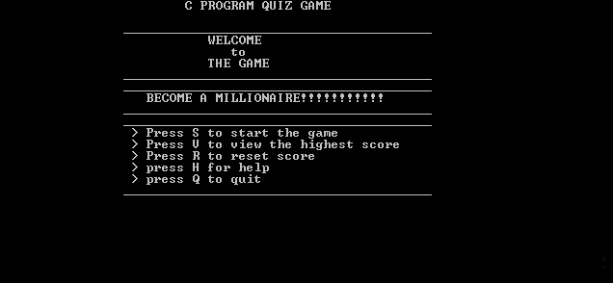

Slide 7
CONCLUSION:
Overcoming the limitation, we had tried to fulfill the objectives and scopes as committed and Finally the system is implemented and tested according to test cases.

