Slide 1
Smart Attendance System
Shreya Bamane Mitali Belge Shweta Nikam
Guided by:
PROF. SONALI BODEKAR KALE
Smart Attendance System

Slide 2
TABLE OF CONTENTS
Introduction Literature Survey Existing System Proposed System Implementation
Hardware and Software requirement Future Scope
Conclusion References
1
2
3
4
5
6
7
8
9
Smart Attendance System

Slide 3
Introduction
Attendance system is used to track and monitor students
Manual methods are long and less efficient for marking attendance
Computerised method for marking attendance Biometric based attendance system
Smart Attendance System

Slide 4
Literature Survey
Title Objective
Attendance Type
Advantage
An Attendances System Unit Using the Radio Frequency Identification Con- cept.
Radio-frequency tification to
iden- mark
RFID Cards
Quick and Rapid: Identi- fies candidates in seconds Provides more accurate iden- tification
attendance which is an automatic identification method that stores and retrieves data using devices called RFID tags
QR Code Based Smart Attendance System
QR code generator takes the attendance with re- spect to the specific sub- ject and generates the student attendance sheet as per attendance details.
QR Code
Maintenance of the system is easy and cost effective.
Fingerprint Attendance
Based System
The goal was to create a system that uses 2 micro- controllers to deal with the fingerprint recogni- tion process that will pass the information for verifi- cation to database.
Fingerprint authentica- tion
No passwords
have to be remembered
Using Microcon- troller and LabView
Smart Attendance System

Slide 5
Literature Survey
Title | Objective | Attendance Type | Advantage
Speech biometric based attendance system | Uses Text independent speaker verification with MFCC and i-vector based speaker modeling | Speech recognition | Requires less equipment
Student Attendance System Using Iris Biometric Recogni- tion | The designed system re- turns an integer value of (1) if there is a match and an integer value of (0) if there is no match | Iris recogni- tion | Great accuracy
Eigenface Algorithm for Face Recognition in Attendance Sys- tem | Face features are sent to the server for ver- ification and identifica- tion process, then several training images are com- pared with input images during the identification process | Face Recog- nition | Best biometric system because it is Efficient
Smart Attendance System

Slide 6
Existing System- EigenFace Algorithm
The existing system for facial recognition is build using eigenface algorithm. A set of m images of dimension N*N are converted into vectors of size N²
Calculate the average of all these face vectors and subtract it from each vector
Then we take all face vectors so that we get a matrix of size of N² * M and we find
Covariance matrix by multiplying A with A_{T}
Calculate eigen values and eigenvectors of covariance matrix and map them For recognition, we subtract average face from the captured image
We generate the vector of the coefficient such and subtract it from the training image to get the minimum distance between the training vectors and testing vectors
If value is less than certain level than face is recognised else not
Smart Attendance System

Slide 7
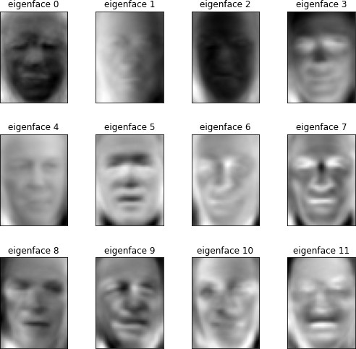
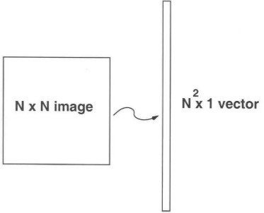
Existing System- EigenFace Algorithm
Figure:Converting image to vector
Figure:EigenFaces
Smart Attendance System

Slide 8
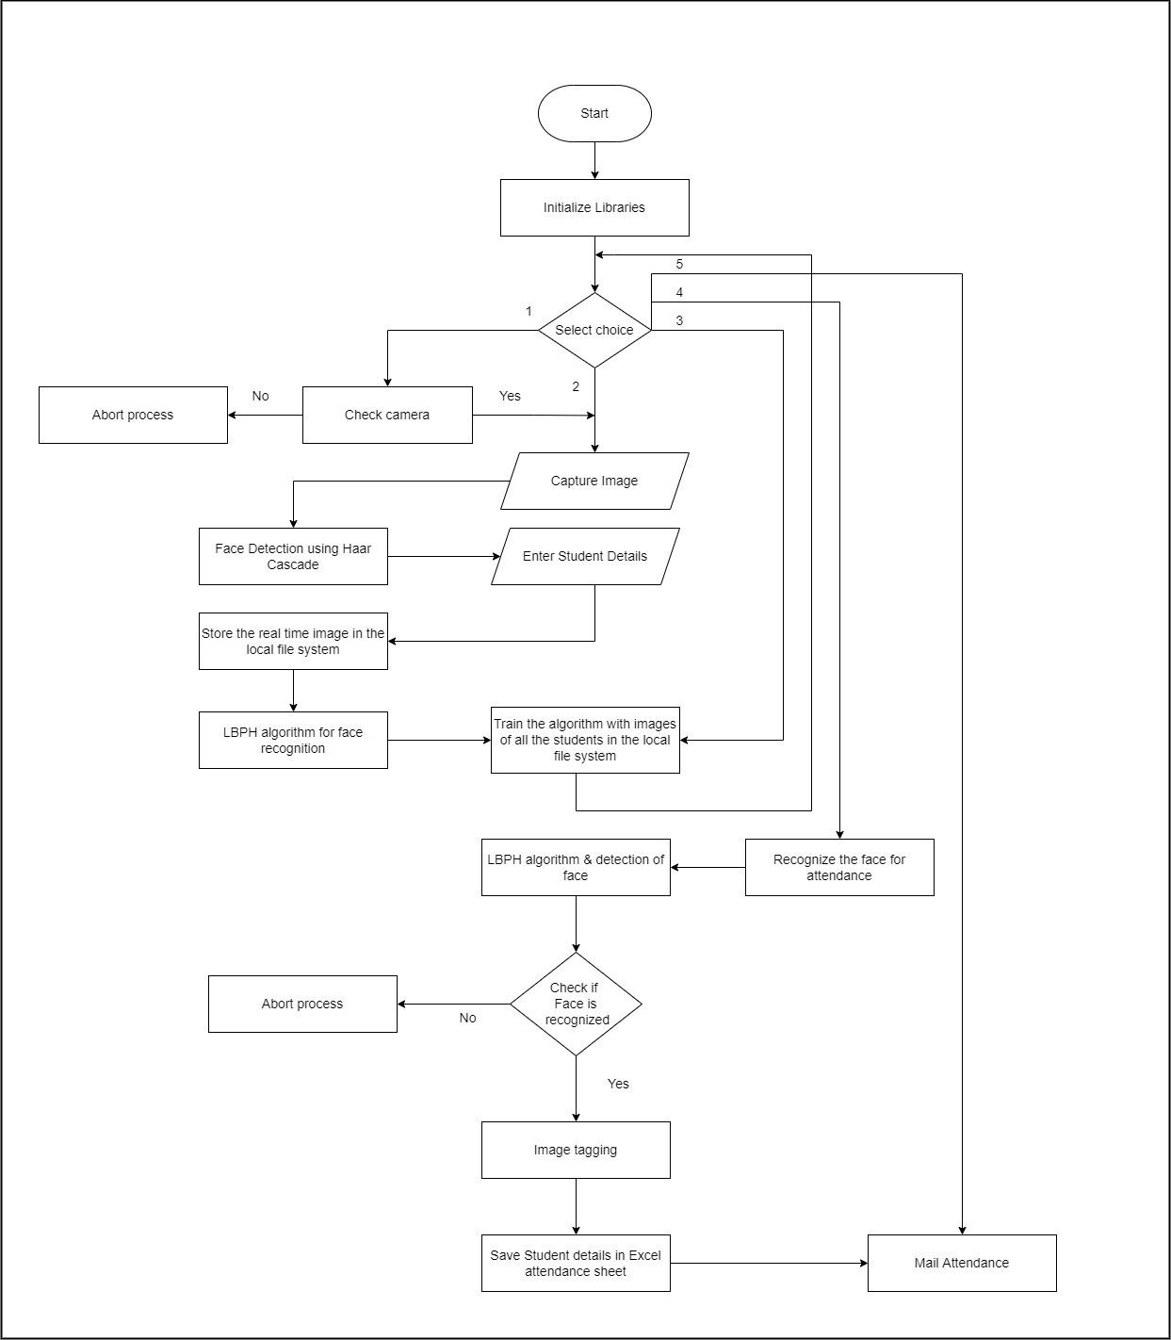
Proposed System
Smart Attendance System

Slide 9
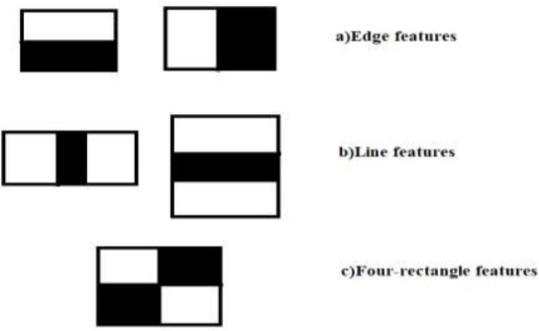
Haar Cascade Classifier
It is a classifier in which Cascade function is trained with positive and negative images.
Collect the HAAR features i.e the edge features, line features and centre surrounded features.
The algorithm is going to be used in face detection and feature extraction
Figure:Haar Feature Extraction
Smart Attendance System

Slide 10
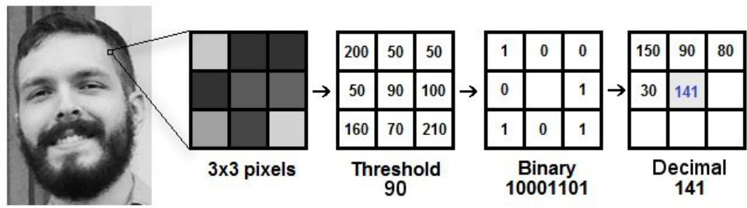
Local Binary Pattern Histogram (LBPH)
Local binary pattern histogram is used for face recognition.
Compares the central pixel with neighbouring pixels, if neighbouring pixels value is lower than central pixels its value it is going to be written as 0 and if value is greater or equal to central pixel then value will be 1.
The binary patterns you can convert them in decimal patterns and these decimal patterns are plotted on histograms
Figure:LBPH Operation
Smart Attendance System

Slide 11
Implementation
Below are the important python codes which are the core of our implementation:
1
Check camera.py: To check whether the face is getting detected properly
Capture Image.py: This will capture the images of the person Train.py: Train the captured images and work on datasets.
Recognize.py: To recognize and mark attendance automail.py: To send mail to a specific mail id. main.py: Main program file to run the program
2
3
4
5
6
Smart Attendance System

Slide 12
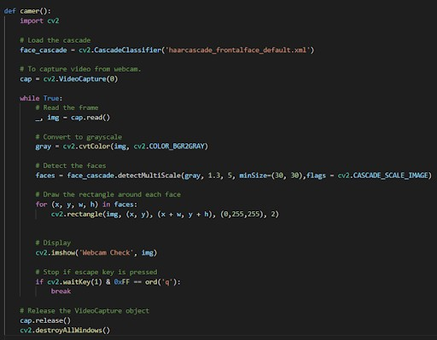
check camera.py
Figure:Code for Detecting Face
Smart Attendance System

Slide 13
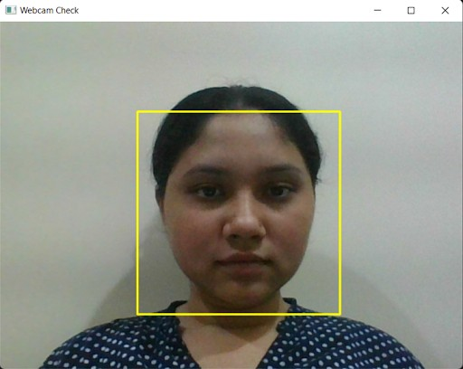
check camera.py
Figure:Face Detected by camera
Smart Attendance System

Slide 14
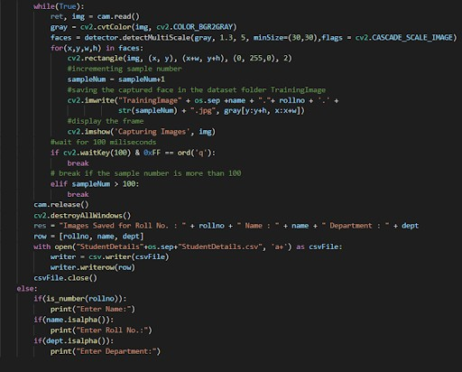
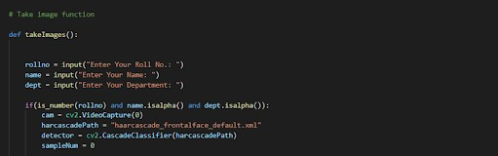
capture Image.py
Figure:Taking Student Details as input
Figure:Capturing Images
Smart Attendance System

Slide 15
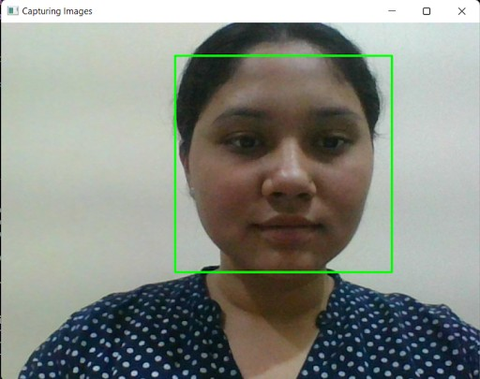
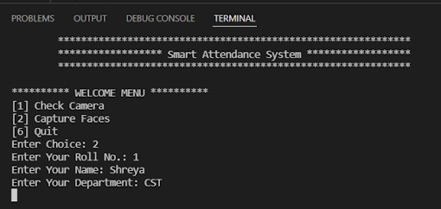
capture Image.py
Figure:Taking Student Details
Figure:Capturing Images of the person
Smart Attendance System

Slide 16
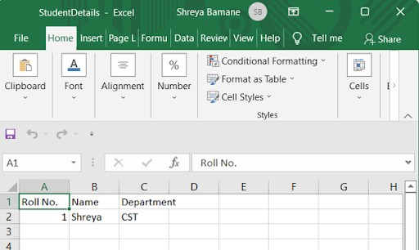
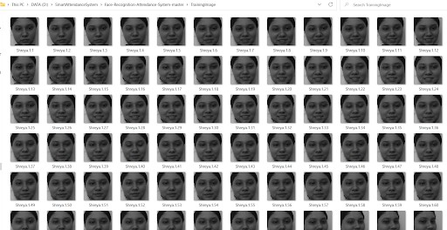
capture Image.py
Figure:Capturing Images of the person
Figure:Student Details saved to excel sheet
Smart Attendance System

Slide 17
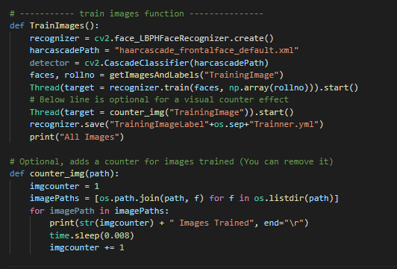
train Image.py
Figure:Code to Train image
Smart Attendance System

Slide 18
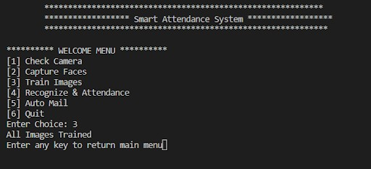
train image.py
Figure:Training Images
Smart Attendance System

Slide 19
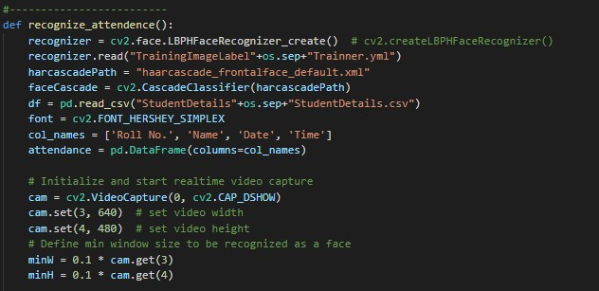
recognize.py
Figure:Function to recognize the person
Smart Attendance System

Slide 20
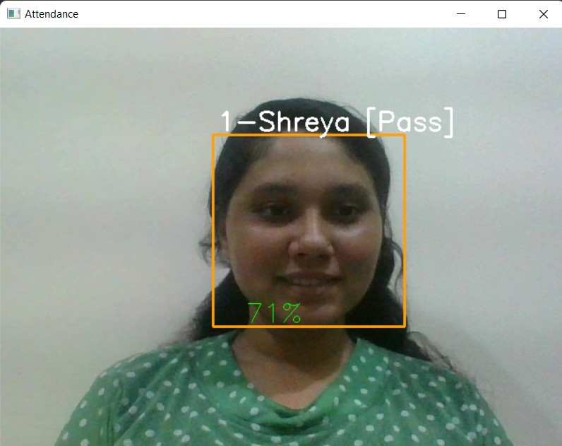
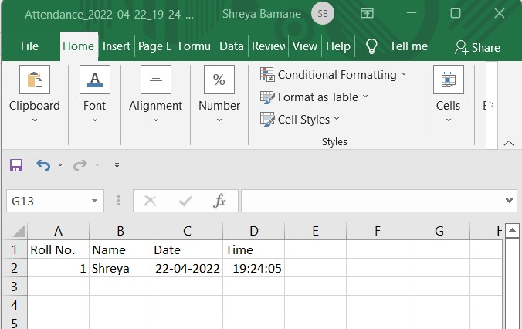
recognize.py
Figure:Student Attendance saved in Excel sheet
Figure:Recognising the person
Smart Attendance System

Slide 21
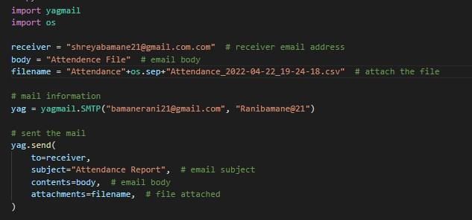
automail.py
Figure:Code to mail the attendance sheet
Smart Attendance System

Slide 22
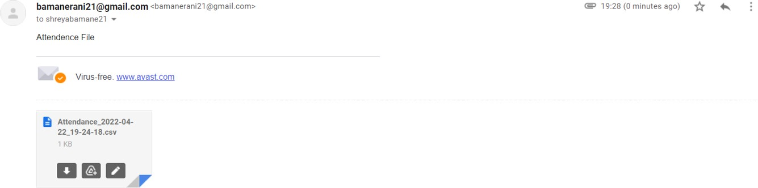
automail.py
Figure:Sheet mailed to the receiver
Smart Attendance System

Slide 23
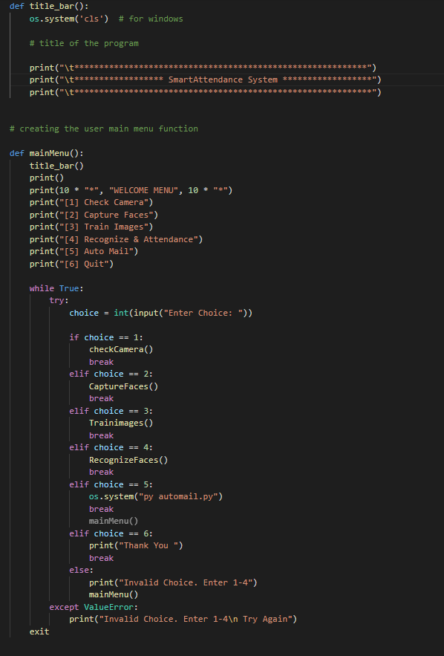
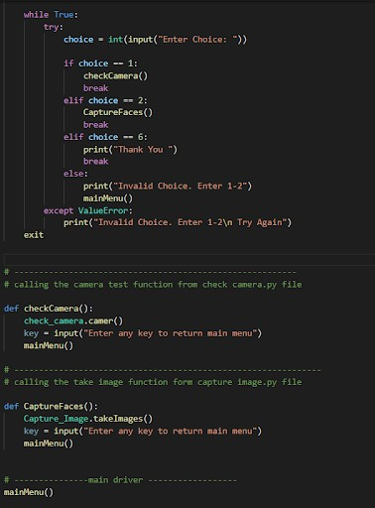
main.py
Figure:Calling all the functions
Figure:Creating User main menu
Smart Attendance System

Slide 24
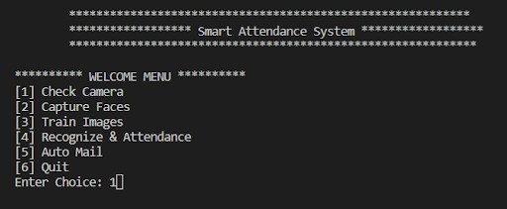
main.py
Figure:User Main Menu
Smart Attendance System

Slide 25
Hardware and Software Requirement
Hardware Requirement:
Web Camera
Software Requirement:
Operating System : Windows 7 or higher. Software : Visual Studio 2019 or higher. Python 3
OpenCV
Pandas Numpy Datetime Pillow
Smart Attendance System

Slide 26
Future Scope
The future work is to improve the recognition rate of algorithms when there are unintentional changes in a person like using a scarf, wearing a mask as per current norms.
We can simplify the system and make it more efficient by taking advantage of multiple face detection to mark attendance of all the visible faces in a single attempt.
These updates will be economical and a more efficient use of face recognition for attendance marking.
Smart Attendance System

Slide 27
Conclusion
The aim of our project is to capture the images of the students, recognize its features, relate it with the data to ensure their presence and the mark attendance to the particular student to maintain the record
This system is designed to minimize the human effort for taking the attendance manually that takes place in every college, the system not only resolves troubles that exist in the old model but also provides convenience to the user to access the information collected by mailing the attendance sheet to the respected faculty.
If such systems are installed throughout the campus we can ensure that social distancing is followed everywhere in the campus as the factor of human contact is minimized.
Smart Attendance System

Slide 28
References
Niket Nagwani et al. “An Attendances System Unit Using the Radio Frequency Identification Concept”. In: Journal of Computer and Mathematical Sciences 10.4 (2019).
Xiong Wei et al. “QR Code Based Smart Attendance System”. In: International Journal of Smart Business and Technology 5.1 (2017).
3 Devendra Kumar Yadav et al. “Fingerprint based attendance system using microcontroller and LabView”. In: International Journal of Advanced Research in Electrical, Electronics and Instrumentation Engineering 4.6 (2015).
Subhadeep Dey et al. “Speech biometric based attendance system”. In: 2014 twentieth na- tional conference on communications (NCC). IEEE. 2014.
Kennedy O Okokpujie et al. “Design and implementation of a student attendance system us- ing iris biometric recognition”. In: 2017 International Conference on Computational Science and Computational Intelligence (CSCI). IEEE. 2017.
Vincentius Kurniawan, Arya Wicaksana, and Maria Irmina Prasetiyowati. “The implementa- tion of eigenface algorithm for face recognition in attendance system”. In: 2017 4th Interna- tional Conference on New Media Studies (CONMEDIA). IEEE. 2017.
7 XueMei Zhao and ChengBing Wei. “A real-time face recognition system based on the im- proved LBPH algorithm”. In: 2017 IEEE 2nd International Conference on Signal and Image Processing (ICSIP). IEEE. 2017
1
2
4
5
6
Smart Attendance System

Slide 29
Thank You
Smart Attendance System

