Slide 1
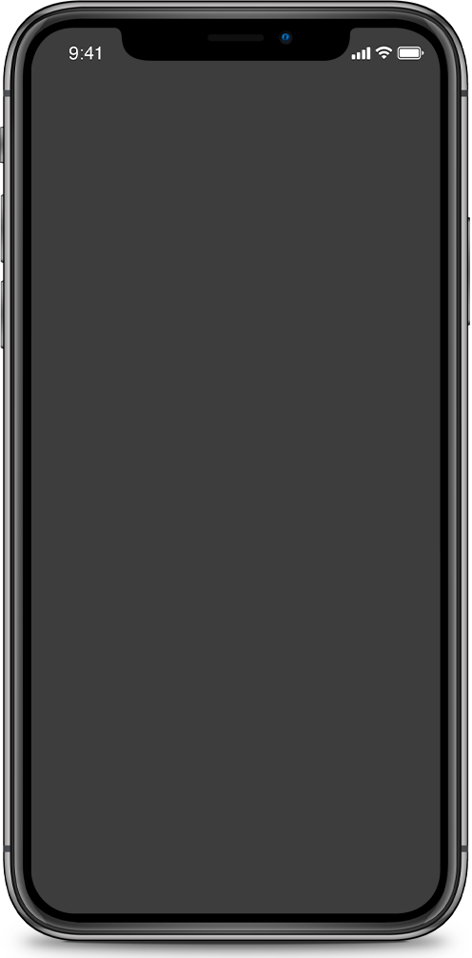
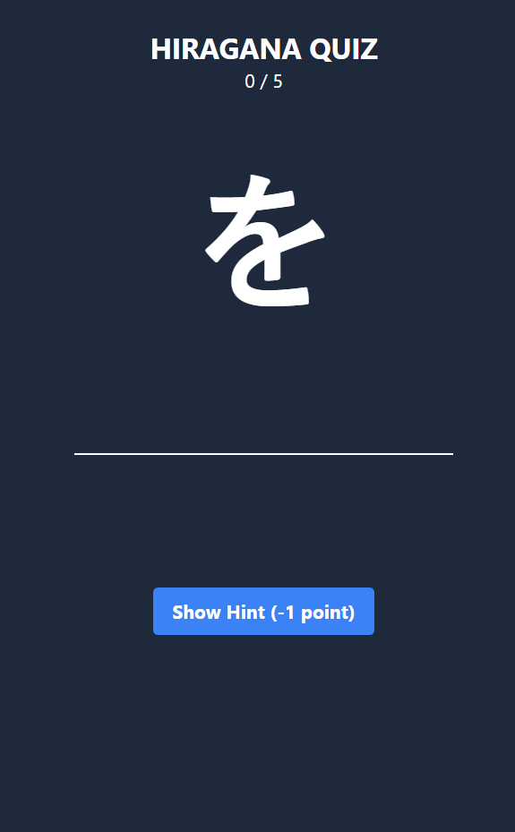
Hiragana Quiz
Learning Japanese Hiragana Made Fun
Shreya Banta
G19
2110992008

Slide 2
紹介
INTRODUCTION
The Hiragana Quiz Application is an interactive educational tool designed to assist individuals in their journey to master the Japanese Hiragana script. Hiragana is one of the fundamental writing systems of the Japanese language, representing syllables and serving as the building blocks for reading and writing in Japanese. Learning and recognizing these characters is a crucial step for anyone interested in understanding and communicating effectively in Japanese.

Slide 3
GOALS
PURPOSE
1
2
1
2
3
Help build a strong foundation to new learners
Test knowledge in a gamified environment.
Reinforce
recognition and recall of characters.
Streak Tracking
User Engagement

Slide 4






Technologies Used
React
HTML
CSS
JavaScript

Slide 5
KEY POINTS
Character Display
The application presents users with a random Hiragana character, along with its Romanized (Romanji) equivalent.
User Input
Users can input their answers in Romanji
to identify the correct Hiragana character.
Streak Tracking
The application keeps track of users' consecutive correct answers, encouraging continuous learning and practice.
Hint Functionality
Users can access hints that provide the correct answer, with a slight penalty to their streak

Slide 6
How It Works
For incorrect answers, the application offers the correct Hiragana character, enhancing the learning experience.
Upon launching the application, users are greeted with a Hiragana character and a text input field.
Users type their answer in Romanji, attempting to match the character with the correct Hiragana.
The application provides instant feedback, indicating whether the answer is correct or incorrect.
Users' streaks are tracked, motivating them to improve their knowledge and challenge themselves.

Slide 7
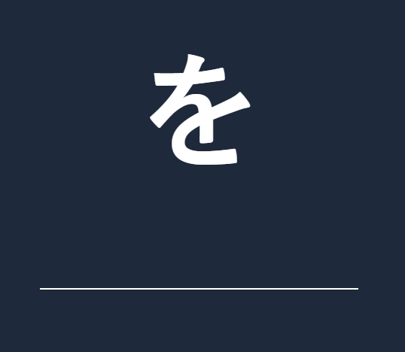
The users are shown a Hiragana Character for which they have to guess the Romanji equivalent . An input field is provided in which the user have to write the answer.
INPUT FIELD

Slide 8
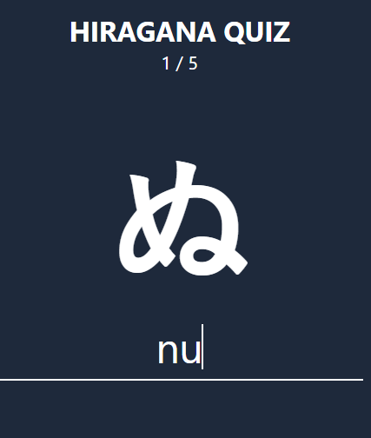
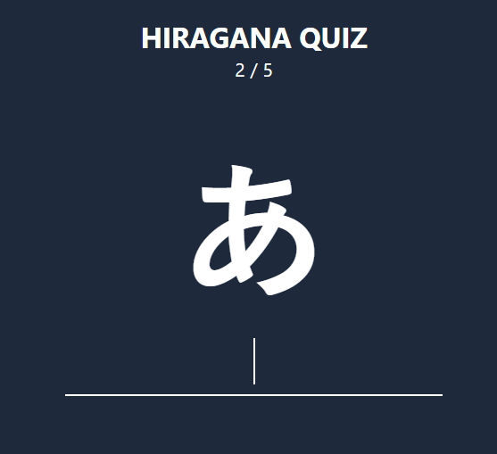
score updated and character changed
When user enters the correct Romanji for the hiragana character , the score increases by 1 and the character is updated to a new character .

Slide 9
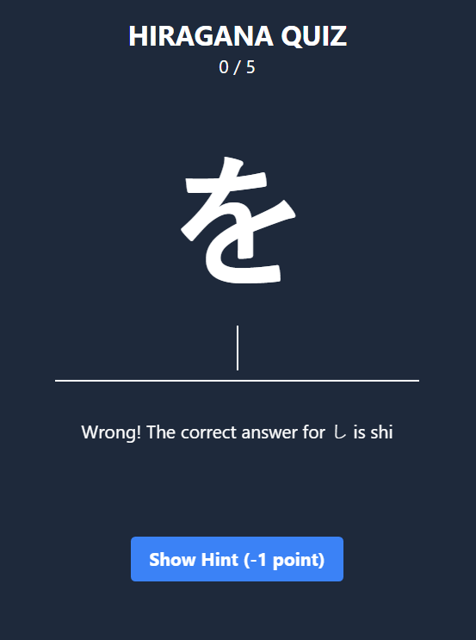
If the input entered is wrong , the current score is set to 0 and the correct answer is given in the feedback .

Slide 10
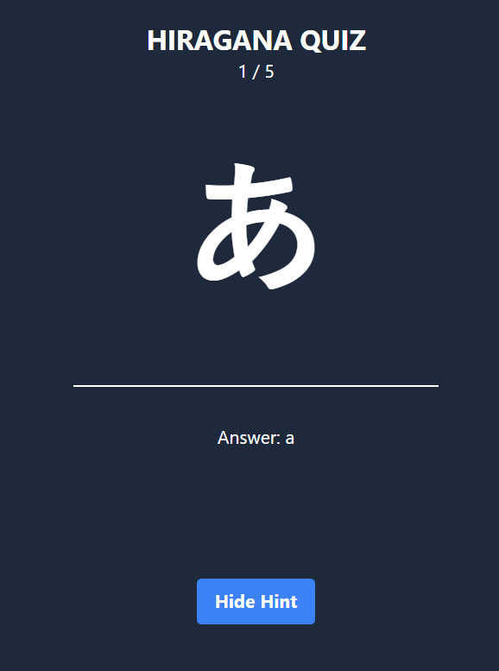
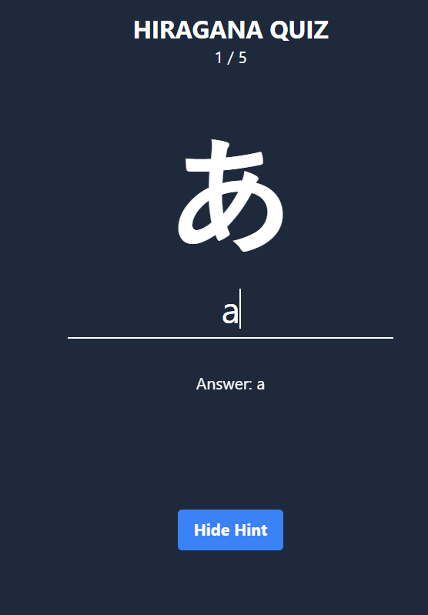
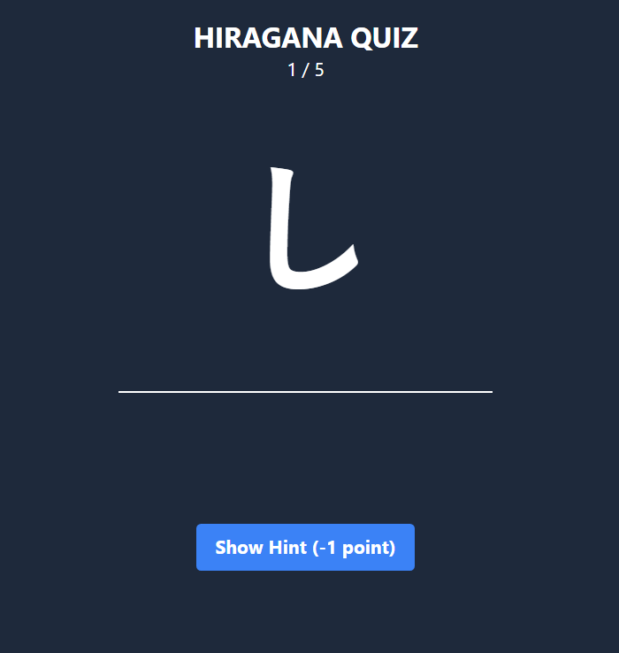
If user needs any help while this fun learning game , he can click on the show hint button for the answer of that particular hiragana character . This will decrease 1 from the current score and after giving the answer the score will not increase and a new character is displayed .

Slide 11
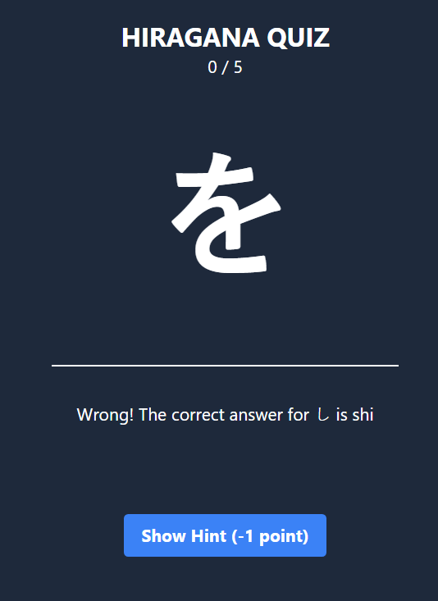
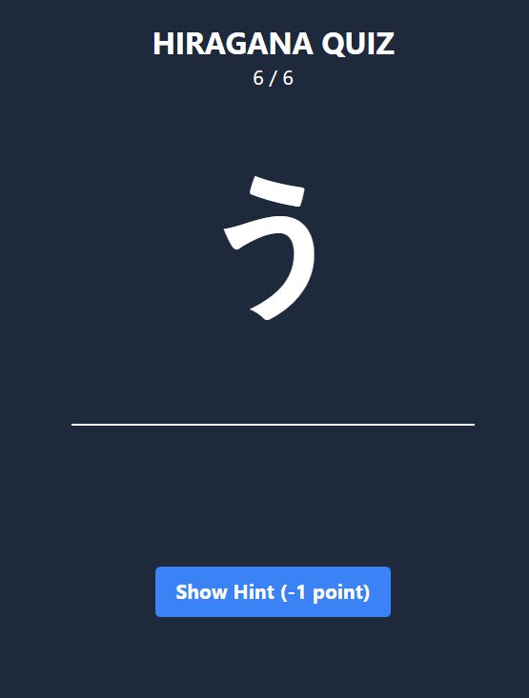
Streak Tracking
This also counts the streaks as you move ahead with the consecutive correct answers creating an environment of encouraging continuous learning and practice.
Initially the streak is 5 . when the user gets to correctly answer more than 5 consecutive answers . The streak will get updated to the further increased number .

Slide 12
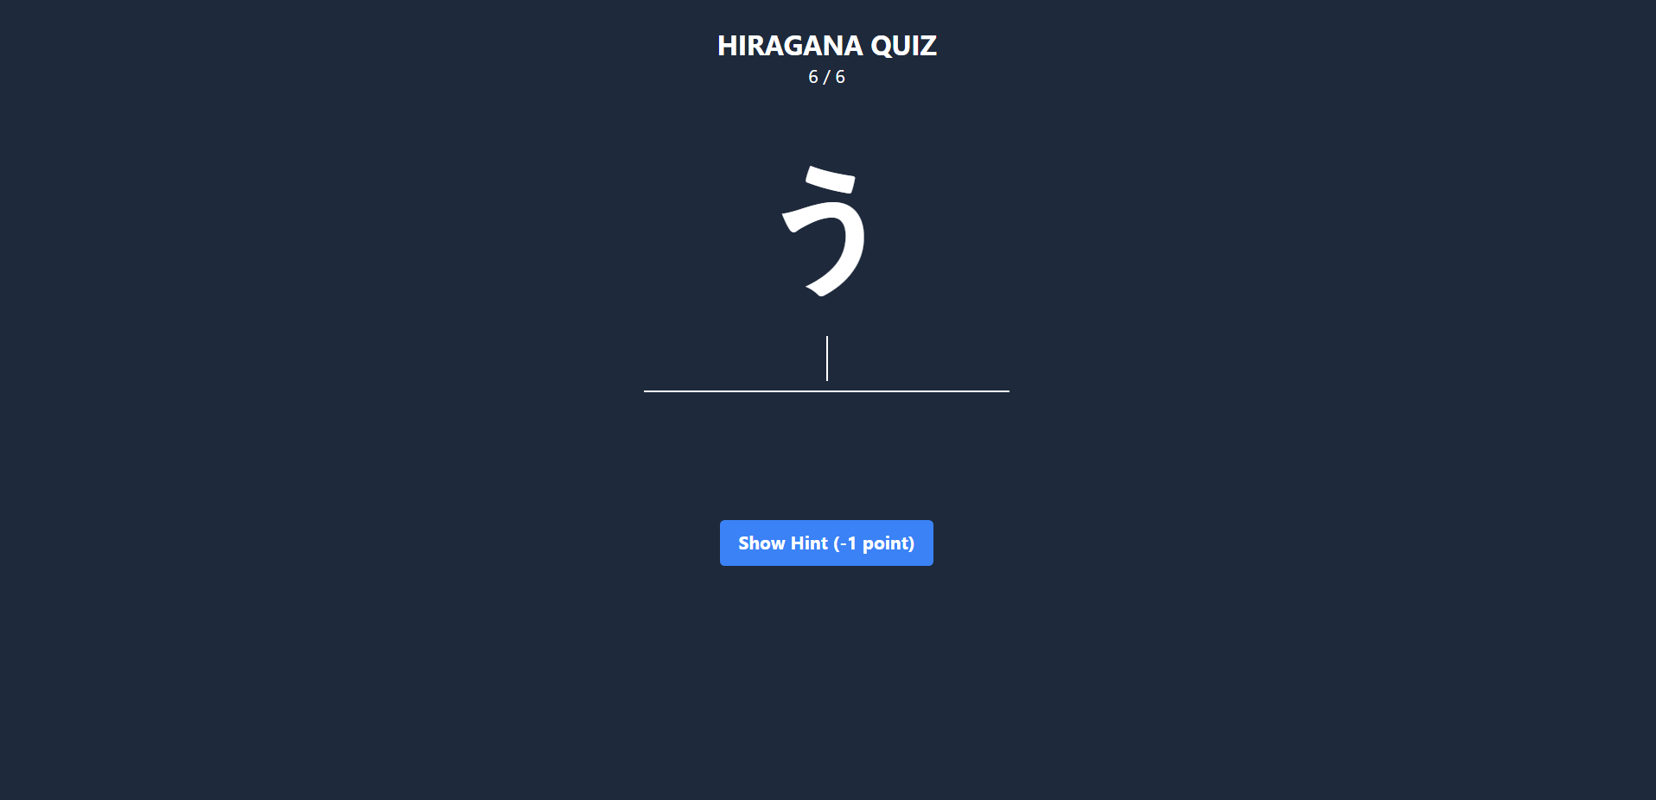
CONCLUSION
Throughout this presentation, we've explored the core features and functionalities of the application, emphasizing its user-friendly interface, instant feedback, and gamification elements. In a world where learning a new script can be daunting, the Hiragana Quiz Application makes it a manageable and enjoyable journey. Whether you're just starting or looking to refine your script recognition skills, our platform is designed to guide you every step of the way.
We encourage you to explore the application, challenge yourself, and experience the joy of mastering Hiragana.

Slide 13
THANK YOU
ありがとう

