Slide 1

Used Cars Price Prediction

Slide 2

Overview
Problem statement
Aim and Objective
Dataset Overview
Data cleaning and Preprocessing
EDA
Feature Selection
PCA
Building machine learning model

Slide 3
Problem statement
Used cars Price prediction using various Machine Learning and Deep learning Algorithms and comparing the evaluation metrics for all.

Slide 4
Aim
To develop an accurate and reliable machine learning model for predicting used car prices based on various features such as make, model and year.

Slide 5
Dataset Overview
Data Source : www.kaggle.com
Features : Model, Make, Mileage, Vin, City, State, Year, Price.
We are using the dataset on used car sales from all over the United States, available on Kaggle. This dataset consists of over 8 Lakh+ rows and 8 columns in total.

Slide 6
Data cleaning and preprocessing
Dropping the column which has no significance.
Checking duplicate values (rows).
Removing the duplicate rows from the dataset.
Checking the missing values.
checking the unique number of values that are present in the categorical columns.
Label encoding the categorical variables as to find out correlation.
Applying Standard Scaler on the columns Year and Mileage.
Removing outlier from the scaled data using z score.

Slide 7
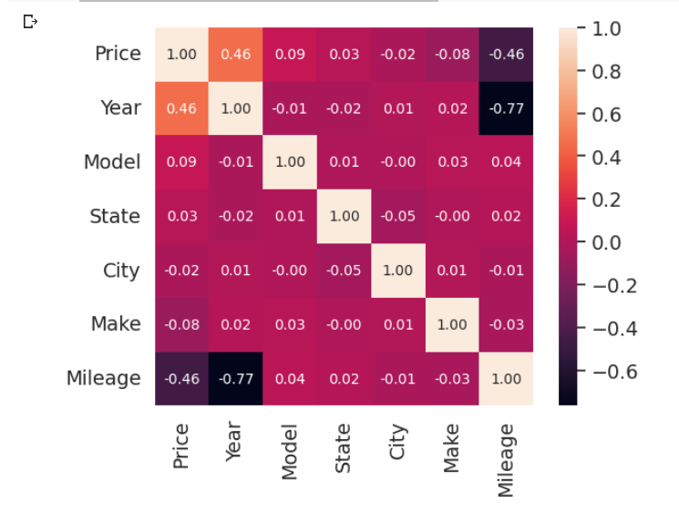
EDA
To check the correlation between all the columns present.

Slide 8
Conclusion from correlation matrix:
Column ‘Year’ has a mild positive correlation with target Price
Column ‘Mileage’ has a mild negative correlation with Price
Column Make and Model have low positive correlation with target Price.
Columns City and State have trivial correlation with the target column price.

Slide 9
Feature Selection
First, we had dropped ‘City’ and ‘State’ from the dataset, because they show weak correlation with response variable i.e. price
Selected Features: Model, Make, Mileage, Year.

Slide 10
PCA
Applying One Hot Encoder the categorical columns.
After train test split, we are applying PCA to select only the significant values that will affect our target variable.
After applying PCA we have 35000 rows and 685 columns.

Slide 11
Building machine learning model
We had trained several Machine Learning models and compare their results.
Considered Models: Lasso Regression , Ridge regression , Random Forest, catboost, XGBoost, Neural Network.
Model Evaluation:
Evaluation Metrics: Mean Absolute Error (MAE), Mean Squared Error (RMSE), r2 score.

Slide 12
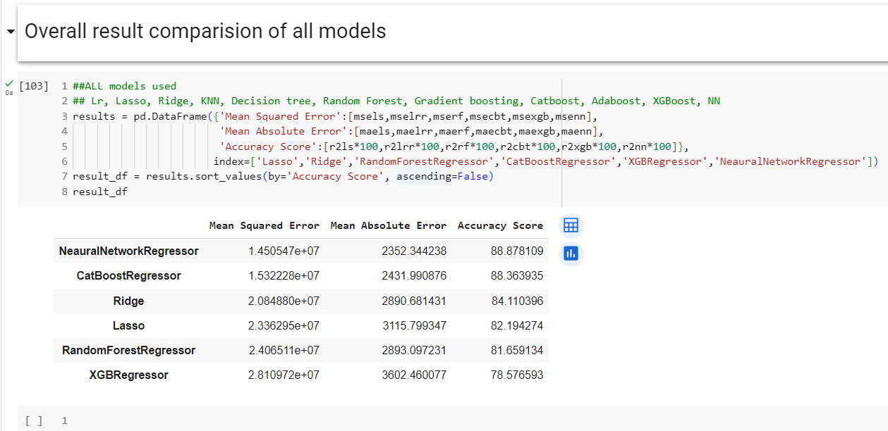
Model Selection:
Evaluate and compare different regression models, such as Lasso regression, Ridge regression, Random forest, catboost and XGBoost, to identify the most suitable one.
Best Model :

Slide 13
ETL
We have applied ETL using Hadoop
First putting the dataset csv file on HDFS using -put command
Creating a table in Hive with same parameters as original dataset and loading the dataset from HDFS to Hive table
Connecting Pyspark to Hive and accessing table to perform transformation onto it

Slide 14
Conclusion
After preprocessing of data. The null entries and missing values were removed from the dataset and the categorical variables were also processed using One Hot Encoding technique.
The r2_score of Neural network was 0.85 which is good as compare to other models and predictions were quite close to selling prices.

Slide 15
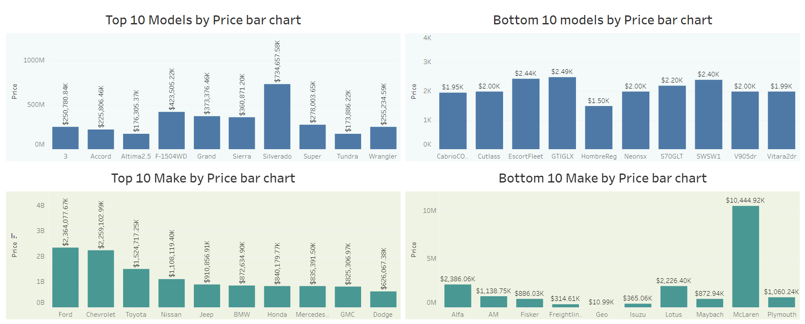
Data Analysis

Slide 16
THANK YOU

