Slide 1
Customer Churn Business Analysis

Slide 2
Business Problem
Customer churn is a major challenge for telecom companies. When customers leave the service, companies lose recurring revenue and must spend more on acquiring new customers.
Key issues:
High customer switching rate
Increased marketing cost
Reduced customer lifetime value

Slide 3
Project Objectives
• Analyze telecom customer data • Identify patterns influencing churn • Perform exploratory data analysis • Build a predictive churn model • Provide data-driven business recommendations

Slide 4
Data Preparation
Steps performed:
Checked missing values
Verified data types
Converted categorical data to numerical values
Removed irrelevant columns
Prepared dataset for analysis
Tools used:
Python
Pandas
NumPy

Slide 5
Exploratory Data Analysis
EDA was conducted to understand customer behavior.
Techniques used:
• Distribution analysis • Correlation analysis • Comparative analysis
Key visualizations created:
Churn distribution chart
Monthly charges vs churn
Tenure distribution
Correlation heatmap
Demographic comparisons

Slide 6
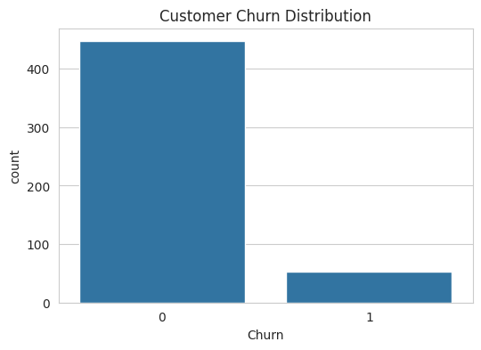
Churn Distribution
Majority of customers remain with the company
A significant percentage of customers leave the service
Indicates a potential revenue risk

Slide 7
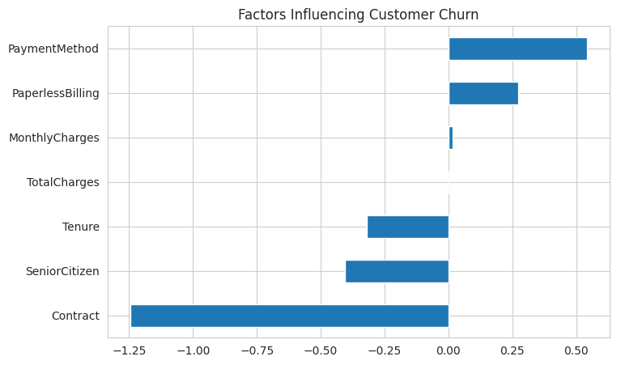
Key Factors Influencing Churn
High monthly charges
Short customer tenure
Month-to-month contracts
Certain payment methods
Senior citizen demographic

Slide 8
Key Business Insights
• Customers with higher monthly charges churn more frequently • Customers with short tenure are more likely to leave • Month-to-month contract customers churn more • Certain demographics show higher churn patterns

Slide 9
Conclusion
This project demonstrates how data analytics and machine learning can help businesses understand customer behavior and reduce churn.
Key outcomes:
✔ Identified churn drivers ✔ Built predictive model ✔ Provided business recommendations
Data-driven strategies help telecom companies improve retention and profitability.

