Slide 1

ANALYSIS ON RESTAURANTS
SHREYA DEVAGIRI 119 01FE20BCS019
ABHISHEK PATIL 147 01FE20BCS047
ATHAR MUJTABA 153 01FE20BCS054
HRISHIKESH VASTRAD 156 01FE20BCS057

Slide 2
CONTENT:-
PROBLEM STATEMENT
DOMAIN UNDERSTANDING
DATA UNDERSTANDING
DATA PREPROCESSING
EXPLORATORY DATA ANALYSIS
CONCLUSION

Slide 3
PROBLEM STATEMENT
Analysis of day by day growing restaurant business in different cities with respect to rating, votes, price and cuisine category.

Slide 4
DOMAIN UNDERSTANDING
The foodservice industry has thrived in the early 250 BC in India. There are indeed so many aphorisms about the blooming of restaurant services.
Food is a big part of the Indian culture. Whether it’s an everyday meal prepared lovingly for the family or special celebratory culinary treats made during festivals – food has always been something that Indians have bonded over.
Consumers are seeking newer ways to both eat in and eat out and restaurant majors, especially in the organized market, are responding to these trends fast.
Every restaurant has an online food ordering system is software that allows restaurant businesses to accept and manage orders placed via a website or mobile app which has led them to lot of profits
Consumers can look up for nearby restaurants, services and order food based upon that.

Slide 5
DATASETS:
Restaurant India Dataset:
It consists data of major cities of India.
It contains 105623 X 19.
2. Restaurant Metro Dataset:
It consists data of metro cities of India (Ahmedabad, Bangalore, Chennai, Delhi, Hyderabad, Kolkata, Mumbai, Pune, Surat)
It contains 8691 X 15.

Slide 6
ATTRIBUTES
ATTRIBUTE NAME | DESCRIPTION | TYPE OF DATA
NAME | Restaurant name. | Nominal Data
CITY | Restaurant belongs to that particular city. | Nominal Data
REGION | A particular area or part of the city. | Nominal Data
PRICE | Price Of Food Item. | Continuous Data
VOTES | Number of Customers voted for this restaurant. | Discrete Data

Slide 7
ATTRIBUTES CONTINUED:
CUISINE CATEGORY | Type of food. | Categorical Data
CUISINE TYPE | Type of Restaurant. | Categorical Data
PAGE NO | It specifies on which page the restaurant is available. | Numerical Data
TIMING | Timing of Restaurant. | Continuous Data
RATING | On the scale of 1-5 customers have rated the restaurant. | Ordinal Data
RATING TYPE | It defines whether the restaurant is Bad, Good and Average. | Ordinal Data

Slide 8
ATTRIBUTES CONTINUED:
MEN_EMPLOYEE | Number of men working in the restaurant. | Discrete Data
WOMEN_EMPLOYEE | Number of women working in the restaurant. | Discrete Data
DELIVERED_FOOD_APPROX | Number of food packets delivered from that restaurant in a month. | Discrete Data
DELIVERY_TIME | Time taken for delivering the food | Continuous Data
PEAK TIME | The time at which restaurant has maximum profit | Continuous Data

Slide 9
Data Integration
As Restaurant India Dataset and Metropolitan Dataset contains the same attributes we can merge them to form a single dataset.
After merging the data set the shape of the dataset is 114319 rows × 18 columns
For peak time we should consider only consider the hour.
Data Standardization: -Conversion of Rating and Votes are in object which should be converted into numeric.
Merged data contains missing values and it’s matrix is:-

Slide 10
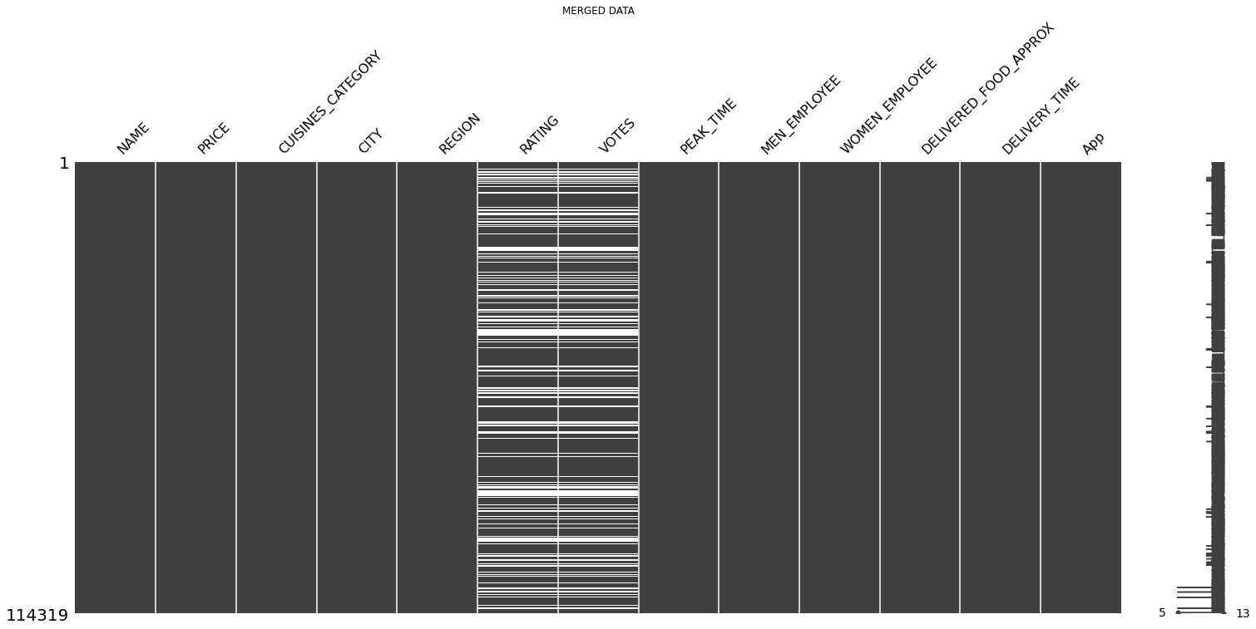
Data Preprocessing

Slide 11
Data Cleaning
Dropped Columns: -
URL, PAGENO, TIMING and RATING_TYPE are dropped as they are no use to our analysis.
Elimination of Null Values present in dataset.
Null values present in NAME, CITY, REGION are dropped.
Null values present in RATING And VOTES can’t be replaced by mean, median or by frequency hence it should be dropped.

Slide 12
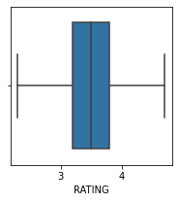
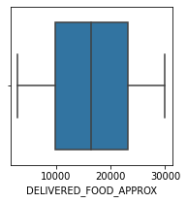
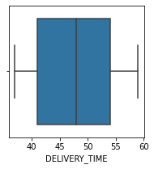
OUTLIERS
Flooring and Capping method
After Removal of outliers in our data set the boxplot looks like this

Slide 13
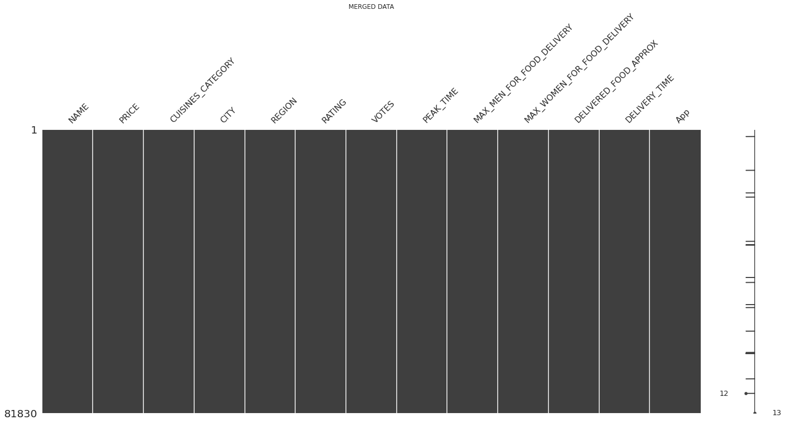
After cleaning the data matrix:
Matrix representing clean data

Slide 14
From the given dataset we have selected top 10 cities with maximum number of Restaurants because we have 29 states in India and analysing all 29 states respectively would be a larger data.
Hence Top 10 cities are selected i.e. Chandigarh, Jaipur, Ahmedabad, Kolkata, Chennai, Hyderabad, Pune , Bengaluru,Mumbai,Delhi.

Slide 15
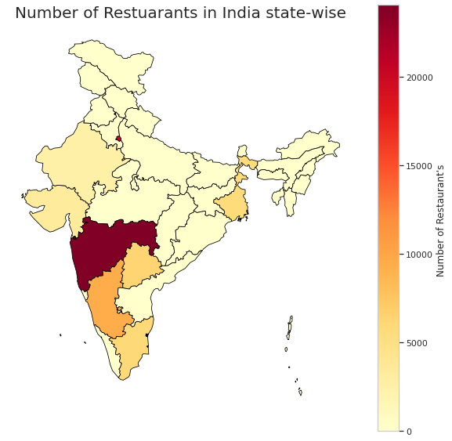
Number of Restaurants Distribution State wise
Delhi
West Bengal
Rajasthan
Gujarat
Hyderabad
Maharashtra
Karnataka
Tamil Nadu

Slide 16
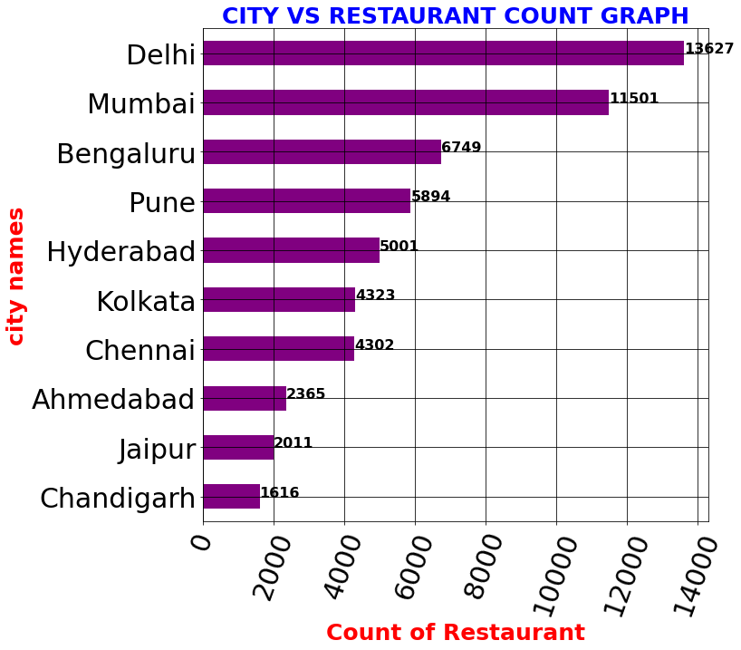
PRELIMINARY EXPLORATORY DATA ANALYSIS WITH VISUALIZATIONS.
TOP 10 CITIES WITH NUMBER OF RESTAURANT

Slide 17
QUESTIONS:
1.City that pays the highest commission price to Zomato for delivering the food.
2. Restaurants with good rating and how well they can advertise.
3. Distribution of restaurant type.
4. Most Famous restaurants Chains in Metro Cities.
5. In various cities price varying based upon the rating category.
6. In metropolitan cities and in non-metropolitan cities how does it vary with price.

Slide 18
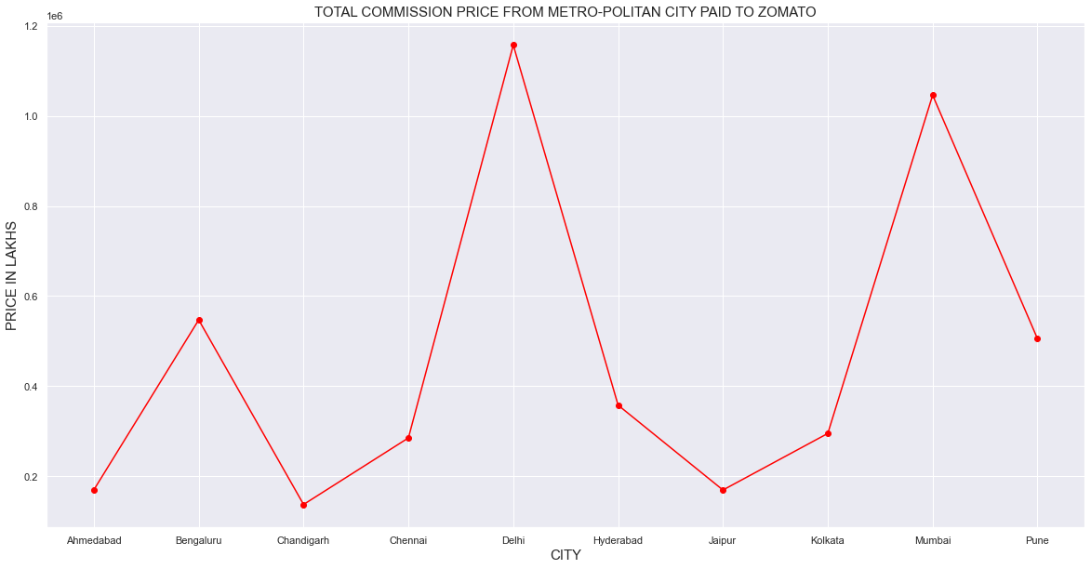
1. City that pays the highest commission price to Zomato for delivering the food

Slide 19
INFERENCE:-
Delhi pays the highest commission price to Zomato they pay 11 lakhs Rs/-
Mumbai is the second highest commission price payer to Zomato they pay 10 lakhs Rs/-
Chandigarh pay’s the lowest commission price to Zomato they pay 1 lakh Rs/-

Slide 20
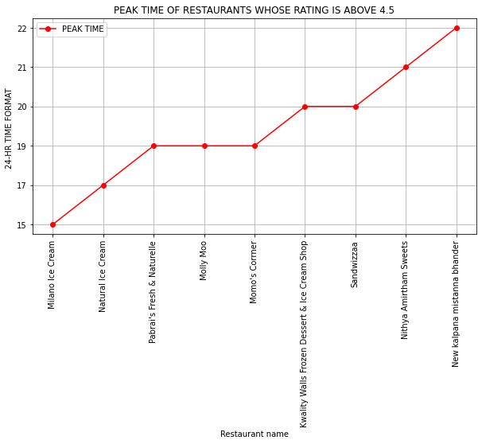
2. Restaurants with good rating and how well they can advertise
INFERENCE:-
From this graph we can say that during their peak time restaurant can send the advertisement to the customers through the food delivery applications or by using any other resources.

Slide 21
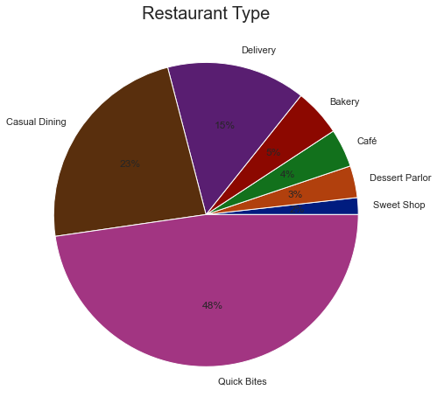
3. Distribution of restaurant type.
INFERENCE:-
The Restaurants in Top Cities are of type Quick bites i.e. of 48% and Casual Dining i.e. of 23% and Delivery i.e. of 15%.

Slide 22
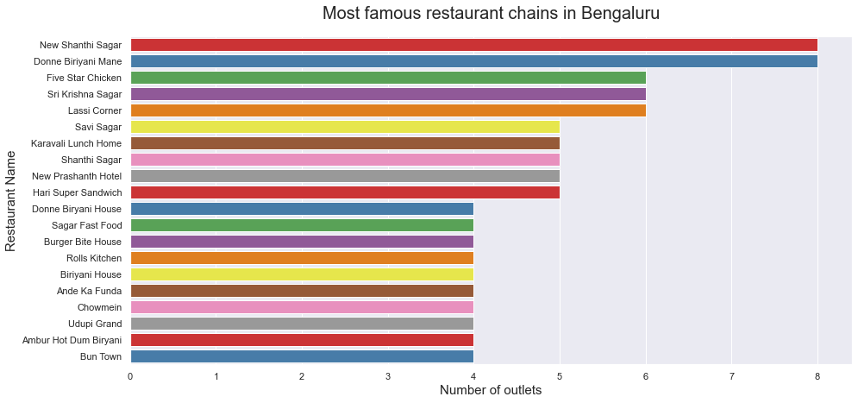
4. Most Famous Restaurants Chains in Metro Cities
INFERENCE:-
New Shanti Sagar and Donne Biriyani Mane has maximum number of outlets in Bengaluru i.e. totally 8 outlets across Bengaluru.

Slide 23
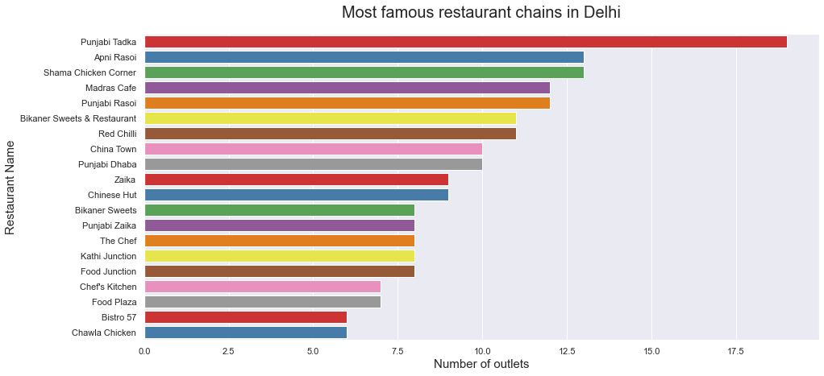
INFERENCE:-
Punjabi Tadka has
maximum number of outlets in Delhi i.e. totally 18 outlets and second is Apni Rasoi with 13 outlets across Delhi.

Slide 24
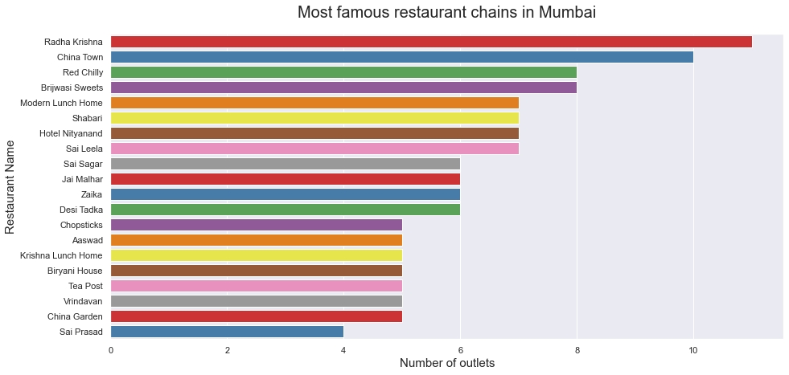
INFERENCE:-
Radha Krishna has
maximum number of outlets in Mumbai i.e. totally 11 outlets and second is China Town with 8 outlets across Mumbai.

Slide 25
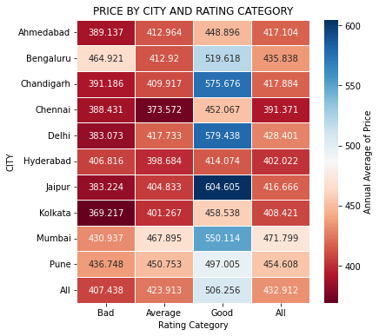
5. In various cities price varying based upon the rating category.
Inference: -
In Chennai the price of the food cost nearly 392 Rs/- which is the lowest among the metropolitan cities.
In Mumbai the price of the food cost nearly 472 Rs/- which is the costliest among the metropolitan cities.
In Hydreabad the food is good and the price is also less compared to other cities.

Slide 26
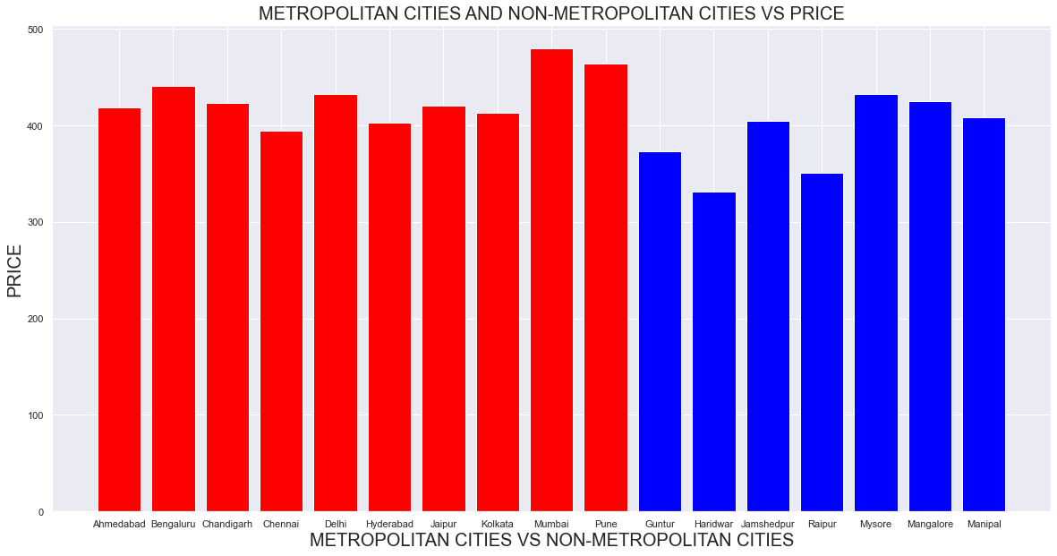
6.In metropolitan cities and in non-metropolitan cities how does it vary with price.

Slide 27
INFERENCE:-
In the above bar graph the red bar represents the metropolitan cities where as the blue bar one represents the non-metropolitan cities, we can see that price of food is more in metropolitan cities compared to non-metropolitan cities.

Slide 28
CONCLUSION:-
1. The city that paid the highest commission price to Zomato app for delivering the food from their restaurant to the customers.
2. The restaurant can use their peak time the time at which the sales of restaurant is more and whenever it’s their peak time they can send a notification to their customers and attract new customers with good advertising of their restaurant
3. The major type of restaurant in Metropolitan cities is Quick Bites.
4. Number of food chains in Bengaluru, Mumbai and Delhi.
5. In cities price varies based upon the rating category
6. In metropolitan and in non-metropolitan cities price of the food varies.

Slide 29
THANK YOU

