Slide 1

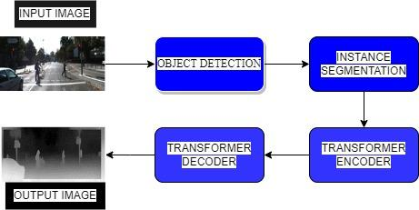
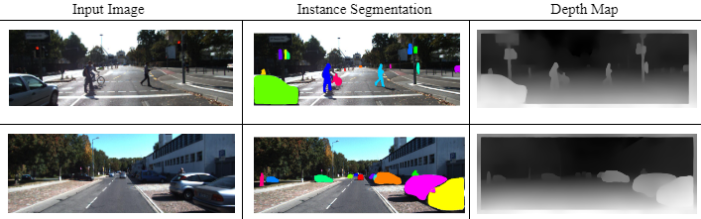
Image Depth Estimation
Team Members: Shreya (01FE20BCS019), Sneha (01FE20BCS035), Rohit (01FE20BCS246), Nishanth (01FE20BCS204)
Guide: Dr.Meena S.M
Team Num: I8
Mini-Project, 5th sem, 2022-23
School of Computer Science and Technology
Problem Domain: Data Analytics/AI and ML Problem Definition: To estimate the depth of each pixel in an image, given a single 2D image as input this is referred to as image depth estimation. The approach to this problem is to use machine learning techniques to learn a mapping from the 2D image to the depth map generation. Objectives: To implement and compare among various methods and algorithms for Object detection, Segmentation and Generation of Depth Map. To perform object detection followed by instance segmentation on a given image for depth estimation. To generate a depth map for the segmented image for depth prediction. To produce better results than already existing state of the art algorithms and models. | Methodology: Mask RCNN is a deep classification algorithm for object detection and instance segmentation. It is a two-stage approach that first creates potential object areas in a picture using a region proposal network, and then uses a different network to categorize and segment the regions. Convolutional neural networks are used as the encoder and decoder in an transformer model for depth prediction. It is possible to train a fully connected network to create the depth map based on the features that the CNN has learned to extract from the input picture. Result: | Dataset: The KITTI dataset is a large dataset of images and 3D point clouds captured by a vehicle-mounted LiDAR and camera system. The KITTI dataset consists of a number of different data modalities, including stereo images, monocular images, LiDAR point clouds, and GPS/INS data. The dataset also includes ground truth data for a variety of tasks, including object detection, object tracking, 3D object reconstruction, and depth estimation. KITTI dataset is the wide range of scenarios it covers, including urban, suburban, and rural environments, as well as different weather conditions and lighting conditions. This makes it a useful benchmark for evaluating the performance of algorithms on a wide range of different types of data. Conclusion: 1) Designed a multi-picture depth prediction network using transformers. 2) To create a depth map without the aid of ground truth depth, the input image's objects were identified, and after instance segmenting them, the objects were passed to the transformers. Publication Status: Under progress

