Slide 1

BLDEA'S V.P. DR.P.G.HALAKATTI COLLEGE OF ENGINEERING & TECHNOLOGY, VIJAYAPUR
PROJECT ON
“Context based sarcasm detection on regional language using machine learning techniques.”
Team members :
Ruchita Atharga(2BL21CS125)
Sachinkumar Madarakhandi(2BL21CS126)
Shreya Dixit(2BL21CS143)
Shyamala Wathare(2BL21CS186)
Project Guide :
Prof.Santosh Chinchali

Slide 2
CONTENTS:-
Introduction
Methodology
Algorithms
References
Problem Statement
Technology Stack

Slide 3
Introduction
Kannada sarcasm detection is the process of identifying sarcastic statements in the Kannada language. This task is challenging as sarcasm often involves the use of language that is opposite to the intended meaning. Automatic detection of sarcasm in Kannada can improve sentiment analysis, humor recognition, and social media monitoring.

Slide 4
Problem Statement :-
Sarcasm detection in Kannada poses a significant challenge due to the complexity of the language and the subtlety of sarcasm. Kannada is a Dravidian language spoken in the southern part of India with a rich vocabulary, and the language is known for its linguistic nuances. The difficulty in detecting sarcasm in Kannada arises due to the lack of clear cues and the usage of intricate grammar patterns. Therefore, developing a reliable sarcasm detection system in Kannada requires addressing these challenges and exploring novel approaches to capture the subtlety of sarcasm in the language.

Slide 5
Pre-processing:-
TEXT MINING
Data Collection
Pre-Processing
Tokenization
Stop Word Removal
Stemming
Part of Speech(POS)
Tagging
1
2
3
4
5
6

Slide 6
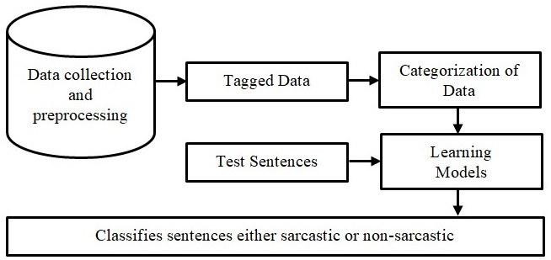
Methodology:-

Slide 7
Technology Stack:-
1.Programming Language
Python: The core language used for implementing the solution.
2.Data Processing and Analysis
Pandas: For data manipulation and analysis.
NumPy: For numerical operations and array handling.
3.Natural Language Processing (NLP)
NLTK: For tokenization and text processing.
TF-IDF Vectorizer (from sklearn): For feature extraction from text.
Custom Text Cleaning and Stemming: Includes handling Kannada text processing through suffix removal rules.
4.Machine Learning Models
5. Data Visualization
Seaborn: For visualizing the confusion matrix.
Matplotlib: For plotting graphs and visual data representation

Slide 8
Linear SVC
Logistic Regression
SGD Classifier
SVC
ALGORITHMS
Multinomial NB
Random Forest Classifier
XG Boost
BERT

Slide 9
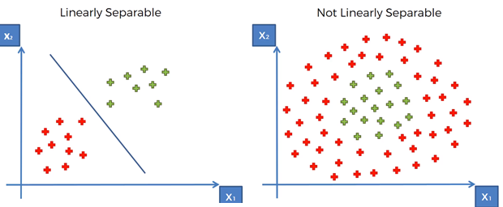
Linear SVC

Slide 10
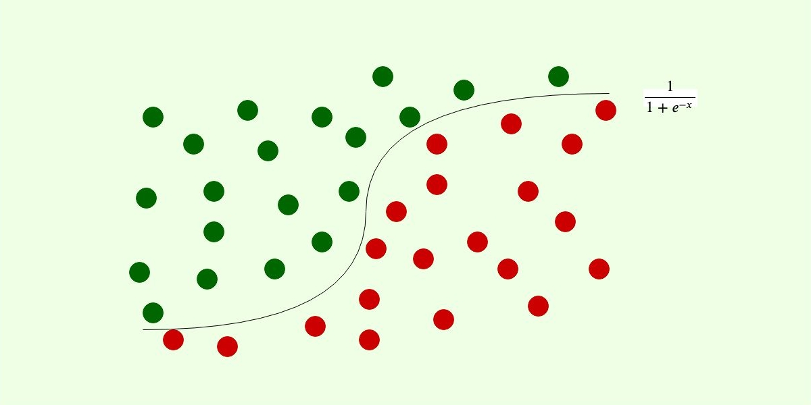
Logistic Regression

Slide 11
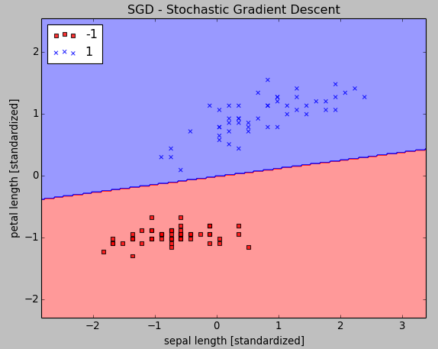
SGD Classifier

Slide 12

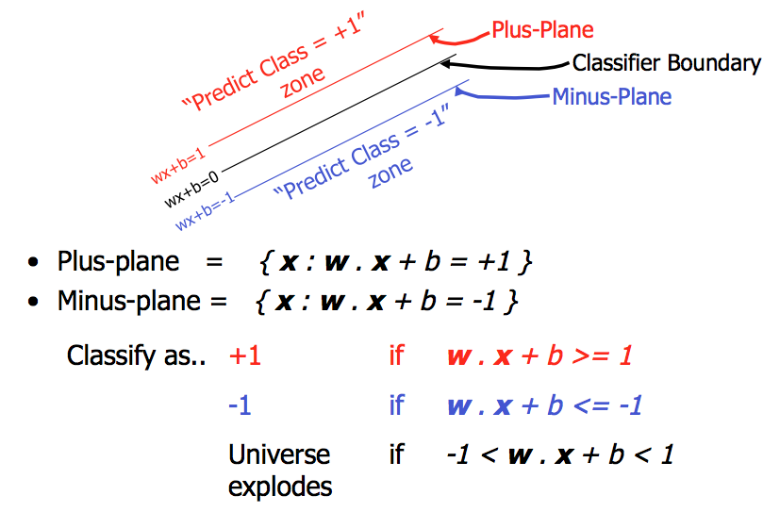
SVC

Slide 13
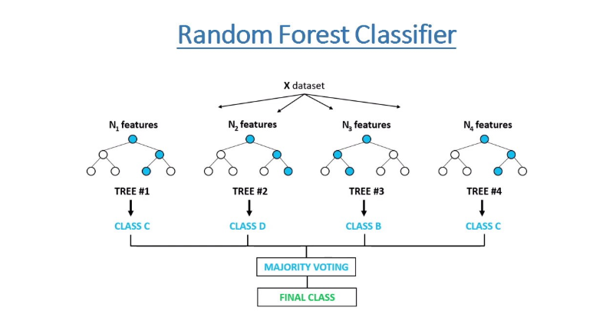

Slide 14
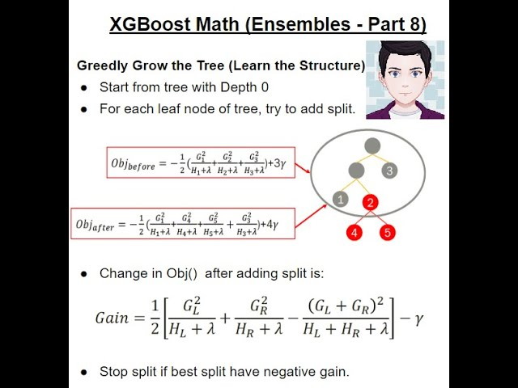
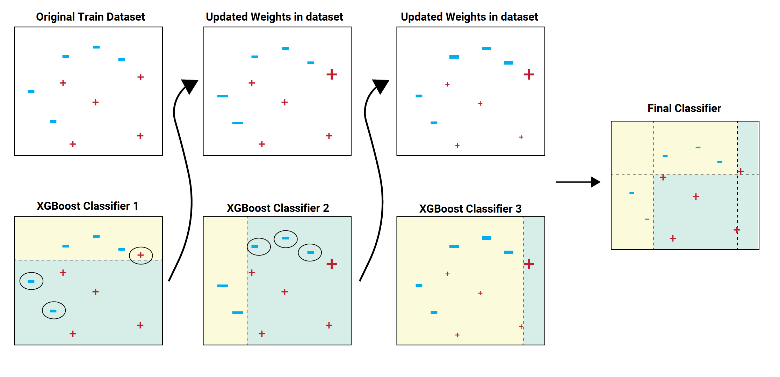
XGBoost

Slide 15
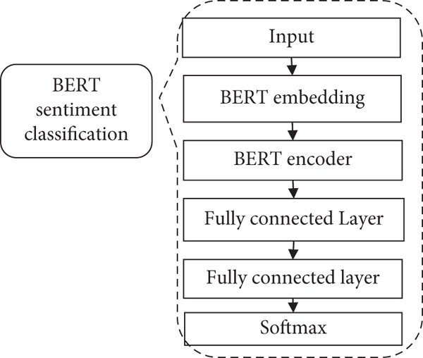
BERT Algorithm
What is BERT?
Definition: BERT (Bidirectional Encoder Representations from Transformers) is a
state-of-the-art NLP model developed by Google.
Key Features:
Bidirectional Context
Transformer Architecture
Pre-trained on Large Corpora
Why BERT?:
It overcomes the limitations of traditional models like Context Ignorance,
Language-Specific Issues, Performance Bottlenecks by capturing deep contextual information.

Slide 16
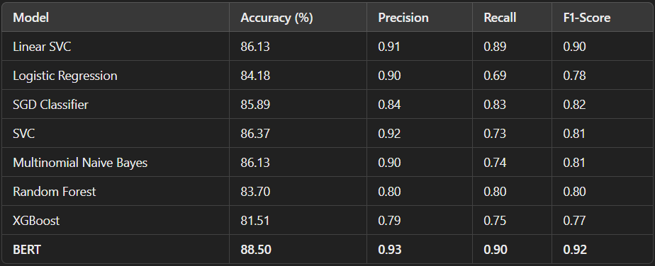
Evaluation Matrix:-

Slide 17
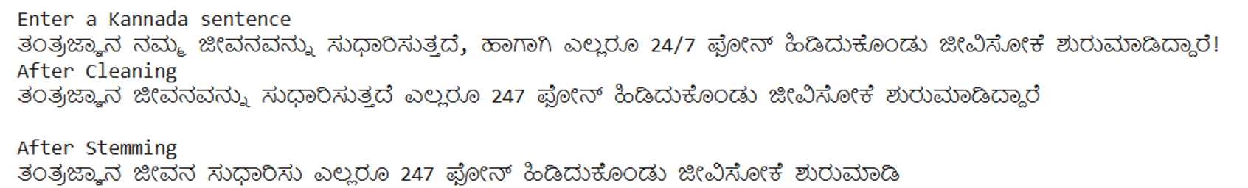

Results :-

Slide 18
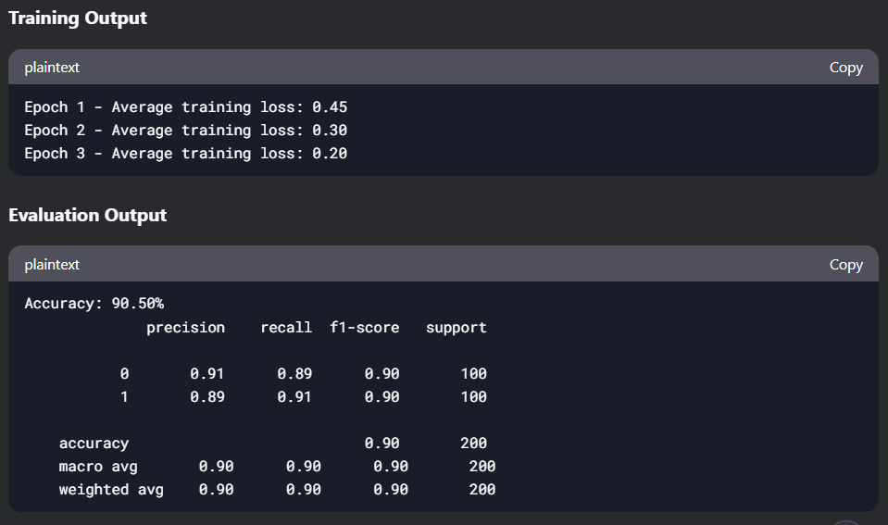

Slide 19
Percentage of Implementation with Attainment of Objectives
Objective | Status | Percentage Completed
Implementation of ML Models | Completed | 100%
Dataset Collection | Completed | 100%
Implementation of new Algorithm | Completed | 100%
Overall Project Completion | Completed | 100%

Slide 20
CONCLUSION
The task of detecting sarcasm in Kannada language has gained attention in recent years due to the increasing use of social media platforms.
Models like Linear SVC and Random Forest performed well but were limited by their inability to capture contextual nuances in text.
BERT’s bidirectional context understanding enabled it to capture subtle sarcastic cues effectively.
Fine-tuning BERT on the Kannada dataset resulted in significantly higher accuracy and F1-score compared to traditional models

Slide 21
REFERENCES
Deep learning for sarcasm identification in news headlines by Rashik Ali , Tayyab Farhat , Sanya Abdllah , Sheeraz Akram ,Mousa Alhajlah on 30 April 2023 by MDPI (Multidisciplinary digital publishing institute)
Detecting sarcasm in customer tweets:an NLP based approach by Shubhadeep Mukherjee,Pradip Kumar Bala on 15 Nov 2016 by Emerald group of publishing
Deep contextualised text representation and learning for sarcasm detection by Raviteja Gedela , Ujwal Baruah , Badal Soni on 14 Aug 2023 by Springer publication.
4. Textual Data Analysis for Identifying sarcasm in Kannada by Manohar R ,Suma Swamy on Tuijin Jishu/Journal of
Propulsion Technology ISSN: 1001-4055 Vol.44 No. 6 (2023)
Context based Sarcasm detection in Hindi tweets by Santosh kumar Bharti , Korra Sathya Babu , Rahul Raman on 4 Nov 2014 by Researchgate publication.
Sarcasm Detection of Sentiments in Telugu Language by Suneetha Eluri,Naga santosha Lahari Penmatsa on ISSN:
2249-8958 (Online), Volume-10 Issue-1, October 2020
Deep CNN-LSTM with Word Embeddings for News Headline Sarcasm Detection by Md saifullah razali , alfian
adul halin , shyamala doraisamy on Aug 2019 by Springer Nature Switzerland
Sarcasm Detection Using Deep Learning With Contextual Features by Md saifullah razali , alfian abdul halin ,
shyamala doraisamy on April 30, 2021 by IEEE Access with the Digital Object Identifier (DOI)
9. Scola, E. and Segura-Bedmar, I. (2021), “Sarcasm detection with BERT”, Procesamiento Del Lenguaje Natura, Vol. 67, pp. 13-25.DOI: 10.26342/2021-67-1.

