Slide 1

Personalized Music Playlist Recommendation System
MUSIC DATA MINING PROJECT
by
Team: Data Harmonics presenting Shreya Gajbhiye, Ameya Parab

Slide 2

“Music, once admitted to the soul, becomes a part of spirit, and never dies.”
— Edward Lytton

Slide 3
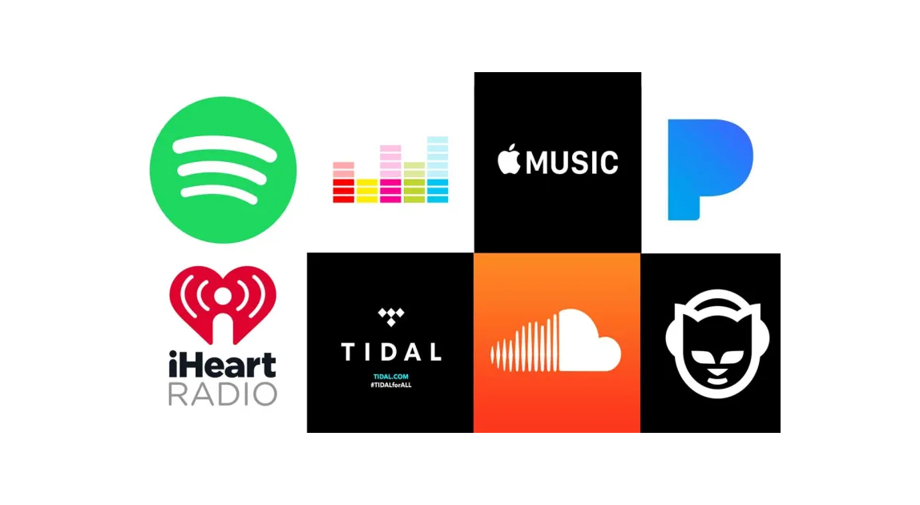
The Essence of Music Recommendation
Spotify, Pandora, Apple Music collect data on what we listen to and recommend new songs.
Types of Recommendation System:
Content Based Filtering - analyze song features and user profile
Collaborative Filtering - user interaction and preferences
Hybrid System - "Mix" of both

Slide 4
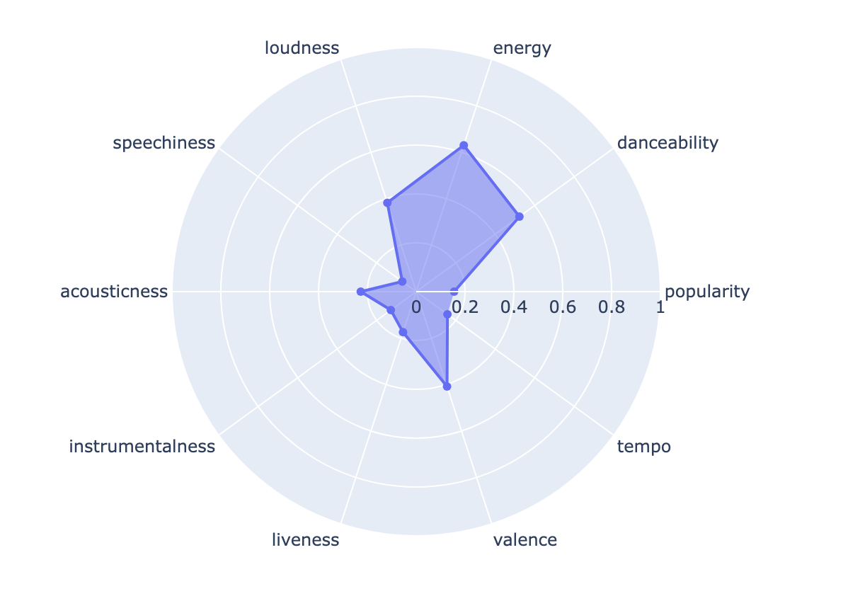
Decoding Musical Language
Beats Per Minute: song's speed (how fast a car is going)
Energy: liveliness of a song (excitement)
Danceability: song's ability to make you dance
Loudness: how loud or quiet a song is!! (volume of TV)
Valence: song's emotional tone (happy or sad)
All these features helps in analyzing the hidden stories behind music.

Slide 5
Previous Research
Challenges
Cold Start: New users, thus, no interactions
Scalability Issues: Sparse Matrix, less interactions between users
Data Sparsity: Computational Complexity can increase with the increase in the users and items.
Solution: "Hybrid Recommendation System"

Slide 6

Spotify Dataset Overview

Slide 7
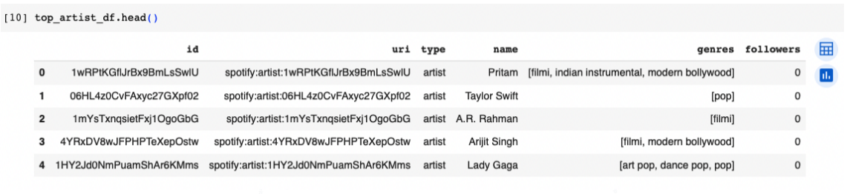
Spotify Dataset Overview
Top-artists: Based on the listening patterns of the user, frequency of their songs played. Exploring this dataset can reveal which artists have captured one’s heart.

Slide 8
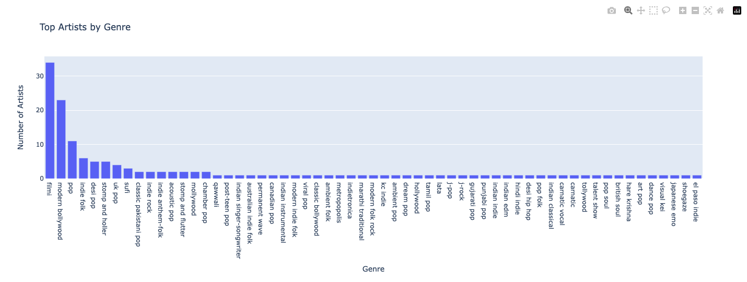
Spotify Dataset Overview
Top-artists: Based on the listening patterns of the user, frequency of their songs played. Exploring this dataset can reveal which artists have captured one’s heart.

Slide 9
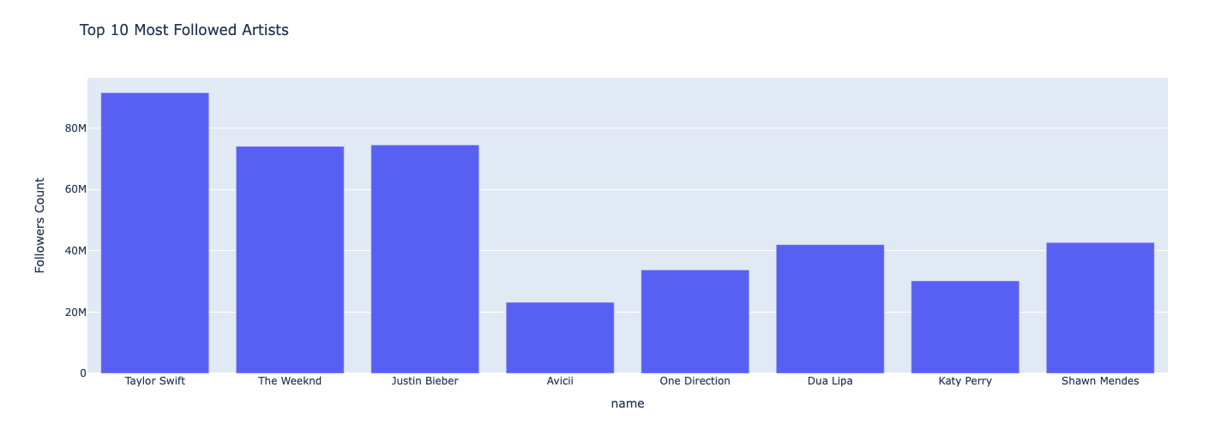
Spotify Dataset Overview
Followed Artists: User's favorite artists whose profiles are followed by the user.

Slide 10
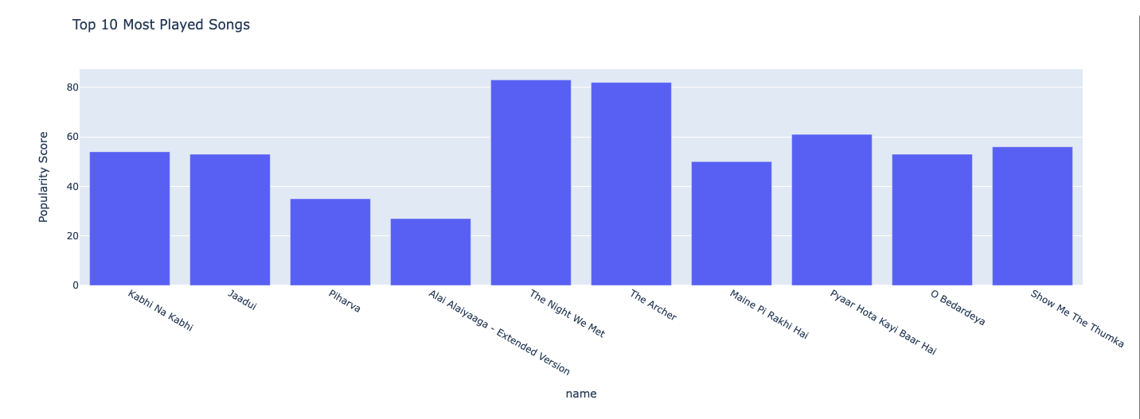
Spotify Dataset Overview
Top tracks: Songs the user listens to the most and are their favorites. This dataset captures various song attributes. Exploring this dataset can reveal which songs have captured one’s heart and become their go-to tunes.

Slide 11
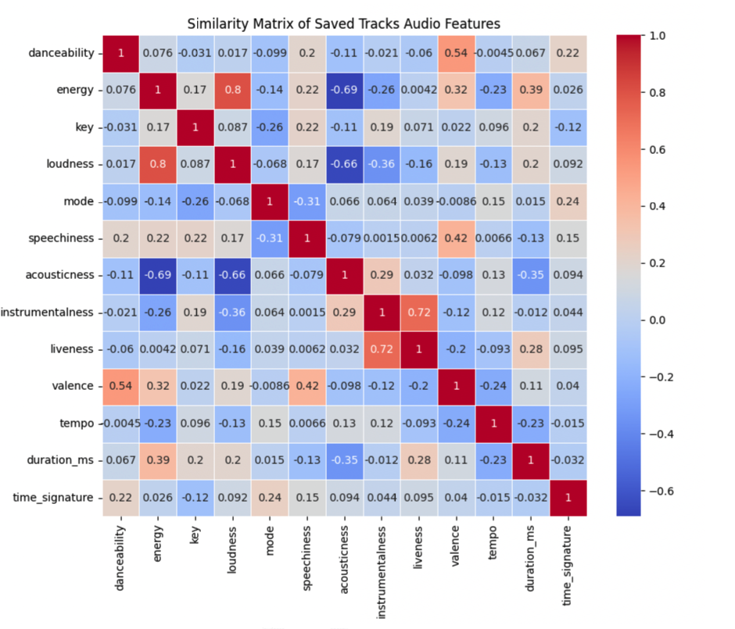
Spotify Dataset Overview
Saved Tracks: User's
saved Spotify library.
It’s like having a collection
of your favorite songs
ready to enjoy!

Slide 12
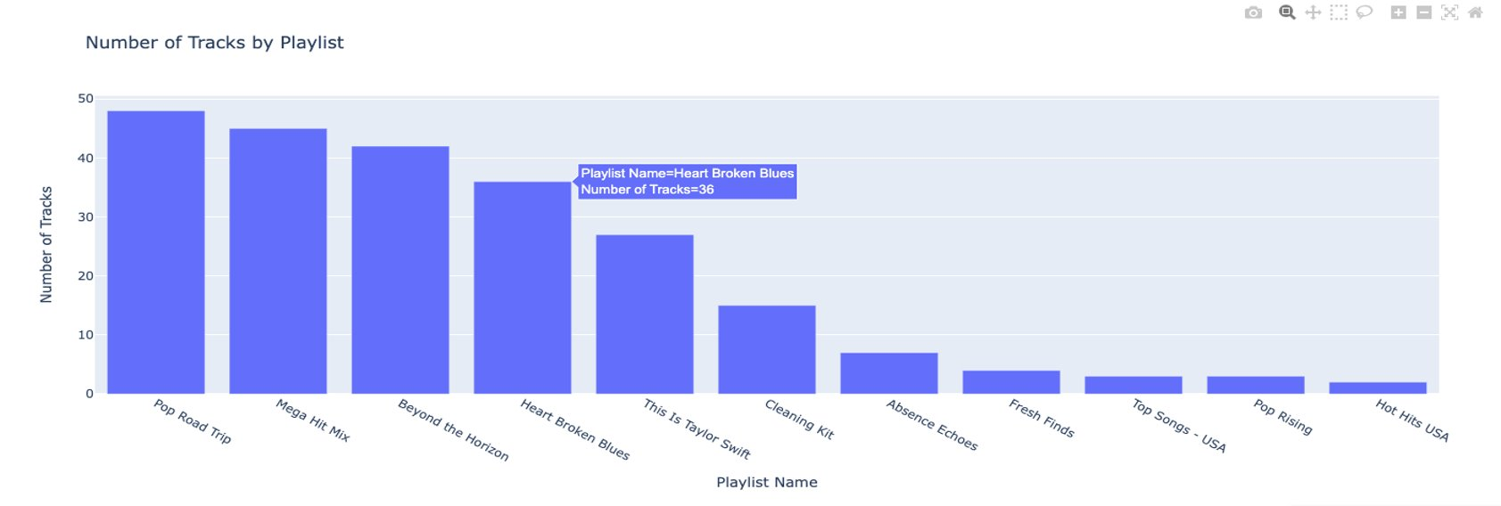
Spotify Dataset Overview
Playlist Tracks: Stores data for tracks from the user's Spotify playlists. Playlists are like customized mixtapes one can create, and this dataset includes details about the songs in them.

Slide 13
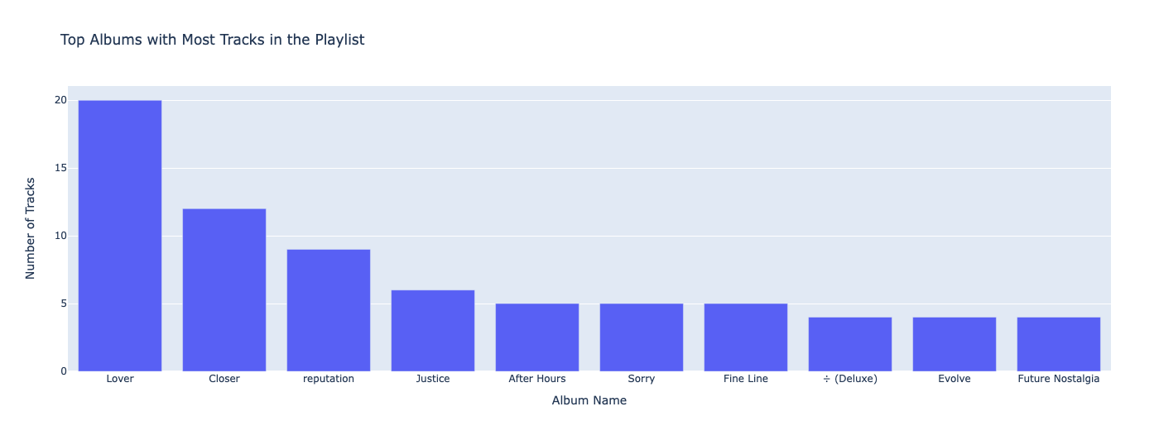
Spotify Dataset Overview
Playlist Tracks: Stores data for tracks from the user's Spotify playlists. Playlists are like customized mixtapes one can create, and this dataset includes details about the songs in them.

Slide 14
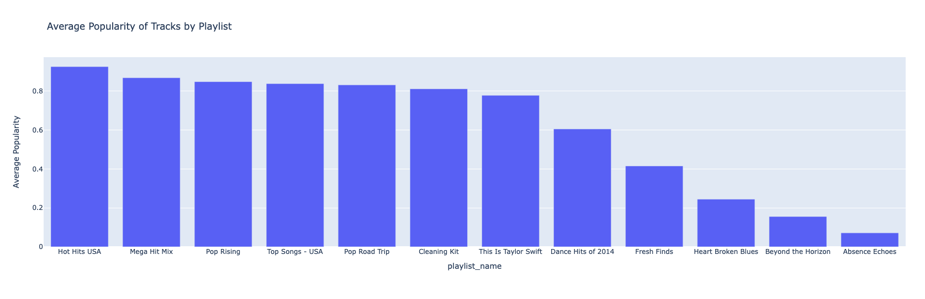
Spotify Dataset Overview
Playlist Tracks: Stores data for tracks from the user's Spotify playlists. Playlists are like customized mixtapes one can create, and this dataset includes details about the songs in them.

Slide 15
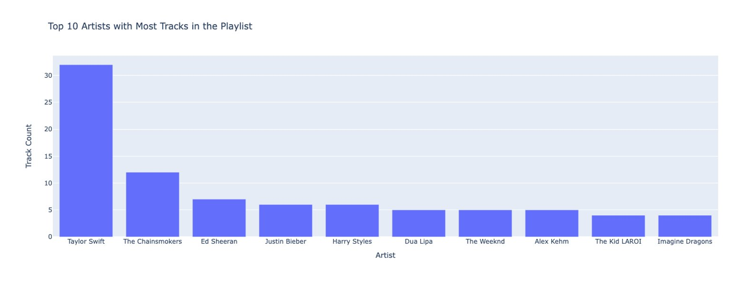
Spotify Dataset Overview
Playlist Tracks: Stores data for tracks from the user's Spotify playlists. Playlists are like customized mixtapes one can create, and this dataset includes details about the songs in them.

Slide 16
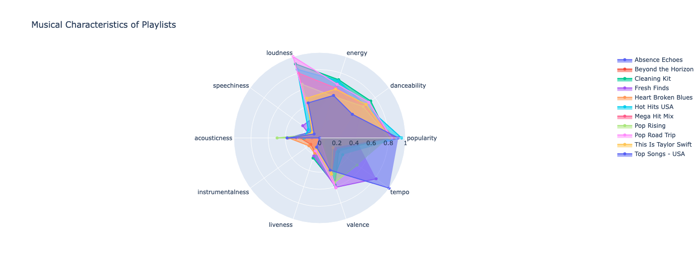
Spotify Dataset Overview

Slide 17
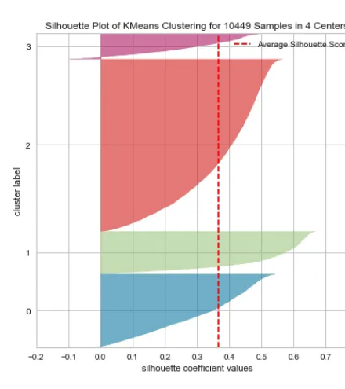
Previous Related Work
K-means Clustering model: Content based approach, when we input a particular song, the model recommends songs by retrieving them from the same cluster.

Slide 18
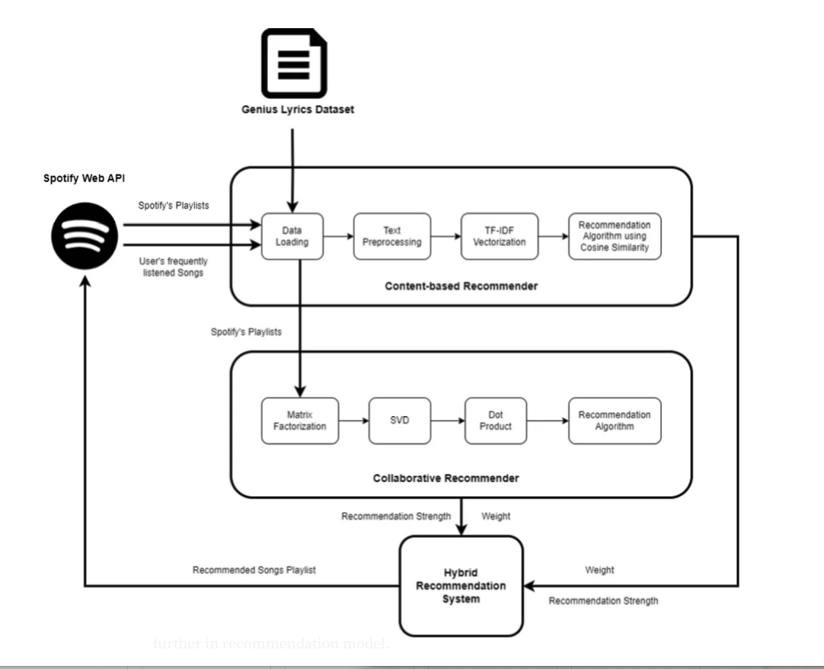
Recommendation System Architecture

Slide 19
Content-based Recommendation System:
Recommendations are made by finding items with similar attributes.
Comparison between content of different items.
Items are represented as vectors so distance and similarity can be easily calculated.
Advantage of using this approach is we can generate recommendations on any unseen items for which attributes are present.

Slide 20
Content-based Recommendation Approach:
Lyrics of the songs are used for finding similarities between songs.
Built using NLP techniques to analyze textual data of lyrics.
Steps involved:
Data Normalization (Cleaning Lyrics)
Text Representation (TF-IDF Vectors)
Similarity Measurement (Cosine Similarity)
Content-based recommendation

Slide 21
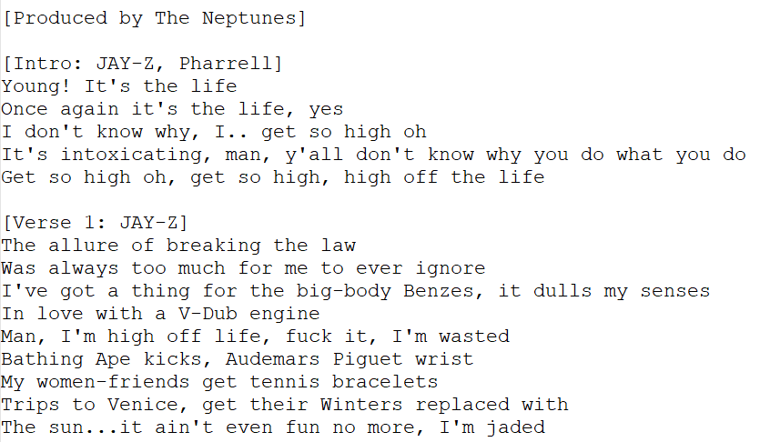
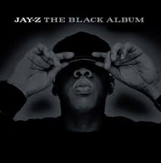
Raw Lyrics Example (Allure by JAY-Z)

Slide 22
Data Normalization
Lyrics for songs present in the playlist are found using Genius dataset.
Filtering on English songs and null values.
Text processing pipeline:
Removal of metadata present in [ ]
Removal of special characters, new lines and whitespaces
Tokenization
Removal of stop words
Lemmatization
Stemming

Slide 23
Text Representation and Similarity Metric
"Term Frequency Inverse Document Frequency" or TF-IDF divides the number of times a word occurs in a document by a measure of what proportion of all the documents a word occurs in.
Tends to reduce the value of common words while increasing the weight of words that do not occur in many documents.
Cosine Similarity is a method of calculating the similarity of two vectors by taking the dot product and dividing it by the magnitudes of each vector.
Since it is based on the orientation, documents of any lengths can be considered similar if they are related to the same topic.

Slide 24
Content-based Recommendation
A profile is created to first get the vectors corresponding with the songs they have interacted with.
Summary of the user's tastes can be found using average of the features represented by TFIDF.
This profile can then be used to find the most songs.
This allows to recommend items based on a user's full history, not just based on individual items.

Slide 25
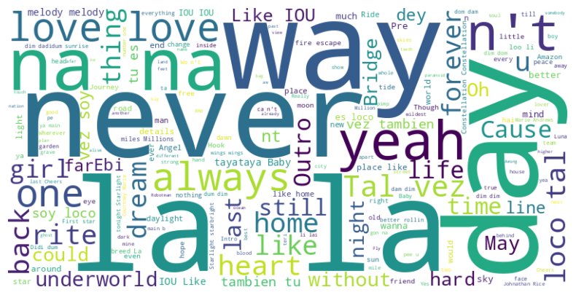
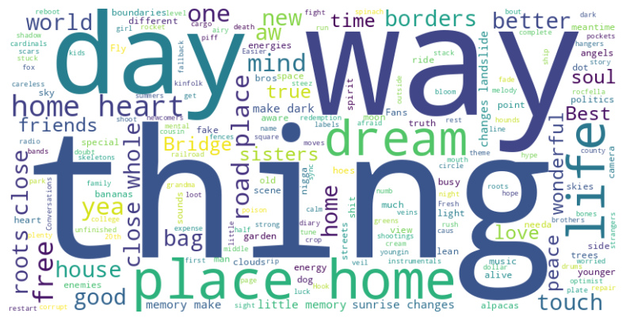
Word cloud of the lyrics of "Beyond the Horizon" playlist
Word cloud of the lyrics of recommendations generated based on "Beyond the Horizon" playlist

Slide 26
Collaborative-based Recommendation System
Definition: Filtering the results based on the user's interests and match them with the interactions and behaviors of other users.
Spotify: Recommend songs or playlists based on what other users with similar tastes liked.
Does not require any metadata information.
Different playlists acting as different users
User item interaction method

Slide 27
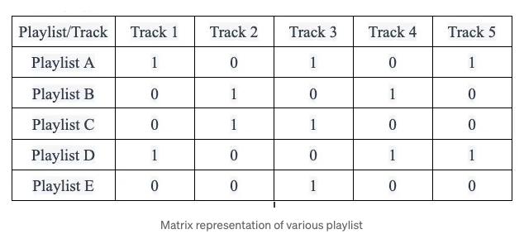
Collaborative-based Recommendation System
Matrix Representation: A sparse matrix

Slide 28
Collaborative-based Recommendation System
Matrix Factorization: Dimensionality Reduction using SVD(Singular Value Decomposition)
Prediction and Normalization: Predicts a missing value. This value is the strength or likelihood of a track being included in the playlist. Then, the values are normalized!
Recommendation algorithm: Non interacted tracks are found and sorted by the predicted strength. Top ranking tracks are recommended to the user.

Slide 29

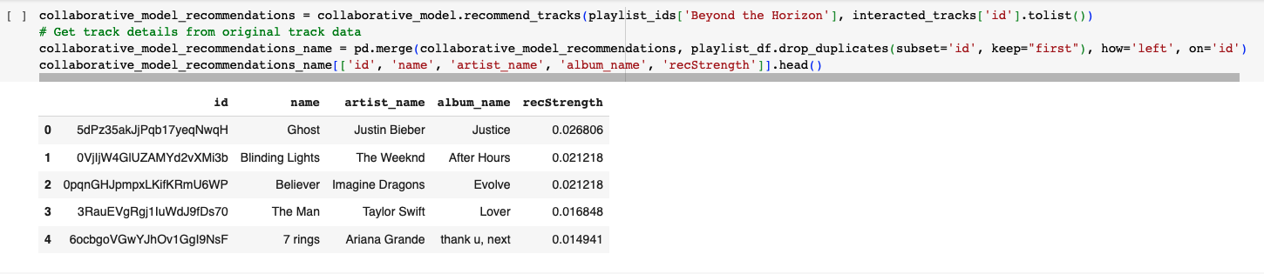
Collaborative-based Recommendation System

Slide 30
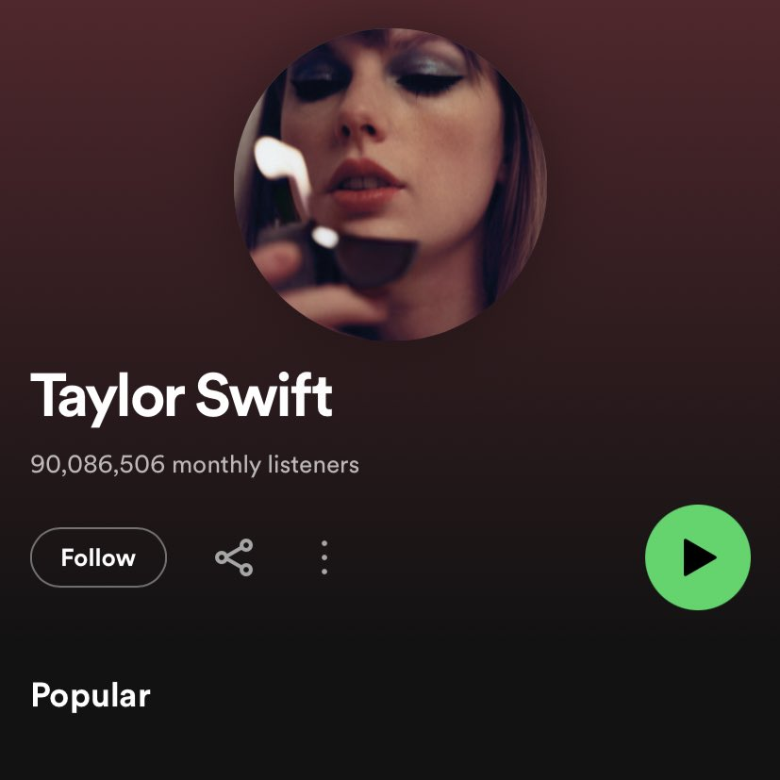
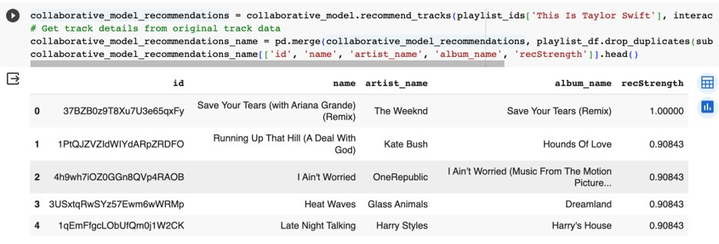
Collaborative-based Recommendation System

Slide 31
Hybrid Recommendation System
Combines the strengths of both the approach.
Steps Involved:
- Hybrid Score: computes an average weighted score of the content-based similarity score and collaborative based filtering score. Proper balance of each score.
- Recommendation Generation: Ranks the tracks based on the scores, suggests the top recommendations

Slide 32
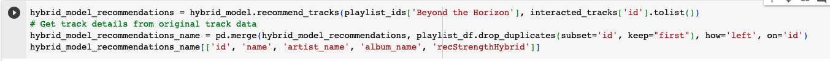
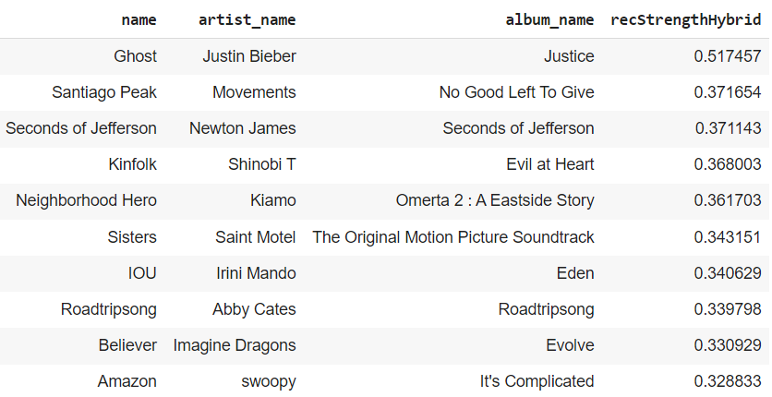
Final Recommendations

Slide 33
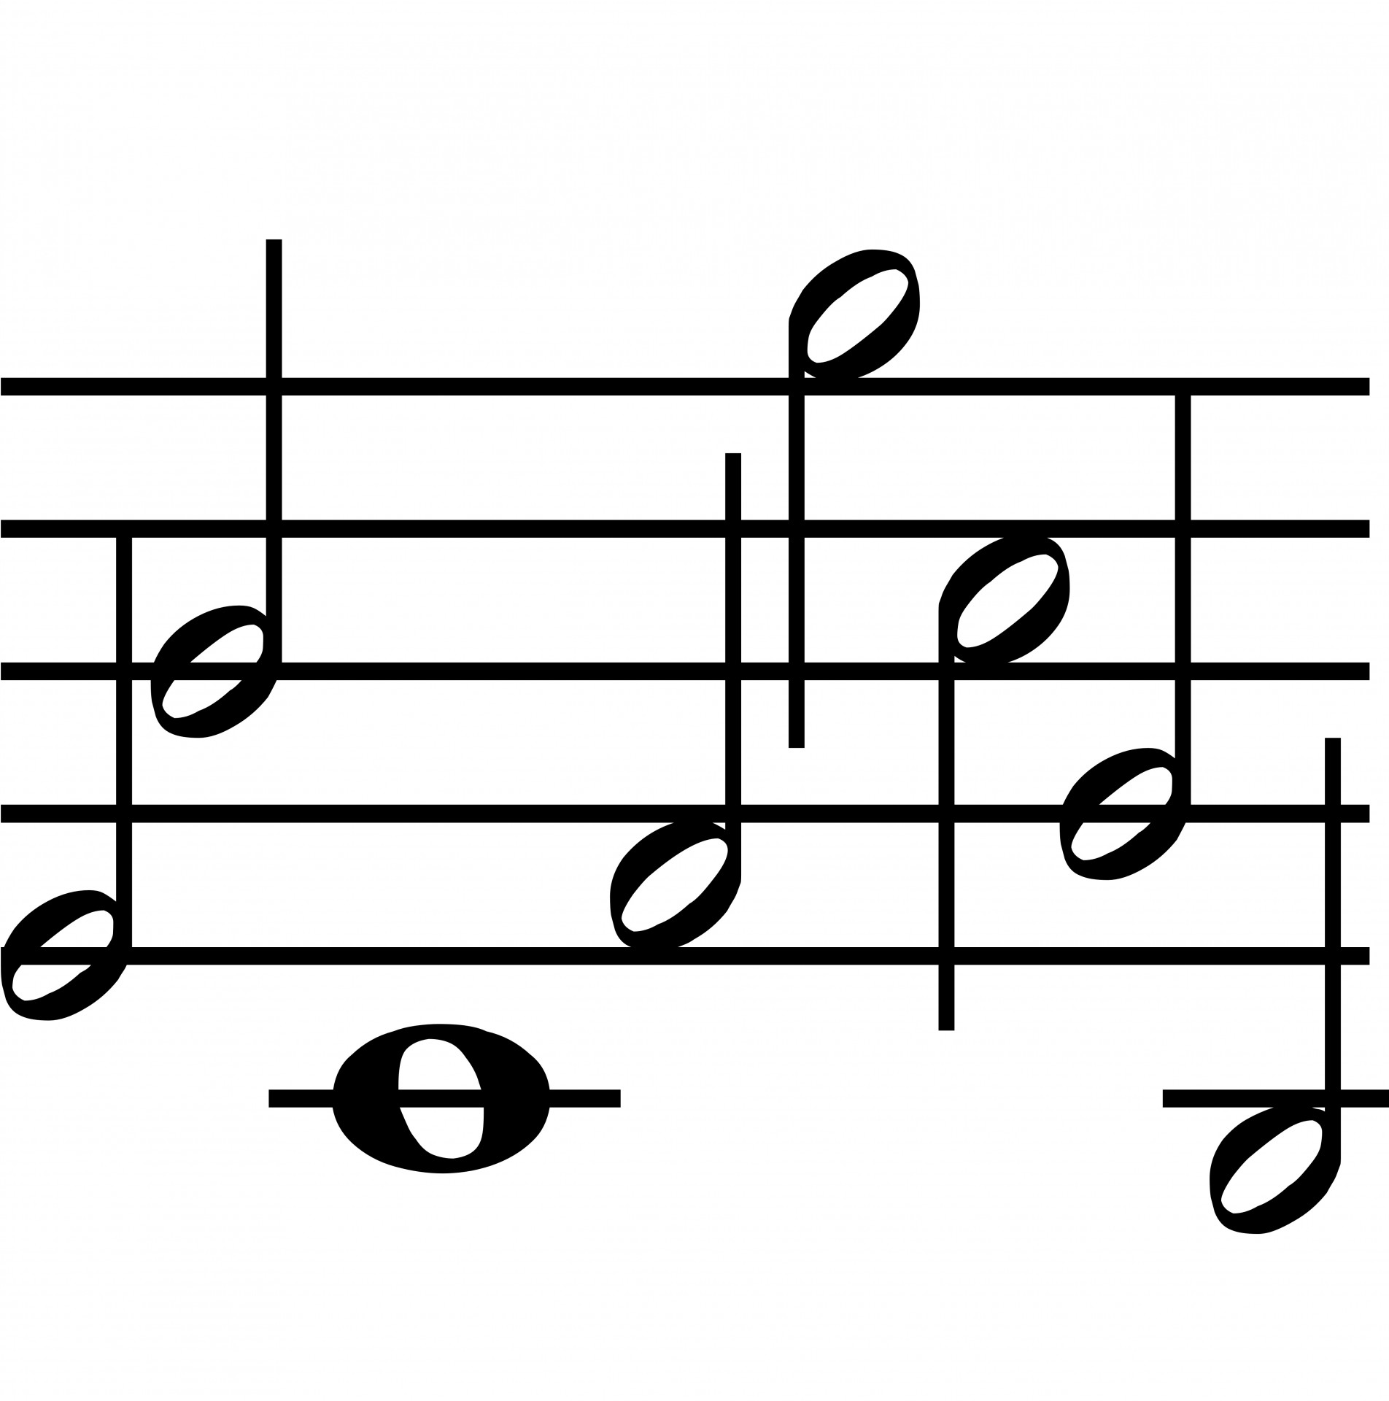
Conclusion
By integrating both collaborative filtering and content-based approaches, hybrid systems can mitigate the weaknesses of each method and provide a more well-rounded recommendation experience. Hence, a hybrid model would outperform a single model resulting in enhanced user satisfaction.

Slide 34

Thank You!

