Slide 1
AUTOMATION TESTING WITH SELENIUM,SPRING AND DOCKER
Presented by : Shreya Ghogare
Employee Id : 201314

Slide 2
INTRODUCTION
This presentation it about an Automated Website using Selenium. The project depicts the flow of Automation ; shows how using different functions we can load a site and perform various functionalities using a testing framework like Selenium.
WorkFlow:
Load the website -> login -> navigate to different pages ->search for the Course -> add products to cart -> enter shipping details -> payment process.

Slide 3
WHAT IS SPRING ?
The Spring Framework (Spring) is an open source software development framework that provides infrastructure support for building primarily Java-based applications.
Spring Boot makes it easy to create stand-alone, production-grade Spring based Applications that you can "just run".
In this project we have initially created an simple spring application for automating the website.

Slide 4
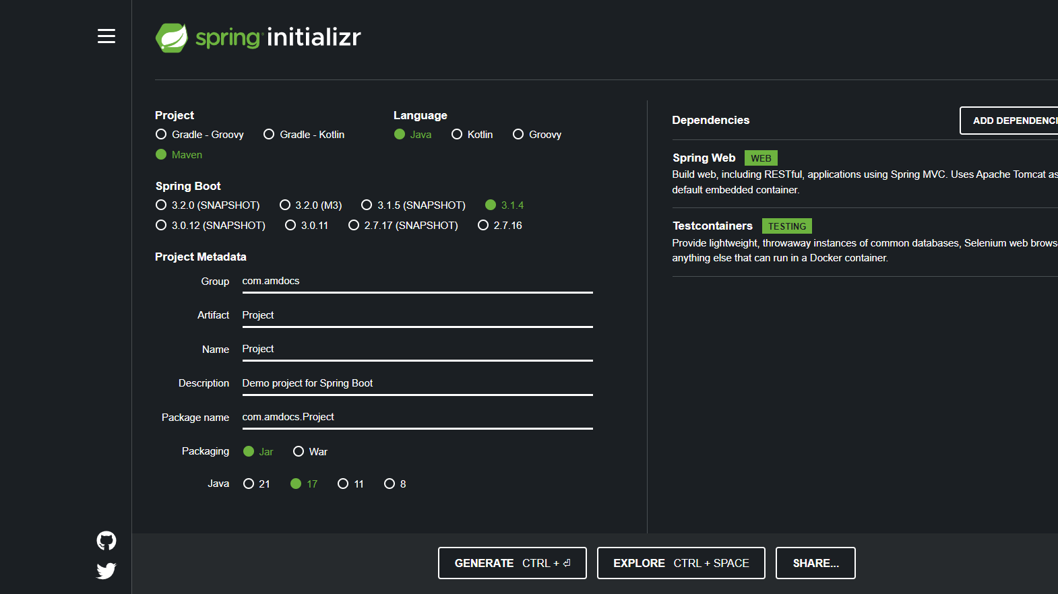

Slide 5
WHAT IS SELENIUM?
Selenium is one of the most widely used open source Web UI (User Interface) automation testing suite.Selenium supports automation across different browsers, platforms and programming languages. Selenium can be easily deployed on platforms such as Windows, Linux, Solaris and Macintosh. Moreover, it supports OS (Operating System) for mobile applications like iOS, windows mobile and android. Selenium supports a variety of programming languages through the use of drivers specific to each language. Languages supported by Selenium include C#, Java, Perl, PHP, Python and Ruby.

Slide 6
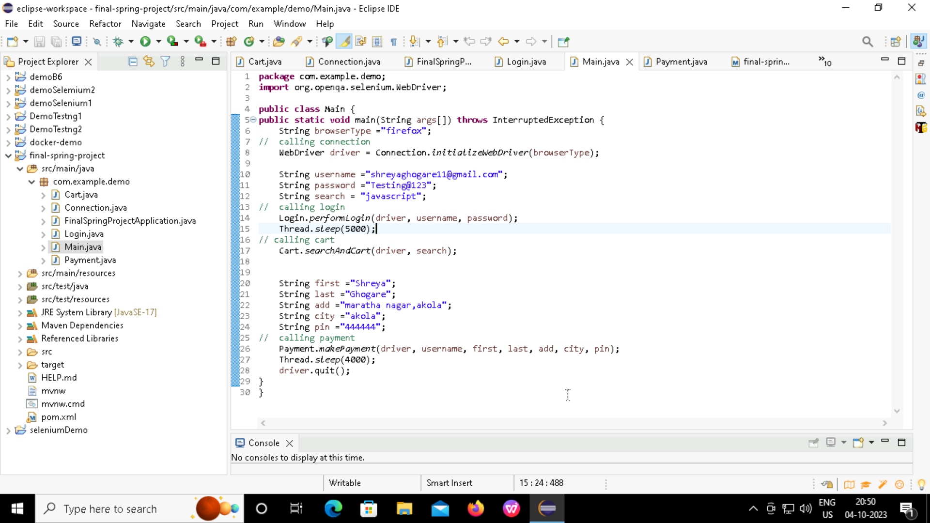
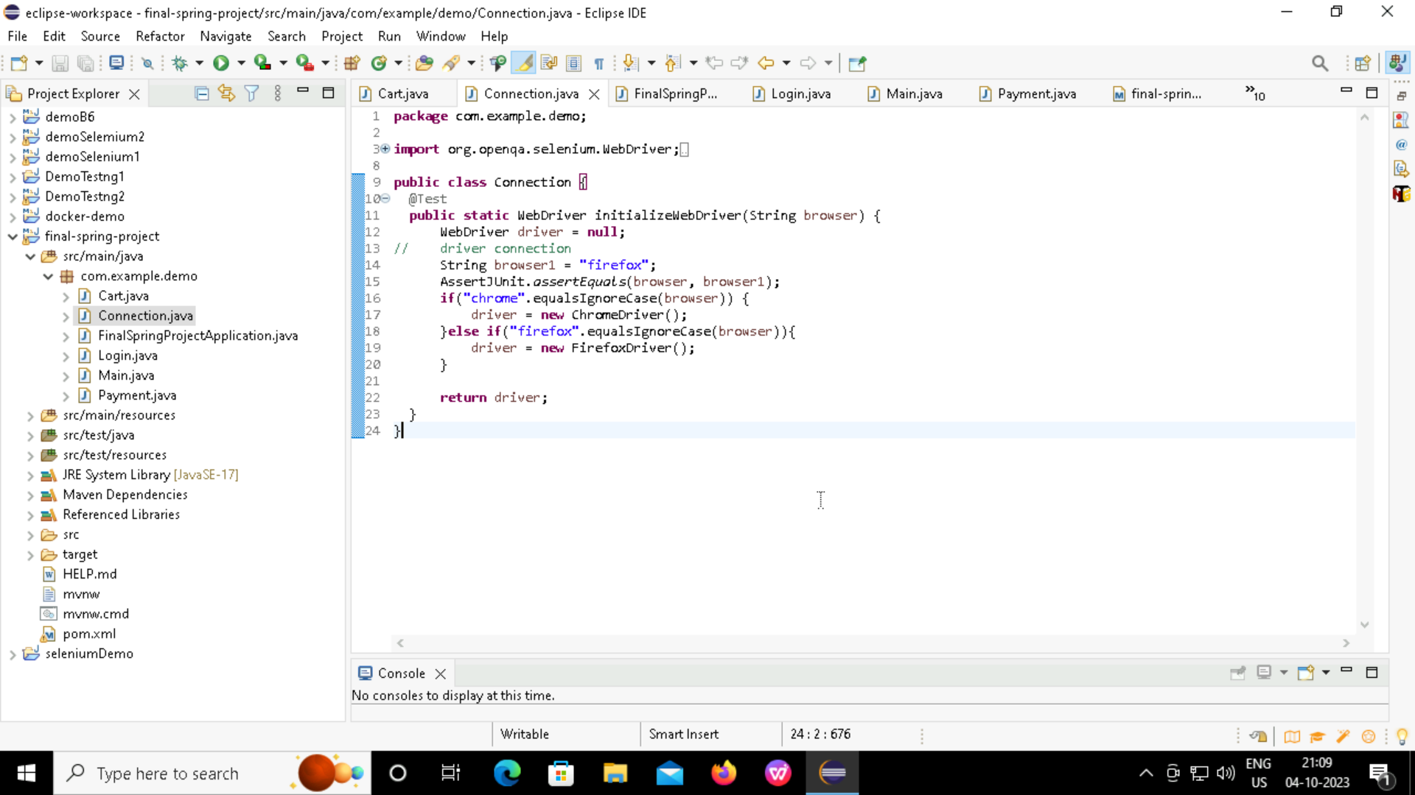
CODE

Slide 7
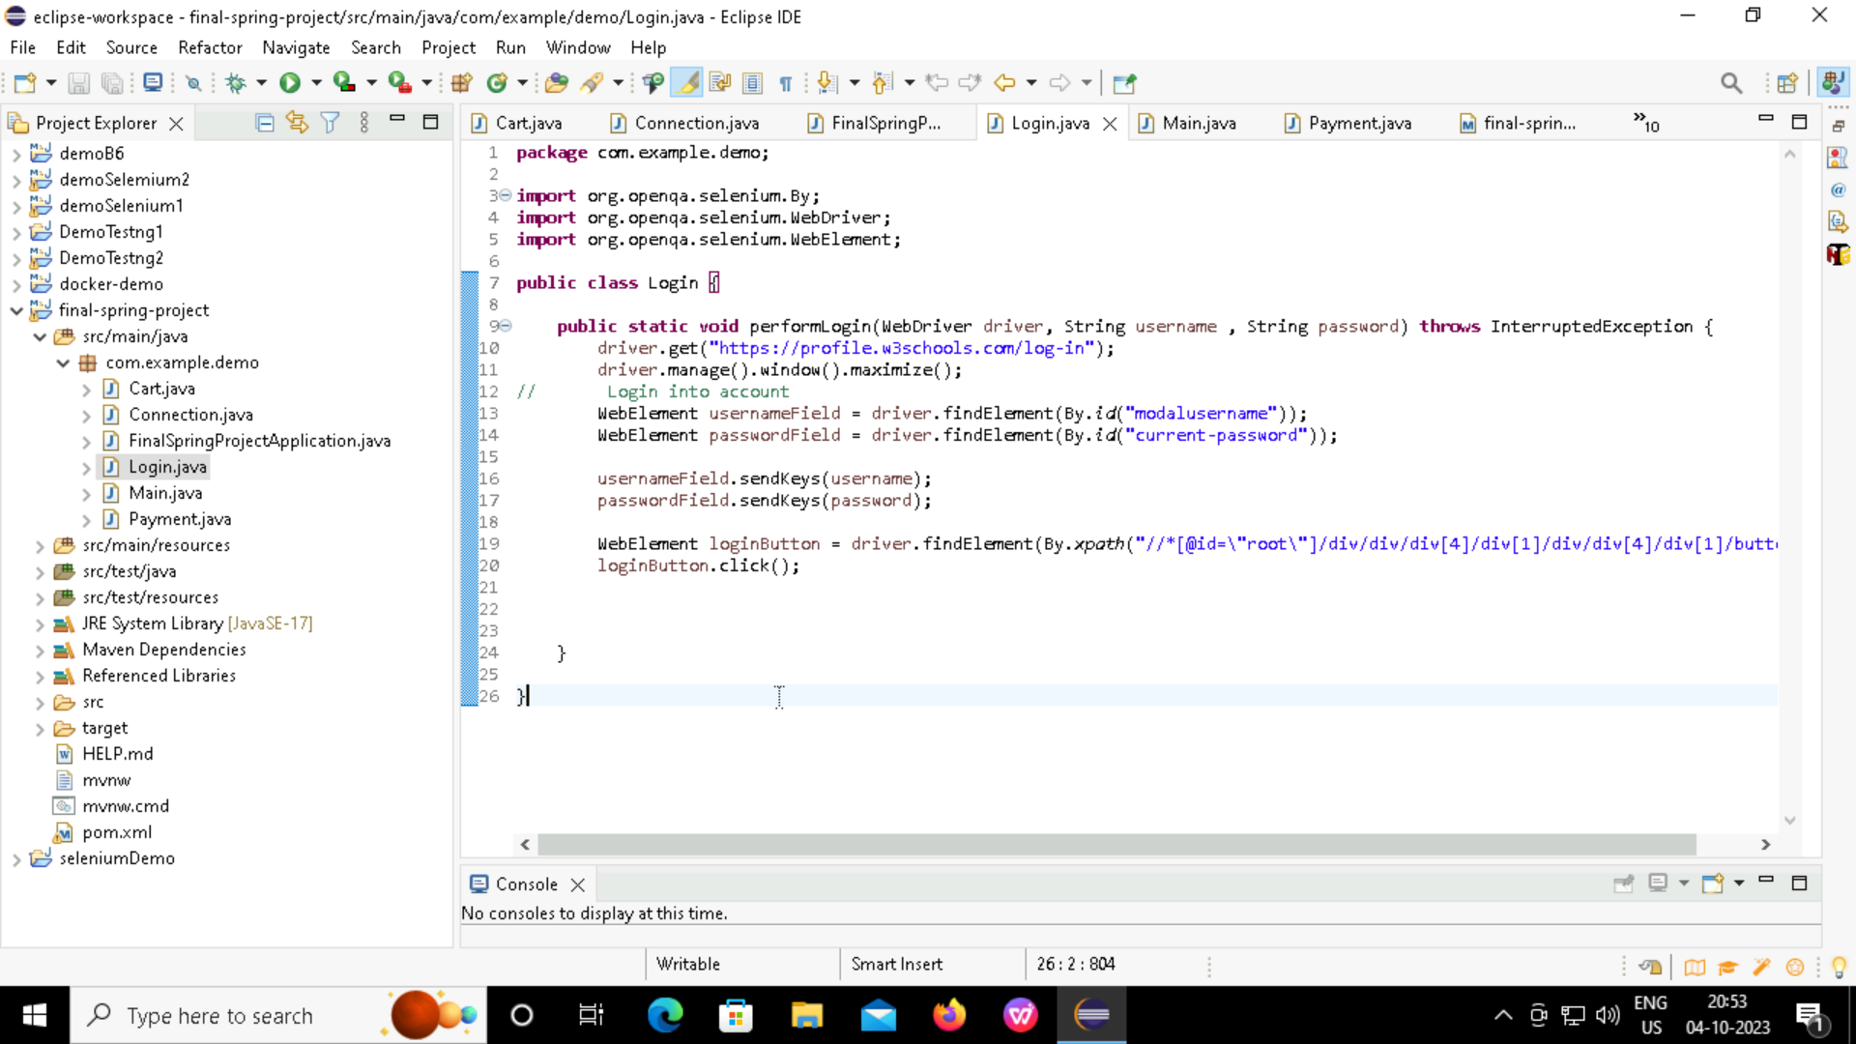
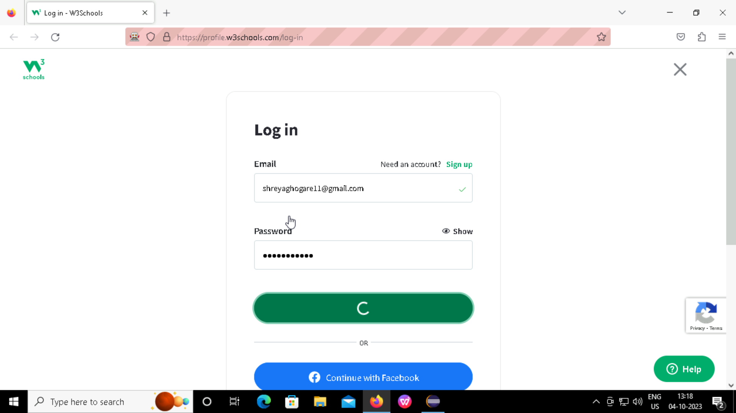
Login PAge

Slide 8
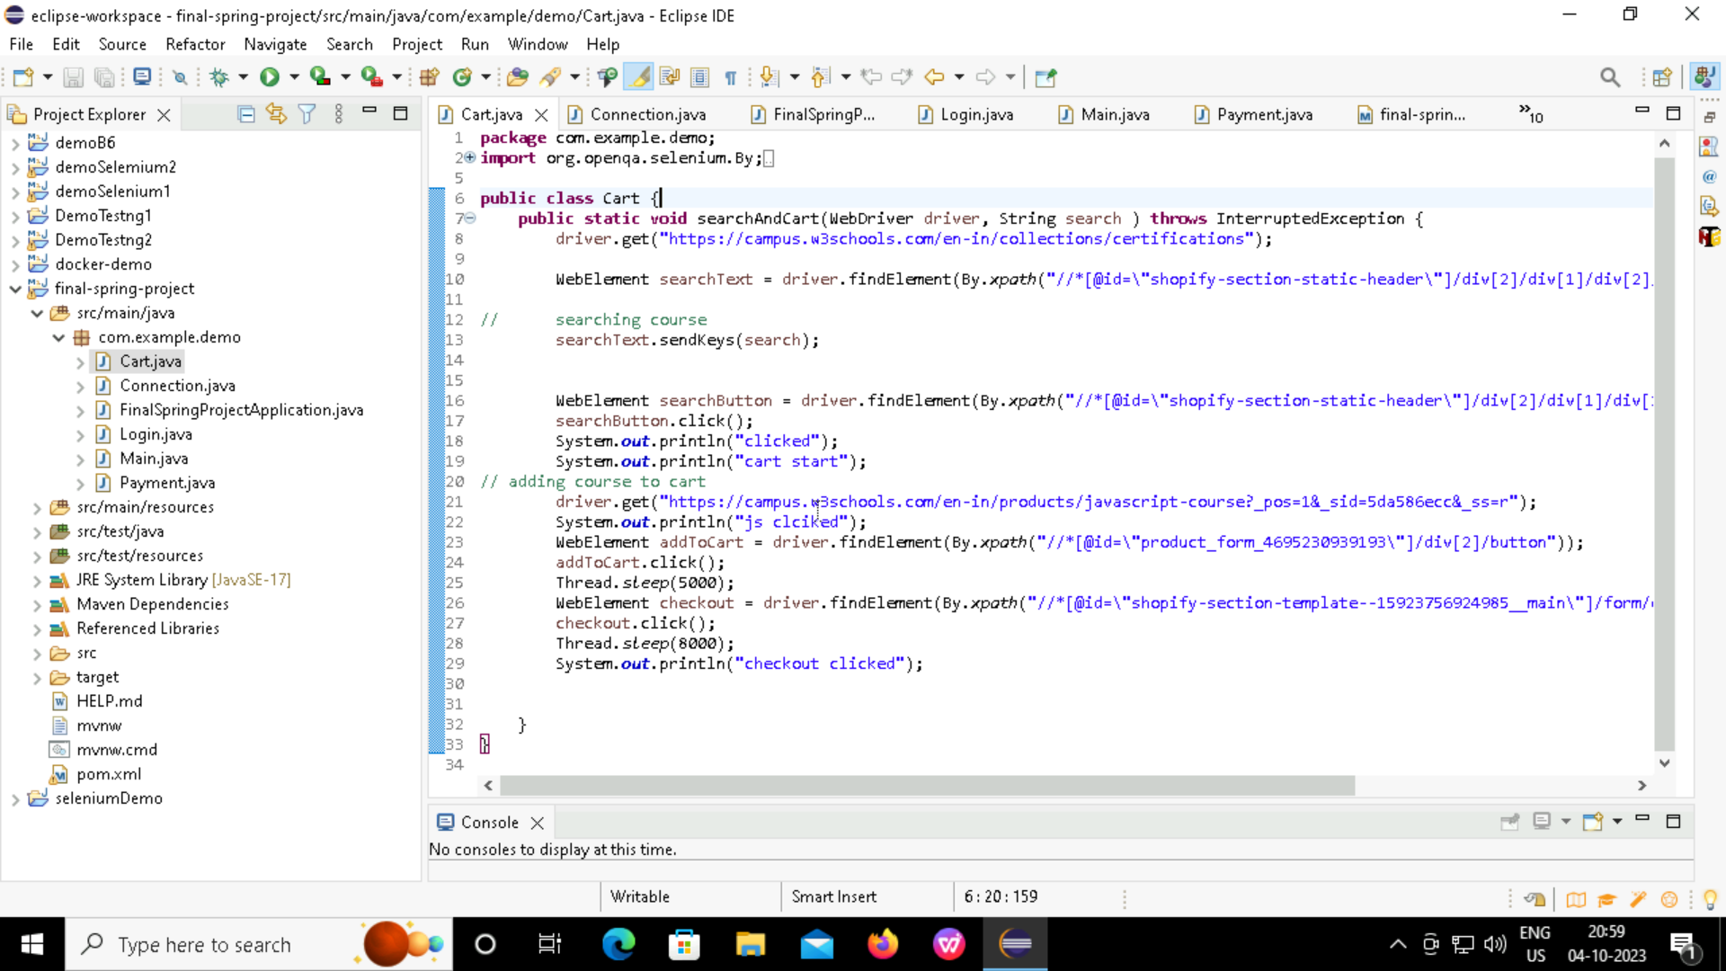
Search and Cart

Slide 9
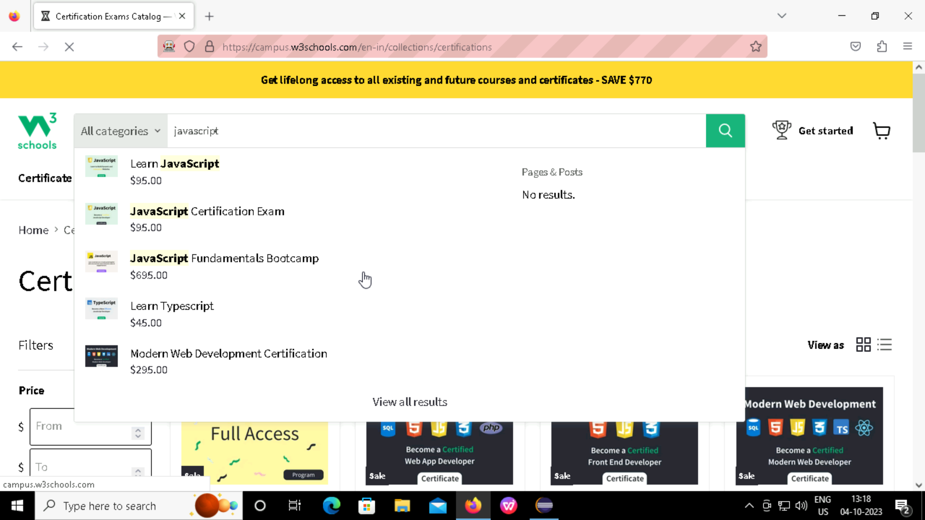
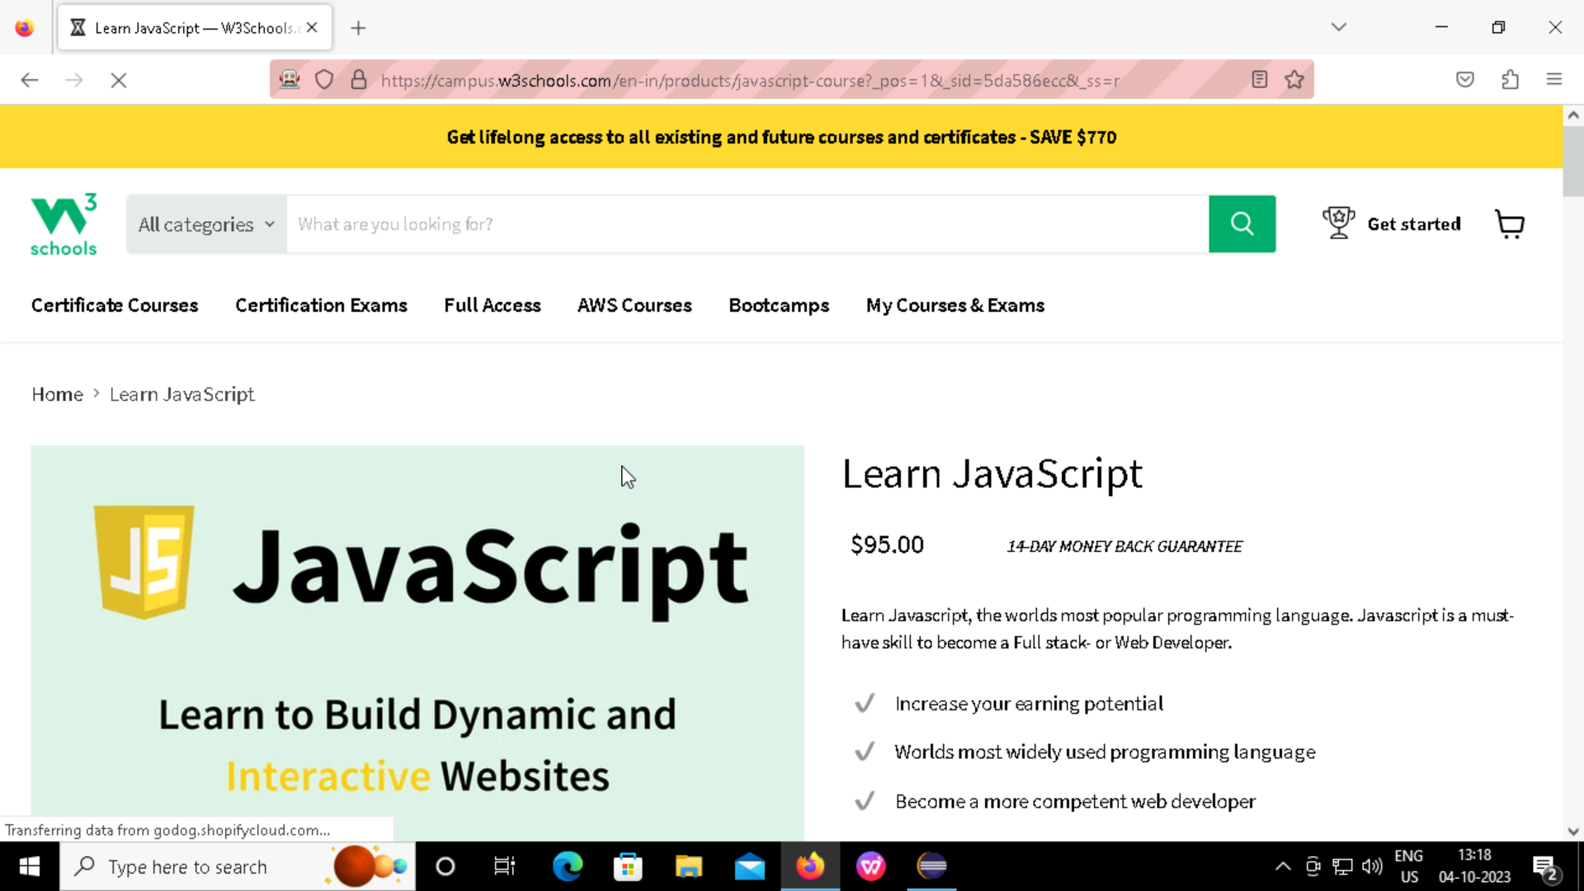

Slide 10
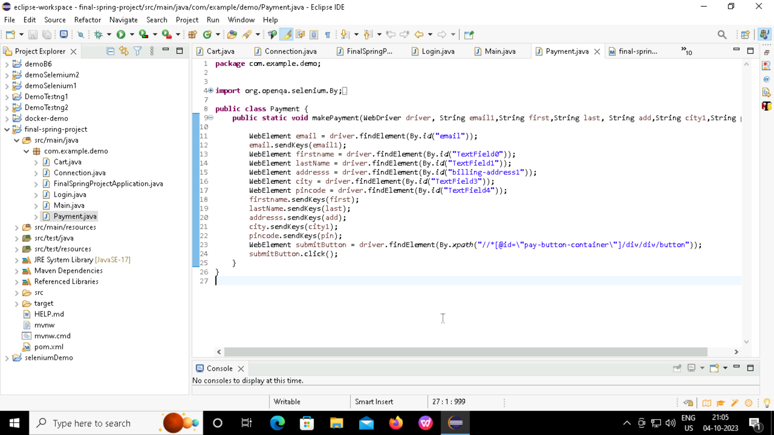
Payment Page

Slide 11
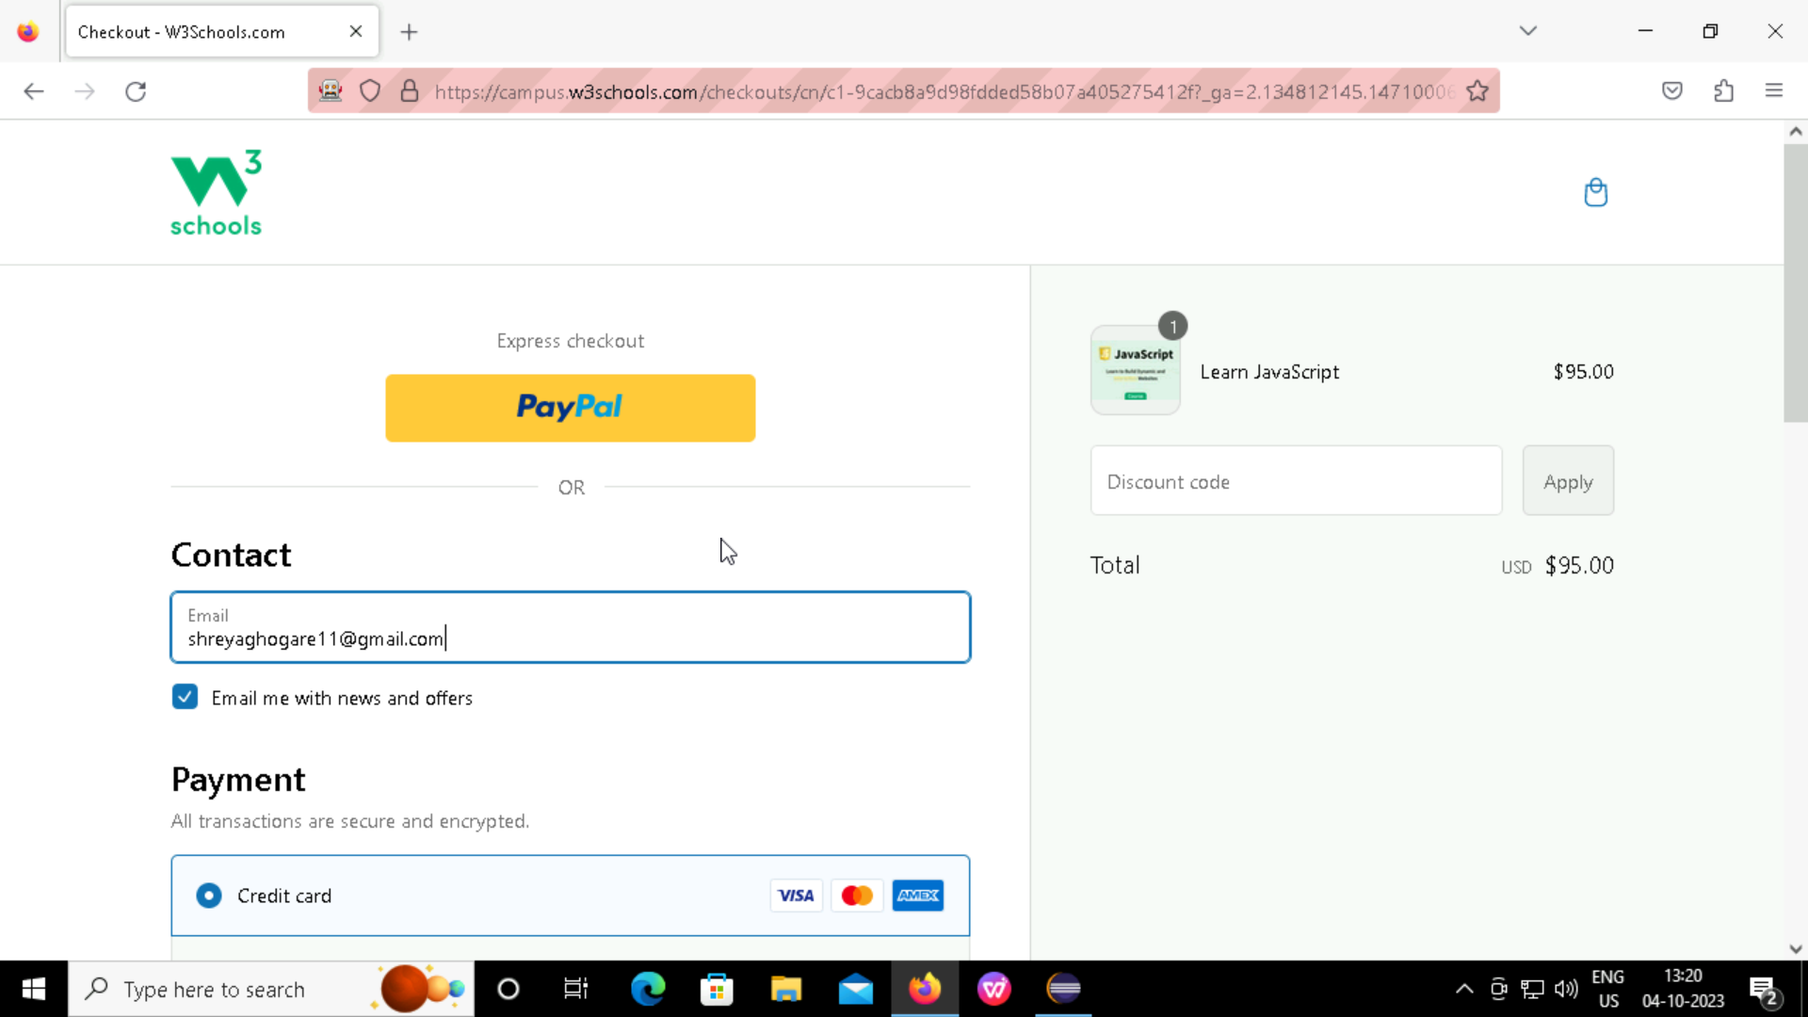
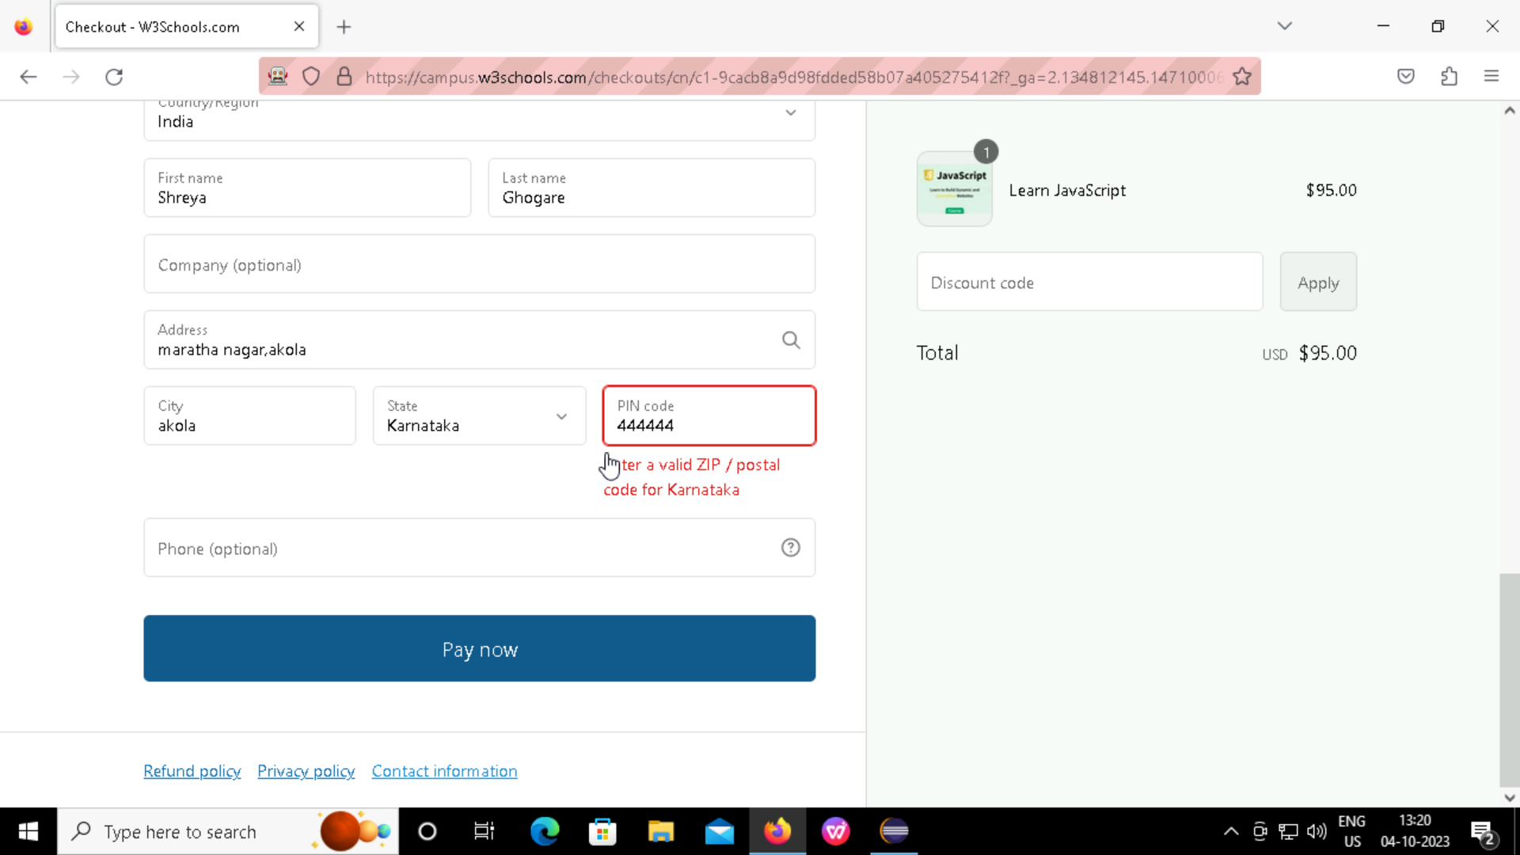

Slide 12
TESTNG
TestNG is testing framework for Java that simplifies the test process.
Its purpose is to facilitate automate testing by providing feature like parallel execution, test prioritization, and flexible test configuration.

Slide 13
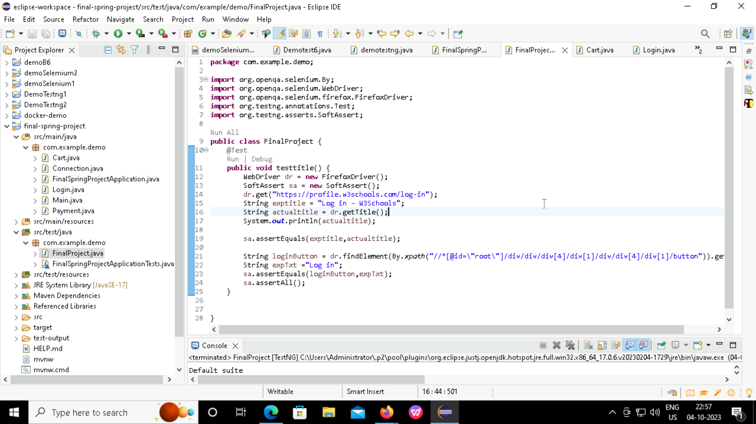
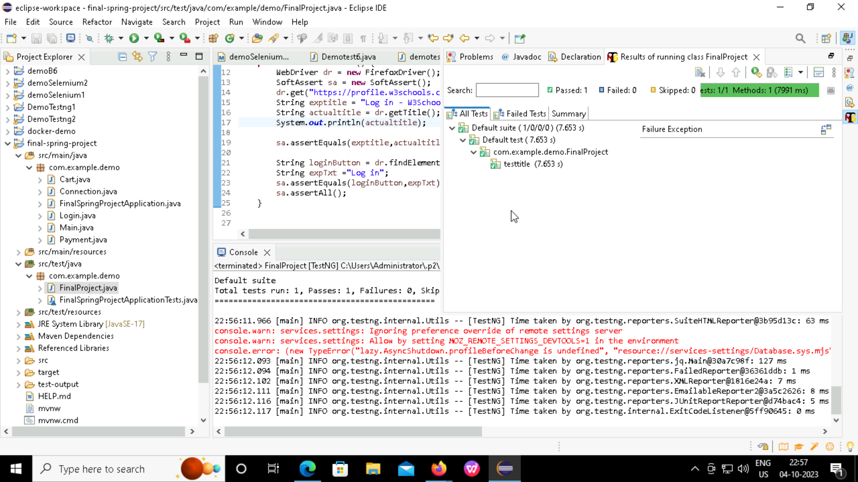

Slide 14

Docker
Docker is tool that puts Your applications and all they need into a neat package
Its like a digital box that includes the app and everything it relies on
These packages are easy to move, work the same on any computer, and help app run reliably

Slide 15
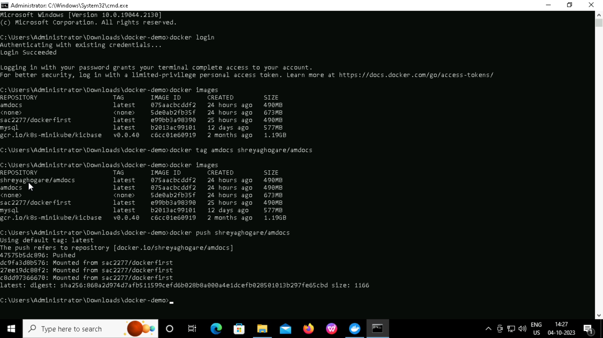

Slide 16
THANK YOU!

