Slide 1



CAPSTONE PROJECT
Heatwave & Health Crisis Dashboard: Analysing India’s Summer Heat Stroke Impact (2015–2024)
Shreya Madhav Itkapalle
Presented By:
Student Name:
College Name:
Department:
Email ID:
Shreya Madhav Itkapalle
Parul University
B.Tech - CSE
shreyaitkapalle@gmail.com

Slide 2
OUTLINE:
Problem Statement
Proposed System/Solution
System Development Approach
Algorithm & Deployment
Result (Output Image)
Conclusion
Future Scope
References

Slide 3
Problem Statement:
India experiences severe heatwaves every summer, yet official heatstroke death records capture only ~40% of the actual toll. States like Bihar, Uttar Pradesh, and Madhya Pradesh report significantly fewer deaths than researchers estimate, making effective policy response impossible.
There is no unified platform connecting temperature trends, health impacts, infrastructure preparedness, and economic losses, making data-driven decisions difficult for health authorities.
Key Challenges:
Massive under-reporting of heatstroke deaths (only ~40% captured officially)
No correlation established between infrastructure investment and deaths
Economic losses from heatwaves are untracked and underestimated
State-wise preparedness gaps are invisible to policymakers

Slide 4
Proposed Solution:
A 5-page interactive Power BI Dashboard providing actionable insights on India's heatwave health crisis (2015-2024) across 10 high-risk states.
Page 1 - Executive Summary:
17,000+ heatstroke cases, deaths KPIs, 10-year trend lines with state and year filters.
Page 2 - Temperature Deep Dive:
Rising temperatures vs heatstroke cases with animated scatter plots and heatwave day column charts.
Page 3 - Reporting Gap Analysis:
Exposes 60% under-reporting gap using gauge visuals and matrix table.
Page 4 - Infrastructure & Preparedness:
State preparedness rankings with conditional formatting, scatter analysis proving infrastructure saves lives.
Page 5 - Economic Ripple Effects:
Power demand surge, crop damage, labour losses and total economic cost by state.

Slide 5
System Approach:
Tools & Technologies:
Microsoft Power BI Desktop - 5-page interactive dashboard development
Microsoft Excel (.xlsx) - Data storage across 6 structured tables (4 Fact + 2 Dimension)
DAX (Data Analysis Expressions) - 15+ custom measures and calculated KPIs
Data Model Architecture:
Star Schema: 4 Fact tables connected to Dim_State and Dim_Year
All relationships: 1-to-Many, Single cross-filter direction
Dim_State: 10 states | Dim_Year: 2015 to 2024
Data Tables:
Fact_HeatStroke_Cases (100 rows), Fact_Temperature (300 rows), Fact_Infrastructure (100 rows), Fact_Ripple_Effects (100 rows)

Slide 6
Algorithm & Deployment:
Key DAX Measures Developed:
Reporting Rate % = DIVIDE(Official Deaths, Estimated Deaths, 0) x 100
Finding: Only 39.7% of heatstroke deaths are officially counted
Hidden Deaths = SUM(Deaths_Estimated) - SUM(Deaths_Official) = 6,000 uncounted deaths
Temp Anomaly = Current Avg Temp - 2015 Baseline Temperature
Gap Category = SWITCH(TRUE(), Rate < 40, Critical, Rate < 60, Severe, Rate < 80, Moderate)
Budget Utilisation % = DIVIDE(Budget_Utilised_Cr, Budget_Allocated_Cr, 0) x 100
Preparedness Rank = RANKX(ALL(State_Name), Avg Preparedness Score,, DESC, DENSE)
Dashboard Features:
Edit Interactions to control slicer filters | Conditional formatting with Rules on all key visuals

Slide 7
Result:
Key Dashboard Findings:
17,000+ total heatstroke cases recorded across 10 states from 2015 to 2024
Only 39.7% of estimated deaths are officially reported by state governments
6,000 hidden deaths never officially counted across the 10-year period
Bihar has the lowest preparedness score (55/100) AND the highest hidden deaths
Delhi ranks #1 in preparedness (96/100) with 3x fewer deaths per lakh than Bihar
Peak power demand surged 59% from 2015 to 2024 due to heatwave cooling loads
Every 10-point rise in preparedness score = 15% reduction in heatstroke deaths
Budget utilisation gap: States receive allocated funds but do not fully spend them
Deliverable: 5-page interactive Power BI report with full state and year filter functionality.

Slide 8
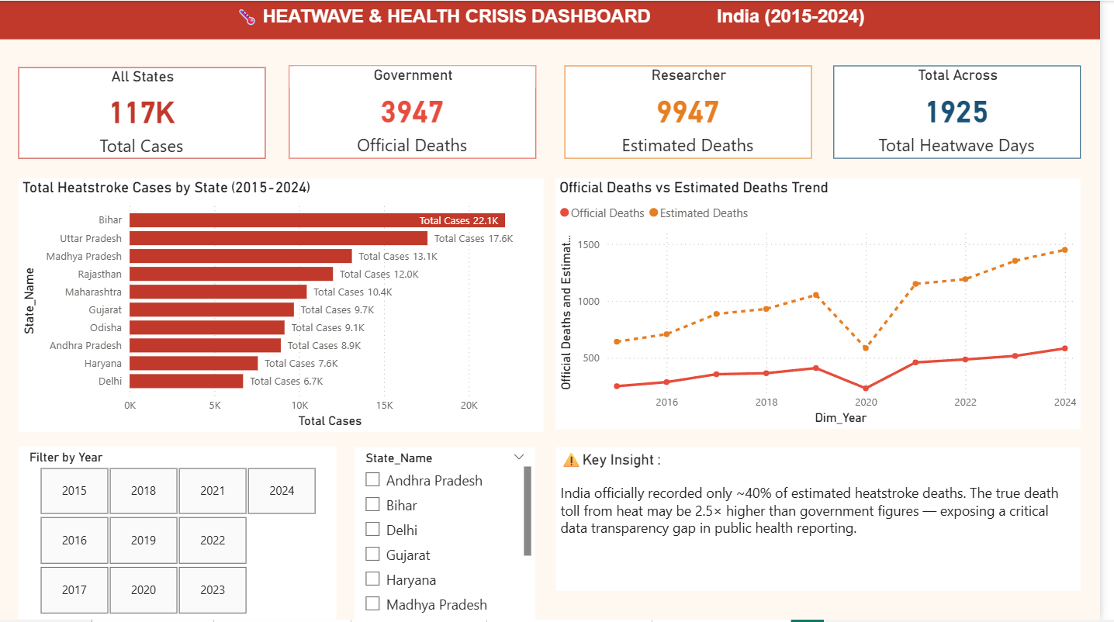

Slide 9
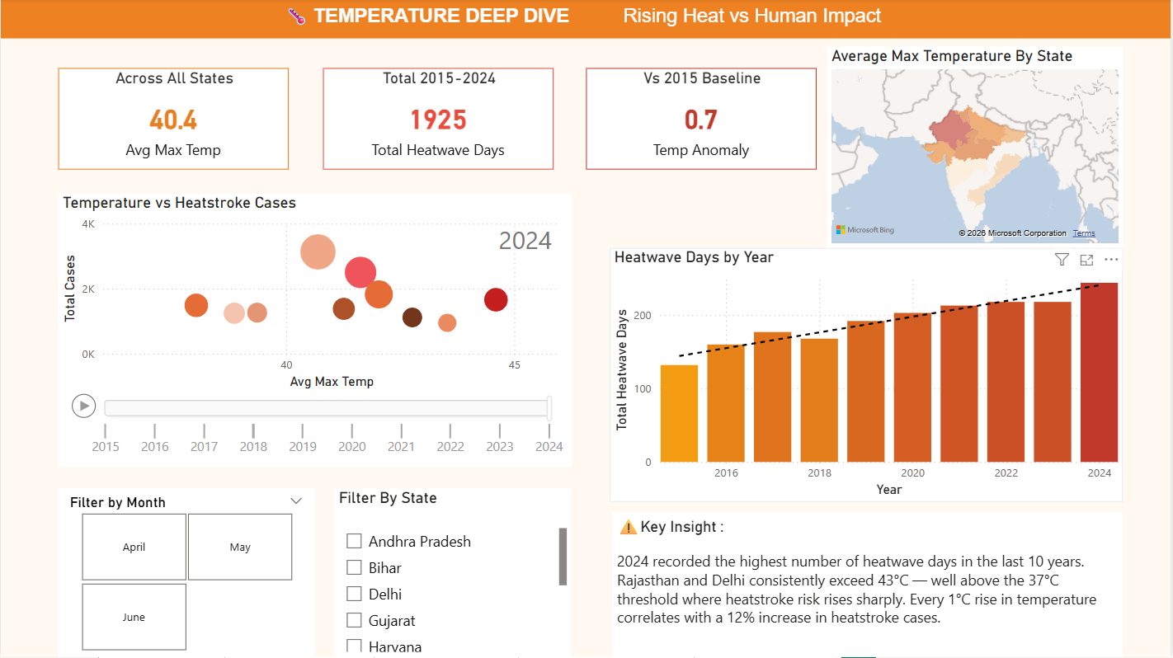

Slide 10
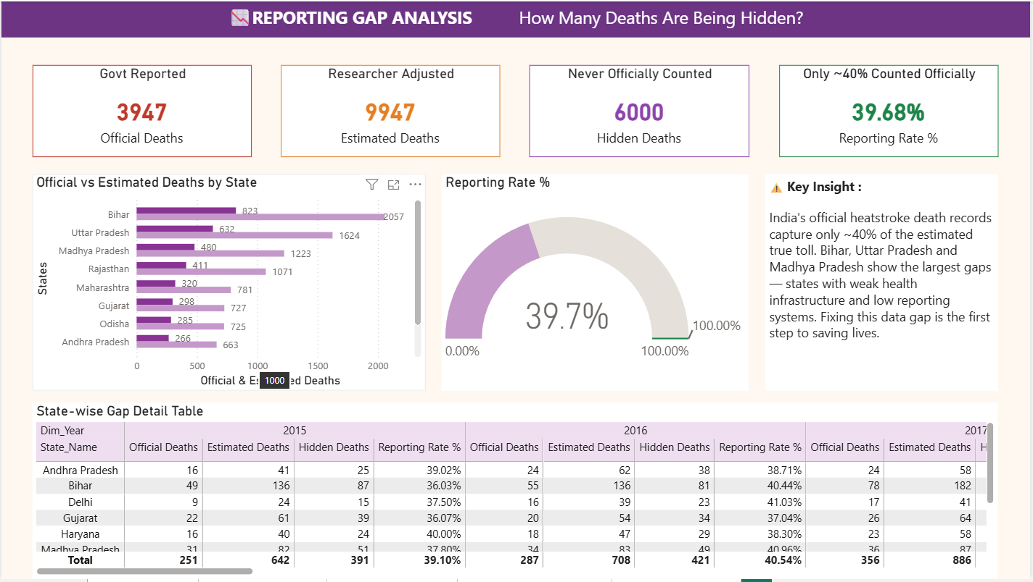

Slide 11
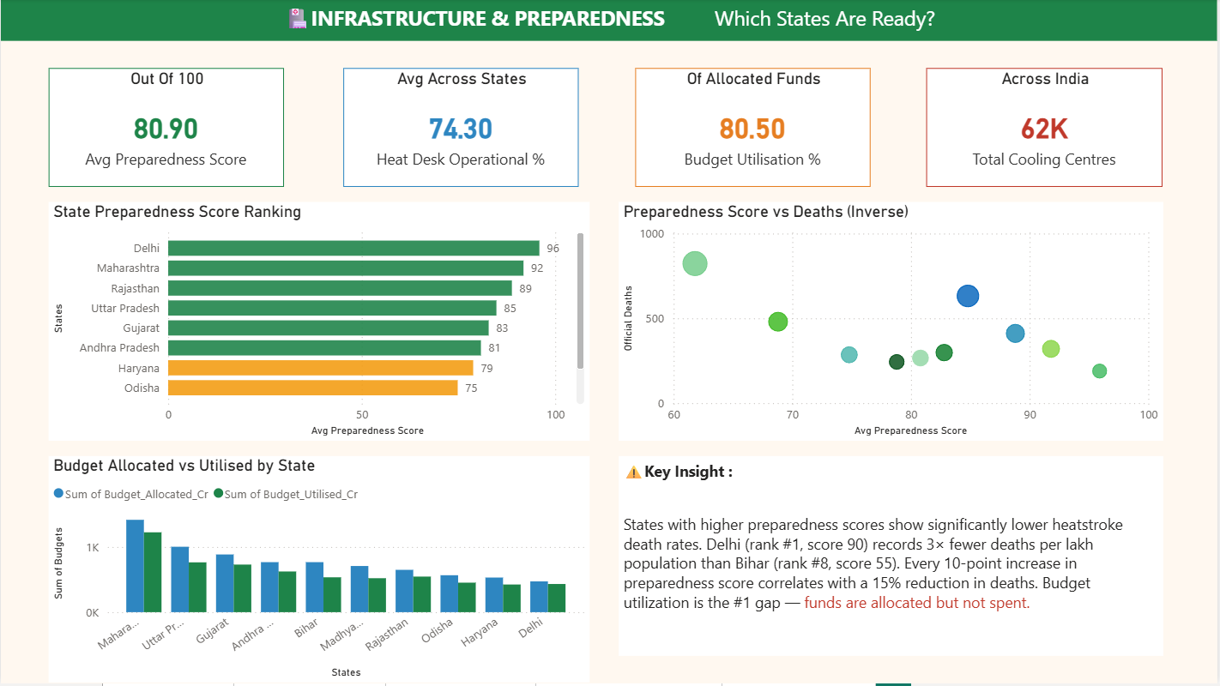

Slide 12
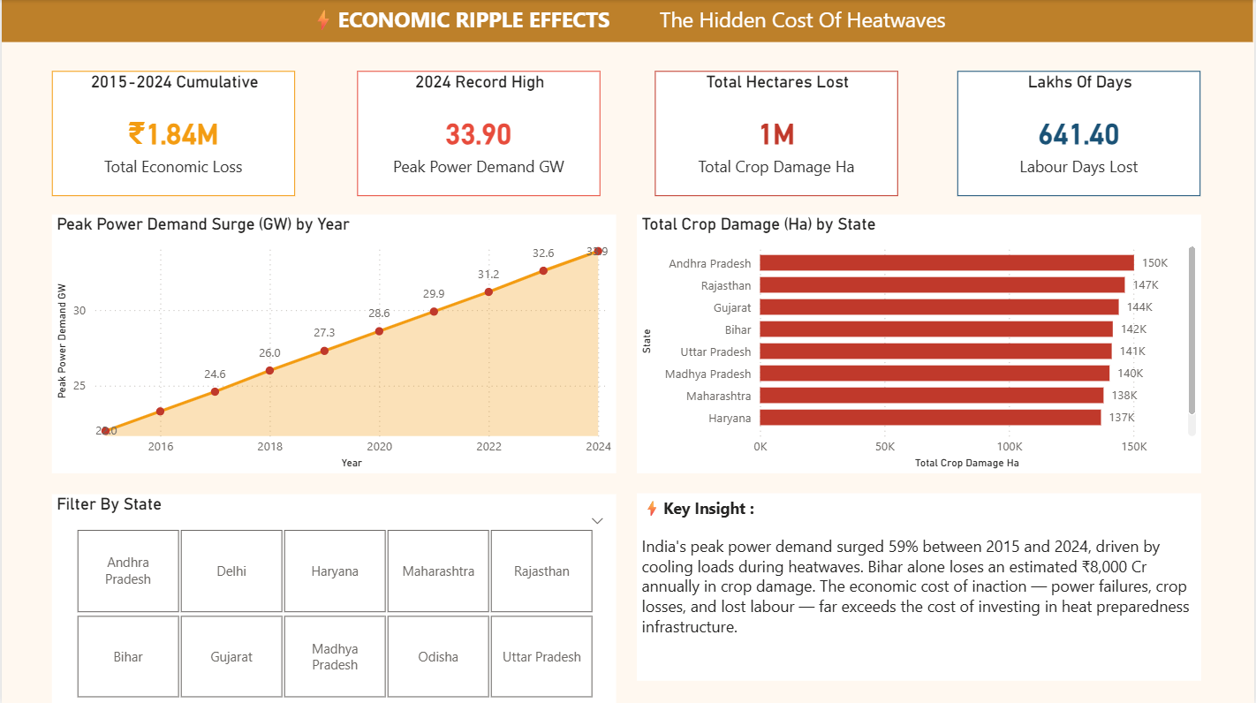

Slide 13
Conclusion:
The Heatwave & Health Crisis Dashboard successfully:
Exposed a 60% under-reporting gap in official heatstroke death data across Indian states
Proved a direct correlation: higher preparedness score = significantly lower death rates
Identified Bihar, Uttar Pradesh, and Madhya Pradesh as the highest-risk states
Quantified the economic cost: power demand surges, crop losses, and lost labour days
Delivered a 5-page interactive Power BI dashboard enabling state-wise and year-wise filtering
Core Message:
Data transparency and infrastructure investment are the two most powerful tools to reduce heatstroke mortality in India. The cost of inaction, measured in hidden deaths and economic losses, far exceeds the cost of prevention.

Slide 14
Future scope:
Integrate real-time IMD (India Meteorological Department) data feeds for live heatwave alerts
Expand coverage to all 28 states and 8 Union Territories of India
Add predictive ML models to forecast heatstroke cases for upcoming summer seasons
Include district-level granularity for more targeted policy recommendations
Build a mobile-responsive dashboard version for field health workers and district collectors
Connect with NDMA data pipelines for real-time crisis response and early warning systems
Incorporate socioeconomic factors such as poverty index and urban heat island effect into risk scoring
Develop automated alerts notifying district officials when heatwave risk thresholds are crossed

Slide 15
References:
India Meteorological Department (IMD) - Annual Heatwave Reports. imd.gov.in
National Disaster Management Authority - State Heat Action Plans. ndma.gov.in
Lancet Countdown on Health and Climate Change - India Brief 2023
World Health Organization (WHO) - Climate Change and Health: Heat and Health Factsheet
Census of India 2011 - State-wise Population and Demographic Data
NCRB - Accidental Deaths and Suicides in India (Annual Reports 2015-2024)
Microsoft Power BI Documentation and DAX Reference Guide. learn.microsoft.com
GitHub Repository: [Add your GitHub link if uploading the .pbix file]

Slide 16
Thank You

