Slide 1


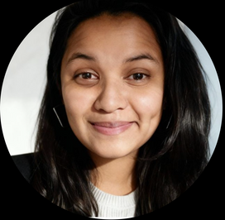

Hack Nation 4th Global AI Hackathon
Presented By :
Shreya Jaiswal
OPENLENS
User-aware AI for the open web
#Opensource AI

Slide 2
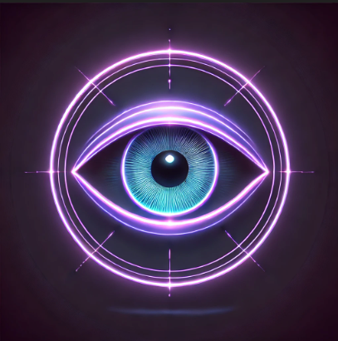
WHO WE ARE?
OpenLens is a browser extension that runs entirely on your machine. It scans your hardware and load your compatible models tlocally first. Pick any compatible LLM, and you're in control.
Your AI, your hardware, your data - finally visible to you.
OpenLens
Our Vision
Our Mission
Every user should see what their AI sees.
Open-source tools that make browser AI transparent, local-first, and user-controlled.

Slide 3
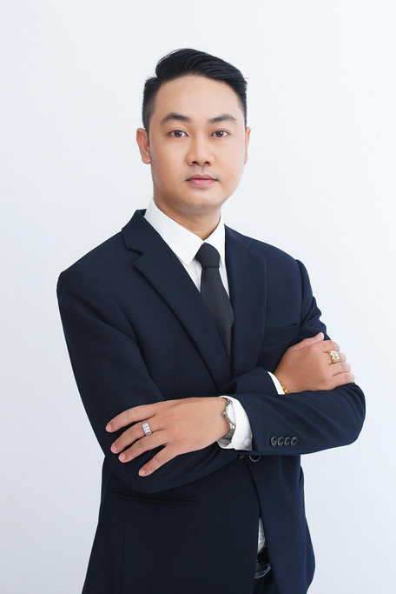
Larana Company
Presented By :
Drew Feig
THANK YOU
Business Presentation

