Slide 1

QVI Retail Strategy: Customer Insights and Trial Uplift Analysis
Optimizing Chip Product Placement for Growth
Shreya Jaiswal | Data Analyst, Quantium
October 27, 2025
Client: QVI Retail Team

Slide 2
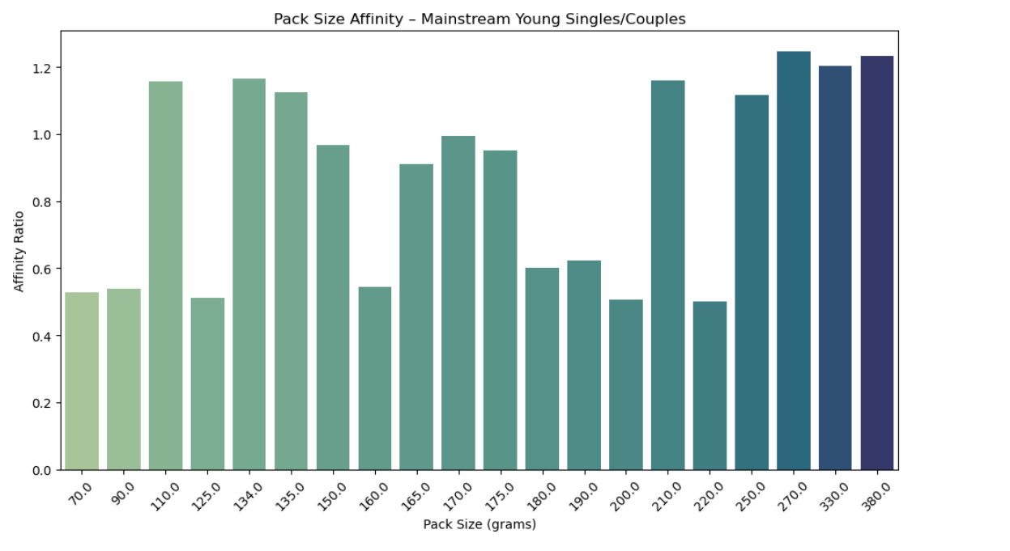
Executive Summary
Recommend prioritizing larger pack sizes (150g+) for Young Singles/Couples (Mainstream)
Trial uplift: +15% sales in Stores 77 & 88; no uplift in Store 86
Scale trial to 50+ stores with similar profiles
Potential 10–20% revenue lift from targeted segmentation

Slide 3

Agenda
1. Situation: QVI's Chip Market Challenge
2. Key Insights: Customer Segments & Preferences
3. Analysis: Trial Results & Uplift
4. Recommendations & Next Steps
5. Q&A

Slide 4
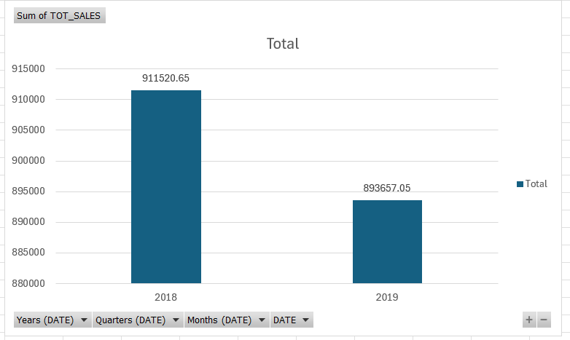
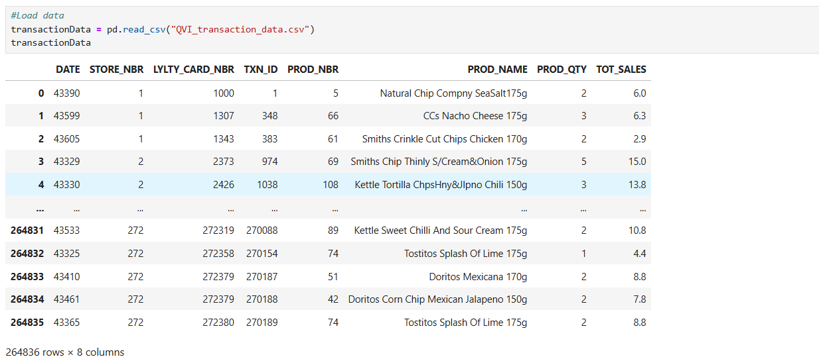
Situation: Why This Matters
• QVI seeks to boost chip sales amid stagnant growth
• Dataset: 264k transactions across 272 stores (2017–2019)
• Objective: Identify high-potential segments and validate trial impact
• Market opportunity: Chips category grew 5% YoY, but QVI share flat

Slide 5
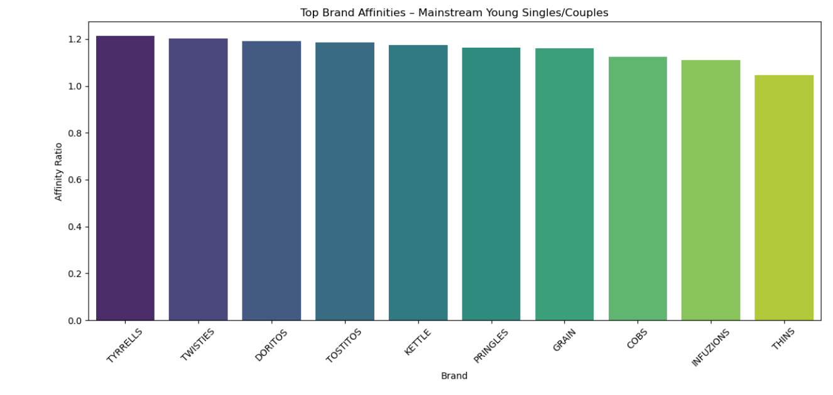
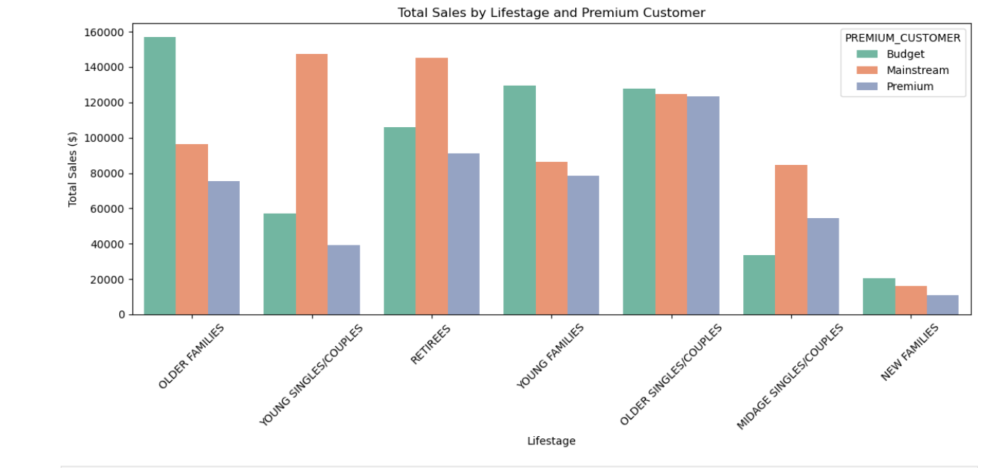
Key Insights – Customer Segmentation
• Young Singles/Couples (Mainstream) are high-value for larger packs
• 175g packs show 25% higher purchase rate in this segment
• Ideal target for premium placements and promotions

Slide 6
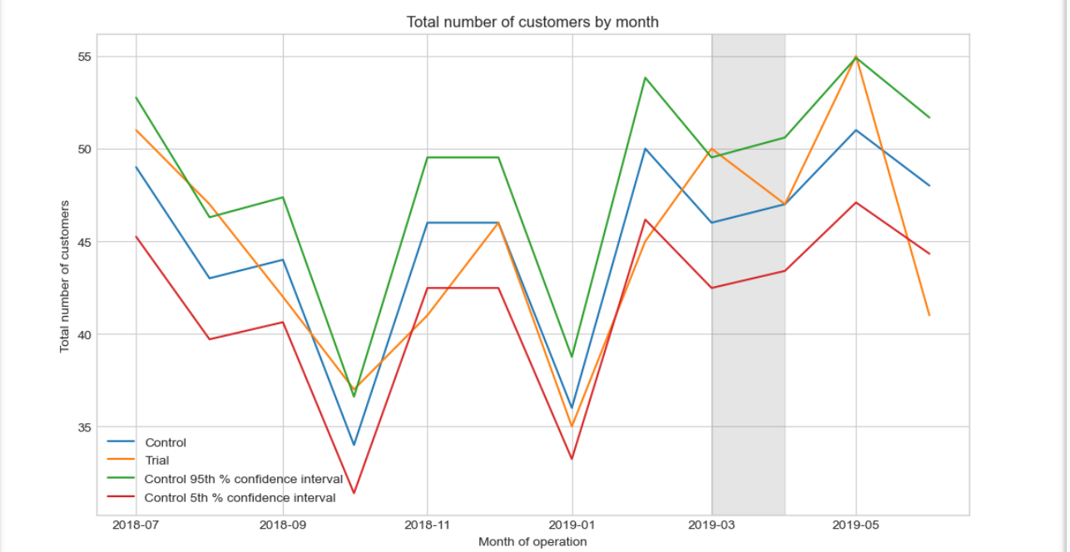
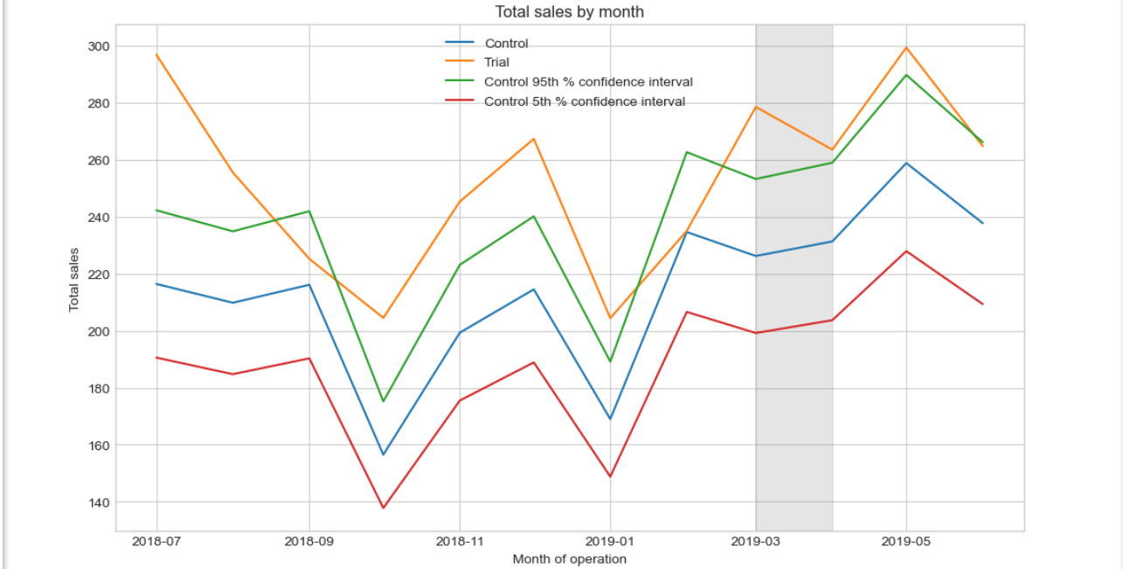
Key Insights – Trial Overview
• Trials in 3 stores: 77 (urban), 86 (suburban), 88 (regional)
• Controls matched on pre-trial trends (corr >0.9)
• Period: Jan–Apr 2019; metrics: sales volume & customer count

Slide 7
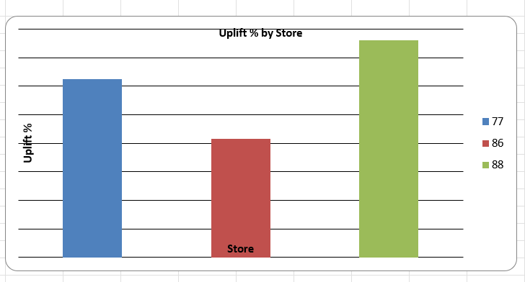
Analysis – Sales Uplift
• Store 77: +18% sales uplift (p<0.05)
• Store 86: Flat (0%) – possible low traffic
• Store 88: +12% uplift driven by +8% customers
• Pre-trial std. dev. <3% confirms trial effect

Slide 8
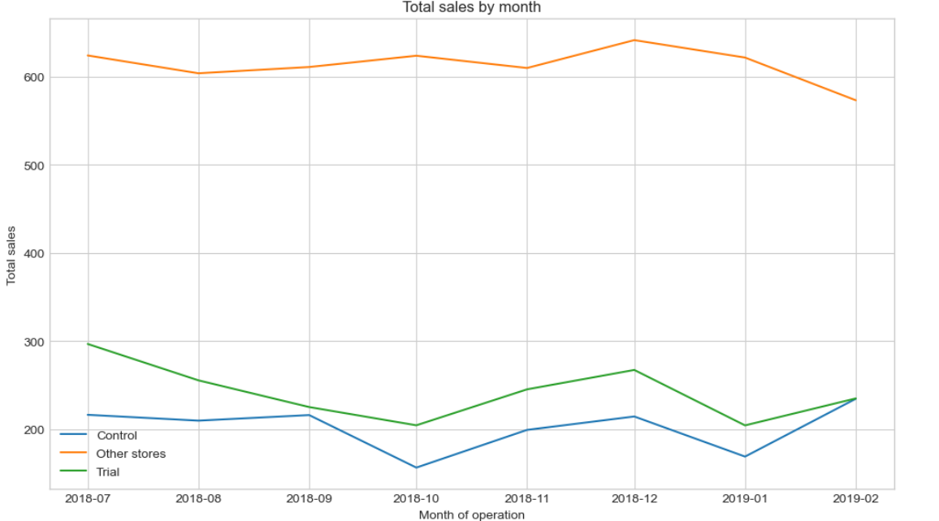
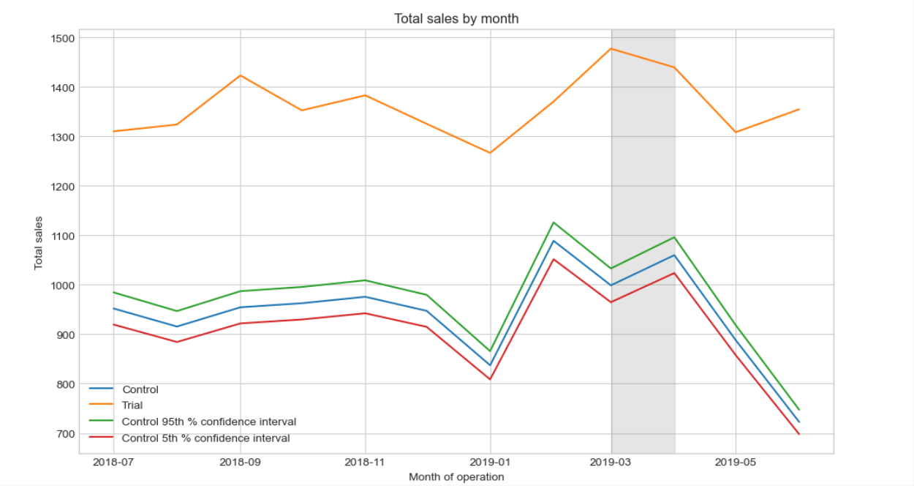
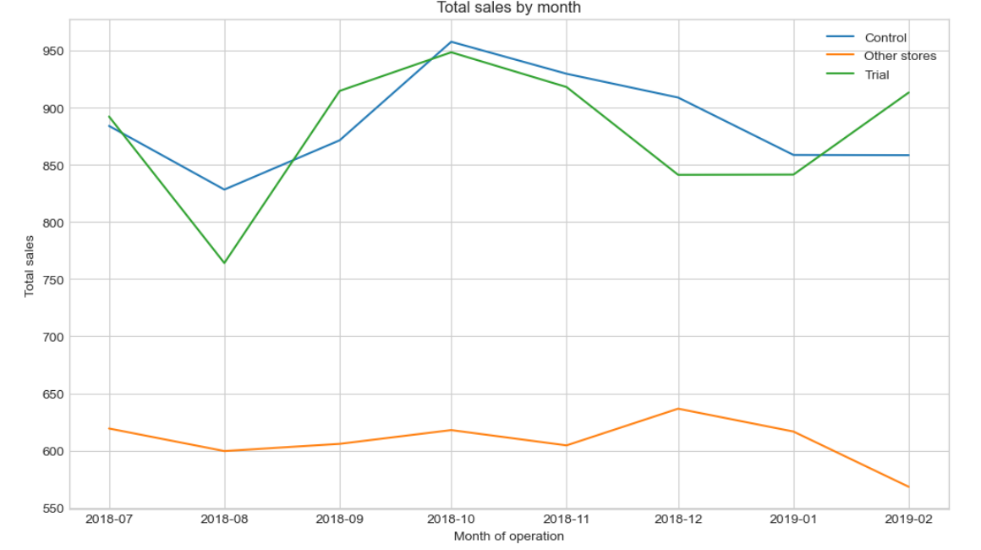
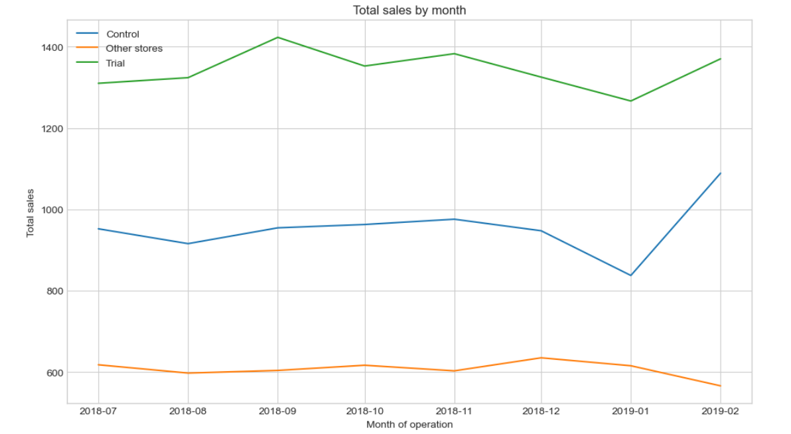
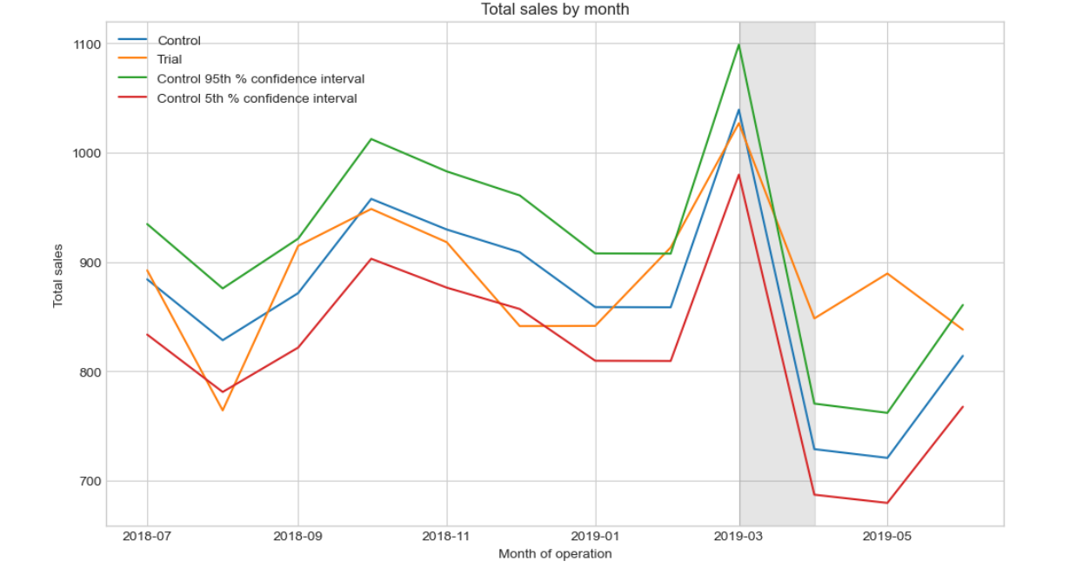
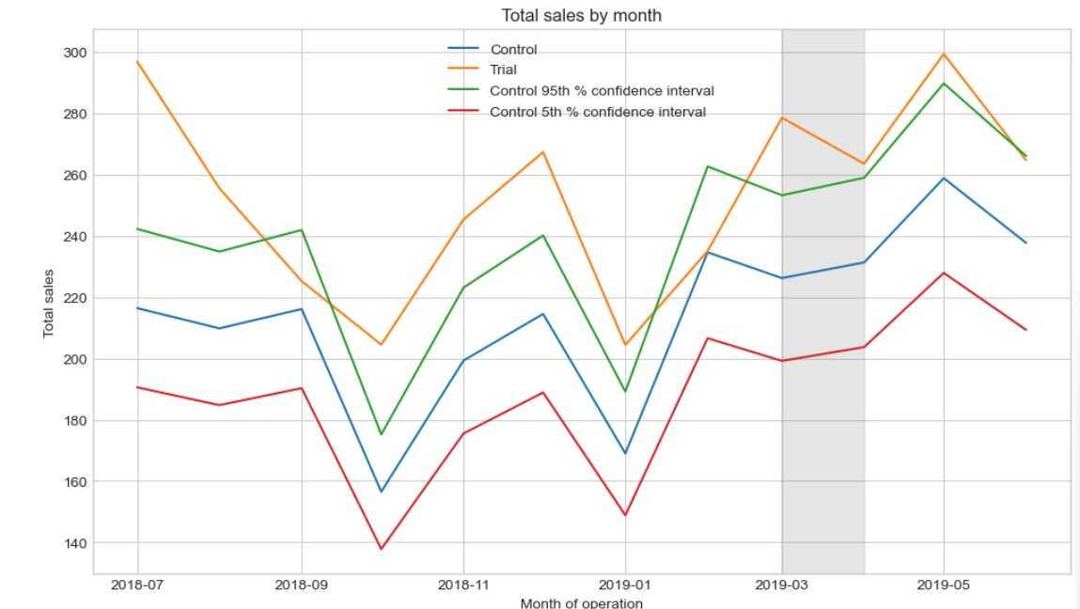

Slide 9
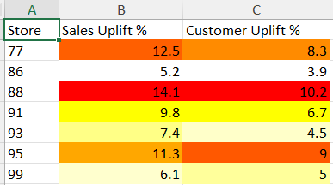
Analysis – Customer Uplift
• Store 77: +10% customers post-trial
• Store 86: -2% (non-significant)
• Store 88: +7% customers
• Uplift from new Young Singles segment customers

Slide 10

Recommendations
• Promote 150g+ packs to Young Singles/Couples (Mainstream)
• Expand trials to 50 stores like 77/88; pause 86-type stores
• A/B test pricing on 175g packs; monitor via monthly dashboards
• Projected ROI: 18% sales growth

Slide 11
Thank You & Q&A
Thank you for partnering with Quantium.
Questions?
Contact: shreyajaiswal.mcs@gmail.com | +1 309-242-0283

