Slide 1
Cryptography
Nafis Irtiza Tripto

Slide 2
Some backgrounds
Cipher: a character-for-character or bit-for-bit transformation, without regard to the linguistic structure of the message.
Code: replaces one word with another word or symbol. Codes are not used any more, although they have a glorious history.

Slide 3
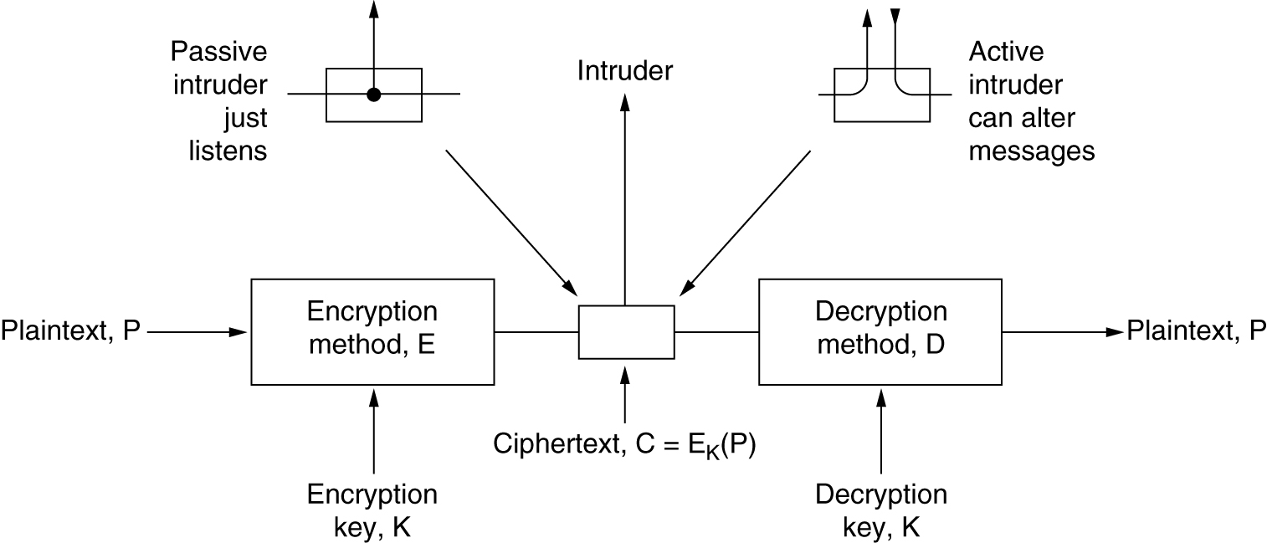
The encryption model (for a symmetric-key cipher)
Same key for encryption and decryption

Slide 4
Fundamental rule of Cryptography
Kerckhoff’s principle: All algorithms must be public; only the keys are secret
cryptanalyst knows how the encryption method, E, and decryption, D, work in detail.
Trying to keep the algorithm secret, known in the trade as security by obscurity, never works
Since the real secrecy is in the key, its length is a major design issue

Slide 5
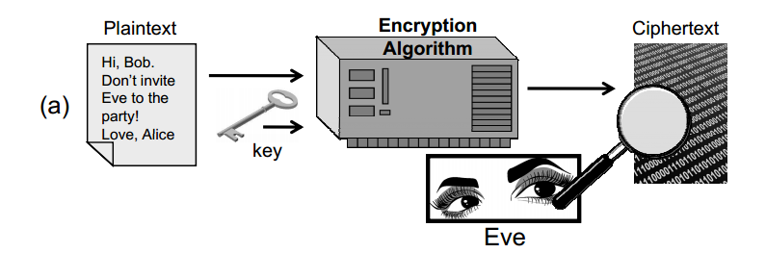
Crypto-system attacks
Ciphertext-only attack. the cryptanalyst has access to the ciphertext of one or more messages, all of which were encrypted using the same key, K

Slide 6
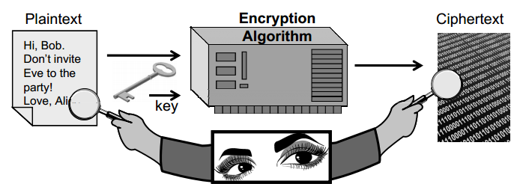
Crypto-system attacks
Known-plaintext attack. the cryptanalyst has access to one or more plaintext-ciphertext pairs, such that each plaintext was encrypted using the same key, K

Slide 7
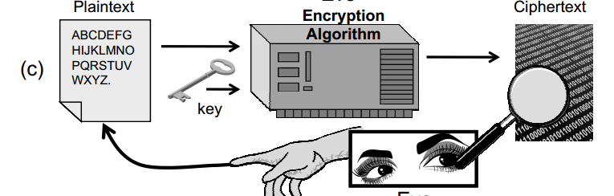
Crypto-system attacks
Chosen-ciphertext attack. the cryptanalyst can choose one or more ciphertext messages and get the plaintext that is associated with each one, based on the use of same key, K
Can be offline or adaptive based

Slide 8
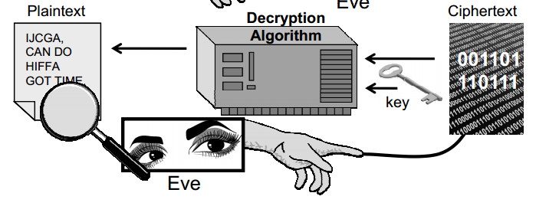
Crypto-system attacks
Chosen-plaintext attack. the cryptanalyst can chose one or more plaintext messages and get the ciphertext that is associated with each one, based on the use of same key, K
Can be offline or adaptive based

Slide 9
Traditional Cryptography Algorithms

Slide 10
Substitution Cipher
Invented by Julius Ceaser
Each letter or group of letters is replaced by another letter or group of letters to disguise it
Ciphertext alphabet to be shifted by k letters
For k =3, attack becomes DWWDFN
How many possibilities?
26

Slide 11
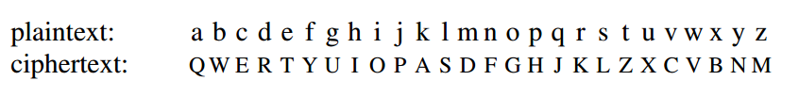
Substitution Cipher
The next improvement is to have each of the symbols in the plaintext map onto some other letter
How many possible keys?
Even at 1 nsec per solution, a million computer chips working in parallel would take 10,000 years to try all the keys
26!

Slide 12
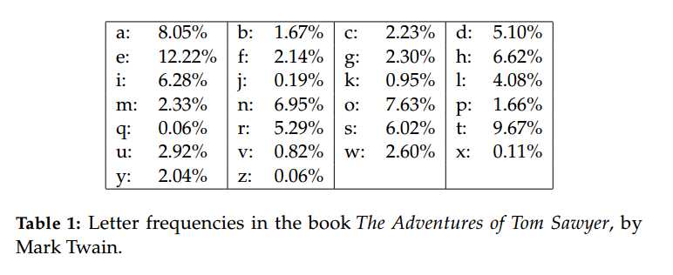
How to break substitution cipher

Slide 13
How to break substitution cipher
In English, for example, e is the most common letter, followed by t, o, a, n, i, etc.
The most common two-letter combinations, or digrams, are th, in, er, re, and an
The most common three-letter combinations, or trigrams, are the, ing, and, and ion
By making guesses at common letters, digrams, and trigrams and knowing about likely patterns of vowels and consonants, the cryptanalyst builds up a tentative plaintext, letter by letter

Slide 14
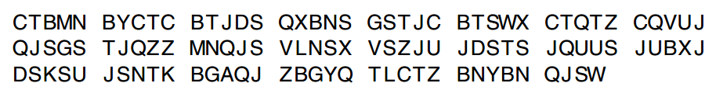
How to break substitution cipher
Another approach is to guess a probable word or phrase
A likely word in a message from an accounting firm is financial
with four other letters between their occurrences, we look for repeated letters in the ciphertext at this spacing
only two of these, 31 and 42, have the next letter (corresponding to n in the plaintext) repeated in the proper place.
Of these two, only 31 also has the a correctly positioned, so we know that financial begins at position 30

Slide 15
Hill Cipher
Invented 1929by Lester S. Hill
The Hill cipher takes a block of m letters, each interpreted as a number from 0 to 25, and interprets this block as a vector of length m.
Needs matrix multiplication
Hill cipher is still relatively easy to break given enough plaintext-ciphertext pairs
Its use of interpreting letters as numbers and using linear algebra to perform encryption and decryption is another idea from classic cryptography that finds its way into the AES cryptosystem

Slide 16
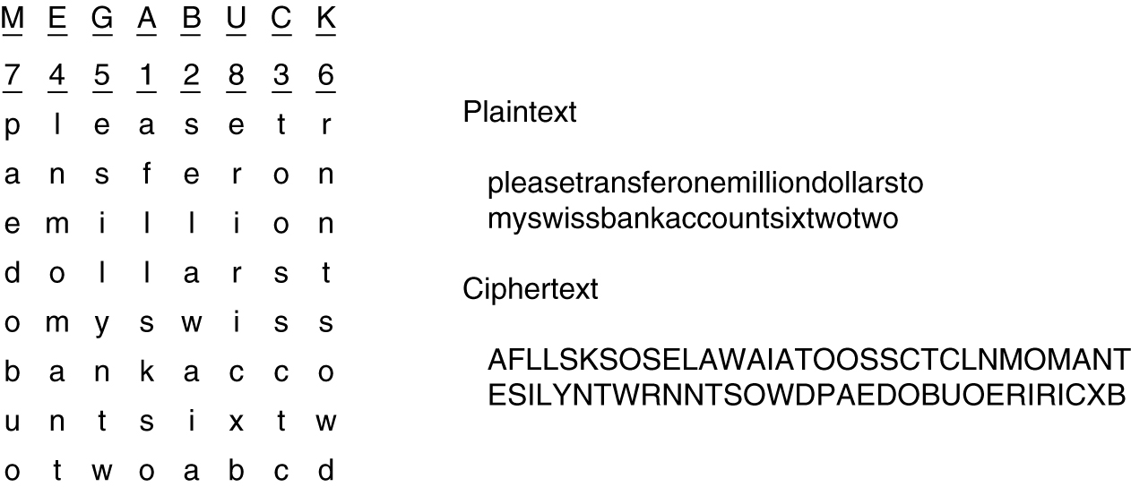
Transposition Cipher
reorder the letters but do not disguise them
The cipher is keyed by a word or phrase not containing any repeated letters

Slide 17
Transposition cipher as hill cipher
Special case of Hill Cipher
any permutation can be performed using matrix multiplication
Consider the permutation:
π : (1,2,3,4,5) → (3,1,2,5,4).

Slide 18
How to break the Transposition Cipher
the cryptanalyst must first be aware that he is dealing with a transposition cipher
The next step is to make a guess at the number of columns
digrams MO, IL, LL, LA, IR, and OS occur in the ciphertext as a result of this phrase wrapping around
The remaining step is to order the columns
When the number of columns, k, is small, each of the k(k − 1) column pairs can be examined in turn to see if its digram frequencies match those for English plaintext
The column whose digram and trigram frequencies give the best match is tentatively assumed to be correct
The entire process is continued until a potential ordering is found

Slide 19
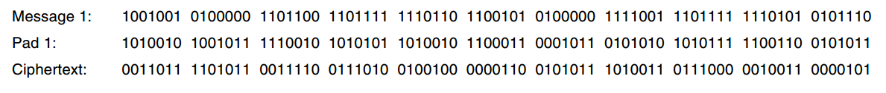
One time pad (The unbreakable cipher!)
First choose a random bit string as the key
Then convert the plaintext into a bit string, for example, by using its ASCII representation
Finally, compute the XOR (eXclusive OR) of these two strings, bit by bit
Example: M = I love you

Slide 20
Break the one time pad???
SORRY, You cant
The resulting ciphertext cannot be broken because in a sufficiently large sample of ciphertext, each letter will occur equally often, as will every digram, every trigram, and so on.
Decoded message M’ = Elvis lives

Slide 21
Then where is the catch???
the key cannot be memorized, so both sender and receiver must carry a written copy with them
the total amount of data that can be transmitted is limited by the amount of key available
Another problem is the sensitivity of the method to lost or inserted characters
If the sender and receiver get out of synchronization, all data from then on will appear garbled

Slide 22
The future! - Quantum Cryptography
light comes in little packets called photons
light can be polarized by being passed through a polarizing filter
To generate a one-time pad, Alice needs two sets of polarizing filters.
Rectilinear Basis
Diagonal Basis
Remember: Quantum cryptography is used to send the one time pad only

Slide 23
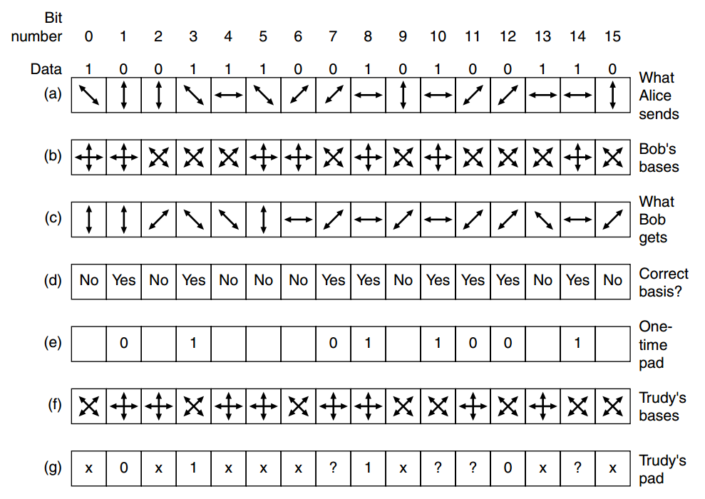
Quantum Cryptography

Slide 24
Two fundamental cryptographic principles
Cryptographic principle 1: Messages must contain some redundancy
Cryptographic principle 2: Some method is needed to foil replay attacks

Slide 25
Symmetric Key Algorithms

Slide 26
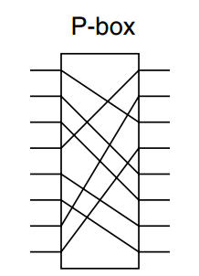
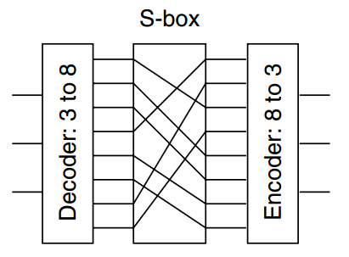
Block ciphers
Cryptographic algorithms can be implemented in either hardware (for speed) or software (for flexibility).
P-box (P stands for permutation), used to effect a transposition on an 8-bit input.
S- Box: In this example, a 3-bit plaintext is entered and a
3-bit ciphertext is output

Slide 27
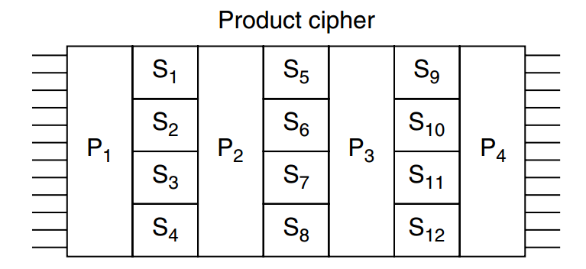
Product ciphers
operate on k-bit inputs to produce k-bit outputs are very common

Slide 28
DES-Data Encryption Standard
Developed by IBM, adopted by US govt in 1977
Plaintext is encrypted in blocks of 64 bits, yielding 64 bits of ciphertext
The algorithm, which is parameterized by a 56-bit key, has 19 distinct stages.
Decryption is the inverse of encryption process

Slide 29
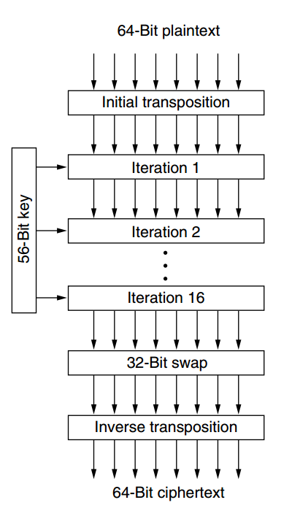
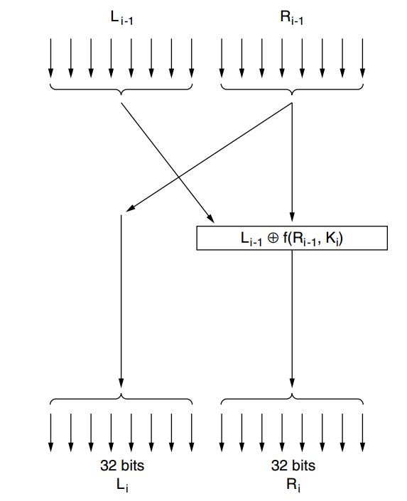
DES-Data Encryption Standard

Slide 30
DES-Data Encryption Standard (Key)
Before the algorithm starts, a 56-bit transposition is applied to the key.
Just before each iteration, the key is partitioned into two 28-bit units, each of which is rotated left by a number of bits dependent on the iteration number.
Ki is derived from this rotated key by applying yet another 56-bit transposition to it.
A different 48-bit subset of the 56 bits is extracted and permuted on each round

Slide 31
To make DES to strong (Whitening)
XORing a random 64-bit key with each plaintext block before feeding it into DES
XORing a second 64-bit key with the resulting ciphertext before transmitting it
it makes an exhaustive search of the key space much more time consuming
same whitening key is used for each block

Slide 32
Breaking DES???
IBM reduced the key from 128 bits to 56 bits and decided to keep secret the process by which DES was designed
In 1977, two Stanford cryptography researchers, Diffie and Hellman (1977), designed a machine to break DES and estimated that it could be built for 20 million dollars
Nowadays, if Such a machine exists, is for sale, and costs less than $10,000 to make

Slide 33
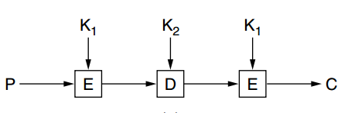
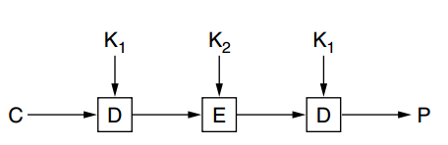
Triple DES
Encryption
Decryption

Slide 34
Triple DES
Why 2 keys used instead of 3???
even the most paranoid of cryptographers believe that 112 bits is adequate for routine commercial applications
Going to 168 bits would just add the unnecessary overhead of managing and transporting another key for little real gain
Why EDE instead of EEE???
Backward compatibility with existing single-key DES systems
By using EDE, however, instead of EEE, a computer using triple encryption can speak to one using single encryption by just setting K 1 = K 2

Slide 35
AES (Advanced Encryption Algorithm)
In 1997, the U.S. (NIST) put out a public call for a replacement of the symmetric encryption algorithm DES
5 finalists and ultimately chosen was the Rijandle
It becomes the new standard of cryptography
A 128-bit key gives a key space of 2128 ∼ 3 × 10^38 keys. Even if NSA manages to build a machine with 1 billion parallel processors, each being able to evaluate one key per picosecond, it would take such a machine about 1010 years to search the key space

Slide 36
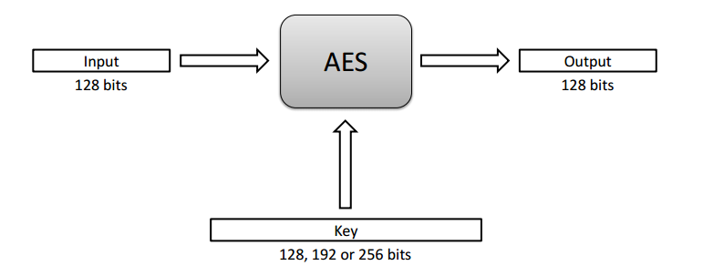
AES (Advanced Encryption Algorithm)
AES is a block cipher that operates on 128-bit blocks
It is designed to be used with keys that are 128, 192, or 256 bits long
It is supported by all mainstream operating systems, including Windows, Mac OS, and Linux.

Slide 37
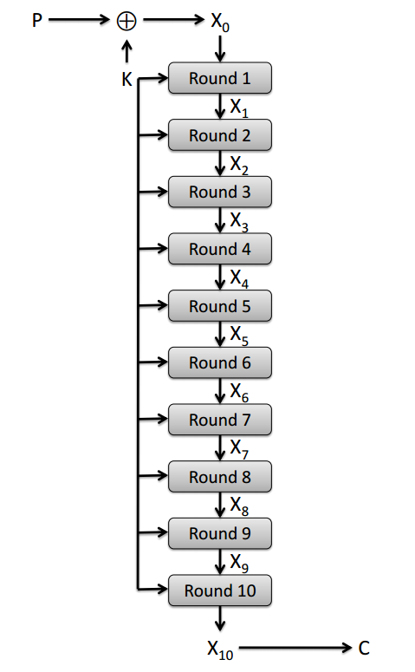
AES rounds
Each round is built from four basic steps: 1. SubBytes step: an S-box substitution step 2. ShiftRows step: a permutation step 3. MixColumns step: a matrix multiplication (Hill cipher) step 4. AddRoundKey step: an XOR step with a round key derived from the 128-bit encryption key
decryption can be done just by running the algorithm backward

Slide 38
Implementation of AES
use several lookup tables to implement the basic steps of each round to optimize execution time
A lookup table stores all the possible values of a function into an array that is indexed by the input of the function
128-bit version of the AES algorithm can be implemented using exactly eight lookup tables
each mapping an input byte (an 8-bit word) to an output int (a 32-bit word)
each of the eight lookup tables stores 256, 32-bit ints

Slide 39
Implementation of AES
• XOR of two ints: y = x1 ⊕ x2, where x1, x2, and y are ints
• Split of an int into 4 bytes: (y1, y2, y3, y4) = x, where y1, y2, y3, and y4 are bytes and x is an int
• Table lookup of an int indexed by a byte: y = T[x], where y is an int and x is a byte

Slide 40
Attacks on AES
the only known practical attacks on AES are side channel attacks.
The timing attack is based on the fact that the cache of the processor where the AES algorithm is executed will store portions of the lookup tables used in the implementation of AES
By timing multiple executions of the algorithm using the same key on a series of known plaintexts of known ciphertexts, the attacker can eventually learn the key

Slide 41
What's potentially wrong with AES and DES
monoalphabetic substitution cipher
If you encrypt the plaintext abcdefgh 100 times with the same DES key, you get the same ciphertext 100 times

Slide 42
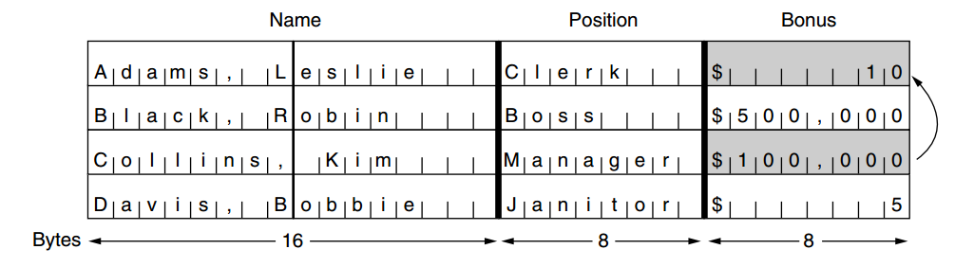
What's potentially wrong with AES and DES
Electronic Code Book Mode

Slide 43
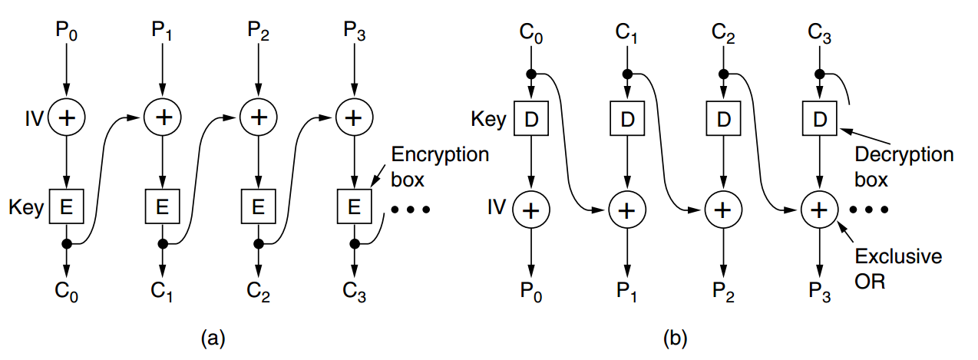
Cipher Block Chaining Mode

Slide 44
Cipher Block Chaining Mode
encryption of block i is a function of all the plaintext in blocks 0 through i − 1, so the same plaintext generates different ciphertext depending on where it occurs
Cipher block chaining also has the advantage that the same plaintext block will not result in the same ciphertext block, making cryptanalysis more difficult
However, cipher block chaining has the disadvantage of requiring an entire 64-bit block to arrive before decryption can begin.

Slide 45
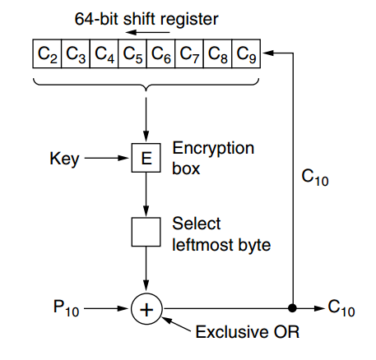
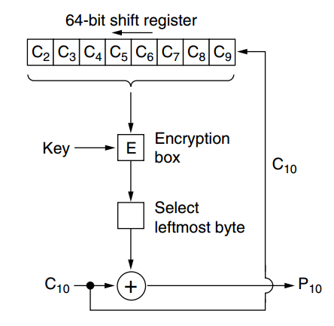
Cipher Feedback Mode
Encryption
Decryption

Slide 46
Cipher Feedback Mode
A problem with cipher feedback mode is that if one bit of the ciphertext is accidentally inverted during transmission, the 8 bytes that are decrypted while the bad byte is in the shift register will be corrupted
Nevertheless, applications exist in which having a 1-bit transmission error mess up 64 bits of plaintext is too large an effect.

Slide 47
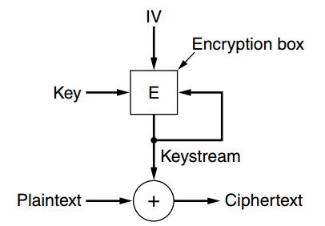
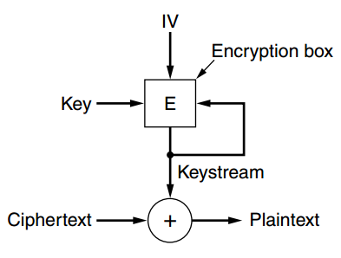
Stream Cipher Mode
Encryption
Decryption

Slide 48
Stream Cipher Mode
Since the keystream depends only on the IV and the key, it is not affected by transmission errors in the ciphertext and can be pre-computed earlier
Thus, a 1-bit error in the transmitted ciphertext generates only a 1-bit error in the decrypted plaintext
Using the same keystream twice exposes the ciphertext to a keystream reuse attack

Slide 49
Counter Mode
One problem that all the modes except electronic code book mode have is that random access to encrypted data is impossible
However, disk files are often accessed in nonsequential order, especially files in databases
With a file encrypted using cipher block chaining, accessing a random block requires first decrypting all the blocks ahead of it, an expensive proposition.
So counter mode has been invented

Slide 50
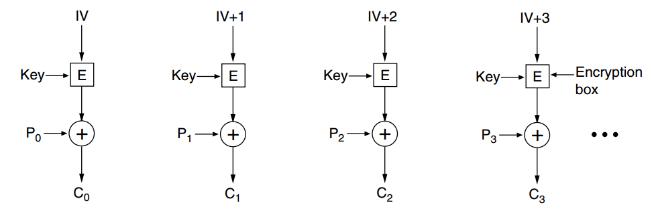
Counter Mode

Slide 51
Counter Mode
Vulnerable to keystream reuse attack if same IV and key pair are used again
However, even if the same key is accidentally used twice, if the IV is different each time, the plaintext is safe

Slide 52
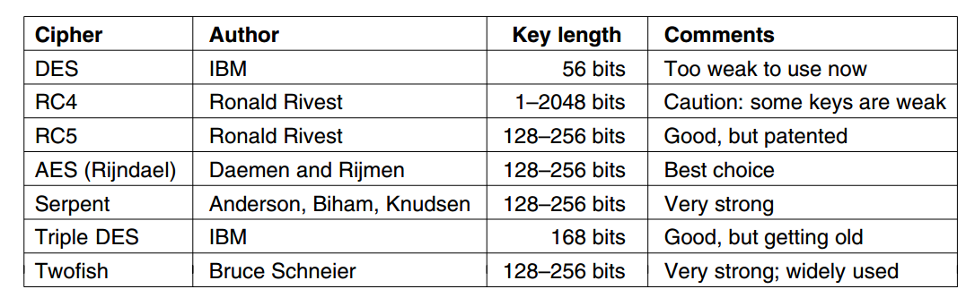
Other ciphers

