Slide 1
Event Management System
Dbms project
ue17cs253

Slide 2
Case Study: TheCollegeFever vs Event Management System Similarities
Each student has his/her own account.
The events are categorized based on their type.
All the details are displayed along with the event.

Slide 3
Case Study: TheCollegeFever vs Event Management System Differences
There are no separate accounts for organizers.
Anyone can create an event in TheCollegeFever, whereas only organizers can create events in our application.
Our system allows the organizers to keep track of where the funds allocated have been spent and find the net profit for that particular event.
The organizers can keep track of the all the registrations, as well as update the details of the winners after the event is over.
In TheCollegeFever, events are categorized into types which can be viewed manually. On the other hand, in our system, we store the user’s hobbies and recommend events to them based on their preferences.

Slide 4
Case Study: TheCollegeFever vs Event Management System Differences
If one cannot find team members, other students who have similar interests and haven’t signed up for the event yet are displayed, without a security breach.
On successful registration, TheCollegeFever sends a confirmation through email.
In TheCollegeFever, one can register for multiple events at once, but in our system, we can only register for one event at a time.

Slide 5
Case Study: TheCollegeFever vs Event Management System Similarities
Each student has his/her own account.
The events are categorized based on their type.
All the details are displayed along with the event.

Slide 6
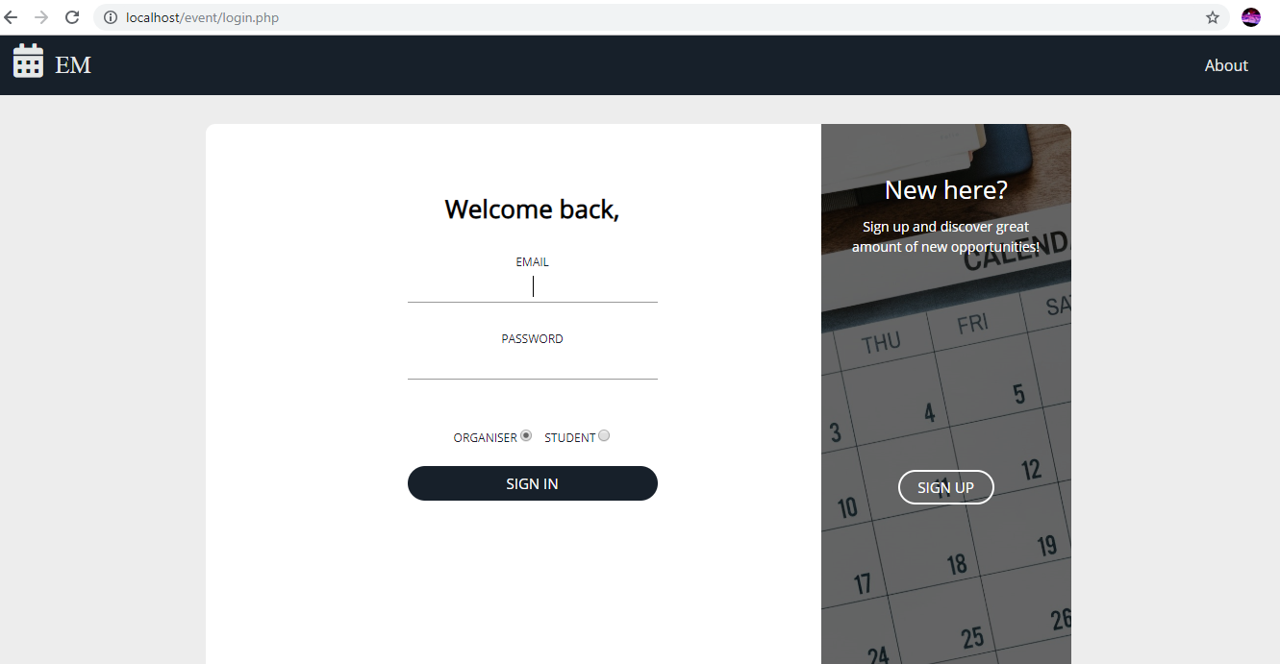

Slide 7
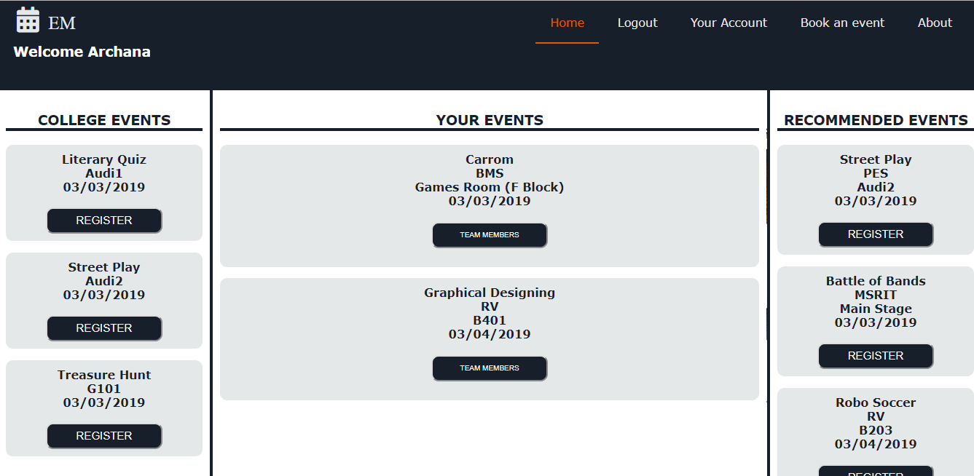

Slide 8
Problems
Security can be improved.
PHP codes can be made more secure.
Receipt generation for registration
Users can receive a confirmation for the events they sign up for via SMS or email

Slide 9
Thank you!
Presented by:
Shreya Maheshwari (PES1201700025)
Archana P (PES1201701543)
Sai Priya L (PES1201701565)

