Slide 1
Placement Project
Data Science
Topic: Forecast the Probability of Successfully Collecting Debts by Analyzing Statute-Barred Status
Project By: Shreya Mankar

Slide 2
Problem Statement
In the realm of debt collection, the ability to discern which accounts are statute-barred—”thus potentially unrecoverable”—holds immense significance.
This project endeavors to develop a sophisticated machine-learning model aimed at accurately predicting the probability of successfully collecting debts by meticulously examining the statute-barred status of each account.
Given a dataset encompassing a multitude of attributes including original creditor information, account IDs, current balances, purchase dates, and a wealth of other pertinent features, the objective is to construct a predictive model that excels in identifying accounts where the statute barred status may influence the likelihood of debt retrieval.
The focal point of this endeavor centers on the IsStatBarred field ‘Y’ status, which serves as the pivotal target variable for classification.

Slide 3
Why Statute Barred Status Matters?
Resource Allocation: Pursuing statute barred debts requires time, effort, and resources. Debt collection companies may prefer to focus their resources on collecting debts that are within the statute of limitations and have a higher likelihood of success.
Legal Compliance: Pursuing a debt that is statute barred may violate consumer protection laws and regulations. Debt collection companies must comply with these laws to avoid facing legal consequences, including fines and lawsuits.
Reputation Management: Debt collection companies rely on their reputation to attract clients and maintain business relationships. Engaging in aggressive or unlawful debt collection practices, such as pursuing statute barred debts, can damage their reputation and credibility in the industry.
Ethical Considerations: Engaging in debt collection activities for statute barred debts can be considered unethical. Debtors may have moved on with their lives, and attempting to collect on old debts can cause unnecessary stress and financial hardship.
Legal Defense by Debtors: If a debtor is aware that the debt is statute barred, they may raise this as a defence in any legal proceedings initiated by the debt collection company. This can result in the case being dismissed by the court, wasting the company's time and resources

Slide 4
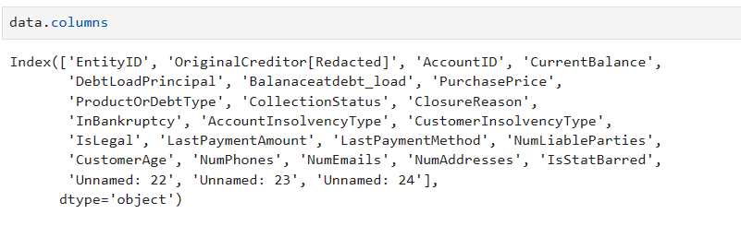
About The Dataset
406423 rows
25 columns (3 unnecessary columns) – removed
Remaining 22 Relevant Columns for analysis
Out of 22, 10 – Categorical columns and 12 - Numerical columns

Slide 5
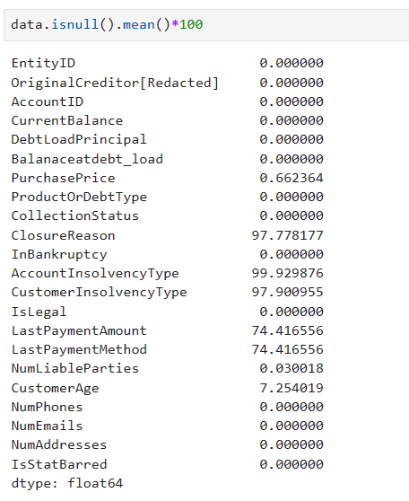
Presence of Null Values?

Slide 6
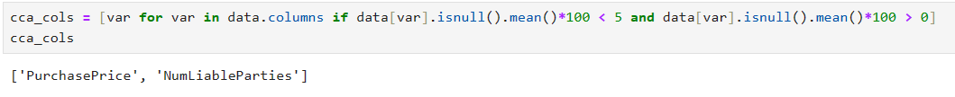
Less than 5% Null Values
Is Missing Completely At Random(MCAR)?
Complete Case Analysis (CCA)- [“list-wise deletion of cases”]
Discarding observations (rows) where values in any of the variable (column) are missing.

Slide 7
More than 5% less than 10% Null Values
Methods tried for handling Null Values:
1. Dropping the null values
2. Mean Imputation (Univariate)
3. Random Sample Imputation
4. KNN Imputation (Multivariate)

Slide 8
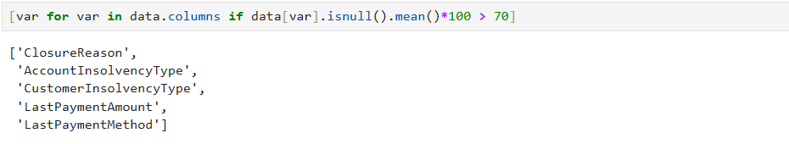
97-99% and 75% of Missing Values
Didn’t remove these columns altogether.
Possibility of adding at least some insights to the model
Hence, are treated at the time of encoding, where Null values are replaced with “NA” label
Even “NA” can contribute to the understanding of the model

Slide 9
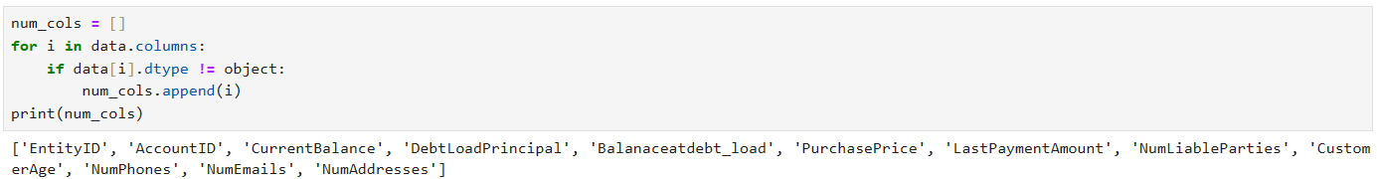
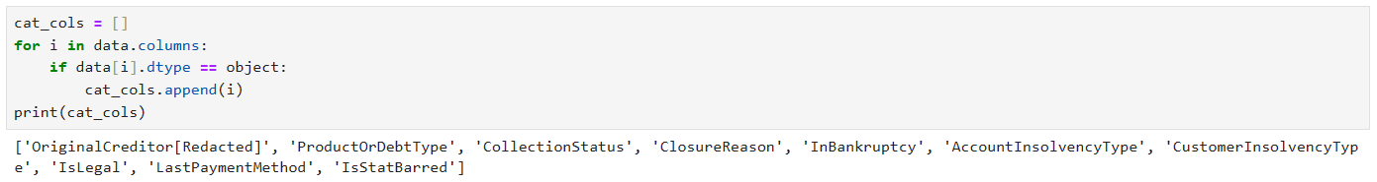
Exploratory Data Analysis
Numerical Columns
Categorical Columns

Slide 10
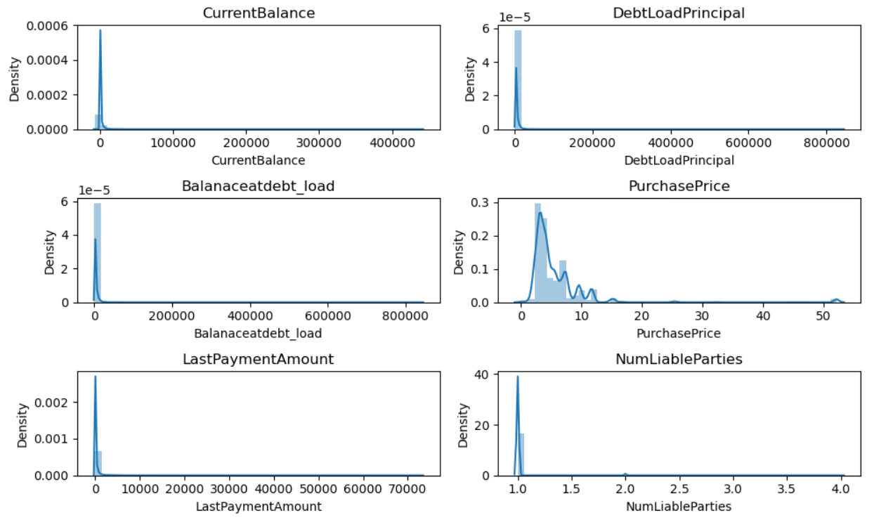
Distribution of Numerical Columns

Slide 11
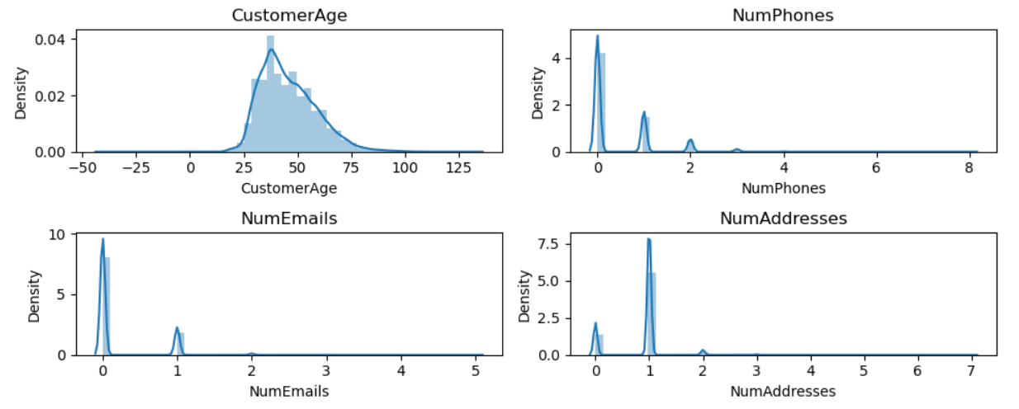
Out of all other columns, it is wise to treat the outliers for CustomerAge column. This is to have sensible input for “Age” .
As the models that we are going to use are mostly Tree-Based, which are robust to outliers, we won’t be touching other columns for outlier treatment.

Slide 12
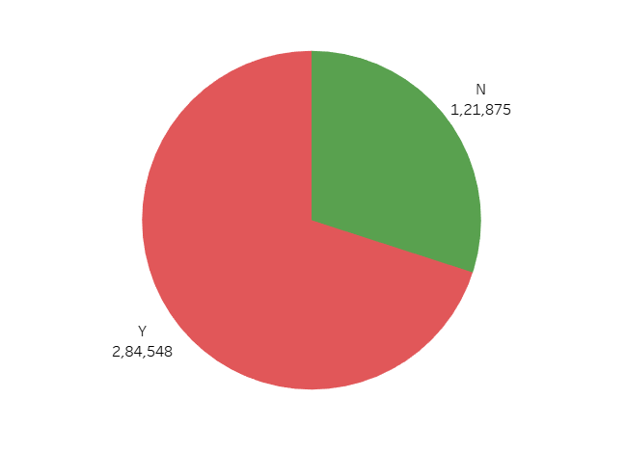
Distribution of Categorical Columns
Statute Barred Status

Slide 13
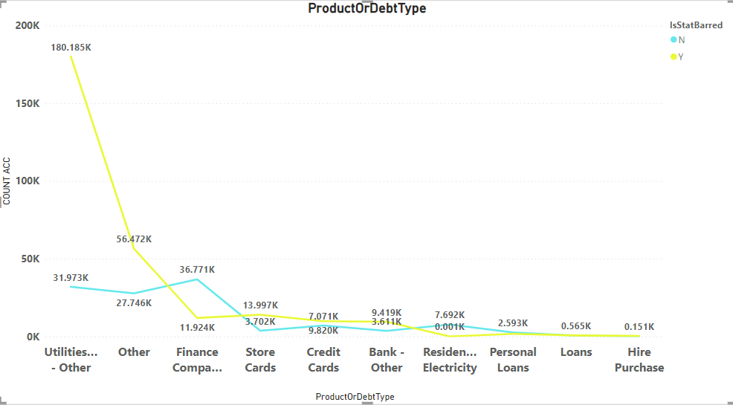
ProductOrDebtType

Slide 14
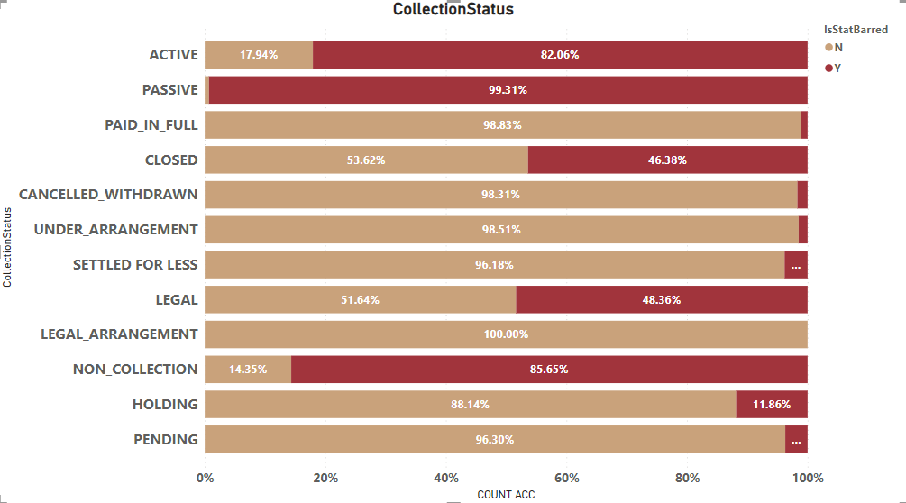
CollectionStatus

Slide 15
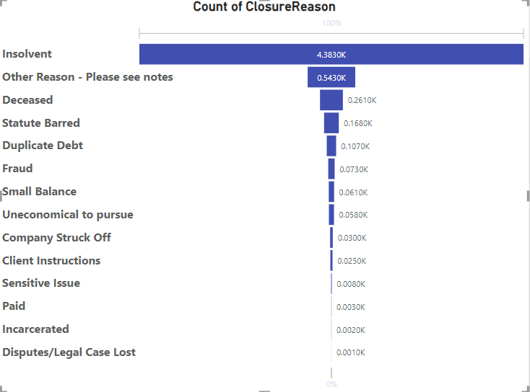
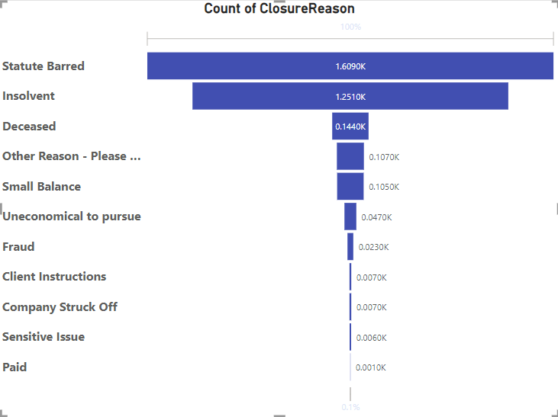
ClosureReason
Statute Barred- NO
Statute Barred- YES

Slide 16
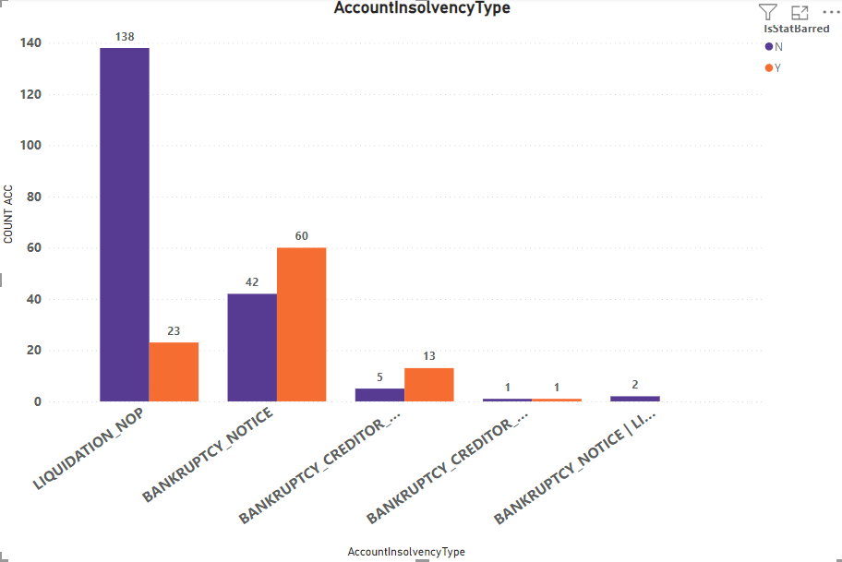
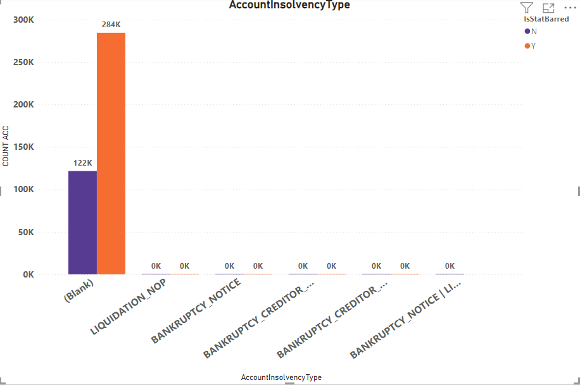
AccountInsolvencyType

Slide 17
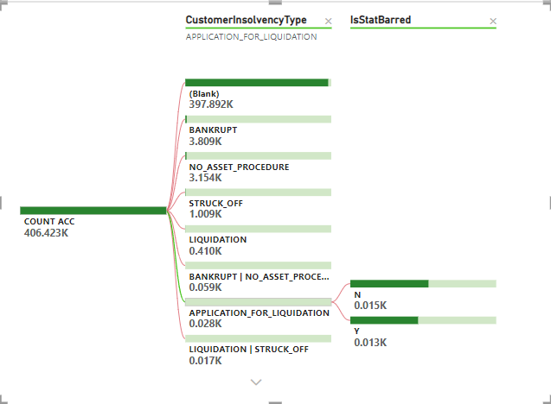
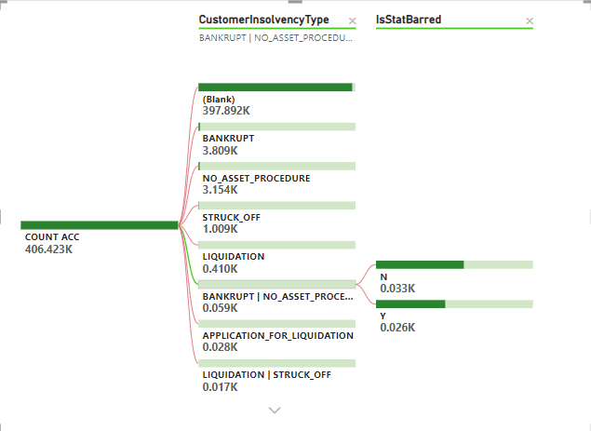
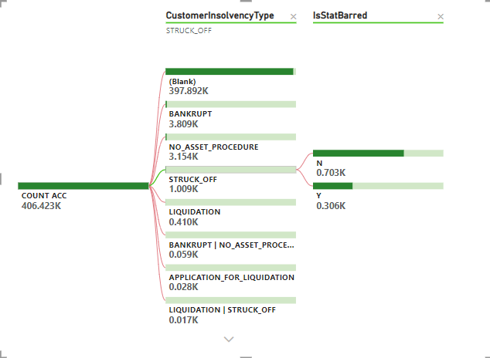
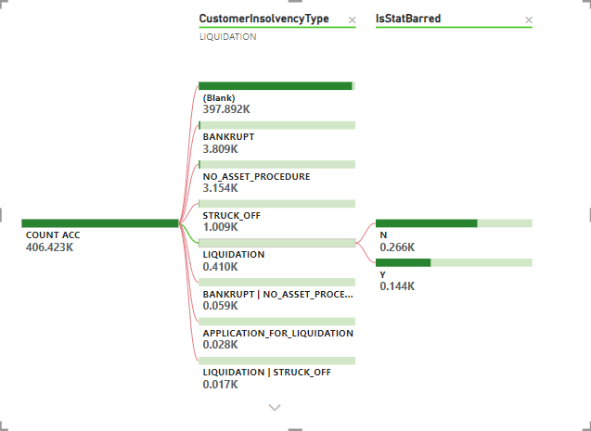
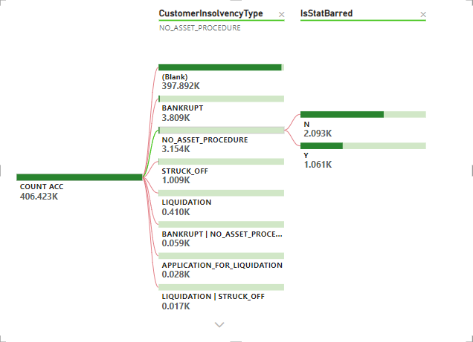
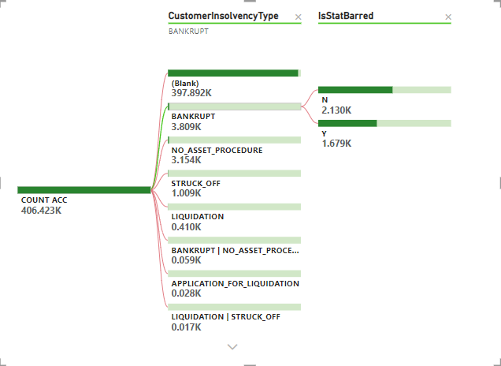
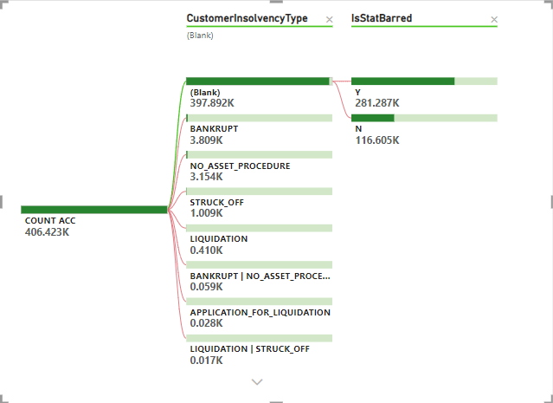
CustomerInsolvencyType

Slide 18
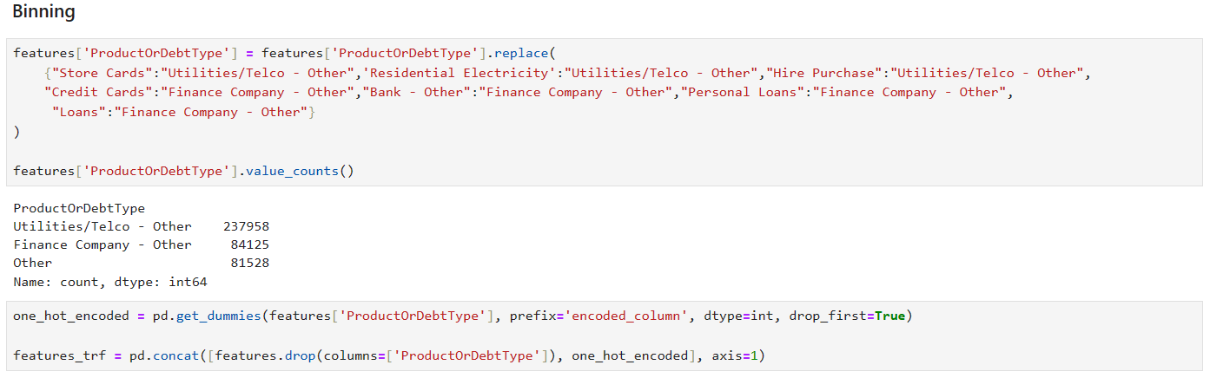
Encoding Categorical Features
Label Encoder: IsStatBarred column
OneHotEncoder : ProductOrDebtType column

Slide 19
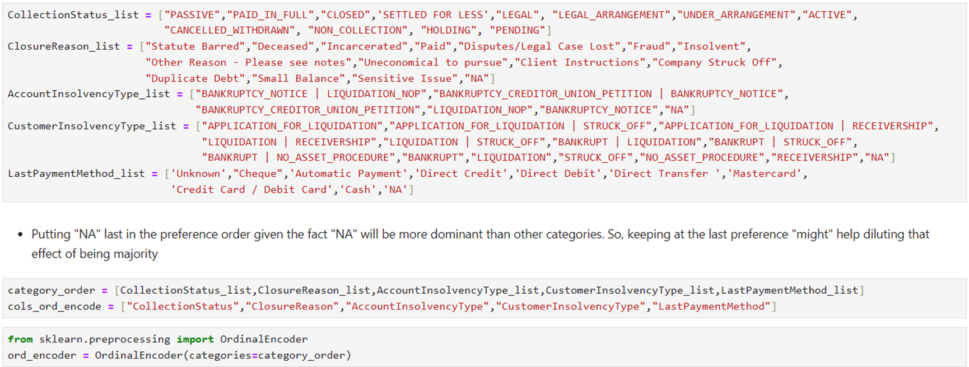
Ordinal Encoding: tried to arrange categories sequences-wise based on gauging the importance

Slide 20
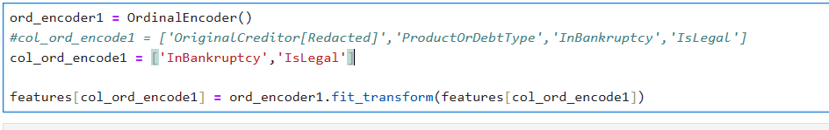
Ordinal Encoding: InBankruptcy, IsLegal columns

Slide 21
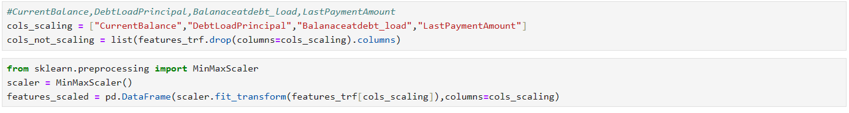
Feature Scaling
Used MinMaxScaler, because StandardScaler would have generated negative values

Slide 22
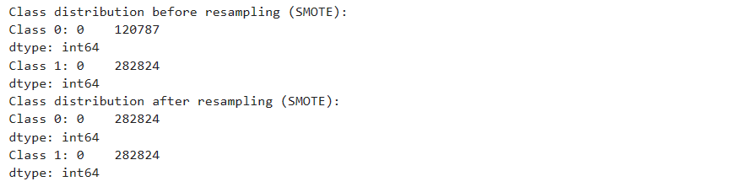
Imbalance Treatment
Used SMOTE(Synthetic Minority Over-sampling Technique) method

Slide 23
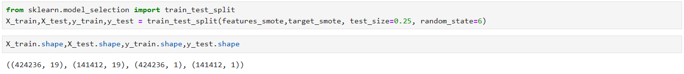
Train-Test Split

Slide 24
Building Models
Logistic Regression
Decision Tree
Random Forest Classifier
Gradient Boosting Classifier
XGBoost Classifier
KNN Classifier
**Hyperparameters were kept unchanged at this stage**

Slide 25
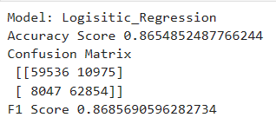
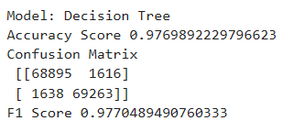
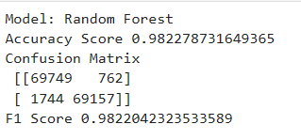
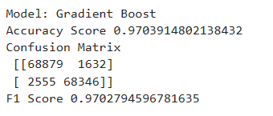
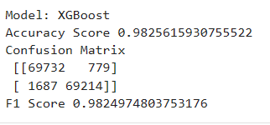
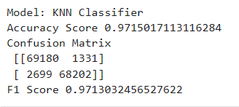
Metrics: Accuracy Score, Confusion Matrix, F1 Score
Analysing Type I and Type II Errors with the help of Confusion Matrix

Slide 26
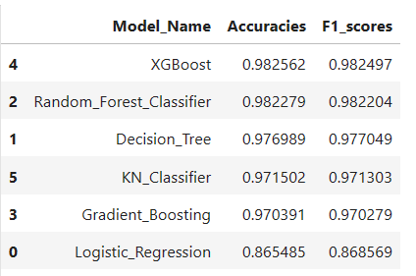
Comparing Performances of Models

Slide 27
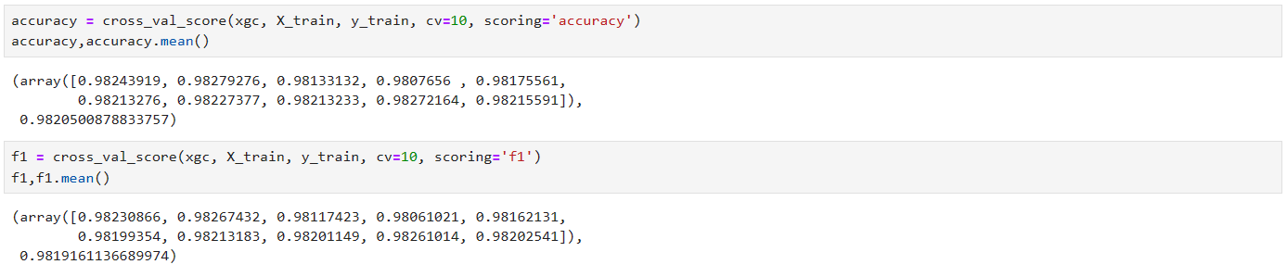
Best Performing Model: XGBoost
To make sure that the model is not overfitting, let’s do the cross validation of the results so obtained.
Thus, our model looks fairly stable!!

Slide 28
Why lookout for F1-score?
As we are working on identifying the IsStatBarred status for a given set of inputs pertaining to a debt, it is important to identify what kind of mistake our model is making while predicting the status.
If we analyze both scenarios for Statute Barred status, having a "False Positive mistake" and having a "False Negative mistake", both of these have their significant impact on the company's resources.
False Positive(Type I error): Not Pursuing a debt which should have, otherwise, been pursued will make the company "miss out on a significant amount of profit".
False Negative(Type II error): Pursuing a Debt recovery which is bound to be statute barred will "waste company's resources", bringing loss to the company.
Therefore, we cannot simply prefer one over the other (i.e. Type I error over Type II error and vice versa).
Precision helps in focusing more on Type I error, whereas Recall helps in focusing more on Type II error.
As we want to focus on both errors, we are choosing F1-score, which will help us finding the right balance between Precision and Recall.

Slide 29
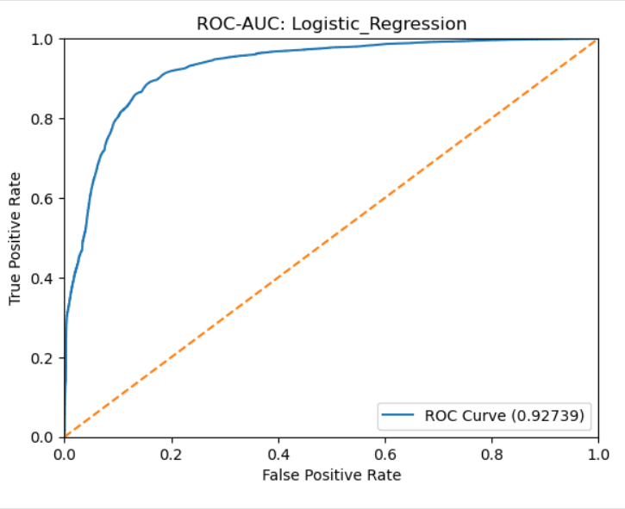
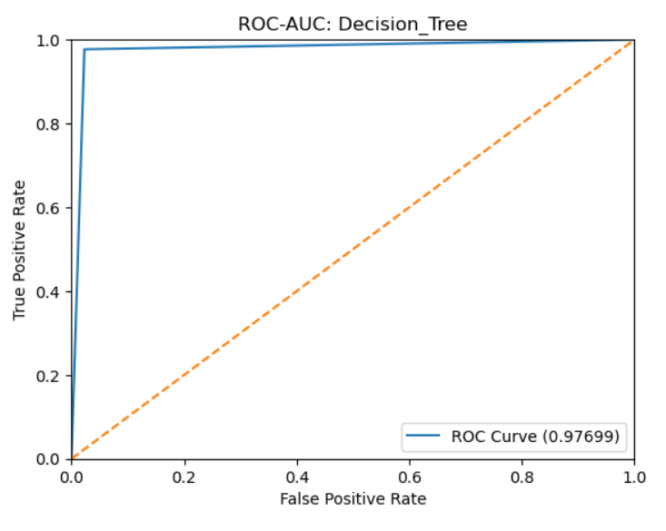
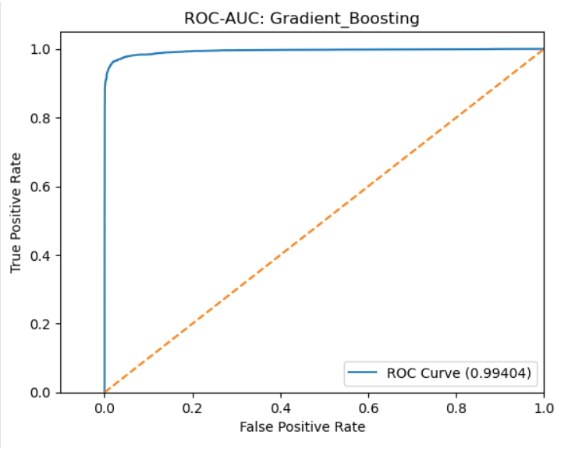
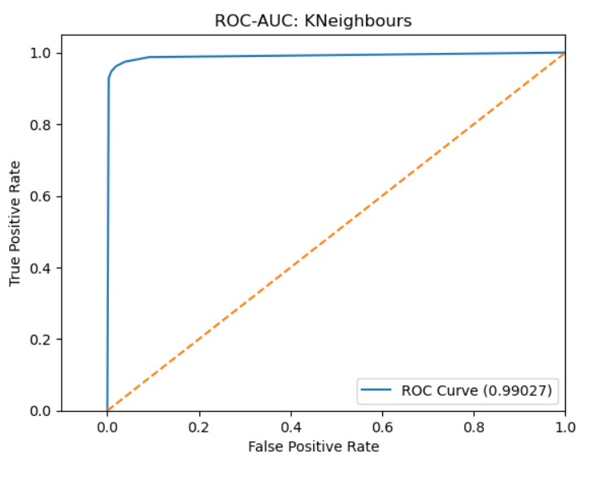
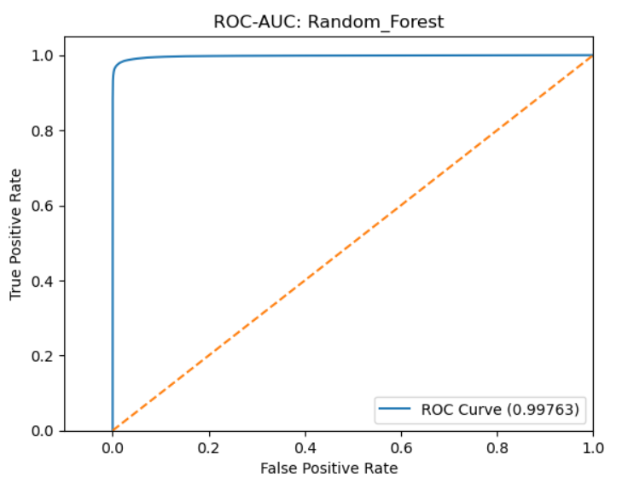
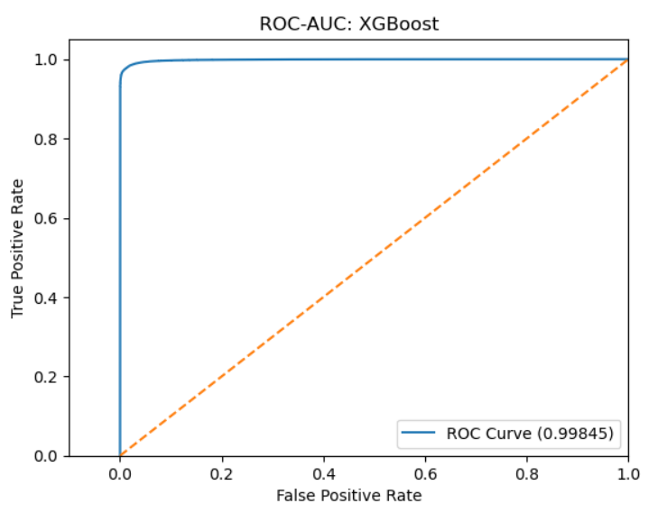
Comparing ROC-AUC

Slide 30
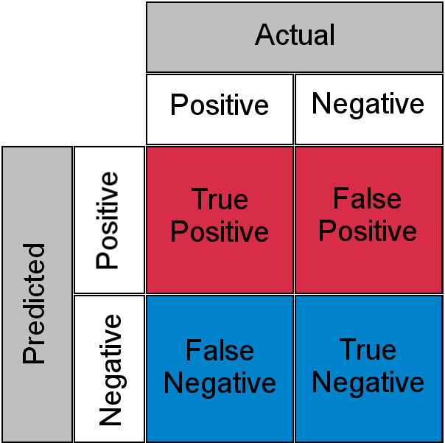
Importance of ROC
TPR- How much is our model benefitting?
FPR- How much is our model costing?
ROC curve is, thus, helping us find the right balance between this benefit and cost
More the Area under ROC Curve, better is our model.
TPR = TP/TP+FN
(Sensitivity)
FPR = FP/FP+TN
(1-Specificity)

Slide 31
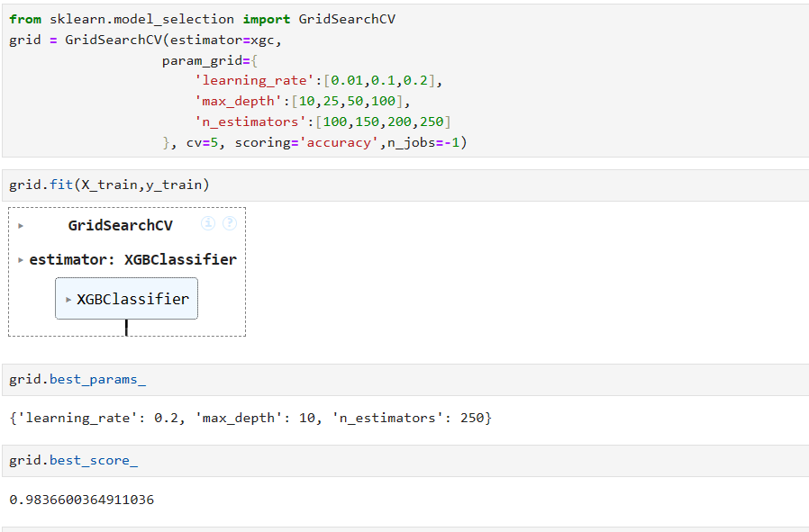
Lastly, Hyperparameter Tuning
sndfjwke

Slide 32
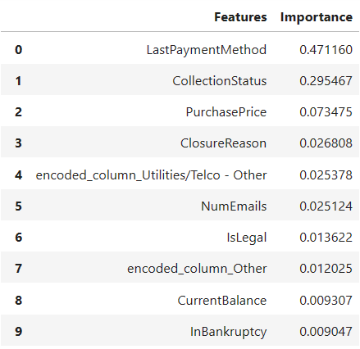
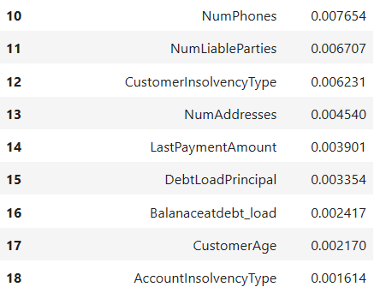
Analysing Feature Importance
“LastPaymentMethod”, ”ClosureReason” initially had more than 70% Null Values
Yet, retaining these columns was a better choice than removing
Whereas, for other columns which were treated in similar way, are not helping much to the model (“CustomerInsolvencyType”, “LastPaymentAmount”, “AccountInsolvencyType”)
Similarly, for “CollectionStatus” feature we used ordinal encoding by manually providing the sequence of categories worked out in our favour.
One Hot Encoding of “ProductOrDebtType” column also is contributing to our model
“DebtLoadPrincipal” and “Balanceatdebt_load” showed similar kind of distribution during EDA, our intuition was correct

Slide 33
Key Takeaways:
While preparing the data for the model, it took some tests and trials to find the appropriate conditioning, but this process itself did help uncover the behaviour of our data.
Our model with around 98% accuracy is able to identify the Statute Barred status for the company.
As we observed, features LastPaymentMethod, CollectionStatus, PurchasePrice will play the most importance in predicting the status.
There is still scope for more exploration by adding more features like time/duration for which debt account remained active, credibility of the Original Creditor, other features to identify the risk associated with portfolio, to name a few.
Having a strong Legal team is of utmost importance in maximizing the overall profit for the company by finding the best possible way-out while staying within the bounds of law.

Slide 34
Thank you…

