Slide 1
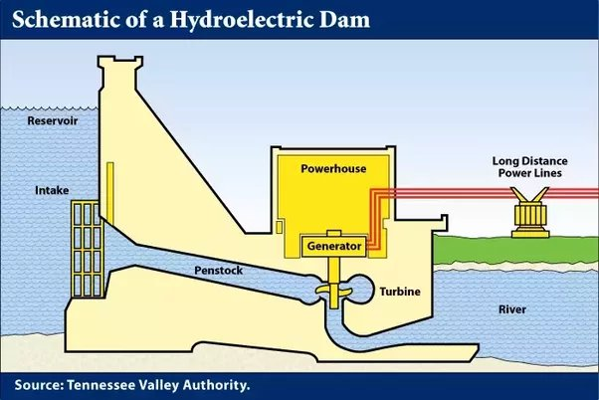
HYDROELECTRICITY
HYDROELECTRICITY
PRESENTED BY :
1] TEJAL SUNIL MAHAJAN [ COMPUTER ] A- 29
2] SHREYA VIJAYKUMAR MOHITE [COMPUTER ] A-33
3] RUTIK DAGADU AVHAD [ COMPUTER ] A-4
KONKAN GYANPEETH COLLEGE OF ENGINEERING , KARJAT
PRESENTED BY : 1] SHREYA VIJAYKUMAR MOHITE [ COMPUTER ] A-33 2] TEJAL SUNIL MAHAJAN [ COMPUTER ] A - 29 3] RUTK DAGDU AVHAD [ COMPUTER ] A-4
INTRODUCTION : Hydro Electric power (HEP) is a major renewable energy source used all over the world today to produce electricity. It utilizes the basic laws of Physics. Falling water under high pressure has high kinetic energy. In an HEP station, the falling water turns the turbines. Hydropower, or hydroelectric power, is a renewable source of energy that generates power by using a dam or diversion structure to alter the natural flow of a river or other body of water.

Slide 2
EXPERIMENTAL WORK : The water turbine changes the kinetic energy of the falling water into mechanical energy at the turbine shaft. In simple words, falling water spins the water turbine. The turbine drives the alternator coupled with it and converts mechanical energy into electrical energy. This is the basic “working principle of hydroelectric power plant.” Hydroelectric power plants are very popular because the stores of fuels (i.e., oil and coal) are exhausting day by day. They are also beneficial for irrigation and flood control purposes.
EXPERIMENTAL WORK :
RESULT : Flooding land for a hydroelectric reservoir has an extreme environmental impact: it destroys forest, wildlife habitat, agricultural land, and scenic lands. In many instances, such as the Three Gorges Dam in China, entire communities have also had to be relocated to make way for reservoirs.
CONCLUSION : Due to fast that the world is now looking for alternative sources of energy and the fast that hydropower is a type of clean energy that uses no limiting resources. It to have less disadvantages as mentioned. Hydropower plants are a vital energy source to the world. Water is an efficient and reliable fuel. The Use, creation, and expansion of power plants should continue being pursued. Because hydropower plants can generate power to the grid immediately, they provide essential backup power during major electricity outages or distruptions. Hydropower provides benefits beyond electricity generation by providing flood control, irrigation support, and clean drinking water. Hydropower is affordable.

