Slide 1
THE DARK SIDE OF SOCIAL MEDIA :-
While we use social media to connect to our far- away friends, at the
same time, we disconnect from those who sit across the table from us.
Social media leads to "shallowing" where certain types of social media activity (e.g., sharing and conversing) lead to a decline in ordinary daily reflective thinking, and instead promote quick and superficial thoughts, that can result in cognitive and moral triviality.
Everything has its dark side, so the technological creatures are not pretty different. Young kids and teens use the social media apps without the consent of their parents.
On the other hand, if parents are totally non-tech savvy, then there huge chances that young kids and teens get harm online by using the social media apps.
All the social media mighty messengers have become the safe havens for evils. Young kids and teens sometimes adopt these evils and most of the time becomes the victim of these evils

Slide 2
SOME OF THE DARK SIDE OF SOCIAL MEDIA ARE :-
TORLLING AND ONLINE STALKING
SHAMING AND CYBERBULLING
ONLINE WITCH HUNTS
ADDICTIVE USE AND “FEAR OF MISSING OUT”[FOMO]
PRIVACY ABUSE
FAKE NEWS
FAKE PROFILE AND BOTS.

Slide 3
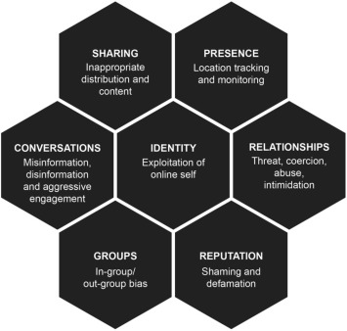
THE DARK SIDE OF SEVEN BUILDING BLOCKS OF SOCIAL MEDIA :-
CONVERSATIONS
SHARING
PRESENCE
RELATIONSHIPS
REPUTATION
GROUPS
IDENTITY
HERE ARE SOME MORE INFORMATION ABOUT THE SEVEN
BUILDING BLOCKS-
1.] CONVERSATIONS :- THE EXTENT TO WHICH USERS USE
SOCIAL MEDIA TO INAPPROPRIATELY COMMUNICATE
WITH EACH OTHERS.
2.] SHARING :- THE EXTENT TO WHICH CONSUMERS
EXCHANGE,DISTRIBUTE,AND RECEIVE CONTENT,THAT IS INAPPROPRIATE.

Slide 4
3.] PRESENCE :- THE EXTENT TO WHICH USERS INAPPROPRIATELY KNOW WHETHER ,WHERE
AND WHEN,OTHERS ARE ACCESSIBLE.
4.] RELATIONSHIPS :- THE EXTENT TO WHICH USERS CAN INAPPROPRIATELY RELATE TO OTHER USERS.
5.] REPUTATION :- THE DEGREE TO WHICH USERS CAN INAPPROPRIATELY IDENTIFY AND INFLUENCE THE STANDING OF THEMSELVES AND OTHERS.
6.] GROUPS :- THE DEGREE TO WHICH USERS INAPPROPRIATELY CREATE,JOIN OR ARE EXCLUDED FROM GROUPS.
7.] IDENTITY :- THE EXTENT TO WHICH USERS HAVE THEIR ONLINE IDENTITIES INAPPROPRIATELY EXPLOITED.
The dark side honeycomb serves as a useful foundation for research to take "a walk on the dark side" and work to:-
1. Build dark side-orientated social media theories, models, and classification frameworks!
2. Use adequate methodologies for online and dark contexts!
3. Collect data and build cases!

