Slide 1
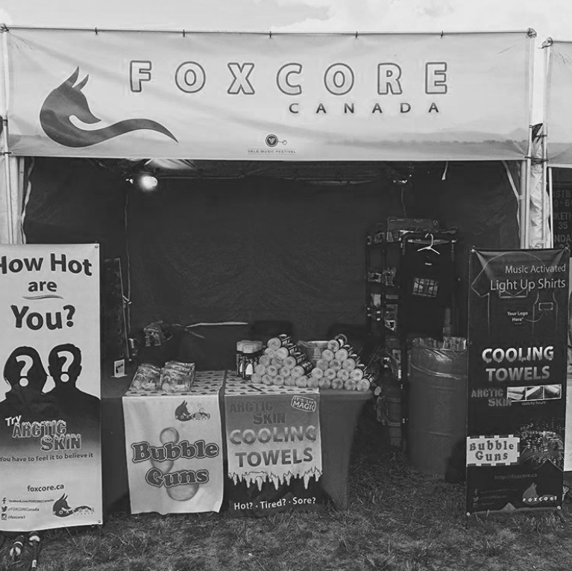
FOXCORE RETAIL

Slide 2
AGENDA
Introduction
Problem Statement
Entities and Relationship
Database Schema
SQL Commands
Data population and Modification
Report
Conclusion
Future enhancement
Questions

Slide 3
INTRODUCTION
Foxcore Retail, a small entrepreneurial venture founded by Liam Corrigan and Mitchell Fox, emerged from humble beginnings, offering novelty items at various events and festivals across Ontario. Initially inspired by the success of products like Bubble Guns and Arctic Skin Cooling Towels, the company gradually expanded its product line and market presence, becoming a prominent player in the retail landscape.

Slide 4
Problem Statement
Manual sales tracking and paper-based record-keeping.
Disjointed data management systems leading to inefficiencies.
Errors and inaccuracies in sales, inventory, and performance tracking.
Lack of a robust database solution hindering data centralization.
Inability to optimize performance across events and product offerings.
Missed opportunities for valuable insights due to fragmented data.

Slide 5
ENTITIES
Event
Venue
Booth
Product
Salesperson
Sales

Slide 6
Relationships
Event - Venue: An event takes place at a venue.
Event - Booth: An event has one or more booths set up.
Booth - Salesperson: Each booth is managed by one or more salespersons.
Product - Sales: Products are sold in sales transactions.
Salesperson - Sales: Each salesperson makes sales transactions.

Slide 7
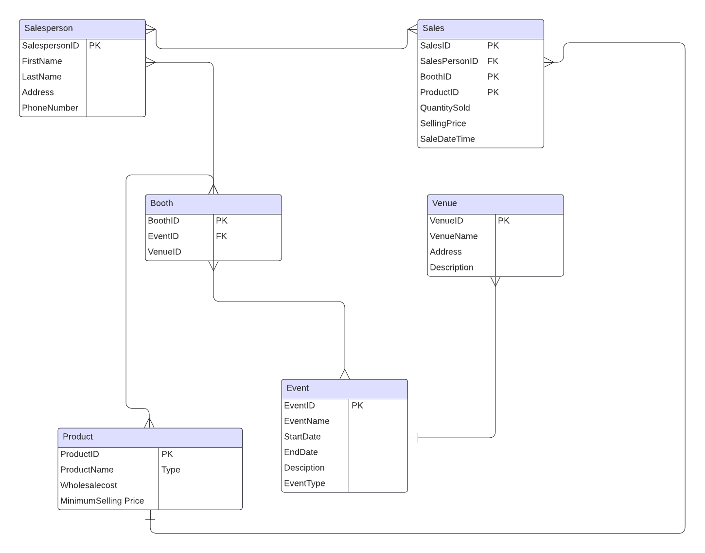

Slide 8
DATABASE Schema
Event (EventID PK, EventName, StartDate, EndDate, Description, EventType)
Venue (VenueID PK, VenueName, Address, Description)
Booth (BoothID PK, EventID FK, Location)
Product (ProductID PK, ProductName, WholesaleCost, MinSellingPrice)
Salesperson (SalespersonID PK, FirstName, LastName, Address, PhoneNumber)
Sales (SaleID PK, BoothID FK, SalespersonID FK, ProductID FK, QuantitySold, SellingPrice, SaleDateTime)

Slide 9
SQL Commands

Slide 10
Creating Tables
CREATE TABLE Event (
EventID INT PRIMARY KEY,
EventName VARCHAR(100),
StartDate DATE,
EndDate DATE,
Description TEXT,
EventType VARCHAR(50));
CREATE TABLE Venue (
VenueID INT PRIMARY KEY,
VenueName VARCHAR(100),
Address VARCHAR(255),
Description TEXT);
CREATE TABLE Booth (
BoothID INT PRIMARY KEY,
EventID INT,
Location VARCHAR(50),
FOREIGN KEY (EventID) REFERENCES Event(EventID));

Slide 11
Creating Tables
CREATE TABLE Product (
ProductID INT PRIMARY KEY,
ProductName VARCHAR(100),
WholesaleCost DECIMAL(10,2),
MinSellingPrice DECIMAL(10,2));
CREATE TABLE Salesperson (
SalespersonID INT PRIMARY KEY,
FirstName VARCHAR(50),
LastName VARCHAR(50),
Address VARCHAR(255),
PhoneNumber VARCHAR(20));

Slide 12
Creating Tables
CREATE TABLE Sales (
SaleID INT PRIMARY KEY,
BoothID INT,
SalespersonID INT,
ProductID INT,
QuantitySold INT,
SellingPrice DECIMAL(10,2),
SaleDateTime DATETIME,
FOREIGN KEY (BoothID) REFERENCES Booth(BoothID),
FOREIGN KEY (SalespersonID) REFERENCES Salesperson(SalespersonID),
FOREIGN KEY (ProductID) REFERENCES Product(ProductID));

Slide 13
DATA Population
-- Inserting into Event table
INSERT INTO Event (EventID, EventName, StartDate, EndDate, Description, EventType)
VALUES
(1, 'Music Festival', '2024-05-01', '2024-05-03', 'Annual music festival showcasing various artists.', 'Music Festival'),
(2, 'Trade Show', '2024-06-15', '2024-06-17', 'Industry trade show for showcasing new products.', 'Trade Show'),
(3, 'Rib Fest', '2024-07-20', '2024-07-22', 'Festival featuring various BBQ ribs vendors.', 'Rib Fest');
-- Inserting into Venue table
INSERT INTO Venue (VenueID, VenueName, Address, Description)
VALUES
(1, 'Central Park', '123 Main Street, Anytown', 'Large outdoor park venue for events.'),
(2, 'Convention Center', '456 Elm Street, Cityville', 'Spacious convention center with multiple halls.'),
(3, 'Waterfront Park', '789 Oak Street, Rivertown', 'Scenic park along the river for outdoor events.’);

Slide 14
DATA POPULATION
-- Inserting into Booth table
INSERT INTO Booth (BoothID, EventID, Location)
VALUES
(101, 1, 'Main Stage Area'),
(102, 1, 'Food Court Area'),
(201, 2, 'Hall A'),
(202, 2, 'Hall B'),
(301, 3, 'Riverside Area'),
(302, 3, 'Entertainment Zone');
-- Inserting into Product table
INSERT INTO Product (ProductID, ProductName, WholesaleCost, MinSellingPrice)
VALUES
(1, 'Bubble Gun', 5.00, 10.00),
(2, 'Cooling Towel', 3.50, 7.00),
(3, 'Emoji Pillow', 8.00, 15.00);

Slide 15
DATA POPULATION
-- Inserting into Salesperson table
INSERT INTO Salesperson (SalespersonID, FirstName, LastName, Address, PhoneNumber)
VALUES
(1001, 'John', 'Doe', '321 Maple Avenue, Townsville', '555-1234'),
(1002, 'Jane', 'Smith', '456 Oak Street, Villagetown', '555-5678'),
(1003, 'Michael', 'Johnson', '789 Pine Road, Citytown', '555-9012');
-- Inserting into Sales table
INSERT INTO Sales (SaleID, BoothID, SalespersonID, ProductID, QuantitySold, SellingPrice, SaleDateTime)
VALUES
(1, 101, 1001, 1, 20, 12.50, '2024-05-01 12:30:00'),
(2, 101, 1002, 2, 15, 8.00, '2024-05-02 10:45:00'),
(3, 102, 1003, 3, 10, 18.00, '2024-05-03 14:20:00');

Slide 16
DATA MODIFICATION
UPDATE Salesperson
SET PhoneNumber = '555-4322'
WHERE SalespersonID = 1001;
DELETE FROM Sales
WHERE SaleDateTime < '2024-05-01 00:00:00';

Slide 17
Tables
Event -
Venue -
EventID | EventName | StartDate | EndDate | Description | EventType
1 | Music Festival | 2024-05-01 | 2024-05-03 | Annual music festival showcasing various artists. | Music Festival
2 | Trade Show | 2024-06-15 | 2024-06-17 | Industry trade show for showcasing new products. | Trade Show
3 | Rib Fest | 2024-07-20 | 2024-07-22 | Festival featuring various BBQ ribs vendors. | Rib Fest
VenueID | VenueName | Address
1 | Central Park | 123 Main Street, Anytown
2 | Convention Center | 456 Elm Street, Cityville
3 | Waterfront Park | 789 Oak Street, Rivertown

Slide 18
Tables
Salesperson -
Product -
SalespersonID | FirstName | LastName | Address | PhoneNumber
1001 | John | Doe | 321 Maple Avenue, Townsville | 555-1234
1002 | Jane | Smith | 456 Oak Street, Villagetown | 555-5678
1003 | Michael | Johnson | 789 Pine Road, Citytown | 555-9012
ProductID | ProductName | WholesaleCost | MinSellingPrice
1 | Bubble Gun | 5 | 10
2 | Cooling Towel | 3.5 | 7
3 | Emoji Pillow | 8 | 15
Booth -
BoothID | EventID | Location
101 | 1 | Main Stage Area
102 | 1 | Food Court Area
201 | 2 | Hall A
202 | 2 | Hall B
301 | 3 | Riverside Area
302 | 3 | Entertainment Zone

Slide 19
TABLES
Sales -
SaleID | BoothID | SalespersonID | ProductID | QuantitySold | SellingPrice | SaleDateTime
1 | 101 | 1001 | 1 | 20 | 12.5 | 2024-05-01 12:30:00
2 | 101 | 1002 | 2 | 15 | 8 | 2024-05-02 10:45:00
3 | 102 | 1003 | 3 | 10 | 18 | 2024-05-03 14:20:00

Slide 20
report
SELECT e.EventType, SUM(s.QuantitySold) AS TotalSales
FROM Event e
LEFT JOIN Booth b ON e.EventID = b.EventID
LEFT JOIN Sales s ON b.BoothID = s.BoothID
GROUP BY e.EventType;
EventType | TotalSales
Music Festival | 45
Rib Fest
Trade Show

Slide 21
report
SELECT sp.FirstName || ' ' || sp.LastName AS Salesperson,
COUNT(s.SaleID) AS TotalSales,
SUM(s.QuantitySold) AS TotalQuantitySold,
SUM(s.QuantitySold * s.SellingPrice) AS TotalRevenue
FROM Salesperson sp
JOIN Sales s ON sp.SalespersonID = s.SalespersonID
GROUP BY sp.SalespersonID;
Salesperson | TotalSales | TotalQuantitySold | TotalRevenue
John | 1 | 20 | 250
Jane | 1 | 15 | 120
Michael | 1 | 10 | 180

Slide 22
Conclusion
The implementation of the relational database for Foxcore Retail has successfully addressed several key challenges faced by the organization. By centralizing data, automating processes, and enabling comprehensive reporting capabilities, the database solution has significantly improved operational efficiency and decision-making processes. The ability to track sales, manage inventory, and analyze performance across events and product offerings has provided valuable insights and facilitated informed strategic planning. Overall, the database solution has laid a solid foundation for the continued growth and success of Foxcore Retail.

Slide 23
Future enhancement
Real-Time Data Integrity
Advanced Analytics
Mobile Access
Customer Relationship Management
Supply Chain optimization
Data Security and Compliance

Slide 24
THANK YOU
Mark
Sonali
Shreya Motay

